Slide 1
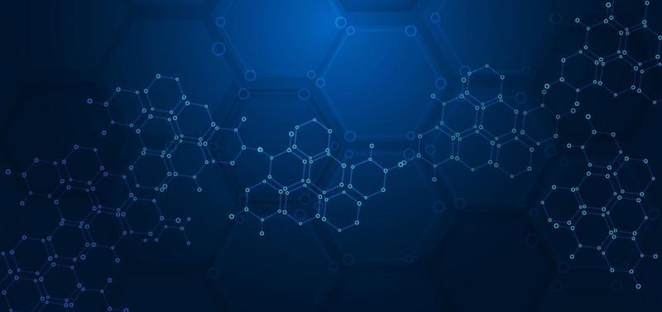
"Exploring Molecular Interactions: Hydrogen Bonding, Dipole Moments, and van der Waals Forces”.
Presented by: Tawhid Rahman
Bsc(Hons),Department of CSE
Chandpur Science and technology university(CSTU)
ID:B230101025
Course: CHEM 1221(Chemistry)
Date: July 27,2025

Slide 2
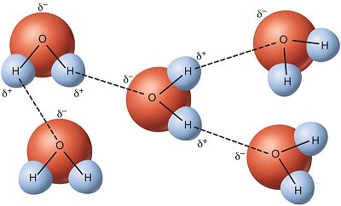

Hydrogen Bond
What Is Hydrogen Bonding?
Hydrogen bonding is a type of intermolecular force that occurs when a hydrogen atom is covalently bonded to a highly electronegative atom—such as fluorine (F), oxygen (O), or nitrogen (N)—and is attracted to another electronegative atom nearby.
For example, in water molecules (H₂O), hydrogen is covalently bonded to the more electronegative oxygen atom.
hydrogen bond of water

Slide 3
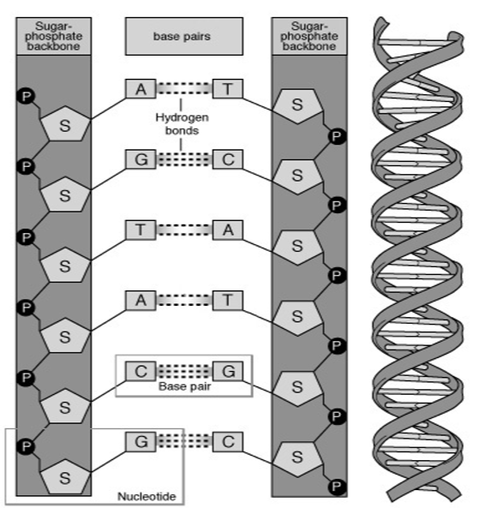
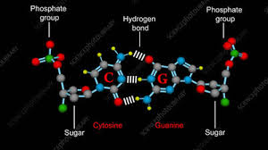
💡 Conditions for Hydrogen Bonding:
Presence of H atom bonded to a highly electronegative atom (O, N, or F).
Small size of the electronegative atom (so the bond is directional).
Lone pair on the electronegative atom available for bondin.
🧪 Chemical Examples:
Water (H₂O);
Ammonia (NH₃);
Hydrofluoric Acid (HF)
🧬 Biological Examples:
DNA Double Helix;
Proteins (Secondary Structure)

Slide 4
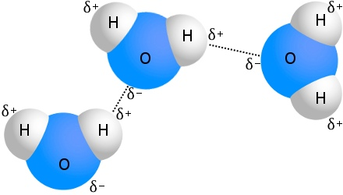
Types of Hydrogen Bonding:
There are two types of H bonds, and it is classified as the following:
Intermolecular Hydrogen Bonding(between two different molecules)
Intramolecular Hydrogen Bonding(within the same molecule)
Intermolecular Hydrogen Bonding:
When hydrogen bonding takes place between different molecules of the same or different compounds, it is called intermolecular hydrogen bonding.
Examples:
Water (H₂O),
Hydrogen Fluoride (HF),
Ammonia (NH₃)

Slide 5
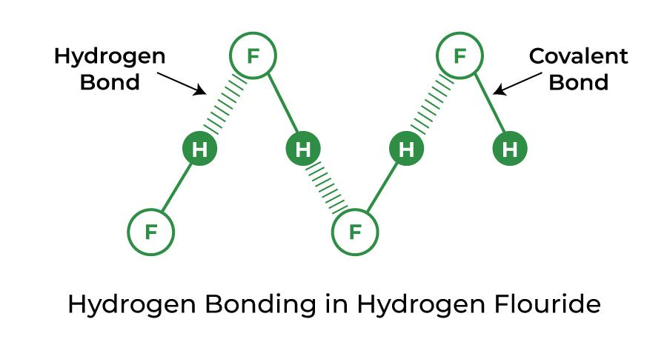
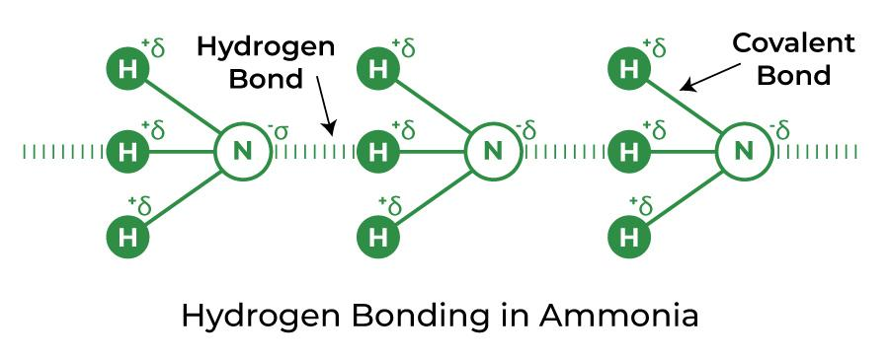

Slide 6
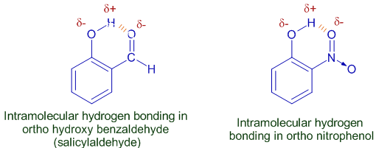
Intramolecular Hydrogen Bonding:
The hydrogen bonding which takes place within a molecule itself is called intramolecular hydrogen bonding.
Examples:
Ortho-Nitrophenol (C₆H₄(OH)(NO₂));
Salicylaldehyde (C₆H₄(OH)(CHO))

Slide 7
Strength of the Hydrogen Bond:
The hydrogen bond is a weak bond. The strength of the hydrogen bond is in-between the weak Van der Waals forces and the strong covalent bonds.
Average hydrogen bond strength: 10–30 kJ/mol
Type | Strength (kJ/mol)
Covalent Bond | 200–1000
Ionic Bond | 400–4000
Hydrogen Bond | 5–40
Van der Waals / London Forces | 0.05–4
🔬 Factors Affecting Hydrogen Bond Strength:

Slide 8
1.Electronegativity of Atoms:
Higher electronegativity of donor (O, N, F) → stronger bond.
F–H···F > O–H···O > N–H···N
2.Distance Between Donor and Acceptor:
Shorter distance = stronger H-bond.
3.Angle of Bond:
Most stable when atoms are in a straight line.
4.Environment (e.g., solvent, phase):
In nonpolar solvents or in gas phase, H-bonds are stronger.
In water (which competes with H-bonding), bonds may weaken.
Hydrogen Bond Example | Approx. Strength (kJ/mol)
HF···HF | ~35
H₂O···H₂O | ~20
NH₃···NH₃ | ~16
DNA base pair (A–T) | ~8 each (2 total)
DNA base pair (G–C) | ~8 each (3 total)

Slide 9
Impact on physical property:
1.Melting Point / Boiling Point:
Compounds containing hydrogen bonds—such as NH₃, H₂O, and HF, formed by elements N, O, and F—exhibit boiling and melting points that are significantly higher than other elements in their respective groups.
Among them, H₂O forms the strongest hydrogen bonds, with the ability to form up to four per molecule. NH₃ and HF follow, each forming two hydrogen bonds. As a result, more energy is required to overcome these interactions, explaining why water boils at 100°C, much higher than similar molecules without hydrogen bonding.
✅ Examples:
Water (H₂O) boils at 100°C, while H₂S (which has no hydrogen bonding) boils at –60°C.
HF boils at 19.5°C, while HCl boils at –85°C.
“Did you know? Water should boil at –80°C, but because of hydrogen bonding, it boils at 100°C!”

Slide 10
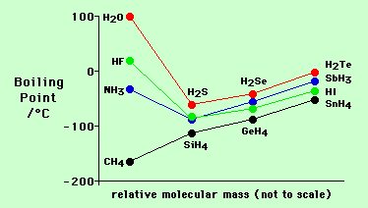
boiling point graph of Hydride:

Slide 11
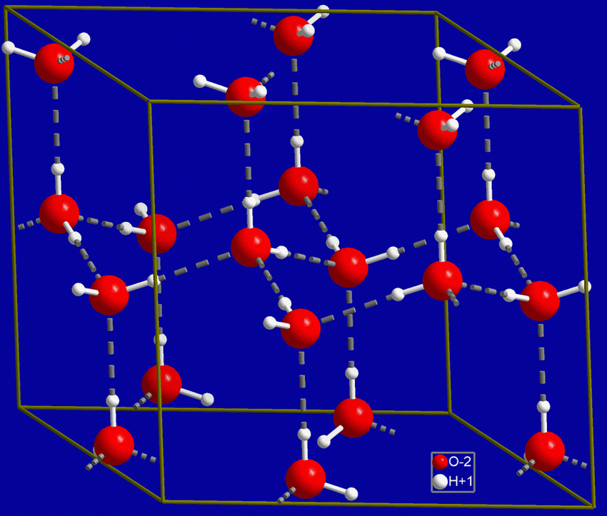
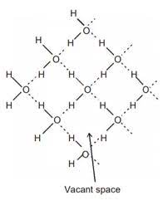
Structure of ice
Tetrahedral Geometry (Molecular Level)
Hexagonal Structure (Macroscopic/Crystal Level)

Slide 12
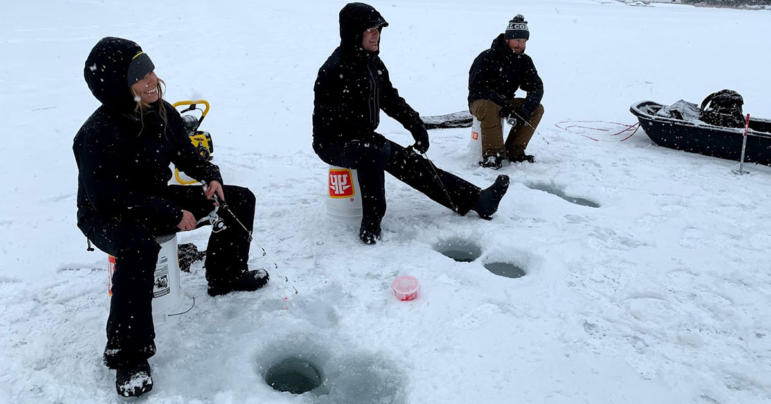
2.Density of Water and ICE:
Density of Water Water is unusual because its solid form (ice) is less dense than its liquid form, causing ice to float. This is due to the open, tetrahedral, hydrogen-bonded structure of ice, which contains large spaces. When ice melts, some hydrogen bonds break, allowing molecules to pack more compactly, leading to increased density up to 4°C

Slide 13
3.Viscosity and Surface Tension:
Liquids with extensive hydrogen bonding, such as water and glycerol, tend to have higher surface tension and viscosity due to the strong attractive forces between molecules.
Property | Effect of Hydrogen Bonding
Boiling Point | Increases
Melting Point | Increases
Surface Tension | Increases
Viscosity | Increases
Solubility in Water | Increases for polar molecules
Density (Ice vs Water) | Ice is less dense (due to H-bond network)

Slide 14
Dipole Bond
The term "dipole bond" generally refers to the concepts of polar bonds and dipole moments within molecules, which are crucial for understanding chemical properties and intermolecular interactions.
polar bond:
A polar bond forms between two atoms when there is an asymmetrical distribution of charge. This occurs when the atoms have different electronegativities, meaning one atom has a greater ability to attract electrons in the bond than the other. The electrons in the bond are drawn closer to the more electronegative atom, resulting in that atom gaining a partial negative charge (8), and the other atom gaining a partial positive charge (8").
Dipole Moment:
⚡ What is Dipole Moment?
A dipole moment is a measure of the separation of positive and negative charges in a molecule or bond.

Slide 15
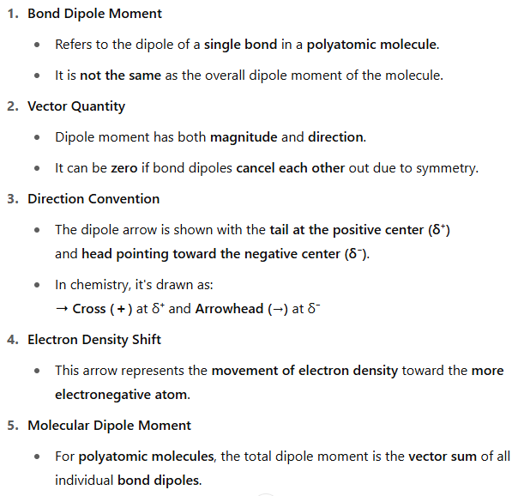
Important Points of dipole moment:

Slide 16
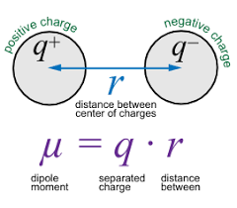
Dipole Moment Formula:
A dipole moment is the product of the magnitude of the charge and the distance between the centers of the positive and negative charges. It is denoted by the Greek letter ‘µ’.
Mathematically,

Slide 17
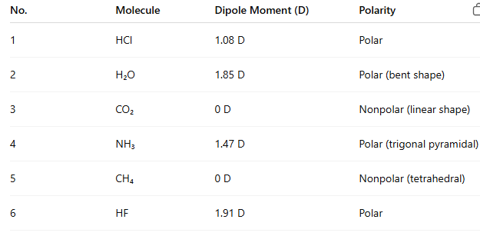
It is measured in Debye units denoted by ‘D’. 1 D = 3.33564 × 10⁻³⁰ C.m, where C is Coulomb and m denotes a metre.
Example:

Slide 18
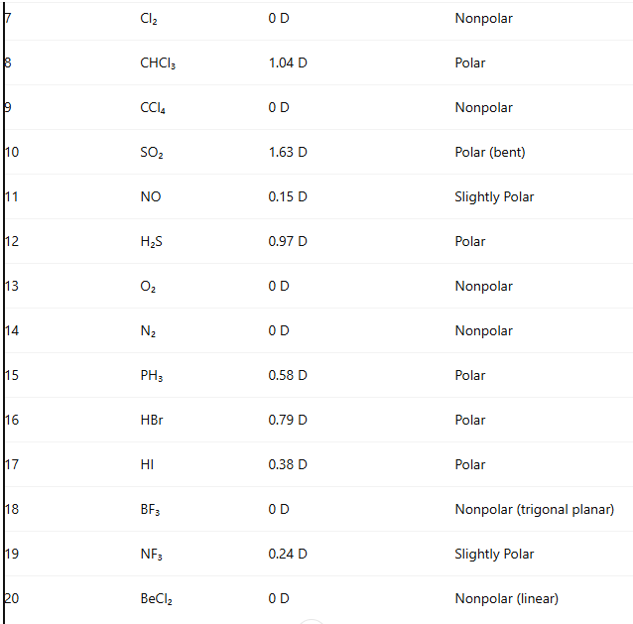

Slide 19
Van der Waals Forces:
Van der Waals forces are a collective term for intermolecular forces that include dipole-dipole forces, dipole-induced dipole forces, and London (dispersion) forces. These forces are generally weak attractive interactions between molecules. Unlike the strong forces holding atoms together within a molecule (intramolecular forces, such as covalent or ionic bonds), van der Waals forces operate between molecules and are crucial for understanding the properties of liquids and solids.
Dipole-Dipole Forces:
Dipole-dipole forces are attractive forces between the positive end of one polar molecule and the negative end of another polar molecule. Dipole-dipole forces have strengths that range from 5 kJ to 20 kJ per mole. They are much weaker than ionic or covalent bonds and have a significant effect only when the molecules involved are close together (touching or almost touching).
🔹 Example:
Hydrogen chloride (HCl),
iodine monochloride (ICl)

Slide 20
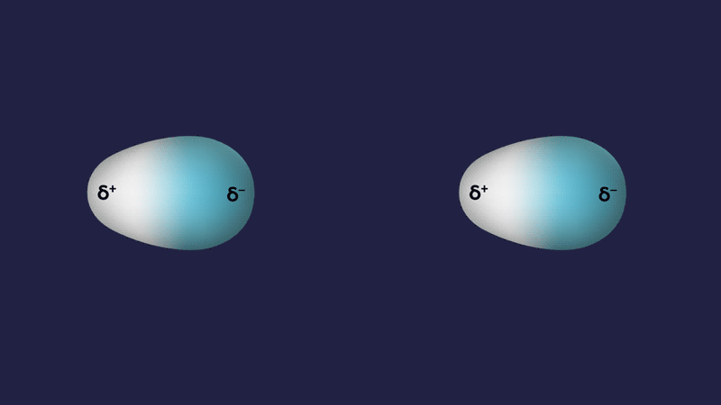
Dipole-Dipole Force

Slide 21
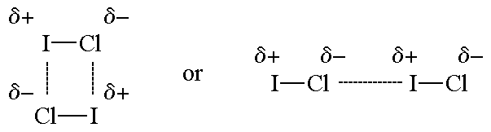
The figures show two arrangements of polar iodine monochloride (ICl) molecules that give rise to dipole-dipole attractions.
Note:
Polar molecules have a partial negative end and a partial positive end.
The partially positive end of a polar molecule is attracted to the partially negative end of another.
In a ICl molecule the more electronegative chlorine atom bears the partial negative charge; the less electronegative iodine atom bears the partial positive charge.
The partially positive iodine end of one ICl molecule is attracted to the partially negative chlorine end of another ICl molecule.

Slide 22
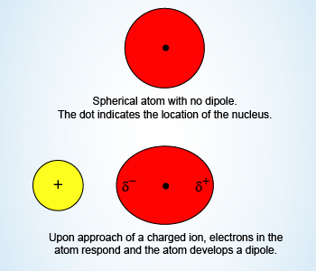
Ion-Induced Dipole Forces:
An ion-induced dipole attraction is a weak attraction that results when the approach of an ion induces a dipole in an atom or in a nonpolar molecule by disturbing the arrangement of electrons in the nonpolar species.

Slide 23
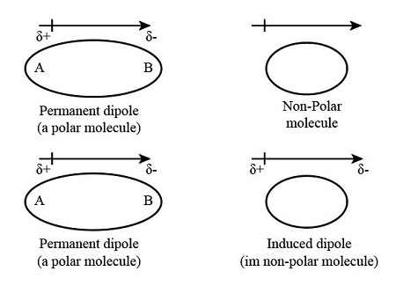
Dipole-Induced Dipole Forces(Debye force):
Dipole-induced dipole forces are weak attractive forces that occur between a polar molecule (which has a permanent dipole) and a nonpolar molecule (which has no permanent dipole).

Slide 24
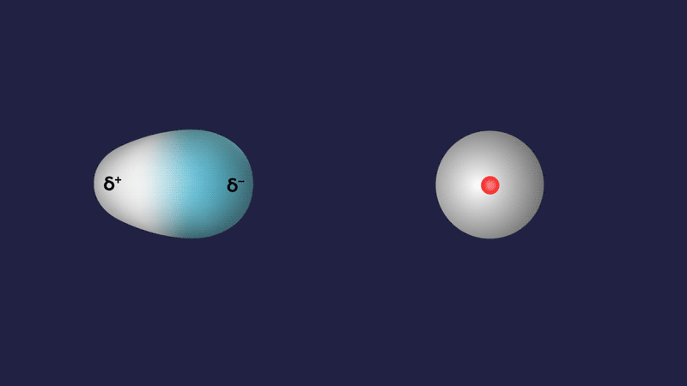
Dipole-Induced Dipole Force

Slide 25
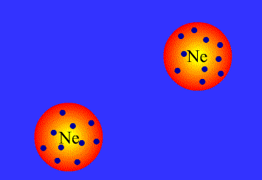
London Dispersion Forces:
F2
The London dispersion force is the weakest intermolecular force. The London dispersion force is a temporary attractive force that results when the electrons in two adjacent atoms occupy positions that make the atoms form temporary dipoles. This force is sometimes called an induced dipole-induced dipole attraction. London forces are the attractive forces that cause nonpolar substances to condense to liquids and to freeze into solids when the temperature is lowered sufficiently.
Because of the constant motion of the electrons, an atom or molecule can develop a temporary (instantaneous) dipole when its electrons are distributed unsymmetrically about the nucleus.

Slide 26
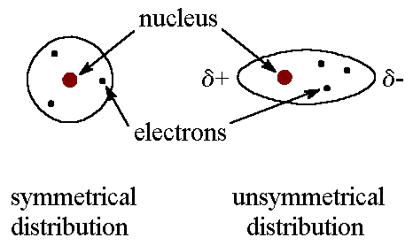

Because of the constant motion of the electrons, an atom or molecule can develop a temporary (instantaneous) dipole when its electrons are distributed unsymmetrically about the nucleus.
A second atom or molecule, in turn, can be distorted by the appearance of the dipole in the first atom or molecule (because electrons repel one another) which leads to an electrostatic attraction between the two atoms or molecules.
Dispersion forces are present between any two molecules (even polar molecules) when they are almost touching.

Slide 27
Force Type | Occurs Between | Cause | Nature of Interaction | Relative Strength | Factors Affecting Strength | Examples
Dipole-Dipole Forces | Two polar molecules | Permanent dipoles interact: partial + attracts partial – | Electrostatic attraction between δ⁺ and δ⁻ ends | Moderate | Magnitude of dipole moment, orientation, and distance | HCl ⋯ HCl, CH₃Cl ⋯ CH₃Cl
Ion-Induced Dipole | An ion and a nonpolar molecule | The ion distorts the electron cloud of the nonpolar molecule | Temporary dipole induced by nearby ion | Weak to Moderate | Charge and size of ion, polarizability of the molecule | Na⁺ ⋯ O₂, Fe²⁺ ⋯ I₂
Dipole-Induced Dipole | A polar molecule and a nonpolar molecule | The polar molecule induces a dipole in the nonpolar molecule | Temporary attraction due to induced dipole | Weak | Dipole strength of polar molecule, polarizability of nonpolar molecule | H₂O ⋯ O₂, HCl ⋯ Ar
London (Dispersion) Forces | Between all atoms/molecules (strong in nonpolar) | Instantaneous dipoles due to random electron movement | Temporary dipole–induced dipole attractions | Weakest (but ↑ in large atoms) | Molecular size, shape, and number of electrons | He ⋯ He, CH₄ ⋯ CH₄, I₂ ⋯ I₂

Slide 28
Van der Waals equation:
The kinetic theory of ideal gases assumes the gaseous particles as –
Point masses without any volume
Independent having no interactions
Undergo perfectly elastic collisions
In practice, Van der Waals assumed that gaseous particles –
Are hard spheres.
Have definite volume, and hence cannot be compressed beyond a limit.
Two particles at close range interact and have an exclusive spherical volume around them.
More significantly, the Van der Waals equation takes into consideration the molecular size and molecular interaction forces (attractive and repulsive forces). Sometimes, it is also referred to as the Van der Waals equation of state.

Slide 29

The Van der Waals equation is an equation relating the relationship between the pressure, volume, temperature, and amount of real gases. For a real gas containing ‘n’ moles, the equation is written as;
Where P, V, T, and n are the pressure, volume, temperature and moles of the gas, respectively, and ‘a’ and ‘b’ constants specific to each gas.

