Slide 1
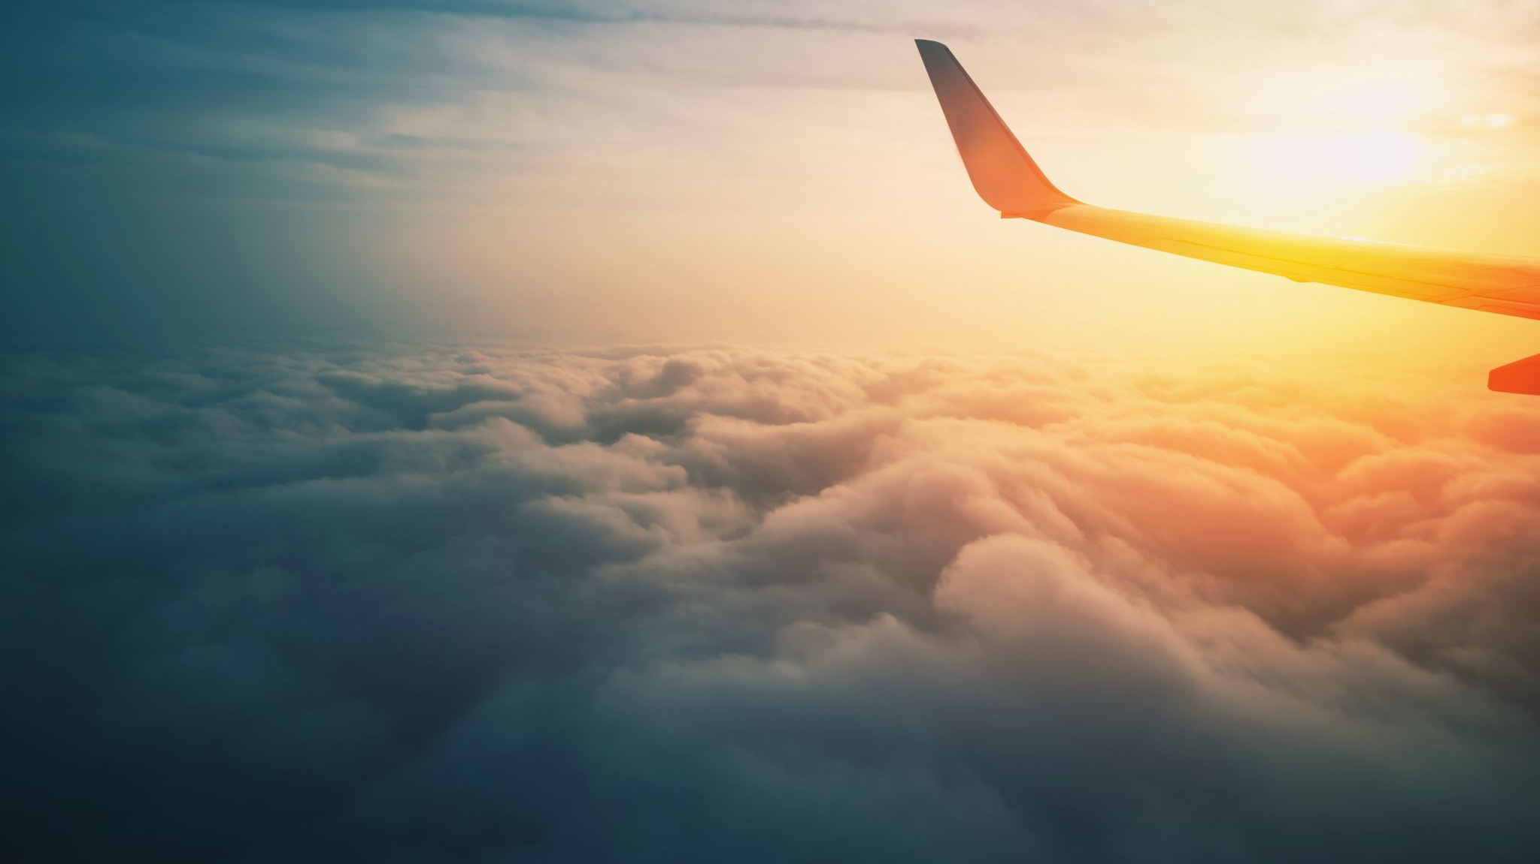
Impact of Weather Changes on Air Travel
Rutgers Data Analytics and Visualization Bootcamp - Team 3 Project 1
February 2023
Calogera McCormick, Tawn Scotton, Jamie Cid, Sana Ayubzai, Minta Burke
DRAFT

Slide 2
Scope
How have (recent) changes in weather patterns affected the flight patterns with respect to:
Change in number of diverted flights from XX-XX
Compare XX region to XX region within North America
Change in number of bird accidents or near misses (due to impact of migratory patterns)
Changes to number of annual cancellations due to local weather (eg, fire, snow)
Impact of change in total airline trip time to the quality of airline travel for passengers (includes time for diversion) (qualitative)
For a particular route:
Change in cost of airline travel for the airline
Change in cost and reliability of airline travel for the passenger

Slide 3
PLANNED ANALYSES - CURRENT
 | Source of Dataset | Programming Tools | Type of Analysis
How have (recent) changes in weather patterns affected the flight patterns with respect to: Pick 4 storms/weather events in different North American regions and run the analyses below for each storm/region
Availability: Change in number of diverted flights in US during from 2003 to 2022 period per subgroup (eg, airline carrier (American Airlines, Delta, United, SouthWest, JetBlue), type of delay and name of airport), year, and year over year changes. | BTS website dataset (csv); association reports | Pandas | Quantitative, Visualization with Tableau
Reliability: Changes to number of cancellations due to local weather (eg, fire in CA, snow in TX) per month in 2022 and per season | BTS website dataset ; association reports | Pandas | Quantitative, Visualization with Tableau

Slide 4
PLANNED ANALYSES of ARRIVAL DELAYS - CURRENT
Team | Topic | Data Output | Question
Minta | Delays | Number of delayed flights in all US for 20 years for any reason Number of delayed flights in all US for 20 years for any reason for 5 AIRLINES Total minutes of delays in all US for delayed flights for 20 years any reason for 5 AIRLINES | How has number and average length of delayed flights for any reason changed in past 20 years? Which reason causes the most delayed flights in the US? How has this changed over the past 20 years? What is month with most delays (number) for any airline? What is month with most delays (number) for the 5 AIRINES? What is month has the average lowest delay for any airline? What is month has the average lowest delay for the 5 AIRLINES?
Tawn | Delays | Number of delayed flights in all US for 20 years for any reason for any airport Number of delayed flights for 20 years for any reason for 10 AIRPORTS (with highest number of delays due to weather) Total minutes of delays in all US for 20 years for any reason for any airport Total minutes of delays in for delayed flights for 20 years any reason for 10 AIRPORTS | Which airports have the most delays for any reason? Are there any airports that are outliers for delays? Of the 10 airports with the most delays due to weather, which had the most number of delays per year? What is month with most delays (number) for any airport? Longest average delay? What is month with most delays (number) for the 10 AIRPORTS? Longest average delay?
Jamie | Delays | Number of delayed flights in all US for 20 years for weather Number of delayed flights in all US for 20 years for weather for 5 AIRLINES Number of delayed flights in all US for 20 years for weather for 10 AIRPORTS Number of delayed flights in all US for 20 years for weather for 5 AIRLINES Total minutes of delays in all US for delayed flights for 20 years for weather for 10 AIRPORTS | Describe the number of delayed flights for weather for the 5 AIRLINES over the past 20 years? Are there any airlines that are outliers for weather delays for any reason? Are there any airports that are outliers for weather delays for any reason? How has the total time of delay due to weather at the 10 AIRPORTS changed over the past 20 years? For each of the 10 airlines, which airport had the most delays due to weather?
Lili | Cancellations | Total number flights in US over 20 years Number of diverted, delayed, cancelled flights in all US for 20 years Number of diverted, delayed, cancelled flights in all US for 20 years, for 5 AIRLINES Number of diverted, delayed, cancelled flights in all US for 20 years for 3 AIRPORTS | Describe the total number of diverted, delayed and cancelled flights in the US over the past 20 years. How has the number of flights diverted, delayed and cancelled changed for the 5 largest AIRLINES and JetBlue in the US over the past 20 years? How has the number of flights diverted, delayed and cancelled changed for the 10 AIRPORTS over the past 20 years?
* Note for “any reason”, use data from weather, carrier, NAS, security, later aircraft delay

Slide 5
Pull a csv for the departure data
https://www.transtats.bts.gov/ONTIME/Departures.aspx
Can pull for a specific airport and airline
We can pull the csv files for one combot (for example, Delta flights from Atlanta in 2022) to show example how to program
Can not see way to pull a concolidated csv of multiple airlines or airports

Slide 6
Major U.S. Air Carrier Delays, Cancellations, and Diversions
Major U.S. Air Carrier Delays, Cancellations, and Diversions | Bureau of Transportation Statistics (bts.gov)
Source:
1988-94: U.S. Department of Transportation, Bureau of Transportation Statistics, Office of Airline Information, Airline Service Quality Performance Data.
1995-2021: U.S. Department of Transportation, Bureau of Transportation Statistics, Office of Airline Information, Airline On-Time Tables, Table 1A - Reporting Operating Carrier Summary of Airline On-Time Performance from 1995 Year-to-date December 2021, available at https://www.bts.gov/topics/airline-time-tables as of Mar. 1, 2022.

Slide 7
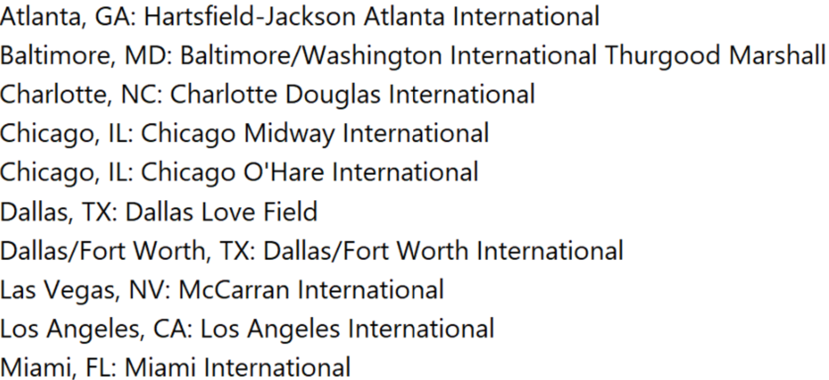
Airports with >100 flgihts delayed IN aNY month DUE TO WEATHER

Slide 8
American Airlines | Delta | SouthWest | United | JetBlue
Atlanta - ATL | Atlanta - ATL | Denver - DEN | Chicago - ORD | Boston - BOS
Dallas/Forth Worth - DFW | Minneapolis – MSP | Baltimore - BWI | Denver - DEN | NY - JFK
Charlotte - CTL | Detroit - DTW | Chicago - IL | San Francisco - SFO
Chicago O’Hare | Salt Lake City - SLC | Las Vegas - LAS | Houston - IAH
Phoenix – PHX |  | Orlando – MCO | Los Angeles - LAX
Miami – MIA |  | Atlanta - ATL | Washington DC - IAD
Philadelphia, PHL

Slide 9
Total months with >50 delayed flights per month due to weather from 2018-2022 per airport
 |  | Region | Total | American Airlines | Delta | SouthWest | United | Sky West
Philadelphia | PHL | Mid Atlantic | 4 | 4
Newark | EWR | Mid Atlantic | 3 |  |  |  | 3
New York | LGA | Mid Atlantic | 1 |  |  |  |  | 1
Washington DC | IAD | Mid Atlantic | 1 |  |  |  | 1
Chicago | ORD | Midwest | 30 | 9 |  |  | 12 | 9
Minneapolis | MSP | Midwest | 25 |  | 1 |  |  | 24
Detroit | DTW | Midwest | 17 |  |  |  |  | 17
Denver | DEN | Mountain | 28 |  |  | 3 | 7 | 18
Salt Lake City | SLC | Mountain | 17 |  |  |  |  | 17
Loas Angeles | LAX | Pacific | 13 | 4 |  |  | 1 | 8
San Francisco | SFO | Pacific | 5 |  |  |  | 3 | 2
Seattle | SEA | Pacific | 1 |  |  |  |  | 1
Atlanta | ATL | South Atlantic | 36 |  | 34 |  |  | 2
Charlotte | CTL | South Atlantic | 12 | 12
Baltimore | BWI | South Atlantic | 2 |  |  | 2
Miami | MIA | South Atlantic | 1 | 1
Dallas/Forth Worth | DFW | South Central | 39 | 35 |  |  |  | 4
Houston | IAH | South Central | 8 |  |  |  | 8
* Regions as per U.S. Census Bureau Regions and Divisions.

Slide 10
Number of FLIGHTS DELAYED due to weather (in months with >50 weather delays) from 2018-2022 per airport
 |  | Region | Total | American Airlines | Delta | SouthWest | United | Sky West
Philadelphia | PHL | Mid Atlantic | 4 | 4
Newark | EWR | Mid Atlantic | 3 |  |  |  | 3
New York | LGA | Mid Atlantic | 1 |  |  |  |  | 1
Washington DC | IAD | Mid Atlantic | 1 |  |  |  | 1
Chicago | ORD | Midwest | 30 | 9 |  |  | 12 | 9
Minneapolis | MSP | Midwest | 25 |  | 1 |  |  | 24
Detroit | DTW | Midwest | 17 |  |  |  |  | 17
Denver | DEN | Mountain | 28 |  |  | 3 | 7 | 18
Salt Lake City | SLC | Mountain | 17 |  |  |  |  | 17
Loas Angeles | LAX | Pacific | 13 | 4 |  |  | 1 | 8
San Francisco | SFO | Pacific | 5 |  |  |  | 3 | 2
Seattle | SEA | Pacific | 1 |  |  |  |  | 1
Atlanta | ATL | South Atlantic | 36 |  | 34 |  |  | 2
Charlotte | CTL | South Atlantic | 12 | 12
Baltimore | BWI | South Atlantic | 2 |  |  | 2
Miami | MIA | South Atlantic | 1 | 1
Dallas/Forth Worth | DFW | South Central | 39 | 35 |  |  |  | 4
Houston | IAH | South Central | 8 |  |  |  | 8
* Regions as per U.S. Census Bureau Regions and Divisions.

Slide 11
Notes
Weather affects airports not directly where the source of weather is.
Many flights were cancelled in Denver in July 2021 due to smoke from wildfires in California (SouthWest 124, Delta 44) - Heavy Smoke From Western Wildfires Leads To Flight Delays And Cancellations At Denver International Airport (forbes.com)
Cause for these are not reported in the dataset as “weather”
Denver has only 1 arrival flight delay per month due to weather in June, July and August 2021
Denver had only 12 total flight delays from June to August
Data from dataset do not support the news story. It may be that the dataset includes only arrival delays >15 min

Slide 12
RATIONALE FOR HOW AIRLINES WERE CHOSEN
Largest fleet size in US
Most number of passengers carried per year
 | Fleet size
American Airlines | 1440
United | 1391
Delta | 1170
Southwest | 737
SkyWest | 509
Air Canada | 353
Alaska Airlines | 329
JetBlue | 270
West Jet | 172
Spirit Airlines | 157
 | Millions of passengers
American Airlines* | 200
Delta* | 200
Southwest* | 160
United* | 140
Air Canada (Canada) | 13
Alaska Airlines | 40
JetBlue | 14
Spirit Airlines | 19
WestJet | 25
Volaris (Mexico) | 24
* Source: https://en.wikipedia.org/wiki/List_of_largest_airlines_in_North_America

Slide 13
Open Questions
To be completed

Slide 14
Team 3
Name | Phone | Email
Calogera McCormick | 973-634-8571
Tawn Scotton
Jamie Cid
Sana Ayubzai
Minta Burke

Slide 15



BACKUP

Slide 16
PLANNED ANALYSES - ORIGINAL
 | Source of Dataset | Programming Tools | Type of Analysis
How have (recent) changes in weather patterns affected the flight patterns with respect to: Pick 4 storms/weather events in different North American regions and run the analyses below for each storm/region
Availability: Change in number of diverted flights from XX-XX per subgroup (eg, region of country, airline carrier, type and name of airport) | Airline website dataset; association reports | Pandas | Quantitative, Visualization
Safety: Change in number of bird accidents or near misses (due to impact of migratory patterns) | FAA dataset | Pandas | Quantitative, Visualization
Reliability: Changes to number of annual cancellations due to local weather (eg, fire in CA, snow in TX) | Airline website dataset; association reports | Pandas | Quantitative, Visualization
Impact of change in total airline trip time to the quality of airline travel for passengers (includes time for diversion)
For a particular route:
Change in cost of airline travel for the airline | https://www.airlines.org/dataset/u-s-passenger-carrier-delay-costs/; IATA | API | Quantitative, Visualization
Change in cost and reliability of airline travel for the passenger | https://www.airlines.org/dataset/u-s-passenger-carrier-delay-costs/, IATA | API, pull down comments from message boards | Quantitative (per star rating) Qualitative (use keywords + or – in comments, or neutral sentiment analysis)

