Slide 1
ATM Simulator System
(Overview and Design)
CSE-2112
Group-20
Members:
Tawyabul Islam Tamim-(04)
Ovijit Chandra Balo-(28)
Abdullah Al Arman Emon-(50)

Slide 2
Introduction
The ATM Simulator System is a software program designed to mimic a real ATM. Its purpose is to simulate the functionalities of an ATM, allowing users to practice and learn about various banking transactions in a safe and controlled environment.
Key features include:
Balance inquiries
Withdrawals
Deposits (optional)
Transfers (optional)
Bill payments (optional)

Slide 3
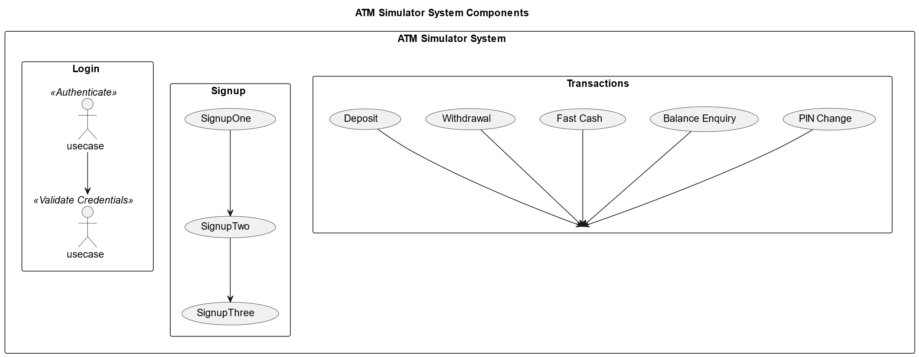
Project Overview

Slide 4
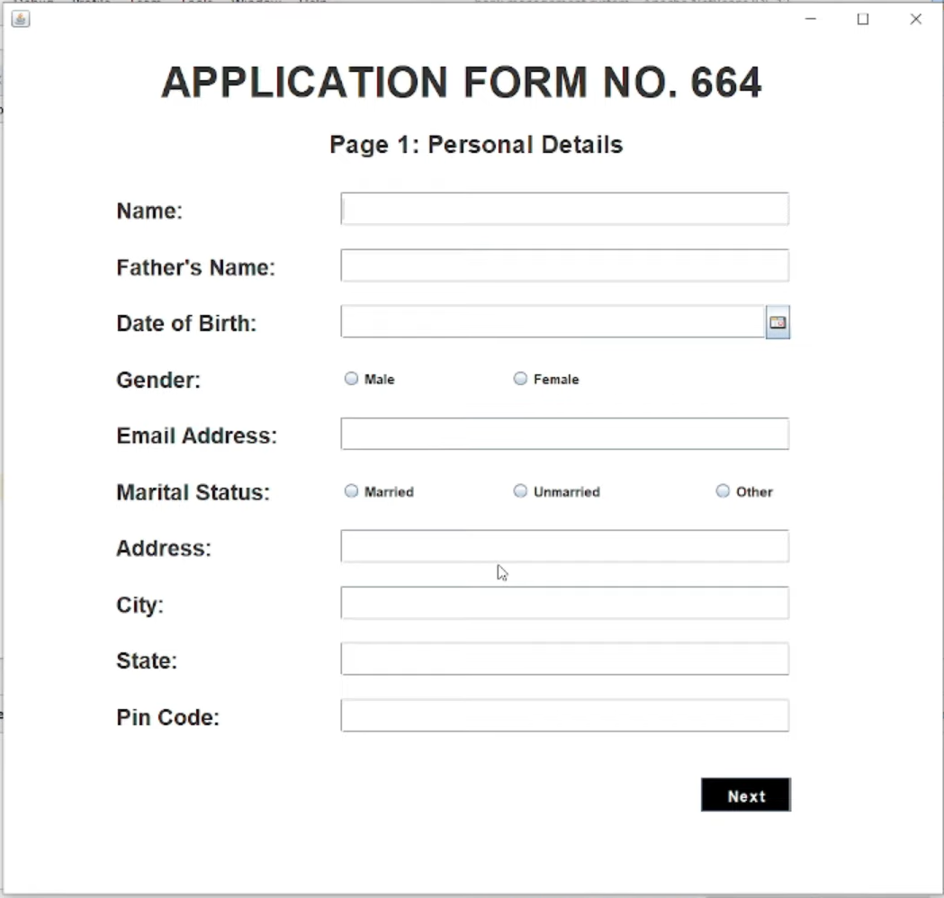
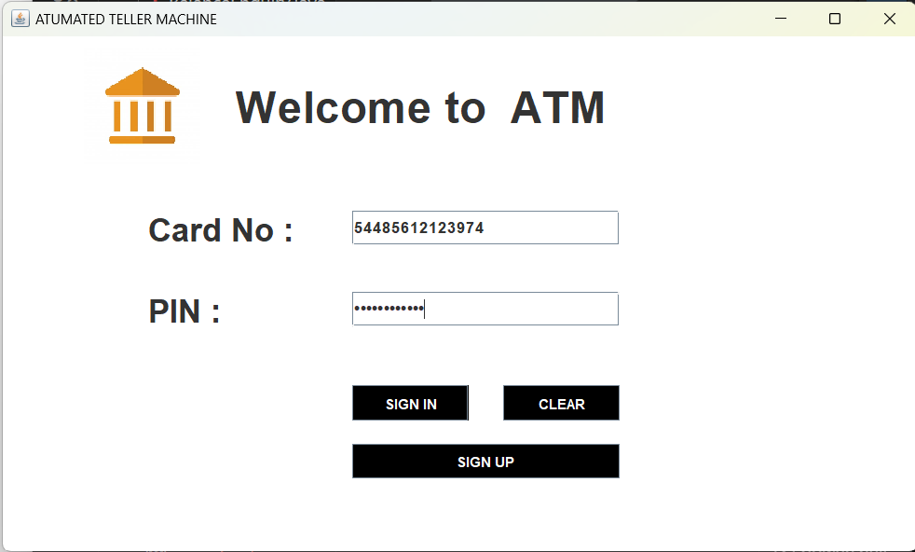
User Interface

Slide 5

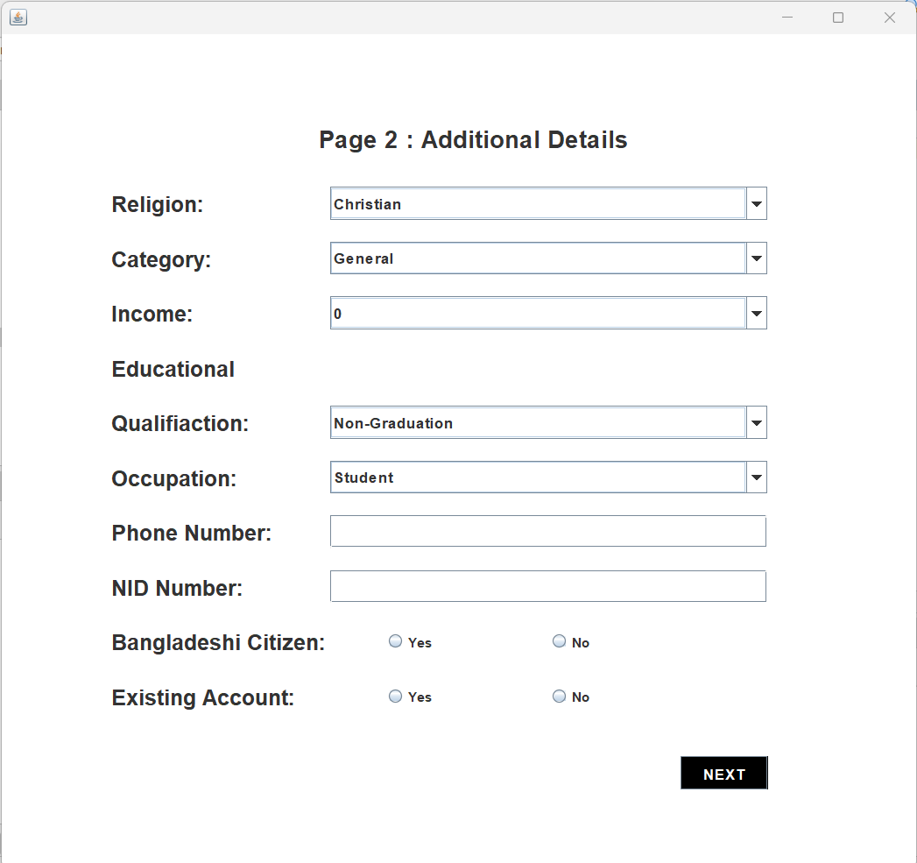
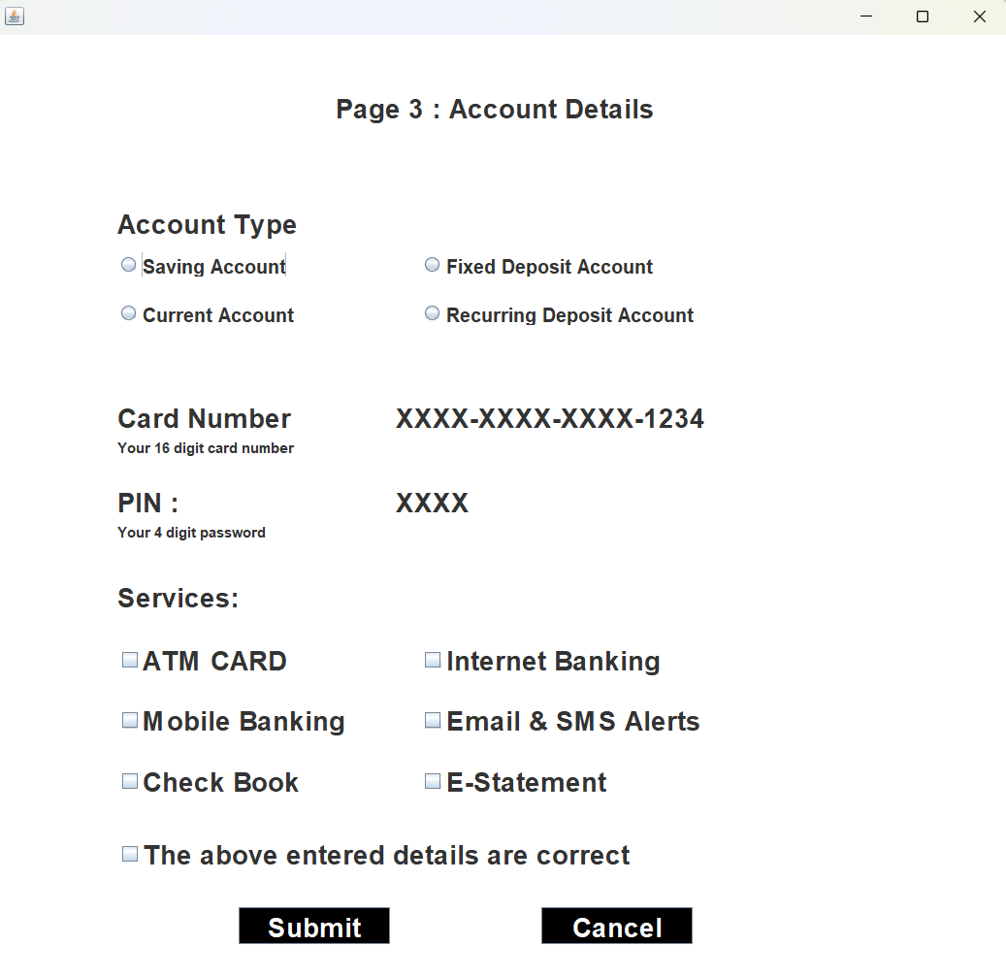

Slide 6

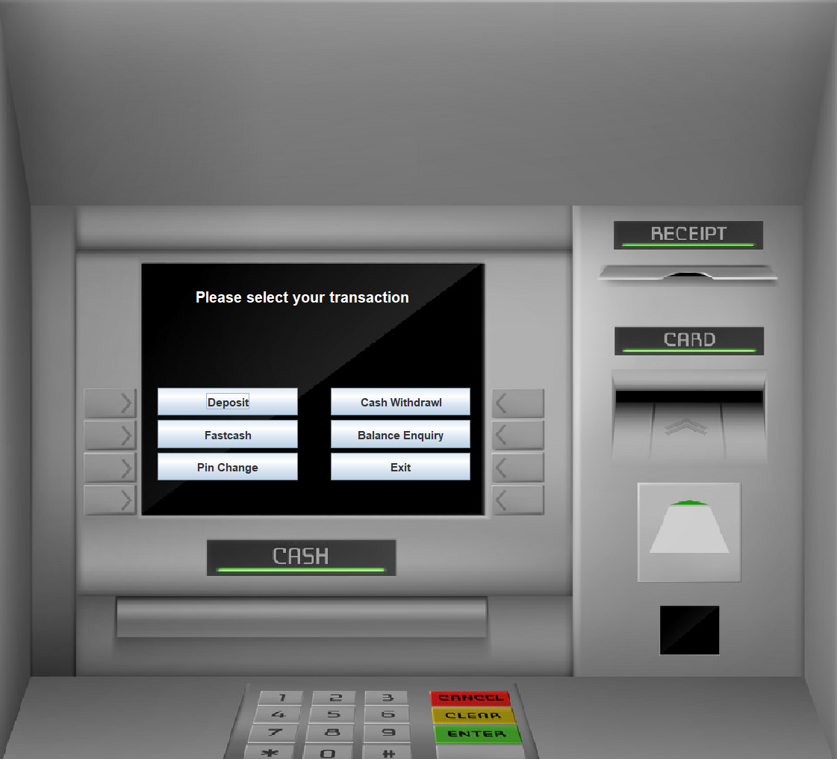
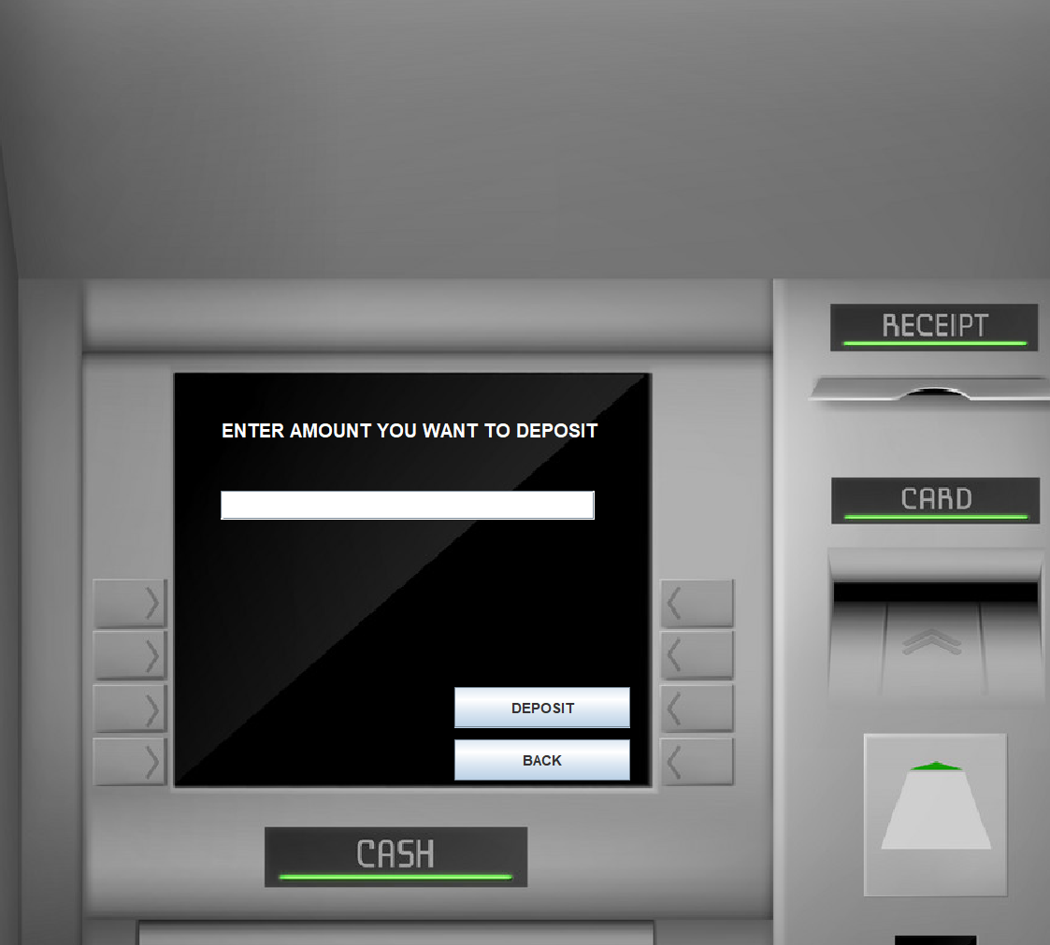

Slide 7
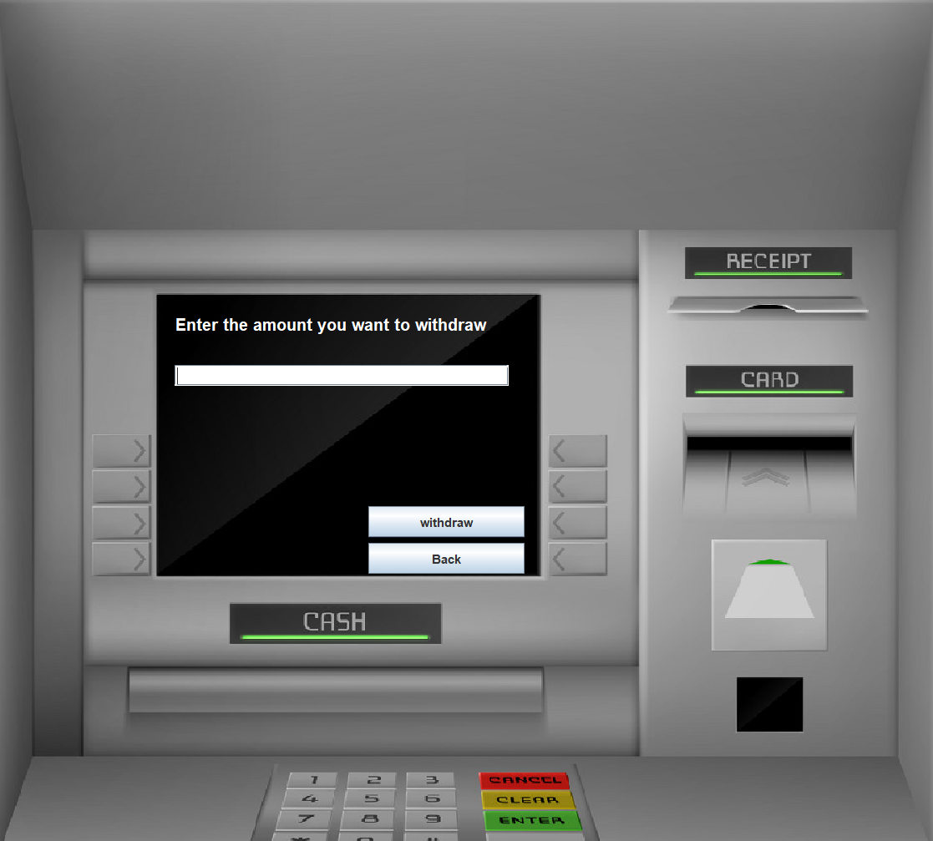
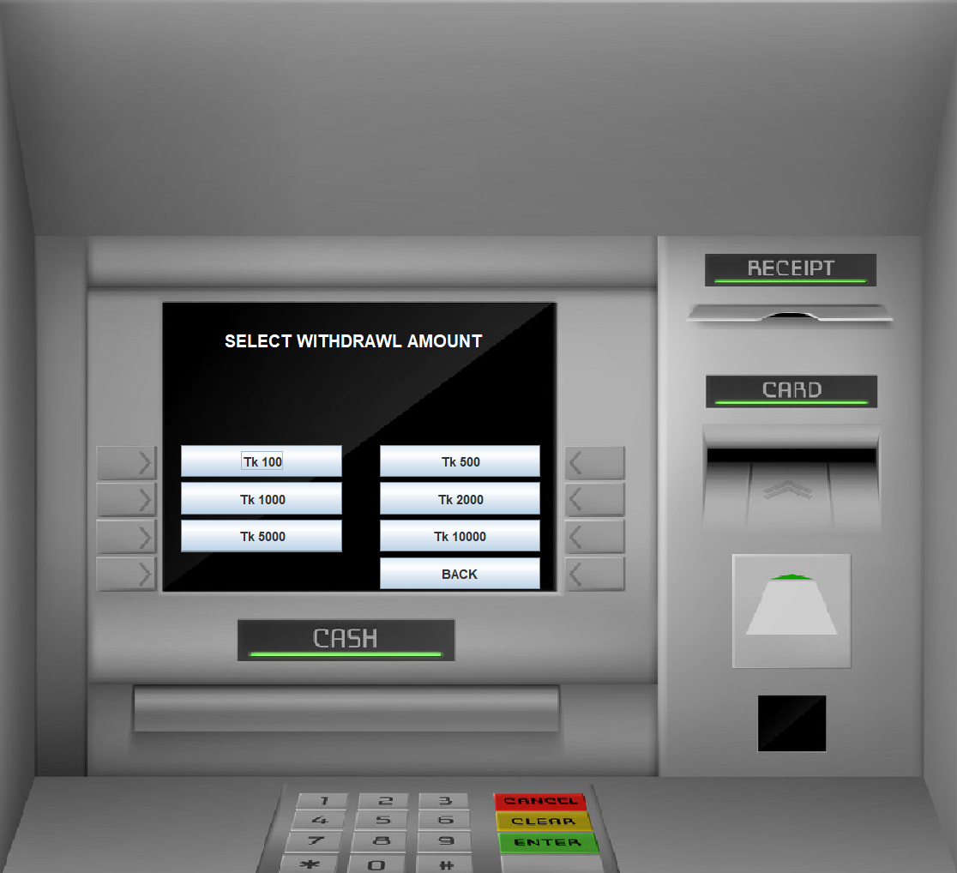

Slide 8
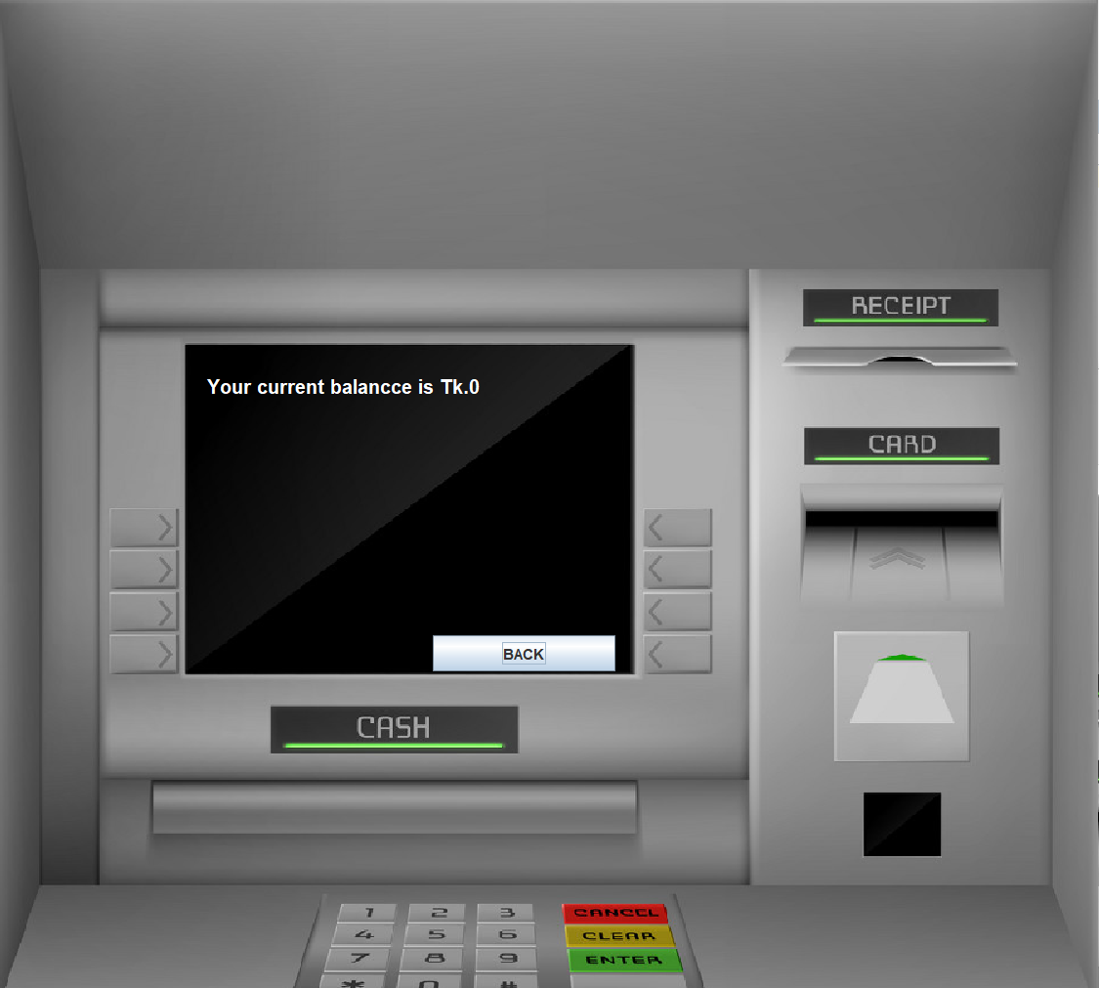
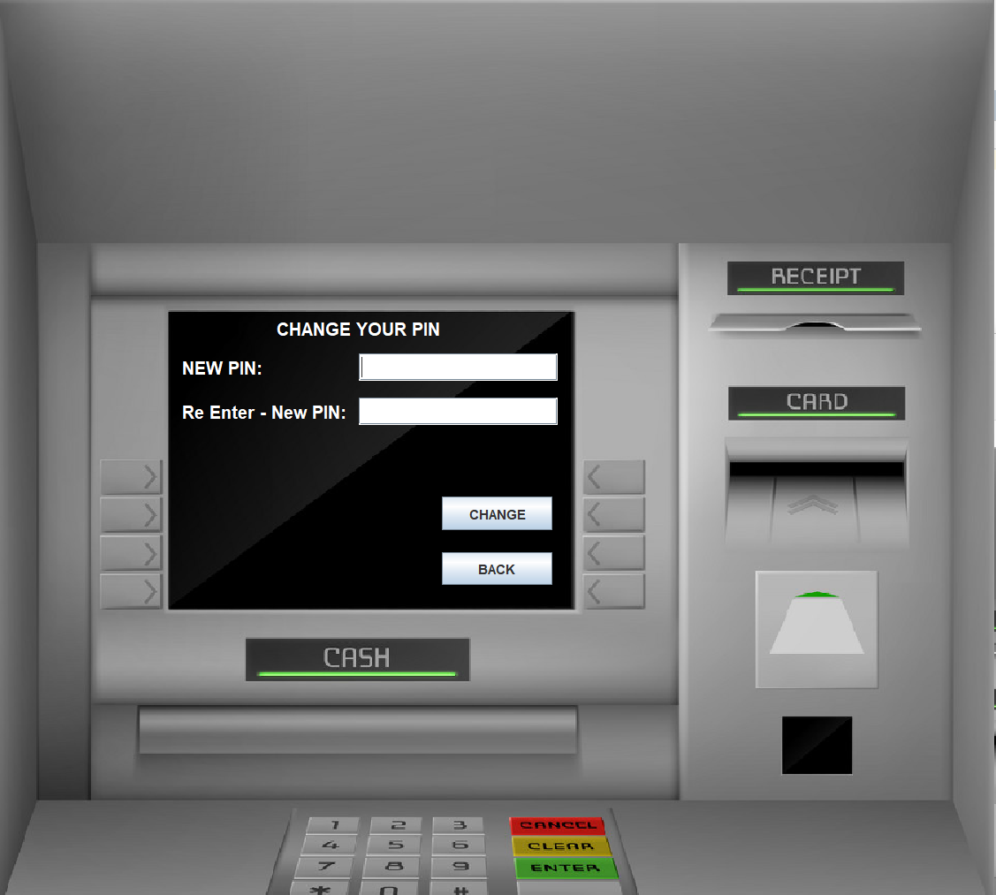

Slide 9
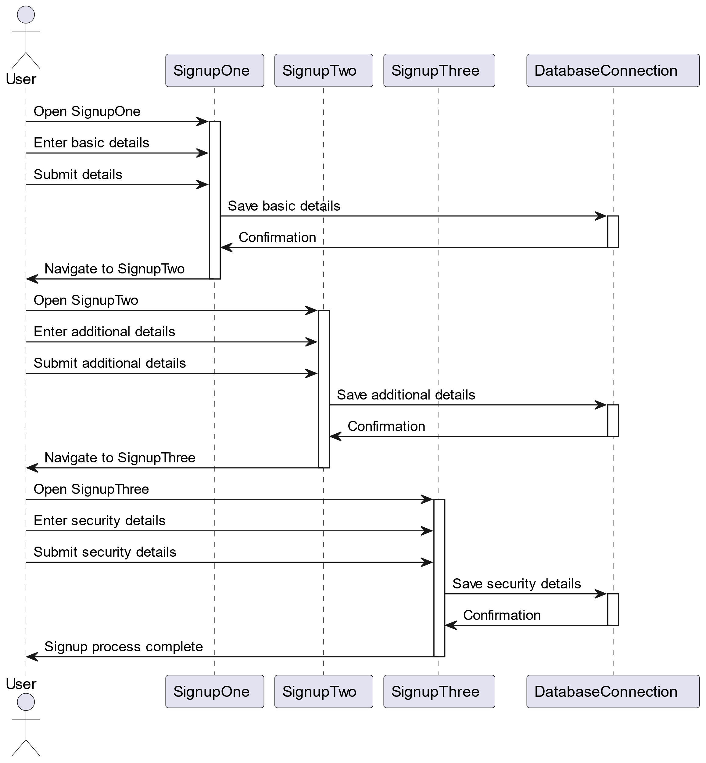
Sign up Process

Slide 10
Transaction Types
List of available transactions:
1. Deposit
2. Withdrawal
3. Fast Cash
4. Balance Enquiry

Slide 11
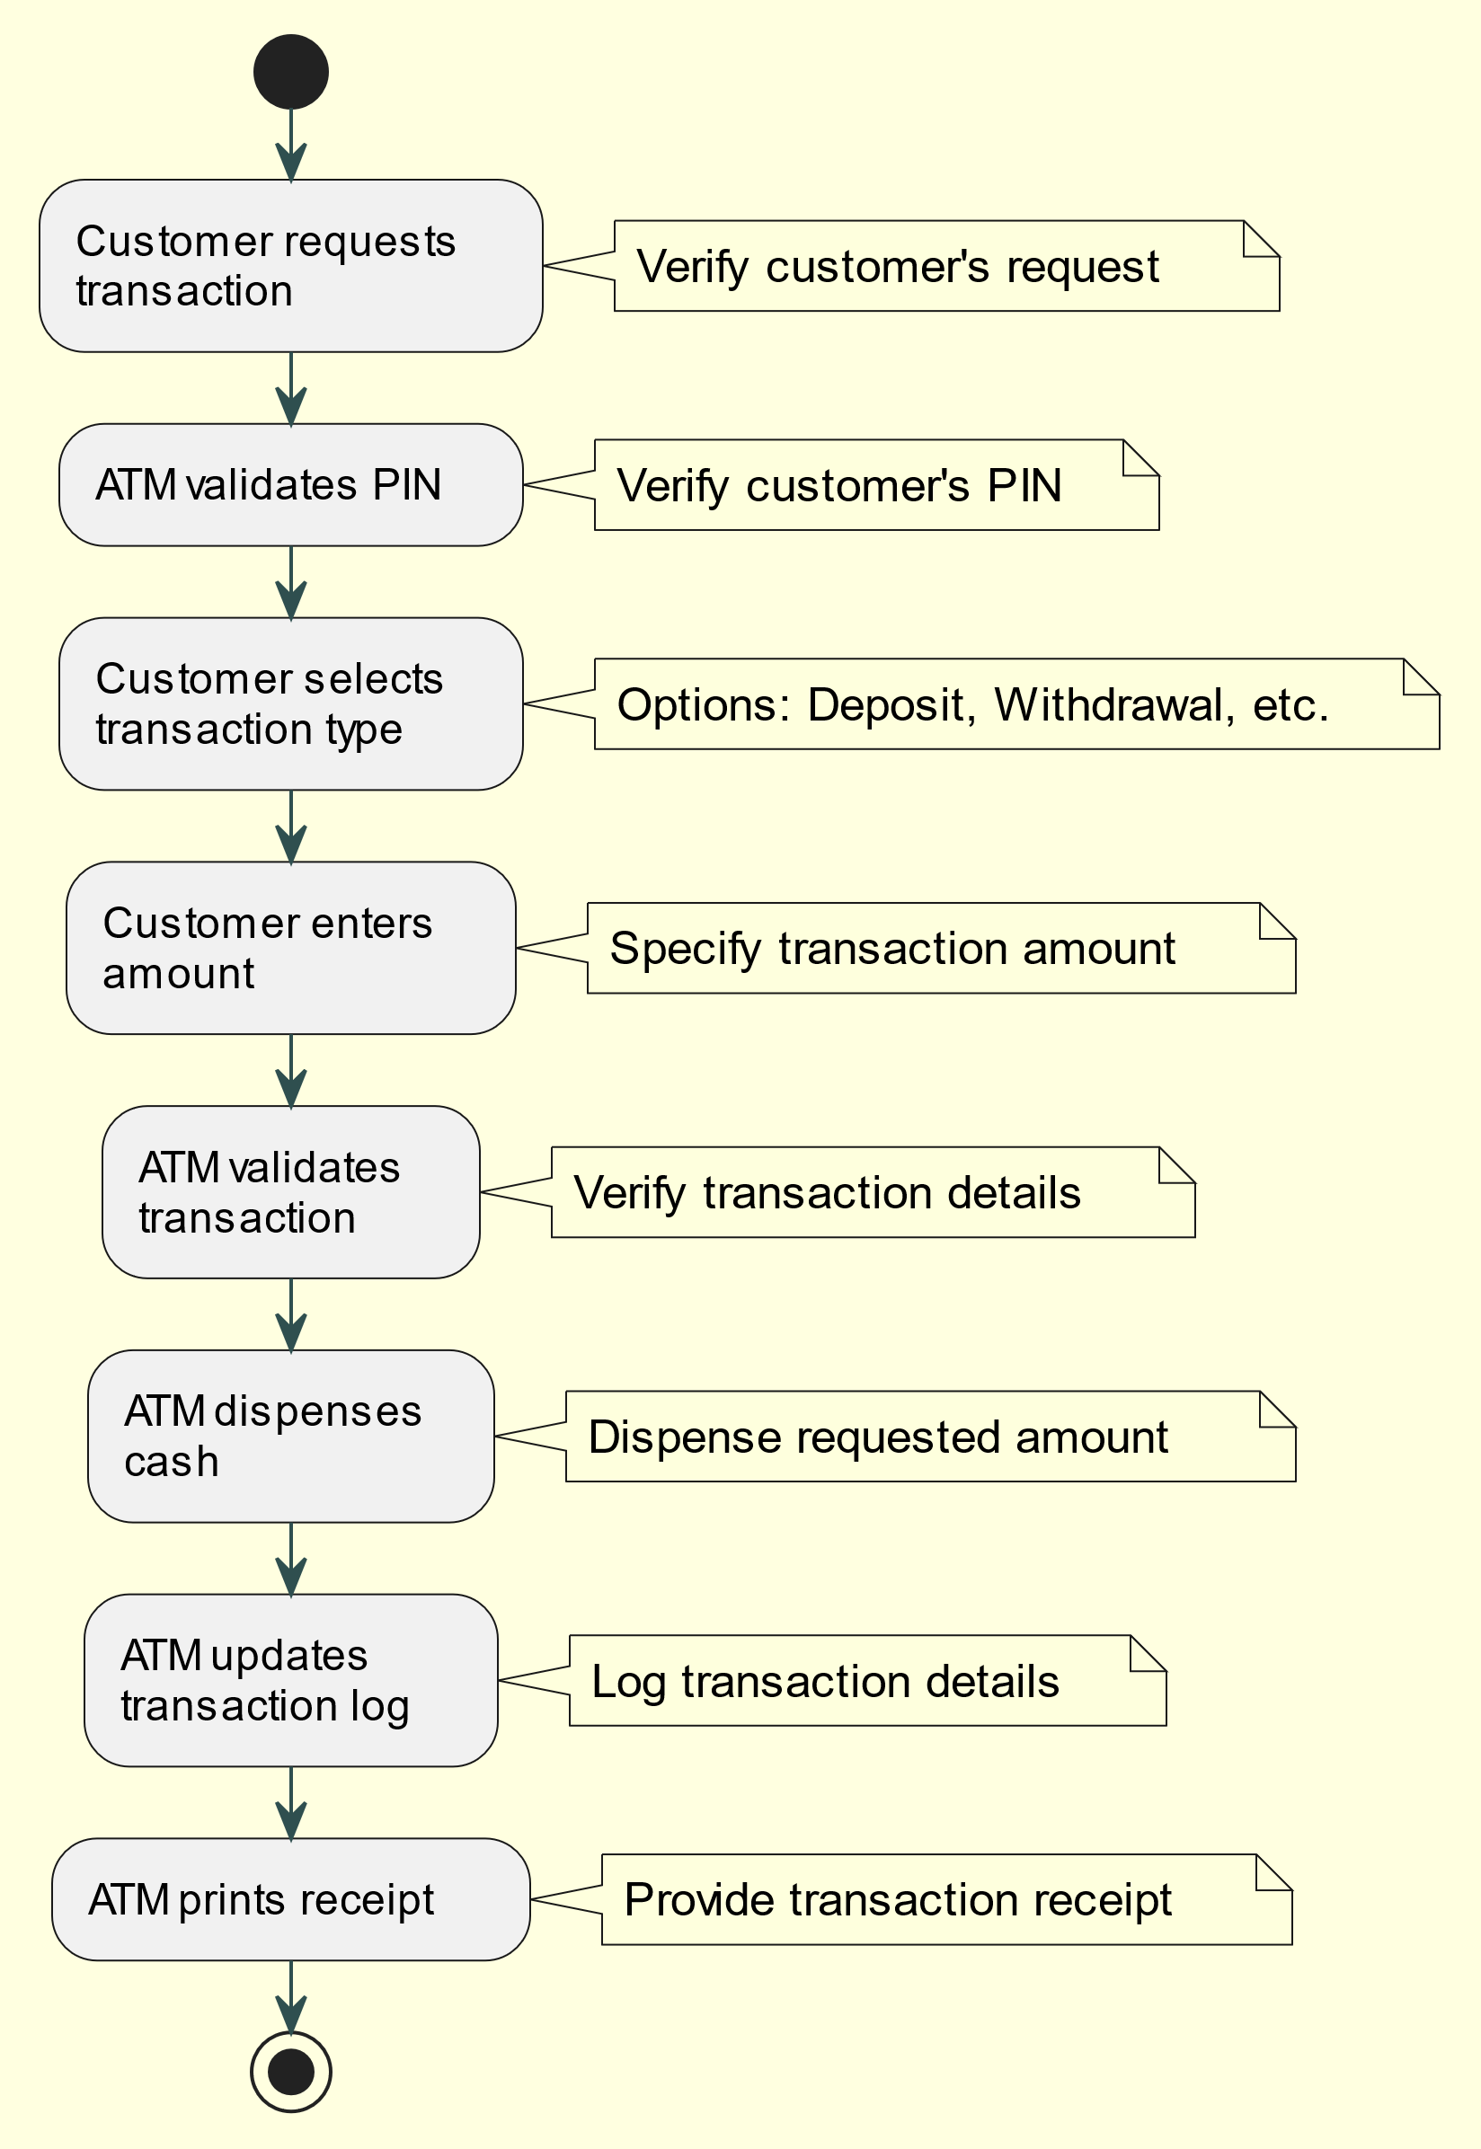
Transaction Flow

Slide 12
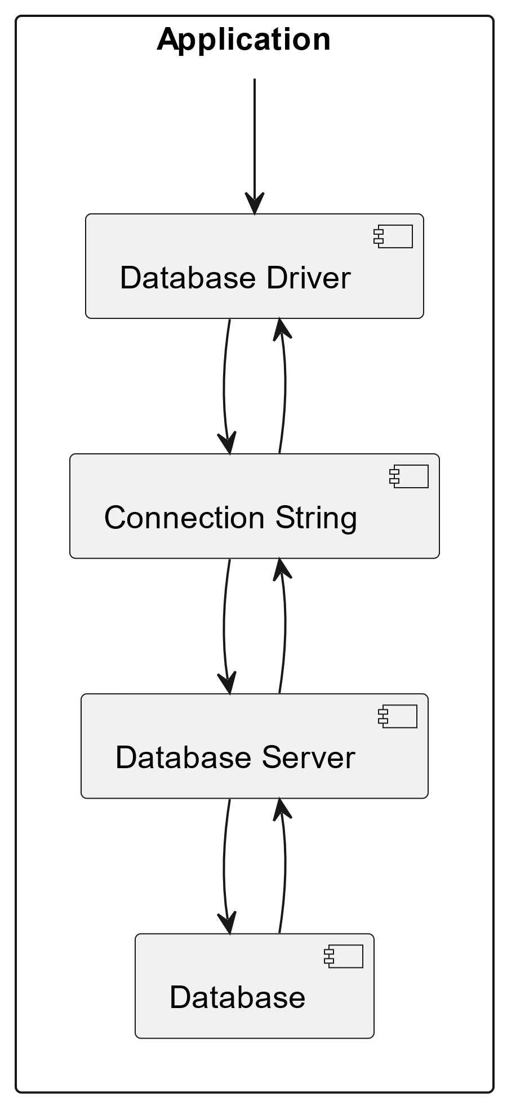
Database Connectivity
The system connects to the database using a connection string that includes server details and credentials. This connection enables it to execute SQL queries to retrieve, update, insert, or delete data. Once operations are complete, the system closes the connection to the database.

Slide 13
Security Features
Encrypted PIN Storage:
Stores PINs encrypted.
Uses a strong encryption algorithm for security.
Secure Login:
Implements multi-factor authentication.
Requires username, password, and OTP for access.
Transaction Verification:
Validates transaction details.
Verifies transaction amount and type for accuracy and security

Slide 14
Challenges Faced
Integration Complexity:
Challenge: It was difficult and time-consuming to connect different parts of the system and third-party services.
Solution: We broke down the system into smaller parts with clear rules for how they communicate.
Security Vulnerabilities:
Challenge: Finding and fixing problems in how the app keeps user information safe, especially with all the rules about privacy and safety.
Solution: We put strong ways to keep information safe in the app.

Slide 15
Future Works
Mobile App Integration: Add a mobile app to make the system more accessible on smartphones and tablets.
More Transaction Types: Include new types of transactions to better meet user needs.
Enhanced Security: Improve security with features like fingerprint or face recognition for login

Slide 16



Thanks!
ANY QUESTIONS?

