Slide 1
Specialism Project (SDET) - Choonz
Week 12 Final project - Client Web Application Testing & Deployment
Team Ice
Tay Dzonu
Owen Jackson
Mohammad Rashid
Oforitsesan Towesho
06/11/2020

Slide 2

Presentation
Project description
Risk Assessment
Sprint
Demo
Testing
Improvement
Our Journey

Slide 3
Project description
To improve upon, and provide a full test suite for, the full-stack music library web application, Choonz, that we were provided with from Angelica (client).
With utilisation of supporting tools, methodologies and technologies that we have developed during training.
What was out focus?
Agile working, collaboration within the team was priority and ultimately very successful.
Rigorous testing.
MVP. A product/sprint review with Angelica at the end of sprint 1 provided us with useful feedback on what to work towards:
User experience
Functionality

Slide 4
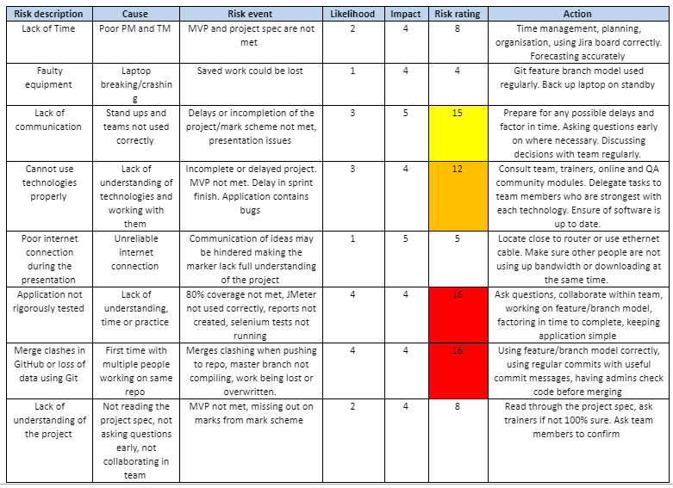
Risk Assessment

Slide 5
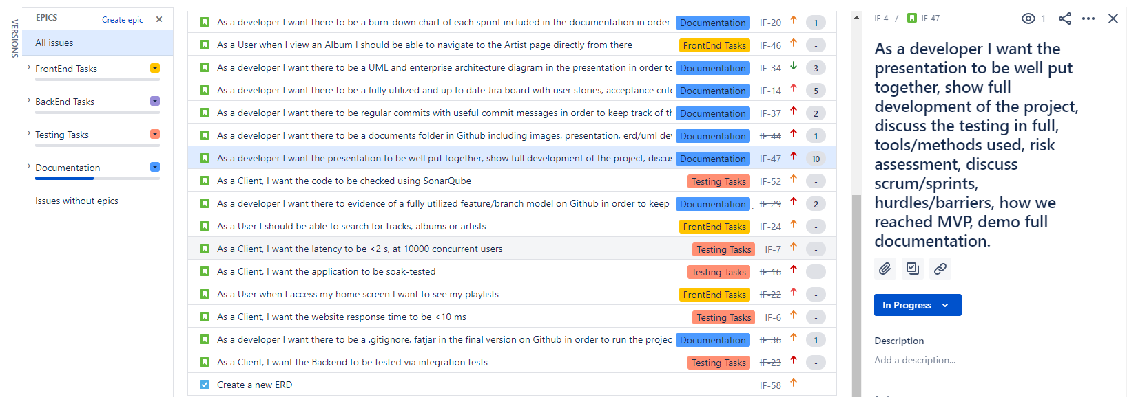
Sprint Plan
Jira
2x 5-day sprints + ‘sprint zero’
User Stories
MosCow principles
Delegation of tasks
Meeting the MVP

Slide 6

Application demonstration

Slide 7
Testing
Backend Testing -
Unit tests - tests how each class (Unit) works by itself
Integration tests - tests to ensure that the integration of the class (Unit) with the rest of the code works
Coverage test - Checking the extent of the code which is checked by the tests above
97.0% of main [industry standard : ≥80%]
Frontend Testing-
Selenium tests – Checking whether the application interface works by automating ‘users’
Tested whether all buttons work
Ensured that processes returned the expected results
e.g. Playlist delete button is clicked ➝ Playlist is no longer found
Non-functional Testing-
JMeter tests - Observing the system’s performance at different levels of concurrent users
Sonarqube - Used to ensure code adheres to standards and to spot bugs

Slide 8
Further improvements
Functionality-
Search Bar to find artists,albums etc.
Ability to create public / private playlists
A stronger frontend design and capabilities
Security (use cookies) - instead of URL Search Parameters to keep track of logged in user
User Experience
Incorporate a better method for forgotten passwords
Collaborative playlists
Testing -
Sonarqube - A lot of issues came up that were not clear.
Fix the code smells

Slide 9
Our Consultant journey
Thank you for listening!
How have we improved?
Learnt how to use new technologies
Agile methodology of working
Communication and Collaborative working skills
Things we have come to understand are important?
How has our team worked together?
Communication

