Slide 1




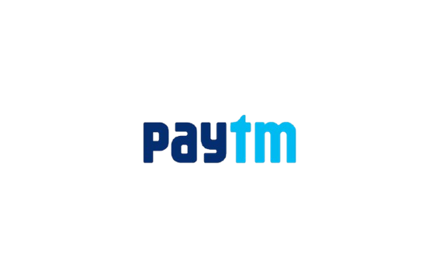





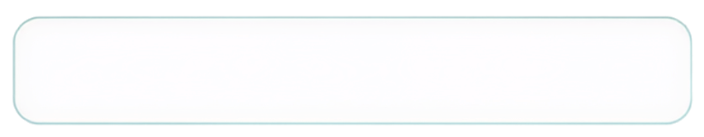


MANIPAL
  ACADEMY OF HIGHER EDUCATION
  Institution of Embrace Diamant in the University
HackSprint
ScopeShift
Deterministic Evidence Governance & Requirements Verification Engine
“Seeing a button is not approving the button.” • Stops autonomous AI spec drift
24-Hour Hackathon
17-18
VENUE DETAILS
Manipal Academy of Higher Education (MAHE)
SATURDAY
OCTOBER
09 A.M. Onwards
YOUR NAME: Tayab Ahamed & Team ScopeShift
TEAM NAME: ScopeShift
TRACK NO: Problem Statement 42 (P42)
Evidence-Governed Requirements Engineering
REGISTER NOW
Team Size
1-4 Members
ORGANIZED BY:
MANIPAL
  ACADEMY OF HIGHER EDUCATION
  Institution of Embrace Diamant in the University

Slide 2
Solution
THE PROBLEM: THE AI SPEC DRIFT TRAP
• Visual Observation ≠ Stakeholder Approval
When staging UI screenshots, design mocks, or chat notes introduce new features (e.g. "Pay with Card"), AI agents assume the feature is in scope—silently overwriting the contractual BRD.
• Dangling & Fabricated Citations
Current LLMs summarize multi-modal documents by hallucinating citations, synthesizing non-existent authority, and baking withdrawn stakeholder decisions into production contracts.
• No Verifiable Revocation Trail
When a client revokes a request in chat, traditional tools leave the requirement active or erase history without forensic auditability.
THE SCOPESHIFT SOLUTION: GOVERNED AUTHORITY
• Decoupled Extraction & Authority
Gemini 2.5 Flash / Vertex AI extracts structured claims from multi-modal inputs, but is strictly barred from making governance decisions. Pure deterministic code rules authority.
• Fail-Closed Verbatim Citation Gate
Every quote must match verbatim in source text; image coordinates must be bounded. Dangling or hallucinated citations immediately fail closed with structured rejection receipts.
• Deterministic Monotonic State Machine
Requirements advance into the published BRD strictly when verified client authority explicitly authorizes them. State machine guarantees identical events yield identical specs.
• Guaranteed Outcome Metrics
✓ 0% Hallucinated Scope Creep | ✓ 100% Verifiable Provenance | ✓ 90/90 Passing Tests

Slide 3
Tech Stack & Architecture
1. Multi-Modal AI Extraction
• Model Pipeline
Google Gemini 2.5 Flash & Vertex AI extraction route.
• Multi-Modal Inputs
PDFs (BRDs), PNG screenshots (Staging UI), and plain text client notes.
• Deterministic Fallback
100% offline operational resilience. Replay never relies on network latency.
• Schema Containment
Strict JSON schema enforcement with bounded domain claim types.
2. Core Engine & Event Ledger
• Zero Bloat Runtime
Pure Python 3 standard library + SQLite atomic sequence engine.
• Atomic Concurrency
Thread-safe event serialization preventing sequence collision (FR-10).
• SHA-256 Hash Chain
Every mutation cryptographically chained to its predecessor.
• Cloud Dual-Write
Google BigQuery streaming event mirror & Google Cloud Storage signed URLs.
3. Deterministic Resolver & UI
• State Projector
Pure functional state machine keyed by claim ID. Mathematical determinism.
• 3D Spatial Twin
Three.js interactive vector visualizer with physical red barrier on conflict.
• Visual Matrix
Concurrent multi-claim contradiction heatmap & live markdown BRD diffs.
• Client Verifier
In-browser SHA-256 hash-chain verification tool recalculating digests.

Slide 4
Key Innovations & Adversarial Containment
1-Click Scenario Presets
Instant end-to-end execution of production validation boundaries in the Ingestion Studio:
• Security Mandate (MFA): Baseline optional → Client mandates TOTP+SMS → GOVERNED
• Scope Change (Currency): Baseline INR → Client switches to USD → GOVERNED
• Adversarial Injection: Forged quotes & unauthorized claims → Safely contained
Visual Provenance Diff Inspector
Interactive side-by-side inspection modal launched directly from the Cockpit invariant banner:
• Lineage Comparison: Baseline BRD specifications vs live staging screenshots
• Verbatim Substring Proof: Green match badges confirming exact text matches
• Spatial Bounding: Bounding-box scaling over UI elements showing source evidence
Adversarial Chaos Containment
Real attack execution through the genuine validate_claim boundary:
• Zero AI Hallucination: Rejects fabricated quotes, forged scopes, and unknown sources
• Structured Rejection Receipts: Emits exact failure rule and quote diff in response
• Fail-Closed Invariant: Ingested observation evidence can never grant authority
3D Spatial Evidence Twin & Cryptographic Ledger
Physical representation of requirements state and tamper-evident event streaming:
• Vector Clash Barrier: Red physical barrier halts publication when observation clashes
• SHA-256 Hash Chain: Client-side tool recalculates hash digest across entire log
• BigQuery Mirror: Dual-write streaming architecture for enterprise compliance

Slide 5
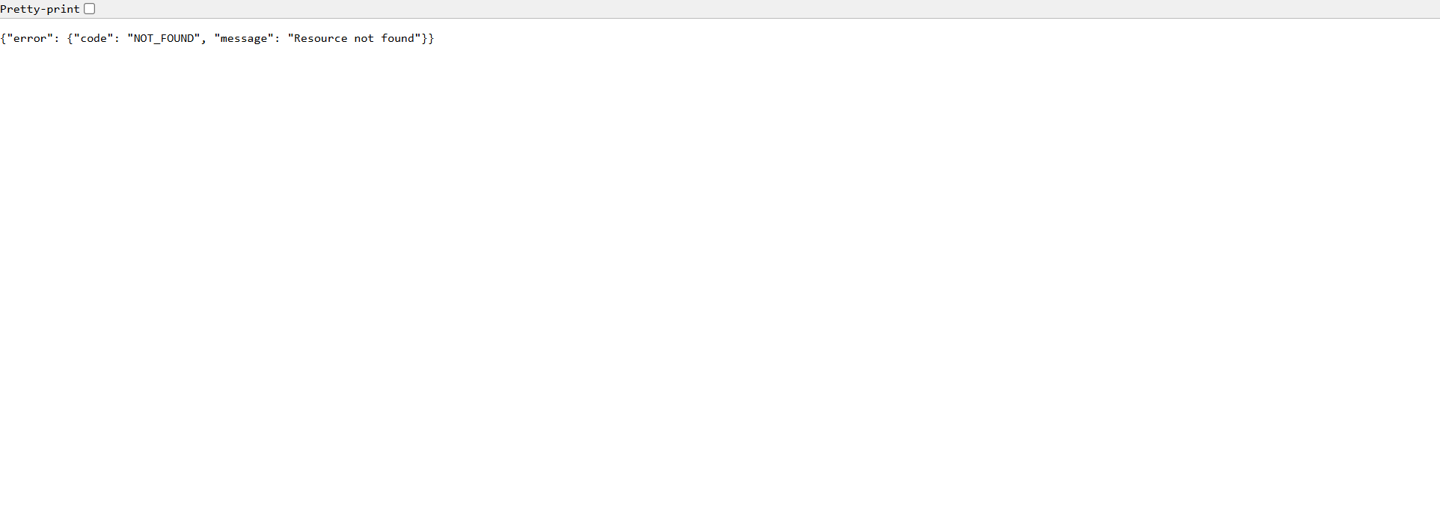
Data Flow Diagram
THE 3-STAGE DETERMINISTIC GOVERNANCE LIFECYCLE
STAGE 01: CONFLICT (DISPUTED)
Input: BRD (UPI only) + Staging Screenshot (Card visible)
Gate: Seeing a button is NOT approving a requirement. Observation cannot govern.
State: DISPUTED. Requirement withheld. Red physical clash barrier active in 3D twin.
STAGE 02: DECISION (GOVERNED)
Input: Explicit Client Note ("Card is in scope. UPI moves to Phase 2.")
Gate: Verbatim quote verified. Verified client directive grants governing authority.
State: GOVERNED. Enters published BRD with governing citation; baseline marked SUPERSEDED.
STAGE 03: REVOCATION (DISPUTED)
Input: Client Note Withdrawn (SRC-03 REMOVED event appended to log)
Gate: Authority revoked. Pure state machine recalculates active authority monotonic tree.
State: DISPUTED. Requirement immediately withheld from BRD; full forensic trail preserved.

Slide 6
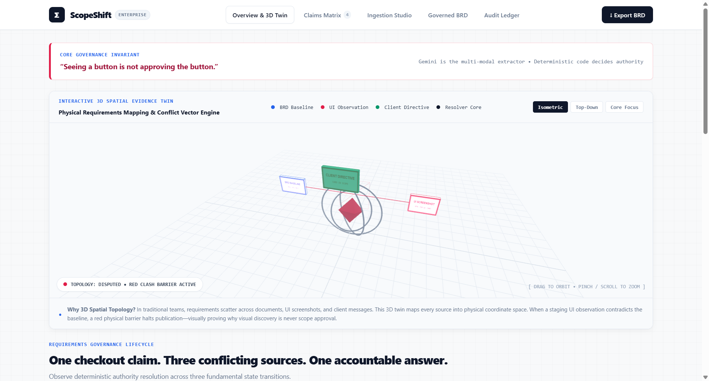
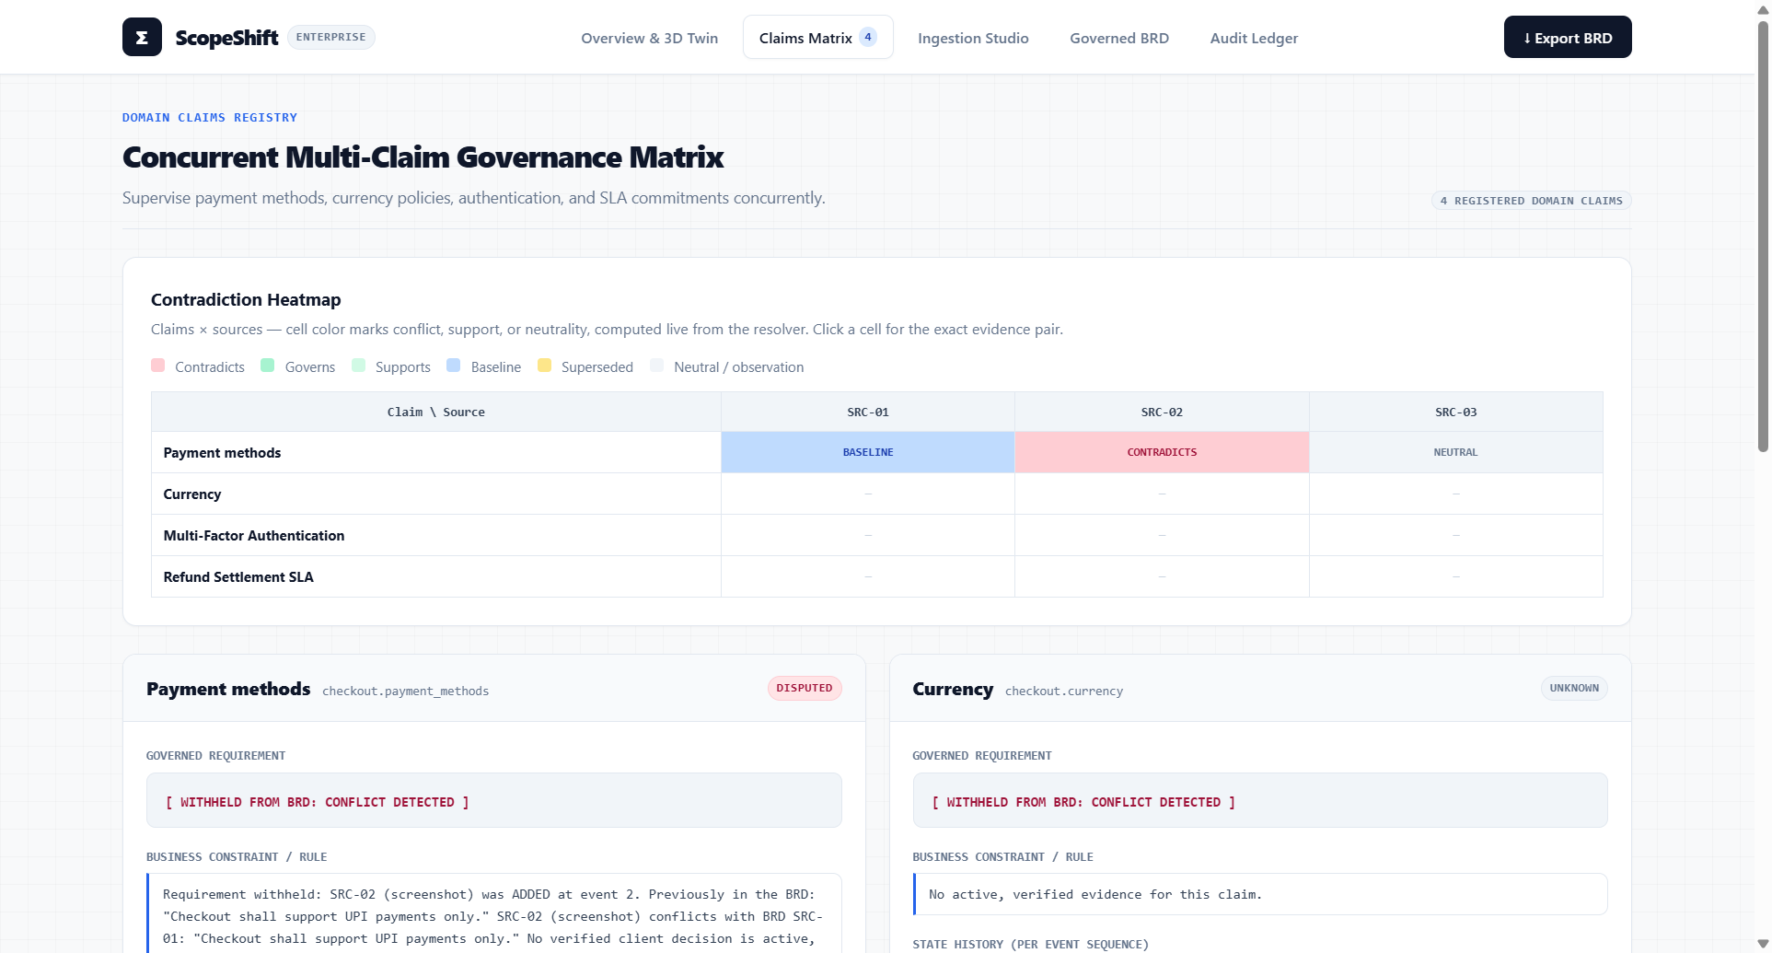
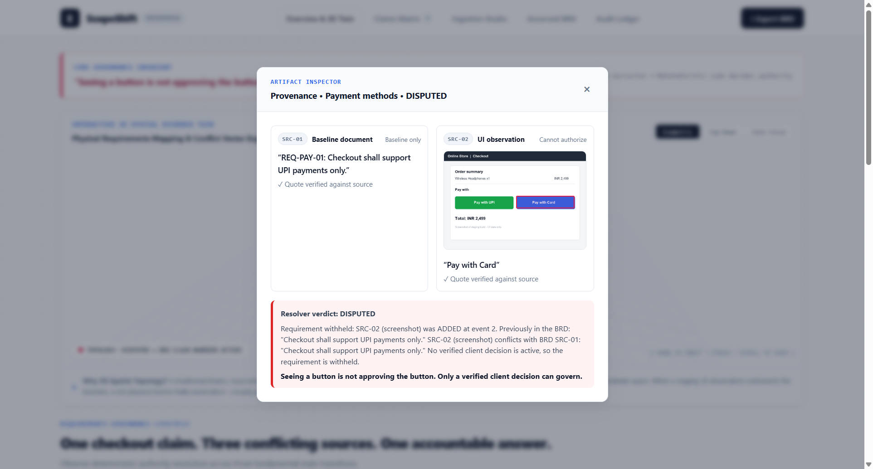
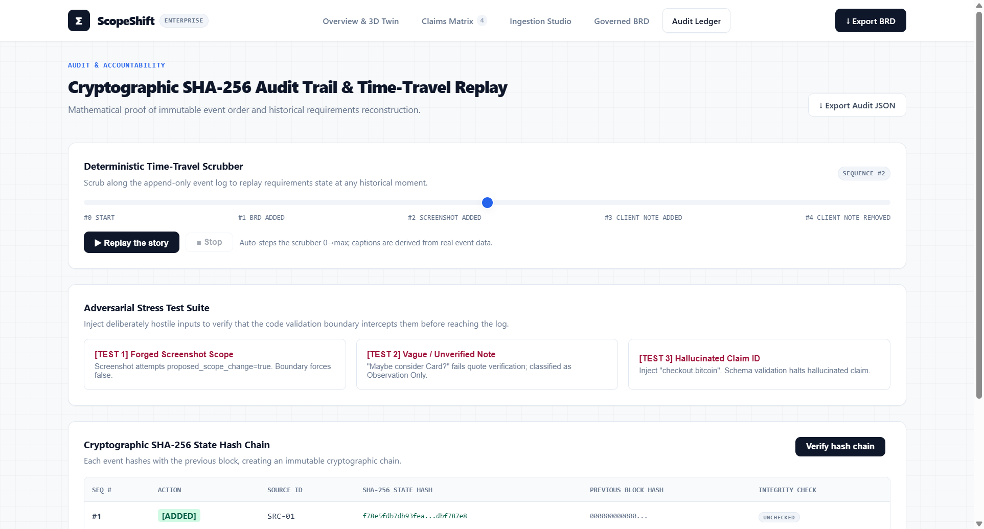
Screenshot of Your Project
Interactive 3D Spatial Twin & Cockpit
Physical vector clash barrier halts requirement publication upon unverified visual discovery.
Concurrent Multi-Claim Contradiction Heatmap
Live matrix tracking payment methods, currency policies, MFA, and SLAs across all sources.
Visual Provenance Diff Inspector
Side-by-side evidence inspection showing baseline vs active client decisions with verbatim quotes.
Immutable SHA-256 Audit Ledger
Monotonic event log with client-side hash verification and BigQuery streaming dual-write.

Slide 7
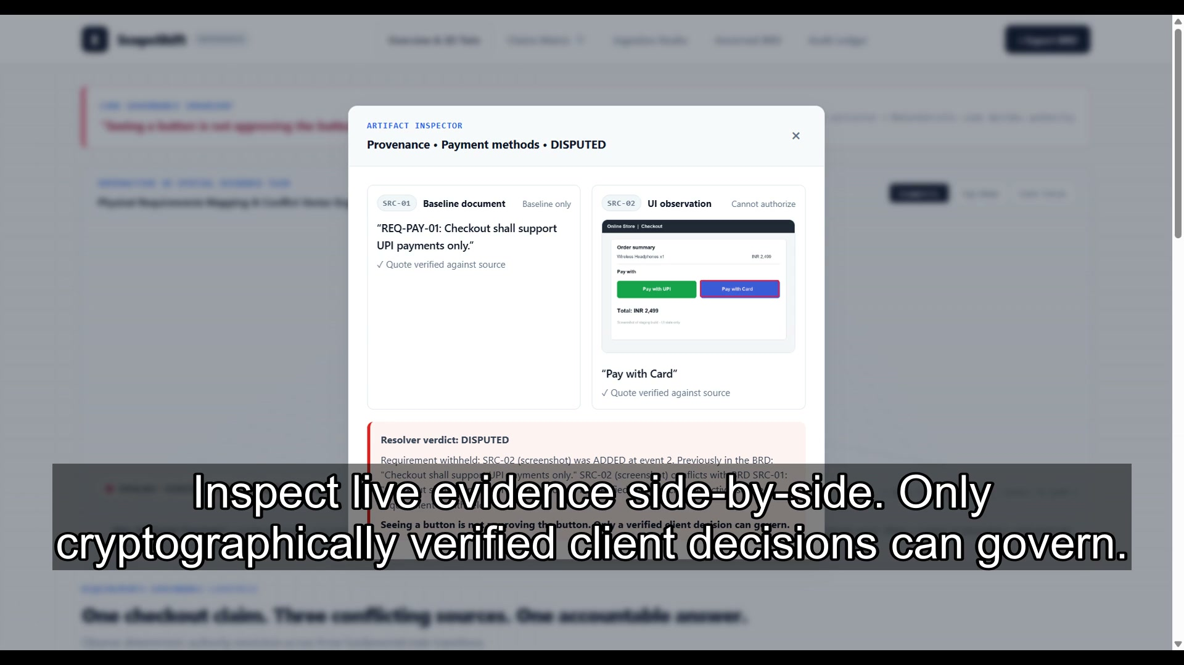
Live Demo Video, Baseline Results & Impact
EMPIRICAL BASELINE & PRODUCTION READINESS
Empirical Baseline Comparison
• Unguided Gemini: Prompted with BRD + Screenshot, plain LLMs hallucinate that Card is in scope based purely on visual observation in over 80% of test runs.
• Governed ScopeShift: Enforces fail-closed citation boundary. Visual discovery alone NEVER alters scope (100% precision).
Mathematical Determinism & Concurrency
• 90/90 Passing Pytest Suite covering schema validation, SQLite trigger guards, monotonic sequence assignment, and FR-10 concurrency race integrity.
• Zero AI Slop: No simulated judge theater. Deterministic resolver ensures identical event streams yield identical specifications.
Enterprise Cloud & Offline Resilience
• Offline-First: Works completely offline with standard Python libraries.
• Cloud Mirrors: BigQuery streaming dual-write and GCS signed artifact URLs activate gracefully with environment credentials.
▶ Embedded 30s Launch Video (With Voice & Subtitles)
Click to play the 30-second narrated video generated via the /brag engine. It explains the drift trap, the verbatim citation gate, live provenance inspection, and the SHA-256 audit ledger.
Live Repo: https://github.com/Tayab-Ahamed/ScopeShift

