Slide 1
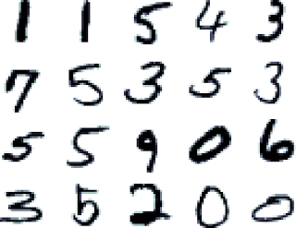
Digit Recognizer
Support Vector Machine (SVM) algorithm

Slide 2
SVM ?
A statistical learning theory.
An algorithm popular for its success on digit recognition.
An important example of “Kernel methods”.
A process based on linear learning machine:
→ The main problem is deciding the “Decision Boundary”.

Slide 3
Decision Boundary ?
When we consider a two class linearly separable classification problem :
We should find the Decision Boundary which is the line that we get by regression in normal statistical analysis.
The gap between both sides of the classes is called:
“The margin”.

Slide 4
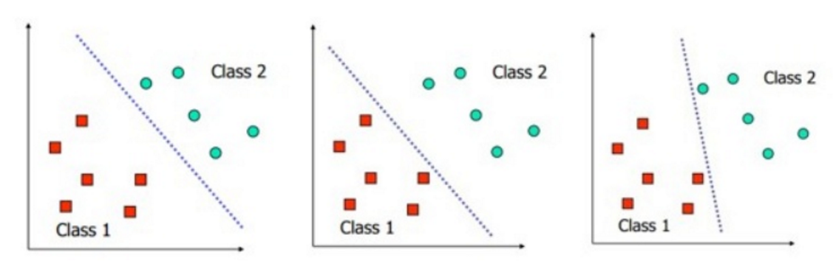
Bad Decision Boundary

Slide 5
Good Decision Boundary

Slide 6
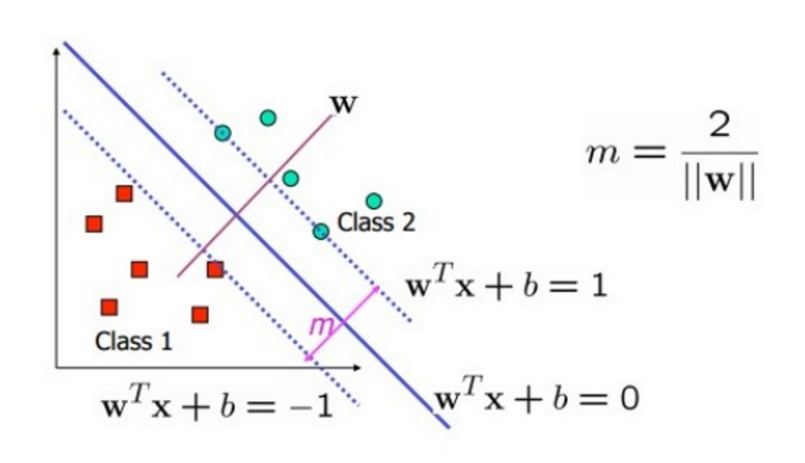

Slide 7
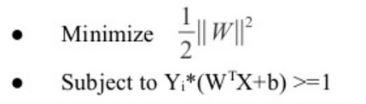
Constrained Quadratic Optimization Problem

Slide 8
Advantages of SVM ?
It uses as we saw the Kernel trick.
→ Hence, we can model even non linear relations.
SVM is defined by a convex optimization problem
→ No local minima

Slide 9
Disadvantages of SVM ?
Sadly, Kernel methods can be quite sensitive to over-fitting the model selection criterion.
SVM method is not meant to work on data containing “Sparseness”.
→ Training time is relatively long compared to the specific classification algorithms.

Slide 10
When to use SVM ?
SVM
Classification
Regression
Complex relationships among data points

Slide 11

When NOT to use SVM ?
When we have sparseness, we don’t recommend to use SVM because the resulting boundary are very difficult to interpret ( Black Box).
→ Kernel Logistic Regression and Informative vector machine are far more suitable.

Slide 12
Digit Recognizer ?
Goal :
→ Determine the hand written digit in a given image.
Data:
→ It’s taken from the “Modified National Institute of Standards and Technology “dataset.
→ It consists of 42000 labelled images (28×28 pixels) of hand written digits 0-9.
→ Each image is modelized with 28*28 matrix containing pixels values(0-255).

Slide 13
Digit Recognizer and SVM?
SVM can only classify into two categories:
1) Differentiation of 10 categories: to train 10x(10-1)/2 classifiers as follows: “0″ vs. “1″ and for “0″ vs. “2″ etc.
2) Input fed to all 10x(10-1)/2 classifiers.
3) Category which got chosen most often, considered to be the correct one.
→ In case several categories share the maximum score, one of it is chosen at random.

Slide 14

The R code
for Digit Recognizer
applied with SVM?

Slide 15
Evaluation metric ?
The categorization accuracy or the proportion of test images that are correctly classified.
→ Example:
Categorization accuracy of 0.97 :
3% of the images aren’t correctly classified.

Slide 16
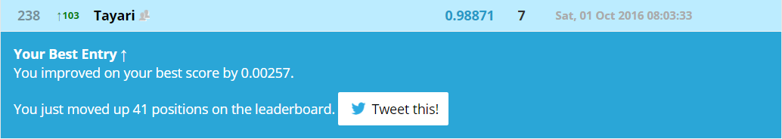
Submission in Kaggle?

