Slide 1
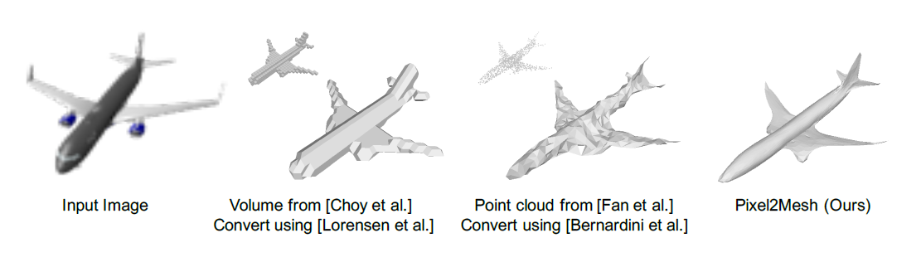
Pixel2Mesh: Generating 3D Mesh Models from Single RGB Images
ECCV 2018

Slide 2
Challenges
represent a mesh model
2D regular grid to an irregular graph（2d Image 到 3d Mesh）
Solution: Graph representation, and GCN （图卷积神经网络）
Vertex->node, edge->connection
Benefit : The known connectivity, high order loss
surface normal loss
an edge loss
a laplacian loss
how to update the vertex location effectively and correctly（通过对椭球进行形变近似到目标模型）
a large number of vertices, limited receptive field
Solution: a coarse-to-fine approach
graph unpooling layer
mesh deformation block
Notes:
图卷积神经网络 非欧空间的数据
3dmesh 比体素和点云好 用的多

Slide 3
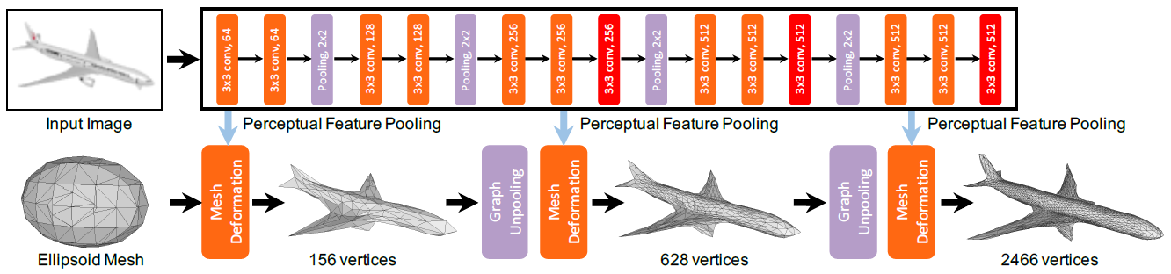
Overview
2DCNN
vgg16
GCN
An image feature network.
A cascaded mesh deformation network.

Slide 4
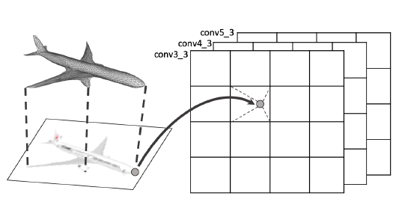
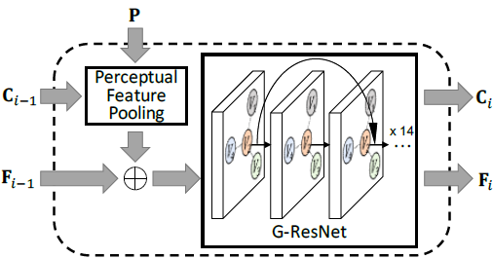
Perceptual Feature Pooling
Mesh Deformation Block
点的三维坐标
点的特征向量

Slide 5
Perceptual Feature Pooling
Projection and bilinear interpolation（双线性插值）
Get (1280,) shaped feature vector for every node（vgg16的三个卷积层决定的）
Notes:
第五个block 第三个layer 至于为什么这么选是试出来的 经验决定

Slide 6

Mesh Deformation Block
Concatenate
(N,1280) image feature and (N,128) node feature, get (N,1408) node feature
Graph convolution
Input: (N,1408) feature and (N,3) 3D location
Output: (N,128) feature and (N,3) 3D location
Shortcut connection（图中的点只能跟邻居节点交换信息，相当于2d中的感受野小。解决办法是deep net with shortcut）
1280维
128维
Notes:
三层卷积层出来是1280维 跟128维3D feature链接起来 = 1408

Slide 7
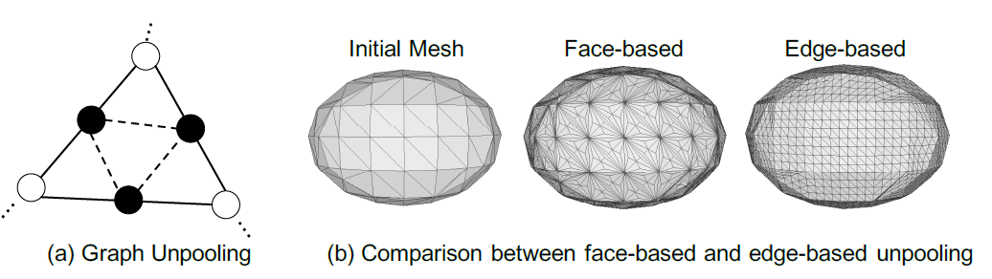
Graph Unpooling
Requirement: balanced vertex degrees
基于面的：imbalanced vertex degrees
基于边的：新点的feature取边上两点平均值

Slide 8




Loss
Chamfer loss：其作用是限制网格顶点的具体位置；
Normal loss：其作用是增强网格表面法向的一致性（增加表面光滑度）；
Laplacian regularization：其作用是在形变时维持临近顶点的相对位置；
Edge length regularization：其作用是防止个别异常顶点的出现。

Slide 9
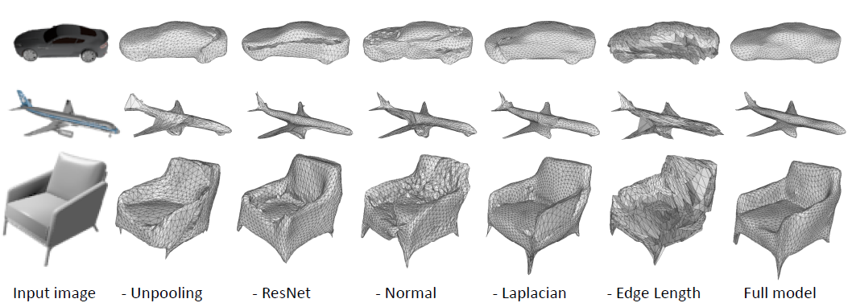
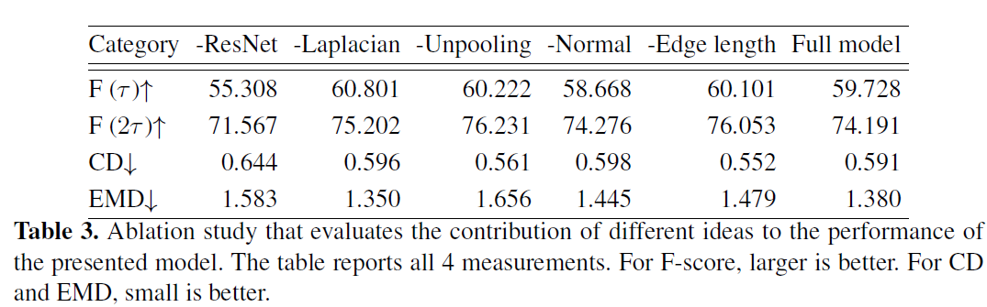
Ablation study

Slide 10
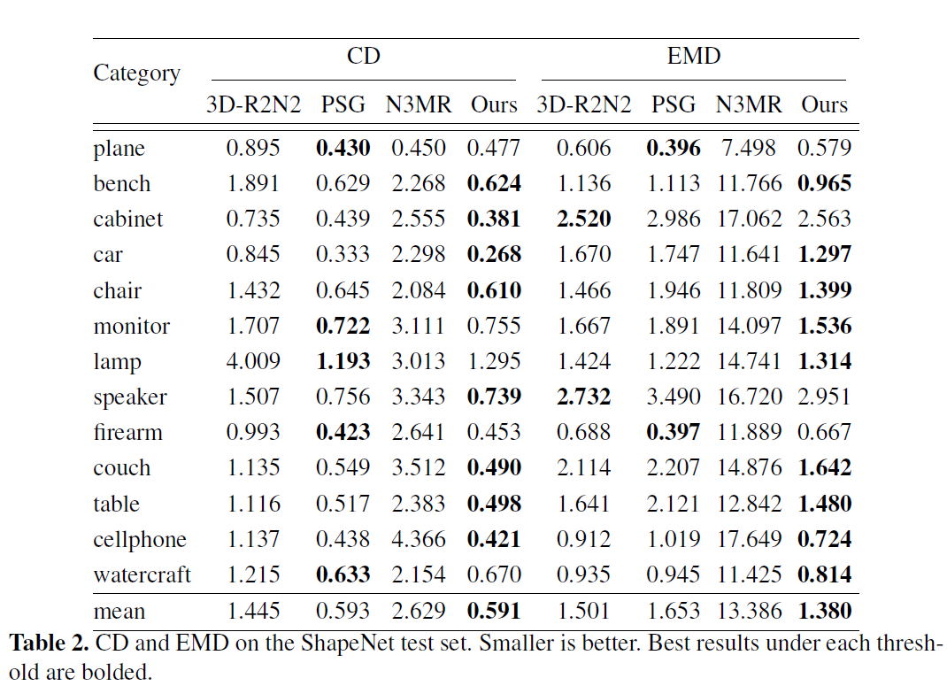
Comparison

Slide 11
Contributions
A novel end-to-end neural network architecture that generates a 3D mesh model from a single RGB image
Design a projection layer which incorporates perceptual image features into the 3D geometry represented by GCN
Predict 3D geometry in a coarse to fine fashion, which is more reliable and easy to learn.

