Slide 1
Welcome Everyone

Slide 2
Tayeb Ahmed
CSE 1st year 1st semester
tayebkpj@gmail.com
HABHIT, Tangail

Slide 3
Loops

Slide 4
Introduction
What is loop ?
Ans: A loop is a sequence of instructions that is continually
repeated until a specific condition is reached.
It allows us to execute a statement or group of statements multiple times.

Slide 5
Why loops ?
It provides code reusability.
Using loops, we do not need to write the same code again and again.
Using loops, we can traverse over the elements of data structures (array or linked lists).

Slide 6
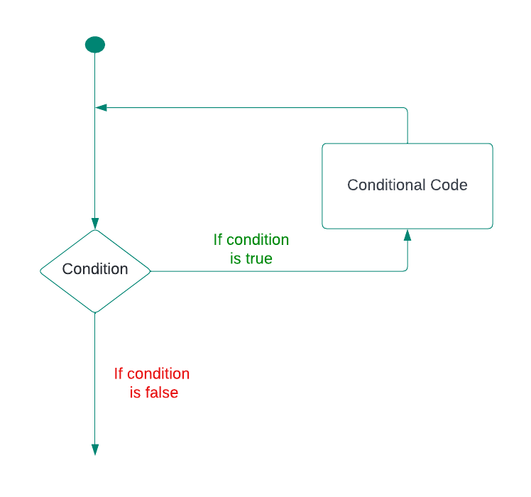
Looping Process

Slide 7
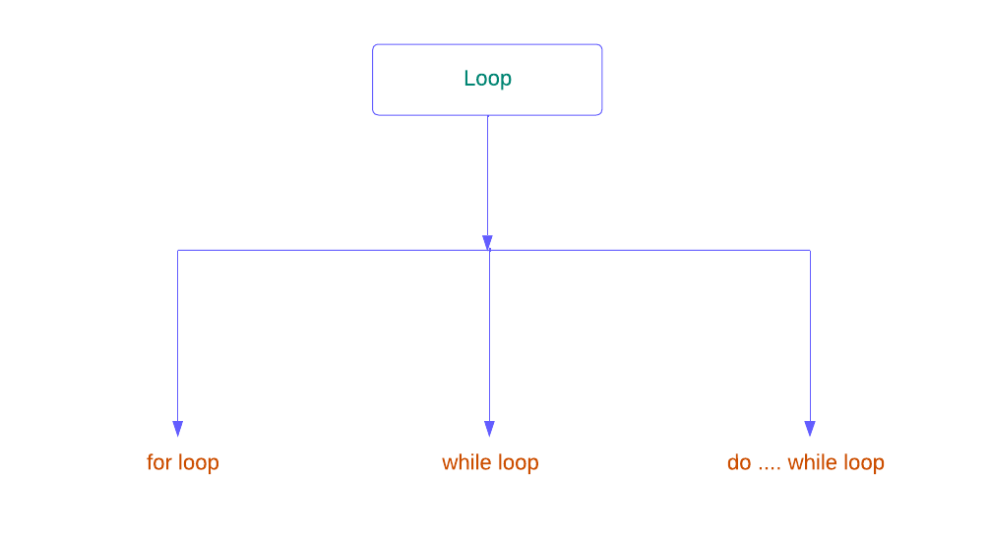
Loops type in C

Slide 8
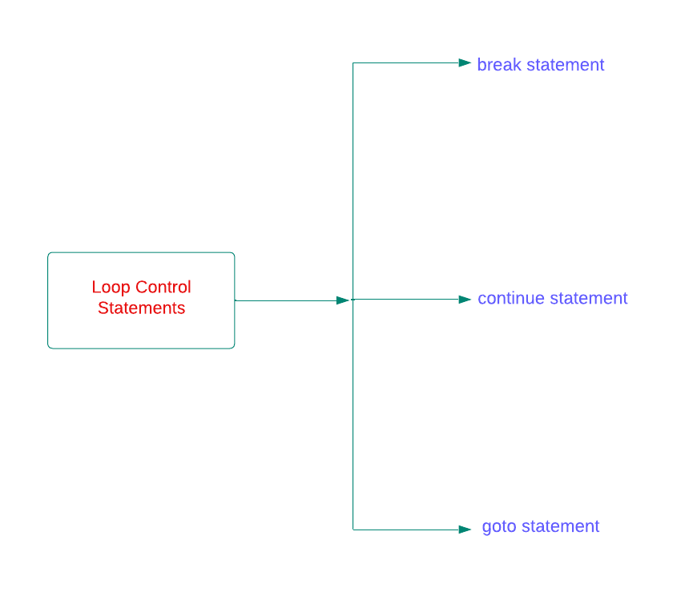
Loop Control Statements
Loop control statements change execution from its normal sequence.
C supports the following control statements :

Slide 9
for statement
This is the easiest loop.
Syntax :
for(init; condition; increment/decrement)
{ Conditional code;
}

Slide 10
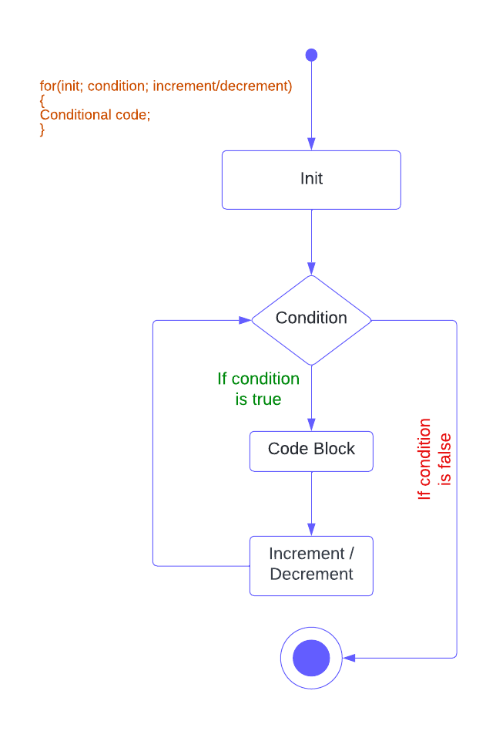
For : Flow Diagram

Slide 11
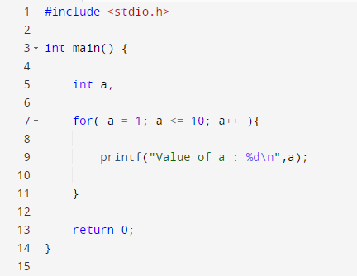
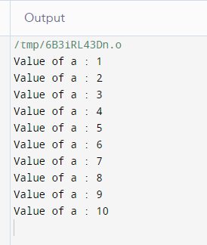
Example

Slide 12
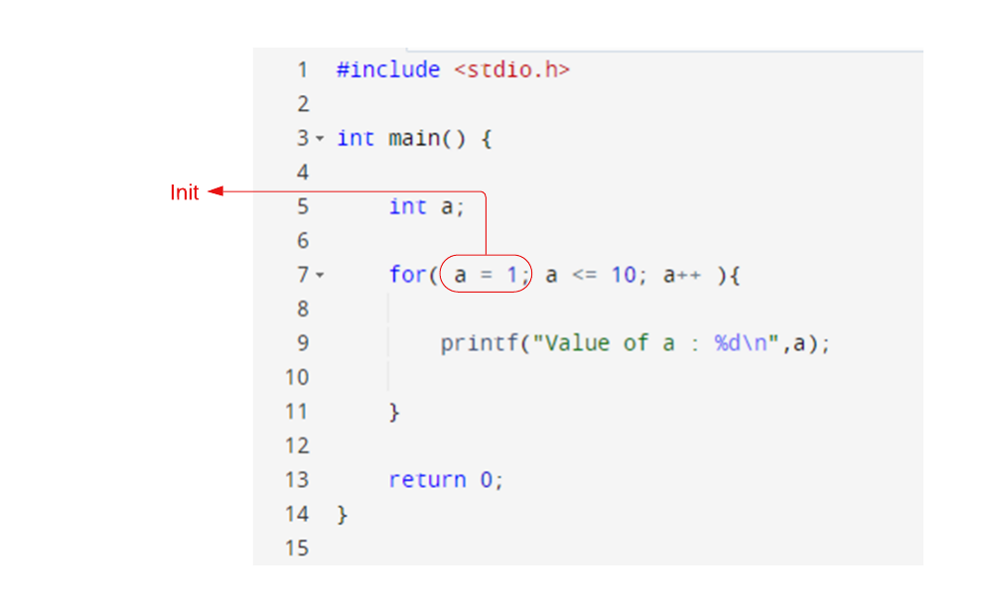

Slide 13
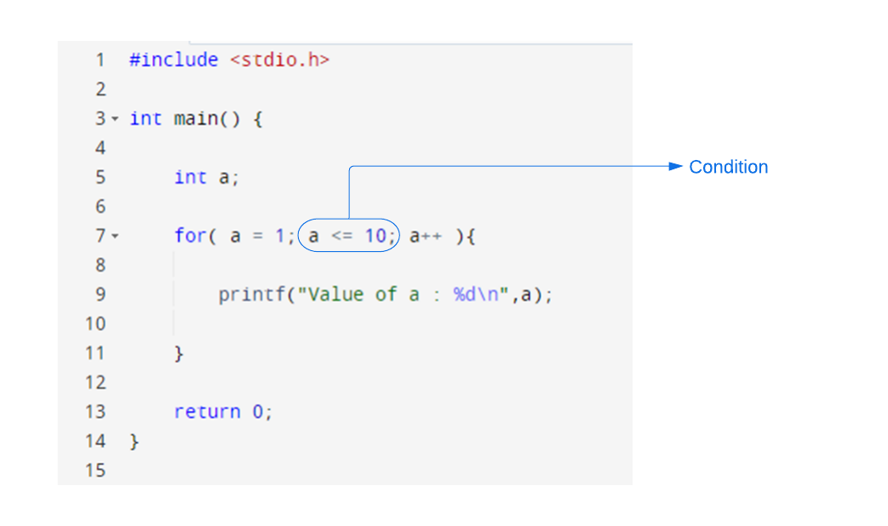

Slide 14
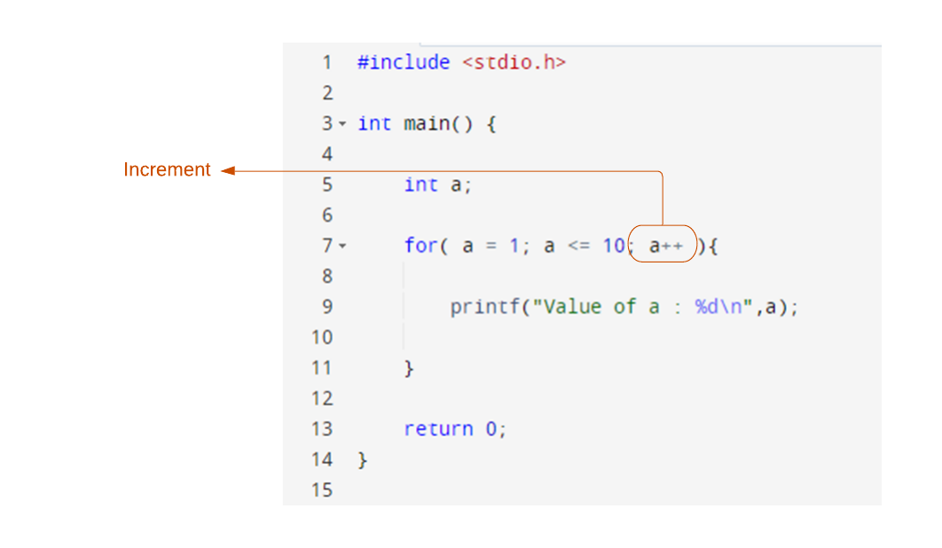

Slide 15
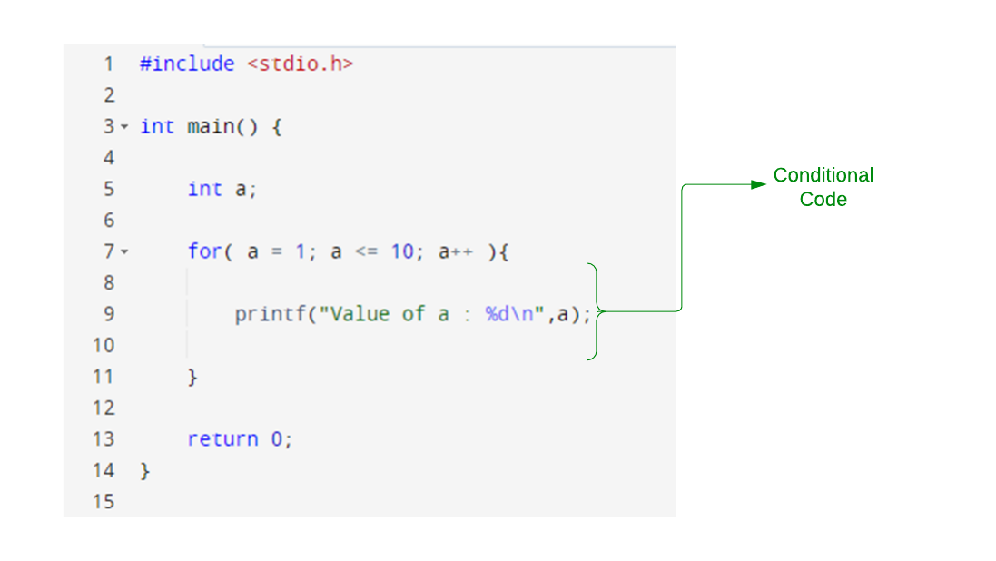

Slide 16
Infinite Loop using for
A loop becomes an infinite loop if a condition never becomes false.
Syntax(or code):
for(;;)

Slide 17
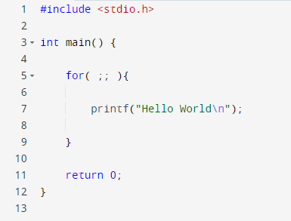
Example

Slide 18
Why for Loop ?
It's easier than while and do-while.
It is clear to a developer exactly how many times the loop will execute before the loop starts.
The Syntax of the for loop is almost same to other programming languages.

Slide 19
Thanks For Watching

