Slide 1
Welcome
To our presentation

Slide 2

PRESENTED TO
Sudarsan Pal
Lecturer
DEPT OF CSE
HABHIT
PRESENTED BY
Jannatul Rahman ( 17 )
Tayeb Ahmed ( 09 )
Fardin Rahman Shamil ( 20 )
DEPT OF CSE
2nd year 3rd Semester
HABHIT

Slide 3
Inheritance
in C++

Slide 4
What is Inheritance ?
Inheritance is the process by which new classes called derived classes are created from existing class.

Slide 5
Diagram
Data Members
Base Class
Methods
Inheritance
Data Members
Data Members
Derived Class
Methods
Methods
Logically Present

Slide 6
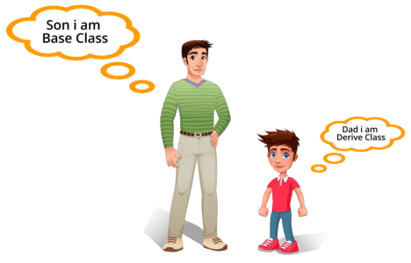
Real life example of Inheritance

Slide 7
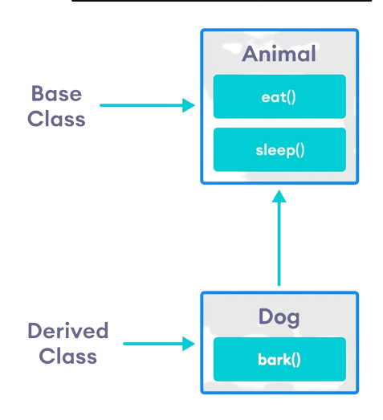
Real life example of Inheritance

Slide 8
Basic Syntax of Inheritance
class <derived_class_name> : <access-specifier> <base_class_name>
{
// data members
// data methods
}

Slide 9
Example of Inheritance
class Animal {
public:
int legs = 4 ;
} ;
class Dog : public Animal {
public :
int tail = 1 ;
};
int main() {
Dog d ;
cout << “Legs are : ” <<d.legs<<“\t”<<“Tail is : ”<<d.tail<<endl ;
}

Slide 10
Example of Inheritance
class Animal {
public:
int legs = 4 ;
} ;
class Dog : public Animal {
public :
int tail = 1 ;
};
int main() {
Dog d ;
cout << “Legs are : ” <<d.legs<<“\t”<<“Tail is : ”<<d.tail<<endl ;
}
Animal is a
Super Class

Slide 11
Example of Inheritance
class Animal {
public:
int legs = 4 ;
} ;
class Dog : public Animal {
public :
int tail = 1 ;
};
int main() {
Dog d ;
cout << “Legs are : ” <<d.legs<<“\t”<<“Tail is : ”<<d.tail<<endl ;
}
Dog is a
Sub Class

Slide 12
Example of Inheritance
class Animal {
public:
int legs = 4 ;
} ;
class Dog : public Animal {
public :
int tail = 1 ;
};
int main() {
Dog d ;
cout << “Legs are : ” <<d.legs<<“\t”<<“Tail is : ”<<d.tail<<endl ;
}
Sub class Dog inherit the properties of Super class Animal

Slide 13
Access Control & Inheritance
A derived class can access all the protected and public members of its Base class.
It can not access private members of the Base class.
Base Class
Public
Protected
Can be Inherited
Private
Can be Inherited
Child Class
Can not be Inherited

Slide 14
Types of Inheritance
Inheritance
Single Inheritance
Multiple Inheritance
Multilevel Inheritance
Hierarchical Inheritance
Hybrid Inheritance

Slide 15
Single Inheritance
Syntax :
class Base_Class
{
// class defination
};
class Derived_Class: access_specifiers Base_Class
{
// class defination
};
int main()
{
Base_Class obj1;
Derived_Class obj2;
// code
}
Class A
Base Class
(Super Class)
Class B
Derived Class
(Sub Class)

Slide 16
Single Inheritance Example
class A
{
public :
int salary ;
};
class B : public A
{
};
Class A is a Parent Class
Class B is a Child Class

Slide 17
Multiple Inheritance
Syntax :
class Base_Class1
{
// class defination
};
class Base_Class2
{
// class defination
};
class Derived_Class: access_specifiers Base_Class1,
access_specifiers Base_Class2
{
// class defination
};
Class A
Class B
Base Class
(Super Class)
Class C
Derived Class
(Sub Class)

Slide 18
Multiple Inheritance Example
class A
{
};
class B
{
};
class C : public B , public A
{
};
Parent Class
Parent Class
Child Class

Slide 19
Multilevel Inheritance
Syntax :
class Base_Class
{
// class defination
};
class Intermediate_Class: access_specifiers
Base_Class
{
// class defination
};
class Child_Class: access_specifiers
Intermediate_Class
{
// class defination
};
Class A
Base Class
of B
Class B
Derived Class
of C
Class C
Derived Class
of B

Slide 20
Multilevel Inheritance Example
class A
{
};
class B : public A
{
};
class C : public B
{
};
Most Parent Class
Parent Class of C and Child class of A
Child Class of B

Slide 21
Hierarchical Inheritance
Base Class
Class A
Class B
Class C
Class D
Derived Class

Slide 22
Hierarchical Inheritance Example
class A {
};
class B : public A {
};
class C : public A {
};
class D : public A {
};
Parent Class
Class B,C & D are Child Classes of Class A

Slide 23
Hierarchical Inheritance Example
Syntax :
class Base_Class {
// class defination
};
class Derived_Class1: access_specifiers Base_Class {
// class defination
};
class Derived_Class2: access_specifiers Base_Class {
// class defination
};
------------------
------------------
class Derived_ClassN: access_specifiers Base_Class {
// class defination
};

Slide 24
Hybrid Inheritance
Syntax :
class A{
// class defination
};
class B: access_specifiers A {
// class defination
};
class C {
// class defination
};
class D: access_specifiers B, access_specifiers B {
// class defination
};
Class A
Class B
Class C
Class D

Slide 25
Hybrid Inheritance Example
class A {
};
class B : public A {
};
class C : public A {
};
class D : public B , public B {
};
Most Parent Class
Parent Class of D
Parent Class of D
Child Class

Slide 26
Features of Inheritance
Reusability of code
Saves Times & Effort
Faster development
Easier maintenance
Easy to extend
Capable of expressing the inheritance relationship

Slide 27
Thanks
For Watching

