Slide 1
Samsung Research China - Beijing at SemEval-2023 Task 2: An AL-R Model for Multilingual Complex
Named Entity Recognition
Haojie Zhang, Xiao li

Slide 2
CONTENTS
Background
System Architecture
Methodology
Experiments & Results

Slide 3
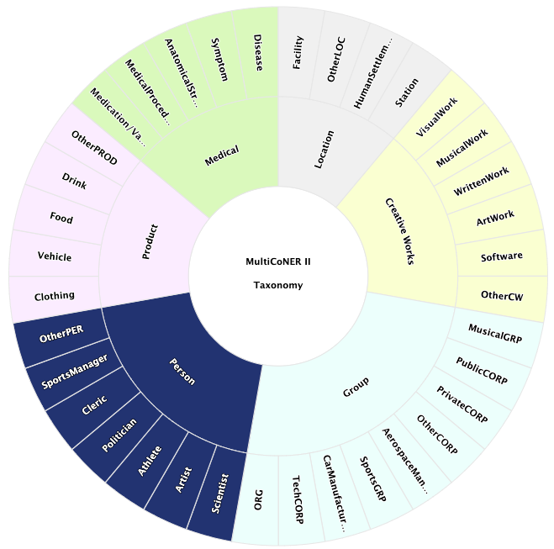
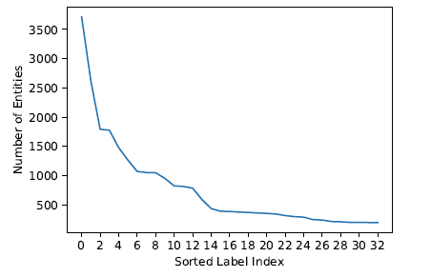
Background
Task Overview
Tagset
Complex named entities (NE), like the titles of creative works, are not simple nouns and pose challenges for NER systems.（2022 MultiCoNER I）
The top systems infused transformers with knowledge bases and gazetteers. However, such solutions are brittle against out of knowledge-base entities and noisy scenarios like the presence of spelling mistakes and typos.
(2023 MultiCoNER II)
data distribution
MultiCoNER I Task Tagset:
- Coarse label tagset (the label number is 6)
- Location, Creative Work, Group, Person, Product, Medical
New challenges
1: out of knowledge-base entities
2: noisy scenarios
3: with much more labels tagset
4: with long-tailed data distribution
VS
2023 MultiCoNER II Task Tagset:
- fine-grained tagset (the label number is 33)
- with much more labels in the tagset.
- with long-tailed data distribution.

Slide 4
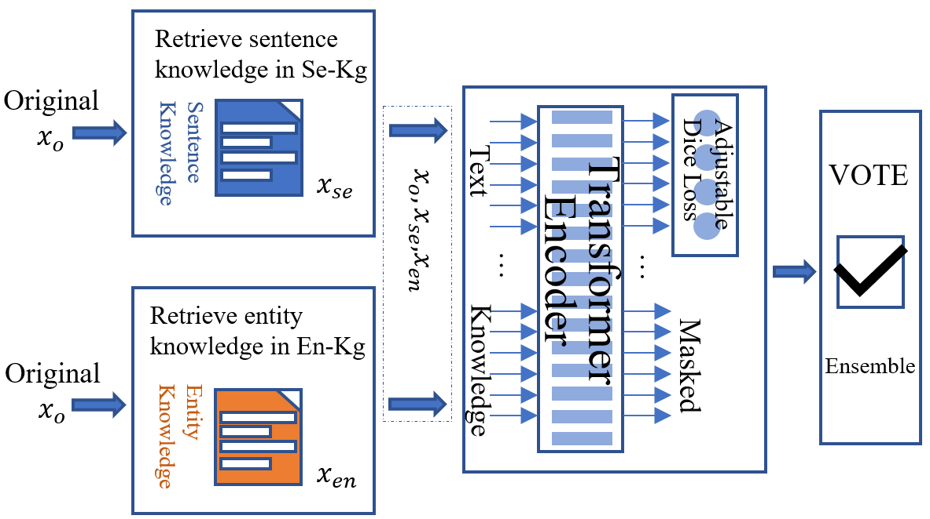
System Architecture
System Structure
Key technology:
Knowledge Enhancement Tools:
Sentence Retrieval Knowledge Base (Se-Kg)
Entity Retrieval Knowledge Base (En-Kg)
Loss：
Adjustable Dice Loss
Label Smoothing
Ensemble models
Majority Votes

Slide 5
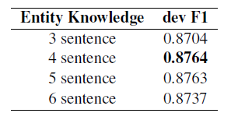
Methodology—Building Knowledge-enhancement Tool
Architecture
Knowledge-enhancement Tool
Sentence Retrieval Knowledge Base (Se-Kg)
We can take advantage of the retrieved
sentences to enrich the context of the
origin texts.
We choose top 10 related sentences in the
Wiki dump.
Entity Retrieval Knowledge Base (En-Kg)
We use entity retrieved sentences to increase
the relativity of the original sentences and the
retrieved sentences.
The original texts with short contexts make it a harder task for NER.
We choose top 4 sentences for Entity Knowledge

Slide 6

Methodology—Building Effective Loss
Adjustable Dice Loss
>=90%
Dice loss is a F1-score oriented loss, which is
consistent with the final evaluation metric.
Dice Loss is an effective option to alleviate imbalanced data distribution.
Fine-grained tagset data distribution
Label Smoothing
We discover that some grained tail labels belonging to the same tail coarse labels are easily confusing by identification during inference process.
By adding uniform noise for the golden labels to alleviate the overfitting during the training process.
Obviously the data is long-tailed distribution.
Long tail can severely degenerate
system performance.
Reference: Li X, Sun X, Meng Y, et al. Dice loss for data-imbalanced NLP tasks[J]. arXiv preprint arXiv:1911.02855, 2019.

Slide 7
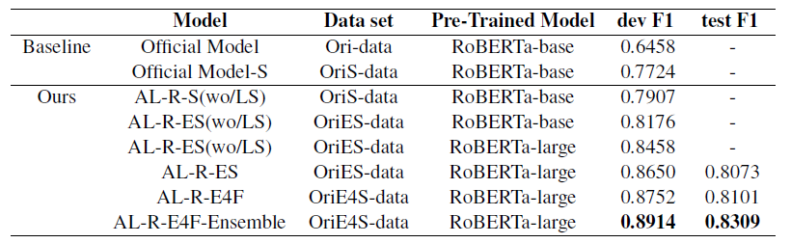
Experiment Setting & Results
Experiment Setting
Results
Setting | Values
Model | Roberta-large
Optimizer | AdamW
Learning Rate | {4e-5,2e-5,1e-5}
Learing Rate Scheduler | Line scheduler
Batch Size | {64, 32,16}
Sequence Length | 512
alpha | 1
beta | 1
#entity retrieval | 4
Ablation Study
Effect of Sentence Knowledge
Effect of Entity Knowledge
Effect of Entity Knowledge Truncation
Effect of Adjustable Dice Loss and LS

Slide 8
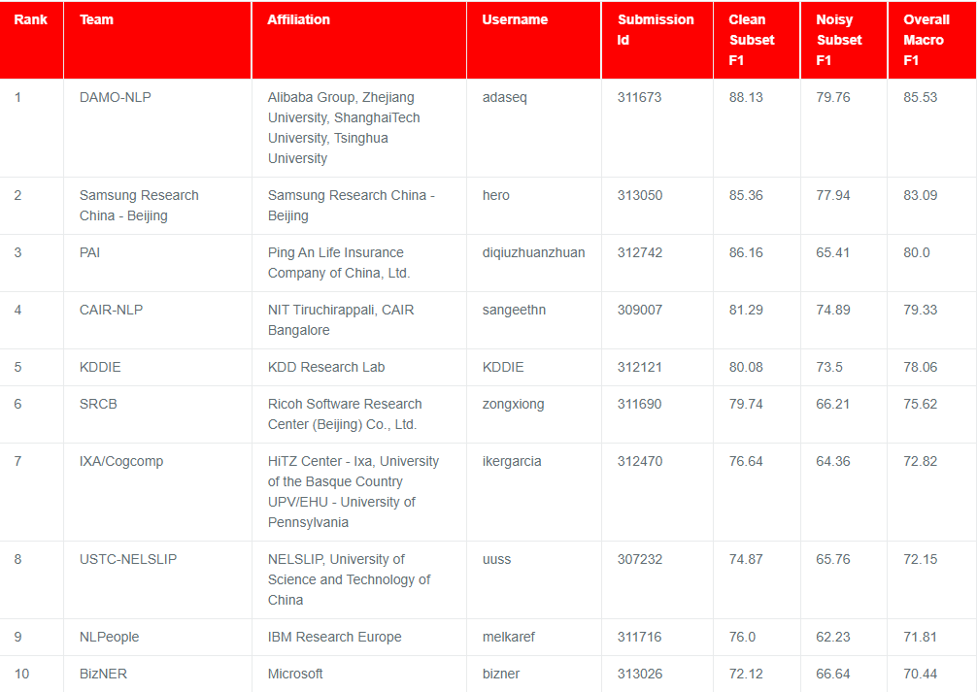
Ranking
Rank at 2/34

Slide 9
Thank you

