Slide 1

Loan Default Prediction- Feature Store
CS611 - Machine Learning Engineering
Assignment 1
Tay Guan Liang

Slide 2


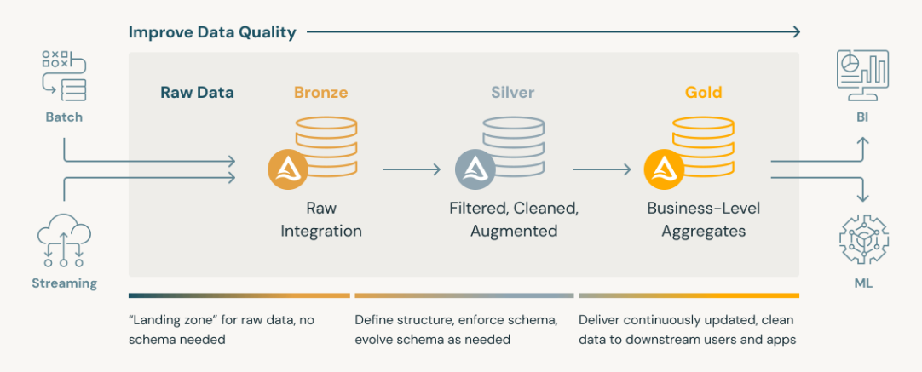


Objective
Raw Data
Medallion Architecture
1.Clickstream
1.Clickstream
Transform
2.Attributes
2.Attributes
To create feature store for downstream machine learning tasks following the medallion architecture
3.Financials
Source: https://www.databricks.com/glossary/medallion-architecture

Slide 3

Bronze Table
Raw Data
Key Transformations
Bronze Table
215377 rows
22 cols
Outer Join
Put together all relevant information in one table
Keys: 'Customer_ID’, 'snapshot_date’
Partition
Split data by snapshot dates
1.Clickstream
12501 rows
6 cols
218902 rows
46 cols
2.Attributes
Partition by snapshot_date
Stored as CSV
12501 rows
22 cols
Raw data are joined together and stored in csv format as different partition based on snapshot date for fast and efficient query
3.Financials

Slide 4

Silver Table
Bronze Table
Key Transformations
Silver Table
Data Cleaning
Trim additional spaces
Removal of unrelated symbols and illogical text (e.g. _, !@9#%8, etc)
Replace invalid values with Null (e.g. negative Num_of_Delayed_Payment)
Extract Information
Credit_History_Age is transformed from strings (e.g. “10 Years and 9 Months”) to numerical value (10.75)
Imputation
Fill empty cells with values as appropriate. Forward fill if possible to prevent data leakage.
Fill with median (numerical cols) and Unknown (categorical cols) if forward fill is not available (Unique Cust ID, no historical data).
Rounding
Numerical columns are rounded to 2dp
Enforce Schema
Columns are casted to their appropriate datatypes
Stored as CSV
Stored as Parquet file
Provide "just-enough" transformations and data cleansing to provide a clean "Enterprise view" of all key business entities, concepts and transactions

Slide 5

Gold Table
Silver Table
Key Transformations
Gold Table
One hot encoding
Convert categorical columns (Occupation, Credit_Mix, Payment_Behaviour, Payment_of_Min_Amount and Type_of_Loan) to one hot encoding.
Use drop_first= True to avoid multicollinearity for linear models.
Feature Engineering
Create and transform existing features to useful features to improve the performance of machine learning model
We engineered 7 features:
Recent_Delays
Income_to_Debt_Ratio
EMI_to_Income_Ratio
Monthly_Saving
Is_Multi_Borrower
Int_across_loans
Delinquency_Score
Rounding
Numerical columns are rounded to 2dp
Stored as Parquet file
Stored as Parquet file
Consumption-ready database for specific project. Create de-normalized and read-optimized data models ready for machine learning.

Slide 6


Feature Engineering
1. Recent_Delays
Transform Delay_from_due_date to binary (Recent Delay =1 if Delay_from_due_date > 10 else 0)
Risk of default is higher if delay in loan payment is recent
2. Income_to_Debt_Ratio
Annual_Income/Outstanding_Debt
Measures the borrower's debt burden relative to their income
3. EMI_to_Income_Ratio
Total_EMI_per_month/(Annual_Income/12)
Evaluates disposable income after EMI payments
4. Monthly_Saving
Monthly_Inhand_Salary- Total_EMI_per_month- Amount_invested_monthly
Lower monthly saving may indicate higher risk of default
5. Is_Multi_Borrower
Is_Multi_Borrower= 1 if Num_Bank_Accounts+ Num_Credit_Card>6 else 0
A multi borrower may indicate riskier loans
6. Int_across_loans
Interest_Rate/Num_of_Loan
Higher average rates may indicate riskier loans
7. Delinquency_Score
Num_of_Delayed_Payment/(Num_Credit_Card+Num_of_Loan)
Normalizes late payments by credit lines

Slide 7
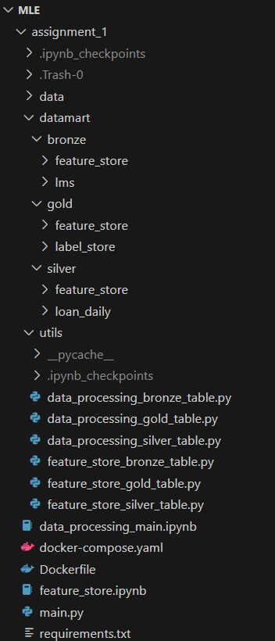
Storage Structure and Environment
File structure
Separate .py files was created to generate the bronze, silver and gold tables required to create the feature store
Feature_store folder was created in the datamart to help separate the feature and label store tables
Feature_store.ipynb was used to explore the dataset to help generate the feature store
Environment
Docker was used to run the jupyter notebook and .py script
Git
Git was utilized to manage version control
https://github.com/Taygl/MLE.git

Slide 8

Summary
Feature store following the medallion architecture
Bronze table: separate by snapshot dates
Silver table: Preprocessing and cleaning (extract information, imputation, rounding, enforce schema)
Gold Table: One hot encoding and feature engineering for machine learning (Recent_Delays, Income_to_Debt_Ratio, EMI_to_Income_Ratio, Monthly_Saving, Is_Multi_Borrower, Int_across_loans, Delinquency_Score)
Docker was used to development in a controlled environment
Github was used to help maintain proper versioning
Ready for modelling in the next assignment!

