Slide 1
Simplifying recurring trips Improving convenience and utilization Team Banh Mi

Slide 2
Our approach

Slide 3
Our approach
low rate of utilization
which demand is not yet served?

Slide 4
Our approach
low rate of utilization
which demand is not yet served?
user behavior
Providing incentives

Slide 5



Feature recurring bookings
Never forget to book
Unlock from lockscreen via notification
Discounts
Reminder the evening before

Slide 6
Feature recurring bookings
Financial incentives for users
Planning safety for everyone
Higher utilization rate and cost coverage for the landlord

Slide 7



Feature Gamification
Eco-friendliness
rewards and progress for good user behaviour

Slide 8
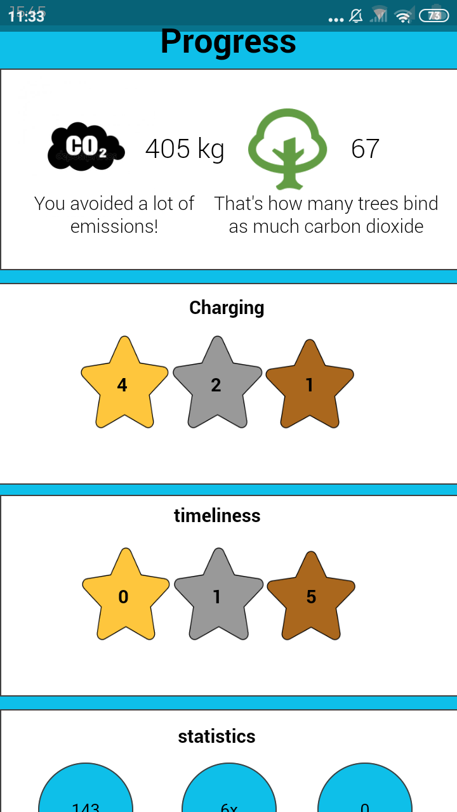
Clickable mockup
Implementation WIP…

Slide 9
Presentation of Code
GUI (Kivy)
Bottle
API
Client
Server
Datenbank
Hack: Pickle
Easy to implement (in principle)
Datenbank
Many nice libaries for python
More experience with application and frontend needed

