Slide 1
SOBIE
Taylor Hogan
&
Saad Aldawsari

Slide 2
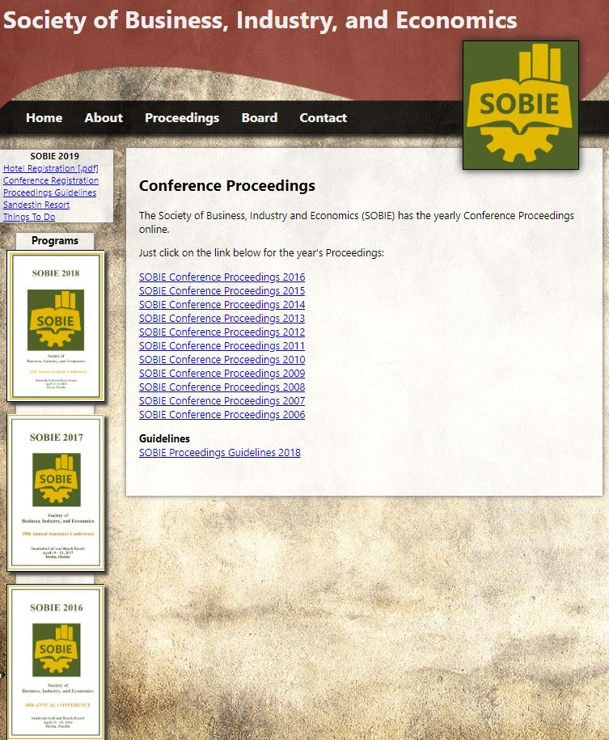


Before

Slide 3

After

Slide 4

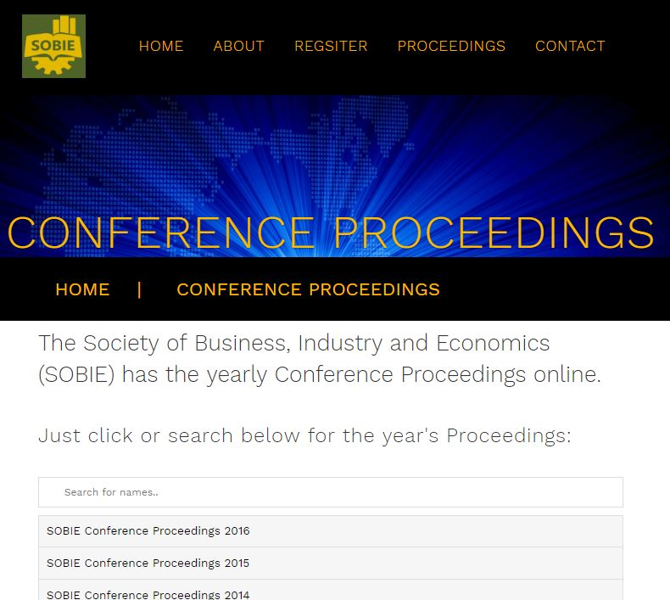
After

Slide 5
Lets Check It Out!!
Home Page: http://192.168.64.2/SobieUpdated/index.html
Admin Login/Page: http://192.168.64.2/SobieUpdated/admin.php

