Slide 1

R Programming
Taylor W. Hogan

Slide 2
WHAT IS R?
An open source programming language
Scripting statistical programming language
Data Science software

Slide 3
WHY DOES R MATTER?
It’s solving the big data problem
R is changing the ways companies are looking at big data
It is business analysts secret weapon when wrangling data
Largely more scalable and efficient over Excel and SAS

Slide 4
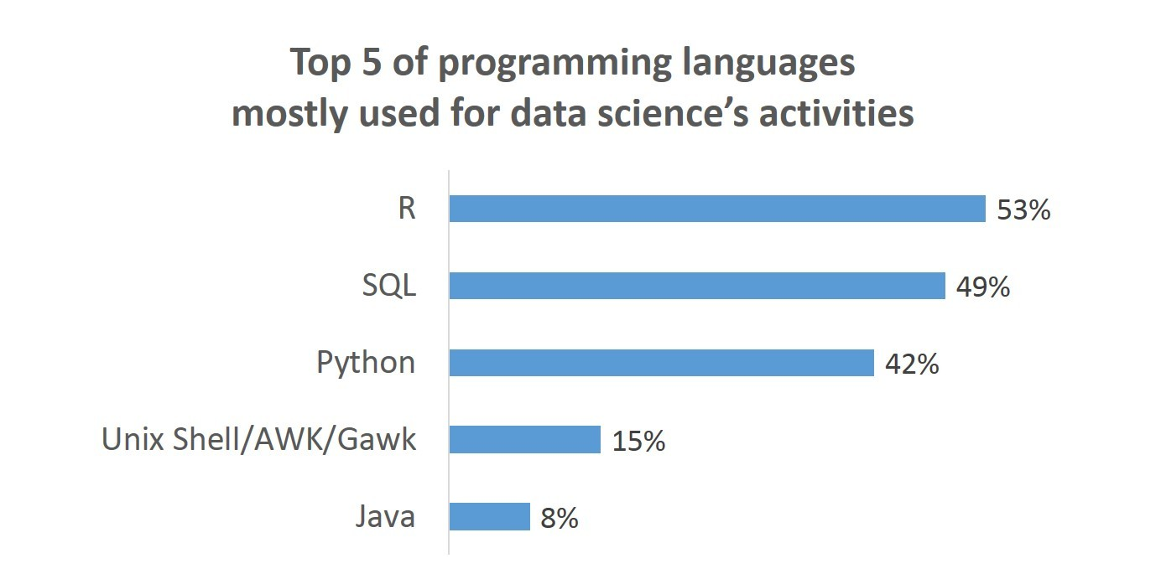
WHY DOES R MATTER?..
Currently leads in big data science projects

Slide 5
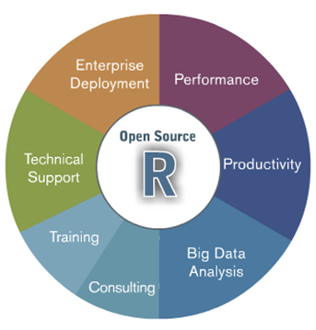
WHAT IS R USED FOR?
Data analysis
Statistical modeling
Visualization
Predicting future trends

Slide 6
EARLY HISTORY
1976 John Chambers Developed S at Bell Labs
S was used in a test environment as a pet project (v1 & v2 developed)
1988 S was not useable and rewritten in C (v3)
1998 John Chambers publicly released S (v4)
1993 John Chambers allowed StatSci to develop and sell his software
2004 Insightful purchased S language for $2 Million and developed S+
2008 Insightful bought TIBCO for $25 Million

Slide 7
CURRENT HISTORY
1991 Ross Ihaka and Robert Gentleman Developed R
1993 R became public
1995 Martin Machler Ross and Robert to make their software free of charge
1997 portions of S+ and R combined The R Core Group was established.
2000 R version 1 was released
2013 R version 3.0.2 was released
2018 R version 3.5.1 (Feather Spay) was released

Slide 8

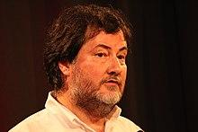


FOUNDING FATHERS OF R
John Chambers
Ross Ihaka
Robert Gentleman
Martin Machler

Slide 9
PROS OF R
R is designed to operate the way that problems are thought about
R is both flexible and powerful
High demand in job market
Free

Slide 10
CONS OF R
Steep learning curve
Heavy RAM insensitive
Will not exceed SQL or Python in Usage
No technical support (form talk only)

Slide 11
RELATABLE LANGUAGES
Python
JAVA
JULIA
SAS
SAGE
SQL
MATHLAB
SCALA
C
F#

Slide 12
COMPANIES THAT USE R…
Facebook- For behavior analysis related to status updates and profile pictures
Google- For advertising effectiveness and economic forecasting
Twitter- For data visualization and semantic clustering
Microsoft- Acquired Revolution R company and use it for a variety of purposes

Slide 13
COMPANIES THAT USE R…
Uber- For statistical analysis
Airbnb- Scale data science
ANZ- For credit risk modeling
MLB- Team Progression /Player Development

Slide 14
WHO USES R?
Data Scientists- clean raw data, makes viewable
Data Analysts- perform analysis on data usage
Data Architects- design how data fits with current system
Data Engineers- build application using big data

Slide 15
WHO USES R?
Statisticians- transform clean data to normal terms
Database Administrators- make databases publicly viewable
Business Analysts- analyze public data to improve business
Data and Analytics Managers- Manage overall project scope

Slide 16
HOW MUCH IS R?
Open source
Free software
Supports multiple operating systems (WIN,MAC,LINUX)

Slide 17
WHAT’S IN R?
Much like Java R is made of many packages
8 core packages (many add ons)
Packages are like the tools
Different tools are used for different projects
No GUI (command line program)
Can be import GUI of choice

Slide 18
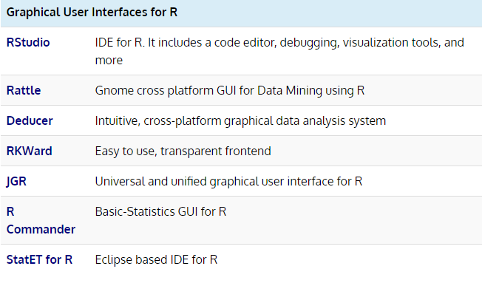
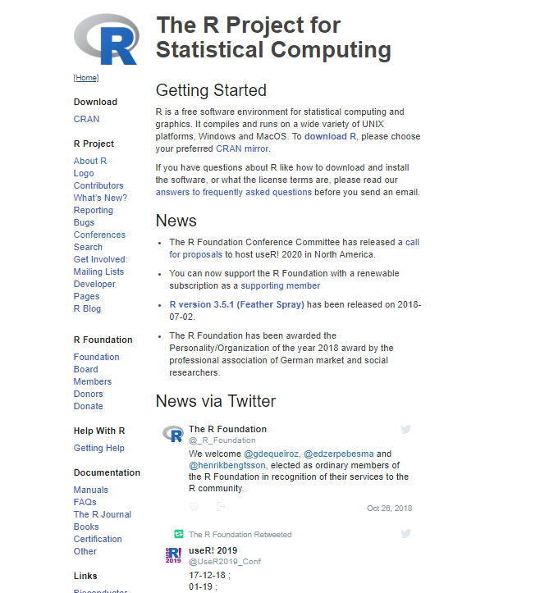
HOW TO START USING R?
Site for downloading R
Top IDES for R programing
https://www.r-project.org/

Slide 19
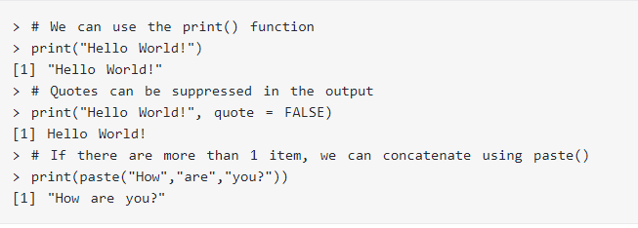
HOW TO START USING R?

Slide 20
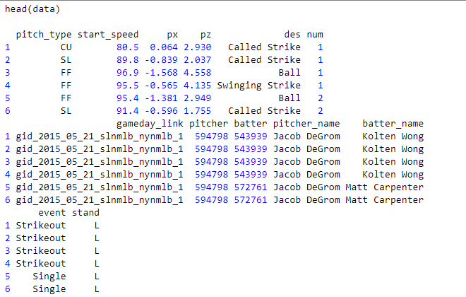
R IN BASEBALL
Download R and an IDE (R STUDIO)
Install packages (pacman)
Install and load (Lahman)(PitchRx)
Run the library you loaded
Enter values ( Pitcher, Batter, Day..)
Enter display results
DeGrom threw a GEM

Slide 21
R IN BASEBALL DATABASE RELATIONSHIP
Can connect to a database or use excel (Optional)
Can take multiple excel sheets and combine them
R is useful when running queries.
As an example, assume you have the Lahman database installed on your computer already. Rather than fire up your favorite SQL tool, run a query, export the data, and then import into R for analysis you can do all of this within R.

Slide 22
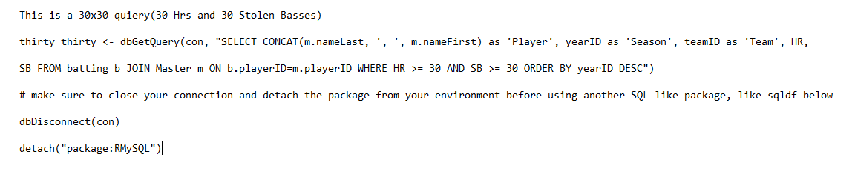

R IN BASEBALL
Results

Slide 23
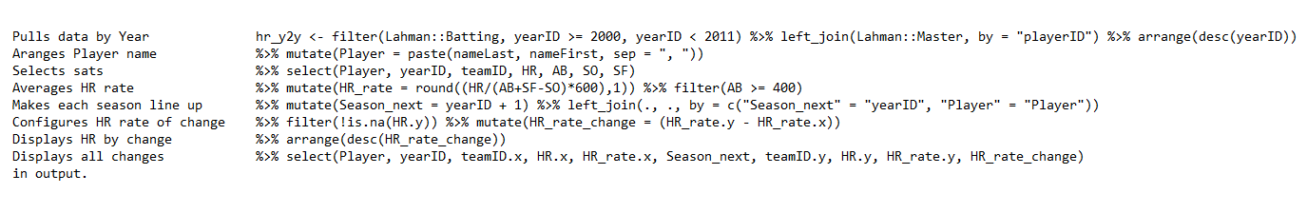
R IN BASEBALL HISTORICAL EXAMPLE
Which players saw the greatest increase in their home run rate (home runs per 600 balls in play) between 2000 and 2010?
We can use Lahman and dplyr to pull this together pretty easily.
Limit: must have at least 400 at-bats in both the first and second season.(eliminates injury time)
Command:

Slide 24
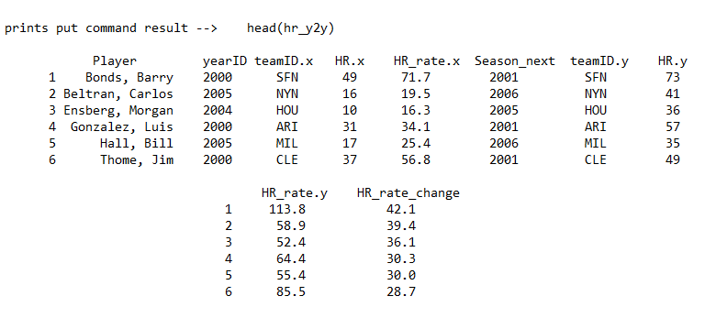
R IN BASEBALL HISTORICAL EXAMPLE OUTPUT

Slide 25
R IN BASEBALL GRAPHING DATA
R can help you visualize your data.
“Ggplot2” is a great package for graph making
This is useful for large and small data sets with many factors.

Slide 26
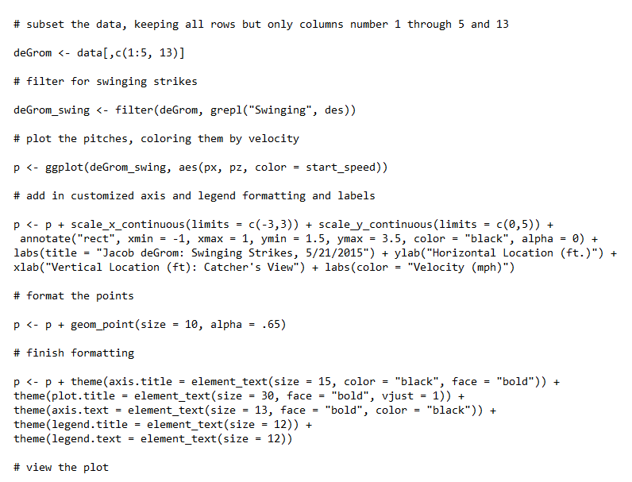
R IN BASEBALL GRAPH/HEAT MAP EXAMPLE

Slide 27
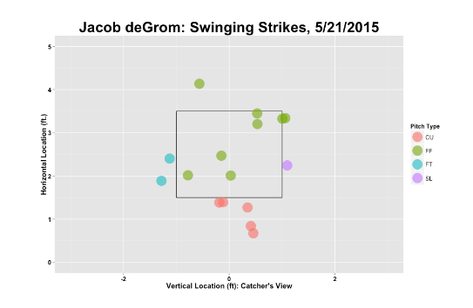
R IN BASEBALL GRAPH OUTPUT

Slide 28
SOURCES
https://www.techopedia.com/definition/28800/r-programming-language
https://www.fastcompany.com/3030063/why-the-r-programming-language-is-good-for-business
https://searchbusinessanalytics.techtarget.com/definition/R-programming-language
https://www.listendata.com/2016/12/companies-using-r.html
https://elearningindustry.com/applications-r-programming-r-eal-world
https://www.burns-stat.com/documents/tutorials/why-use-the-r-language/
https://www.quora.com/Is-it-worth-learning-R-programming
https://www.analyticsvidhya.com/blog/2015/12/job-roles-data-science-industry-who-what/

