Slide 1
Fourier Accelerated Lattice Field Theory
Taylor Baird
Supervisors: Brian Pendleton and Roger Horsley

Slide 2

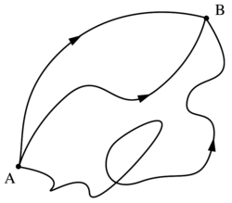
Title
Goal: non-perturbative, numerical approximations of quantum field theories (QFTs).
Motivation: avoid breakdown in perturbative treatment (for example, in strong coupling regimes).
Methodology: Discretize fields and simulate on computer.
Use techniques such as MCMC to efficiently sample from the state space of the system. Essentially we are computing the path integral. Note parallel with sampling from posterior distribution in stats.
Obtain interesting observable quantities from simulations (amplitudes, matrix elements, correlators/propagators).

Slide 3
Background (cont)
We want the simulation procedure to be as performant as possible.
Performance translates into speed of sampling from the entire state space of the system (all the configurations in which it can find itself).
One technique which aims to improve the performance of this sampling is Fourier acceleration (FA).
This project has the goal of determining how Fourier acceleration performs for different theories (scalar field theories) as recently there has been some interest in its application to other field theories (Sine-Gordon etc).

Slide 4
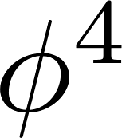
Project Objectives
Develop Hamiltonian Monte Carlo programs to simulate:
the quantum mechanical harmonic oscillator/ free scalar field.
The quantum mechanical anharmonic oscillator/interacting field.
Incorporate Fourier acceleration into implementations
Investigate ability of Fourier acceleration to reduce runtime of simulations.

Slide 5

Methodology: HMC
Let us first consider an overview of what the simulations look like. This will allow us to appreciate how FA speeds them up.
Consider as an illustrative example system the 1 dimensional quantum mechanical harmonic oscillator.
Its state space is described by the two variables: position q and momentum p.
Our method is to set up a discrete lattice. Each successive point corresponds to a step in time (Euclidian time). This lattice represents our QM path.
The path integral is the sum over ALL paths. Need efficient way to compute.

Slide 6

HMC (cont.)
Steps of algorithm:
Start with some initial config/path.
Generate a set of N_tau “fictitious” momenta, p_{i} , each sampled from a standard normal distro.
Allows us to produce a Hamiltonian for the system
Evolve the lattice points in time according to Hamilton’s equations for the system (with choice of parameters T, dt).
Gives final configuration.
Accept the final configuration with probability
Repeat N times.
The configurations/paths generated form a Markov chain.
From the generated configurational data we can extract quantities of interest.

Slide 7


Fourier Acceleration
Aim: Reduce simulation length by decreasing autocorrelations in data.
Premise: speed up slow (physical) modes of system.
Method: Alter dynamics to evolve all modes at similar rate.

Slide 8
Fourier Acceleration (cont)
These equations can be solved efficiently by considering them in Fourier space (hence the name).
Choosing the appropriate modified Hamiltonian allows us to adjust the effective timesteps for the dynamics so as to evolve the long and short wavelength modes at the same rate speeding up process of getting our results.
In practice, we are reducing autocorrelations in our data.
Autocorrelation measures how strongly related subsequent configurations of our system are. Thus, it gives an idea of how inefficiently the state space is being explored.
Currently in the process of implementing FA for the models discussed previously.

Slide 9
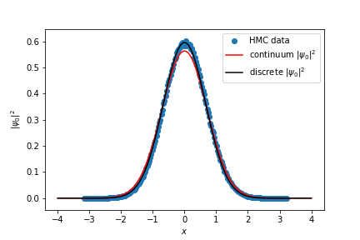
HMC Results
Verified implementation of algorithm.
certain quantities with their known analytical results.
QMHO:
Expectation values (per lattice site):
=0.44628158027979287 (simulation)
= 0.44721435 (analytic result)
Ground state wavefunction:
Autocorrelation time (for comparison with FA sim)

Slide 10
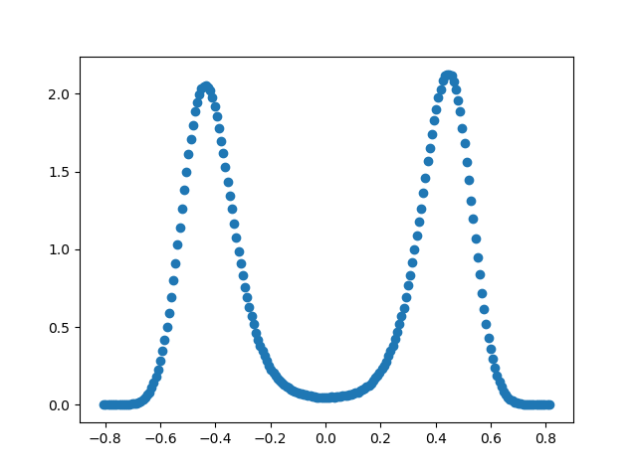
HMC Results (cont)

Slide 11
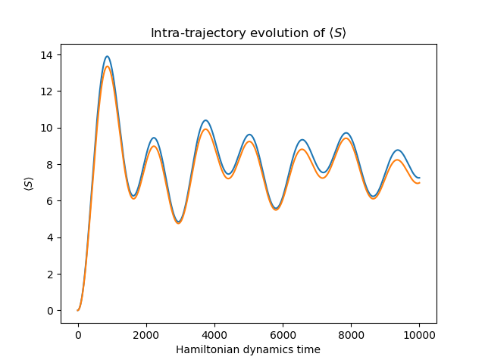
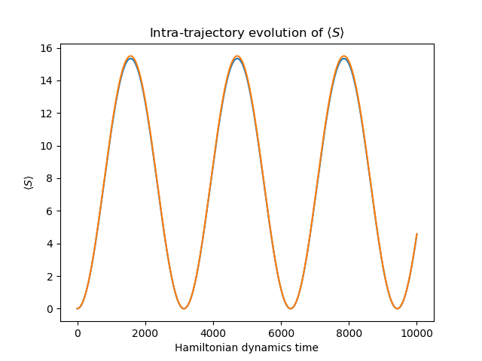
Tuning acceleration for free field theory
Unaccelerated (decoherence from variable
mode evolution rate:
long λ slow, short λ fast)
Full acceleration (all modes in phase)

Slide 12
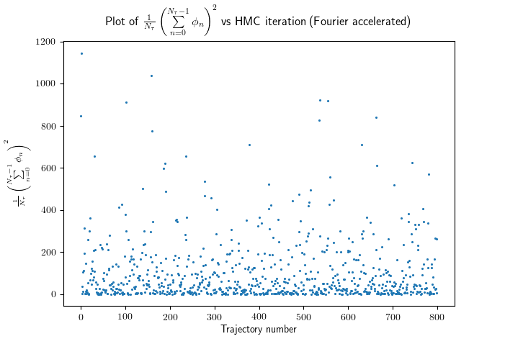
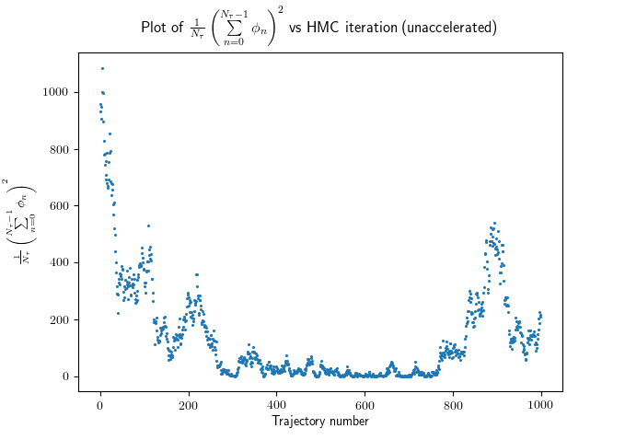
Acceleration for free field

Slide 13
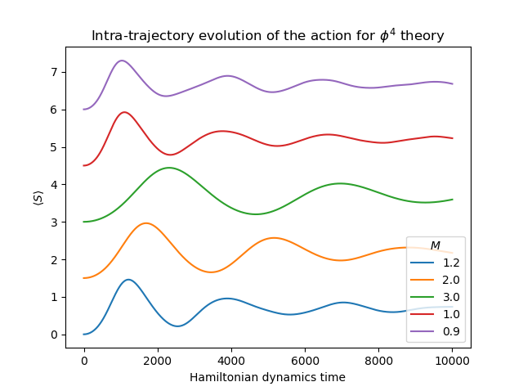
Tuning Acceleration for phi^4 theory

Slide 14
Conclusions and future work
Establish criteria for choosing parameters of the algo (dt, T, lattice size). Incorporate ML to optimize dt
Application to statistical field theories of current importance
Comparison with alternatives (Riemannian manifold HMC etc)

Slide 15
Recap
Purpose of lattice field theory
Motivation for Fourier acceleration and project
Outline of lattice field simulations
How Fourier acceleration improves their performance
Future work

