Slide 1




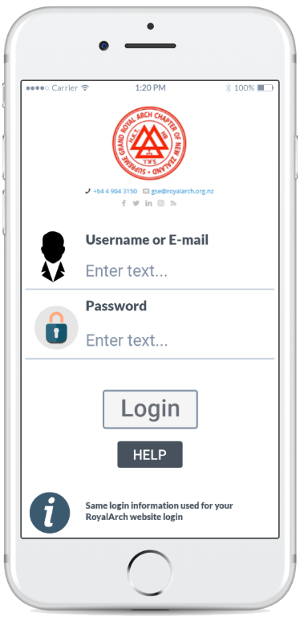
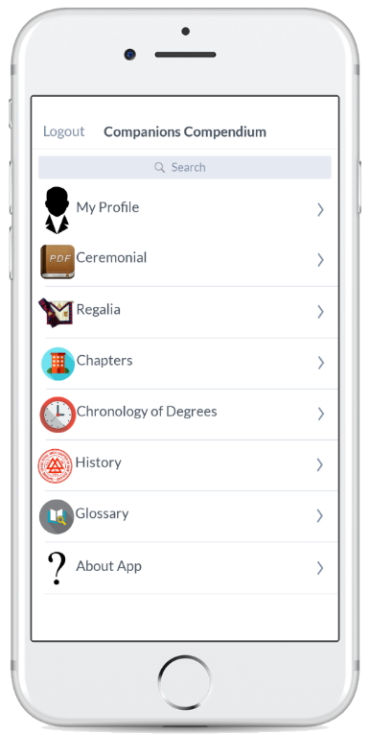
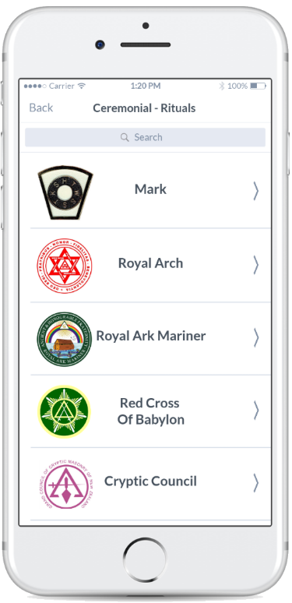
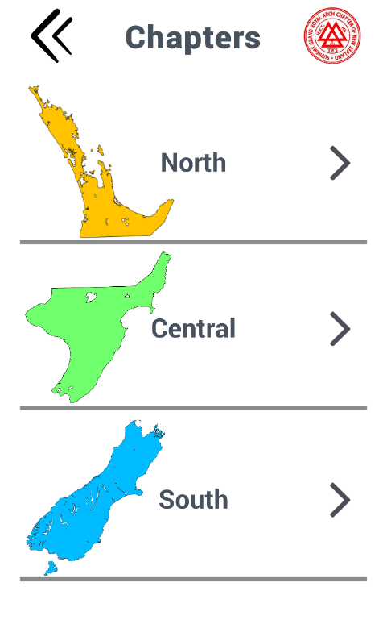
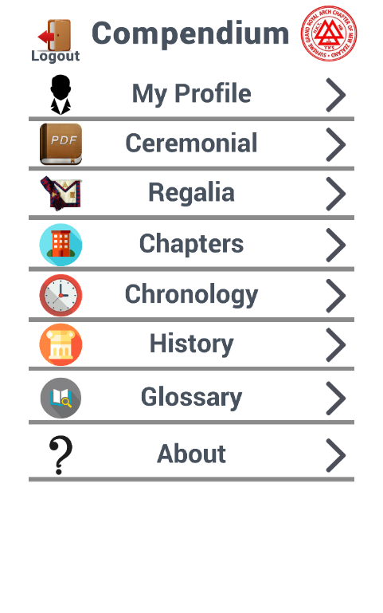
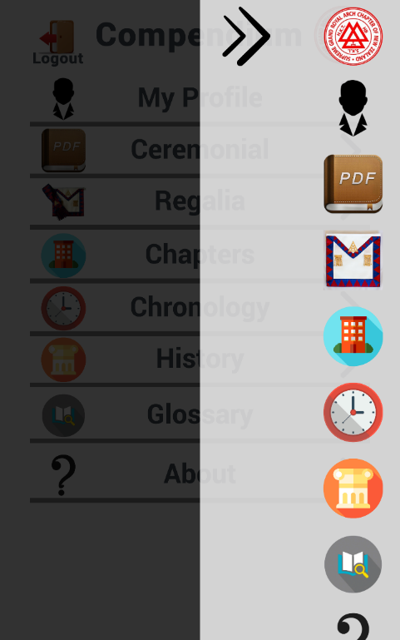
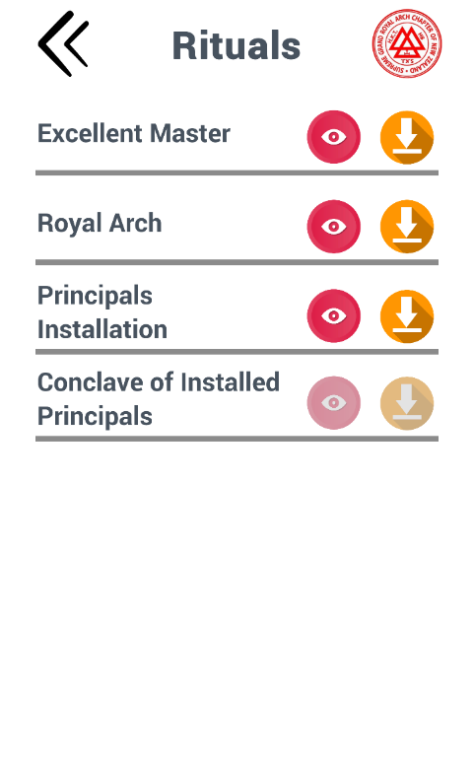
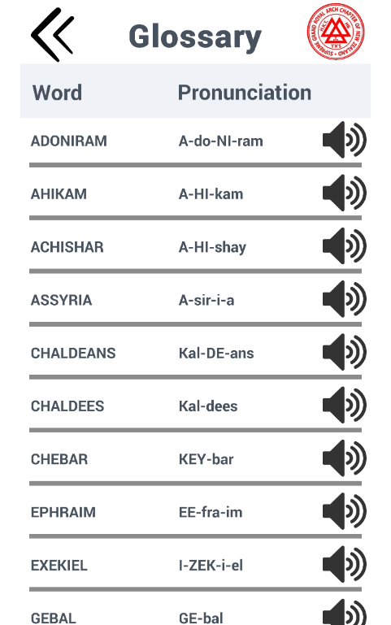
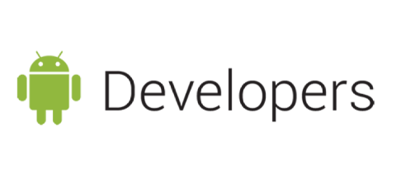
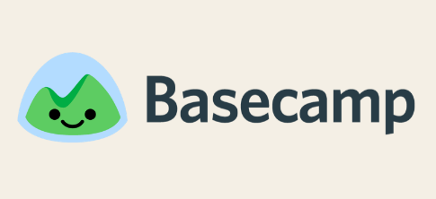

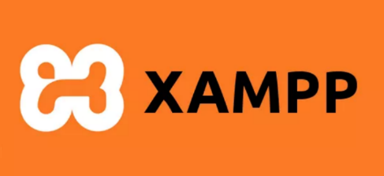
Compendium Application
Project: SGRANCh IT7x01
By: Taylor Everett & Chris Simmons
Semester: 1
Year: 2019
BACKGROUND
LOGIC
SCOPE
This Project was first focused on creating a compendium application for the client and their organization. During our first meeting, we requested a database schema, a blank version of the current websites database, and whether or not their server could support API, none of which has been made available by the completion of this document. This project iteration has been largely impacted by the lack of technical information that has not been provided. The Client has the means to attain this information but requires permission from the council which is still in progress. Because of this, the project has turned into a functional prototype instead of a finished product.
Project Requirements:
Create an app, compatible with Android or/and Apple smart devices.
Wireframe is like a compendium. Based on similar apps, Apple Tips & Tricks, Coursera, or ManageMyHealth.
Login uses website’s already existing API to login.
Registration/Password Recovery to be linked to current website.
Profile page, add member visibility to degrees & dates attained, provide access to Ritual if a date is entered in profile DB, Ritual in pdf format, Ensure the site is “Mobile Accessible”, Downloadable to smart devises.
Ritual page will provide each degree in printable form.
Create functionality/content; Chronology of degrees, History of SGACNZ, Regalia, Glossary of words includes sound bits of proper pronunciation, chapter & council list include meeting bites & locations with map (google maps)
Project Boundaries:
Limit on the number of device compatibility; may have to limit to one Operation system to focus on producing a finished product.
Database and Server Access.
Unable to set up an API (or get access to the working website API) the app's functionality could be greatly reduced
Project Deliverables:
Initiate project development.
Wireframe layout design, flow, and the look of the application.
Create a paper prototype of wireframes.
Functional Prototype
OBJECTIVE
This project was to build an application for smart devices for members of the Royal Arch website to view and download rituals, which the users have access to. The application was originally just an idea, the core idea is to modernize members’ methods of retrieving these ritual files. The application was also required to be informative to its users in similar regards to their current website. This included a login using the current website credentials, access to their Profile, rituals, history, degree chronology, chapter finder, regalia, about app, and an addition of a glossary.
METHODOLOGY
PROTOTYPE EXAMPLES
Scrum is best suited for products and development projects. Kanban is best for production support. We use Scrumban – which combines the best features of both – for maintenance projects. Scrumban is becoming very popular these days in service industries, where we have both development and maintenance projects.
Reason for Scrumban
Short term iteration time (1 week) per sprint, since the project timeline is 4 months.
Scrum allows for the client to have a more regular input into the project, which will aid to the advancement and end goal of the project.
Collaboration with the client is necessary since he and his fellow members are the end-users.
Kanban helps us visualize the project task flow e.g. backlog, ready, doing, testing and done.
Project tasks place on the Kanban board, keeps us on track and gives us a reminder, what we’re meant to be doing and not meant to be during SCRUM sprints.
CONCLUSION & RECOMMENDATIONS
In this iteration of the project we have managed to design and develop a functional prototype for Android devises that is capable of meeting the tasks requested by our client. Though this project is still incomplete, we have managed to create the frontend of the application that is suited for future iterations to expand upon.
The next iteration has a few tasks ahead of them, both frontend and backend. IOS development, students will need all the necessary tools to develop on apple products (client’s devices are all apple). Client system information is still required in order to have a final product which may take more time then what is possible for just one more iteration. Finally, stress testing to find unknown faults within the application or to find the limitations of the client systems.
PROJECT TEAM
TOOLS USED
Ken Burt Client & Project Adviser
Scott Morton Project Coordinator & Supervisor
Taylor J. Everett Design and Documentation
Chris Simmons Product Developer and Programmer
Android SDK – Native Export
Unity – Functional Prototype
DoozyUI – Unity Addon
MavrvelApp - Paper Prototype
XAMPP – Backend Development

