Slide 1



Slide 2
Team 11 - Hackovation
Noelle Bauer UI/Project Manager
Demian Reith PowerPoint
Jill Freivalds Buzzwords/Vocab/Speech
DJ Brown Python
Taylor Kohls Git Hub

Slide 3
New creative way for students to save.
Total control
Total visibility

Slide 4
How do they save?
We teach students through a pie chart where their money is going to go.

Slide 5

What makes it unique?
Students have the ability to adjust the amount of the variable expenses such as gas, restaurant, groceries, entertainment, etc.

Slide 6
Why would someone use this?
The app would teach students how spending x amount in each of the variable expenses adjusted would impact their ability to save money.

Slide 7
What would be their motivation?
It would teach students how to save for a spring break vacation for example instead of purchasing a $7.00 coffee 2-3 times per day, and by eliminating 1-2 of the 3 coffees would allow them to save much faster.

Slide 8
How will their life be better?
Students would have less anxiety with their bills and trying to save for that vacation knowing how their spending habits impacts them financially in both positive and negative ways. It will also show how putting their money in a savings account will add money in a positive, impactful way in the next 2, 5, or 10 years. The app is simple for college students to use by using layman terms, not banker lingo.

Slide 9
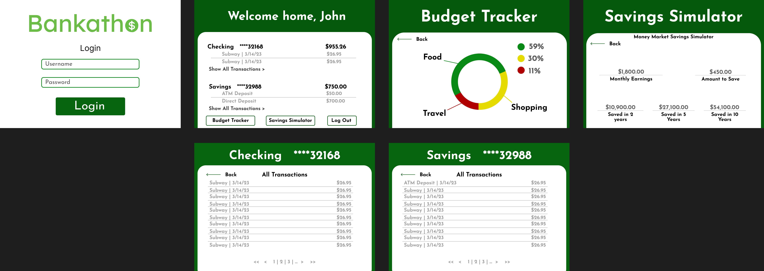
Figma

Slide 10
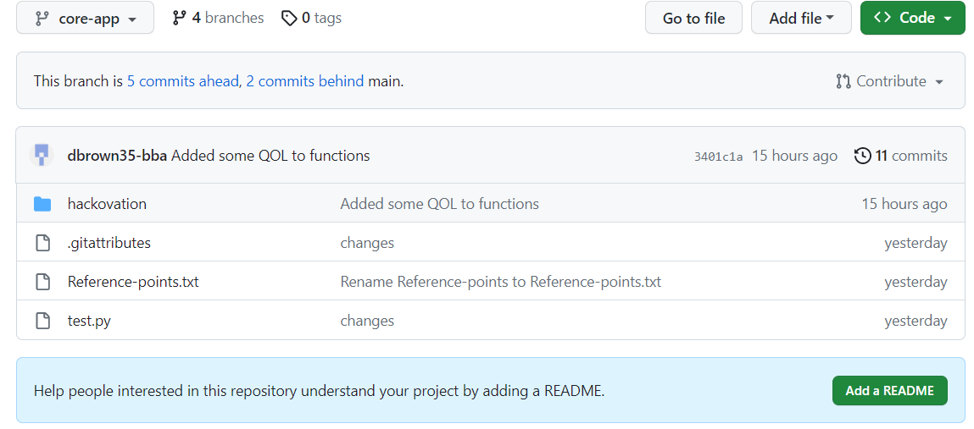
Github Repository

Slide 11
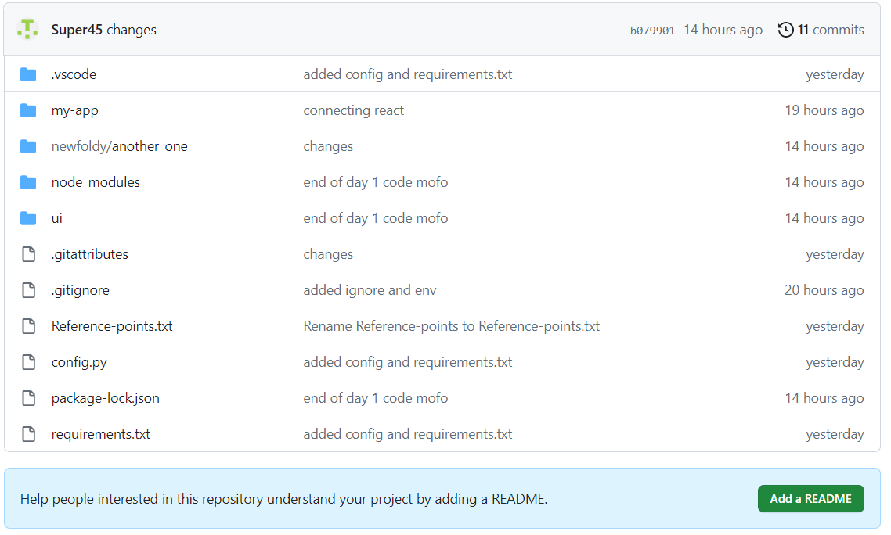
Github Repository

Slide 12
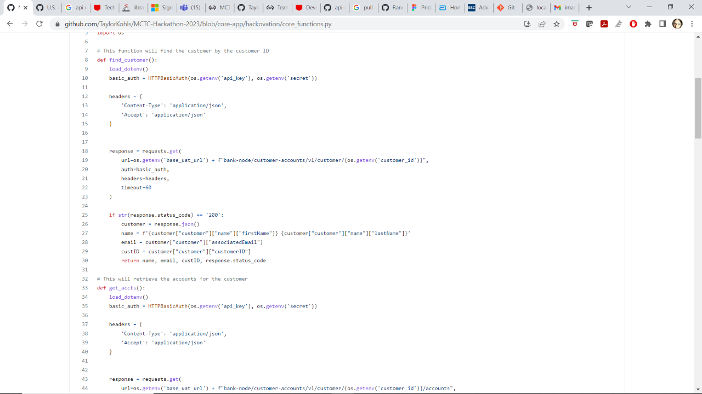
Back End

Slide 13
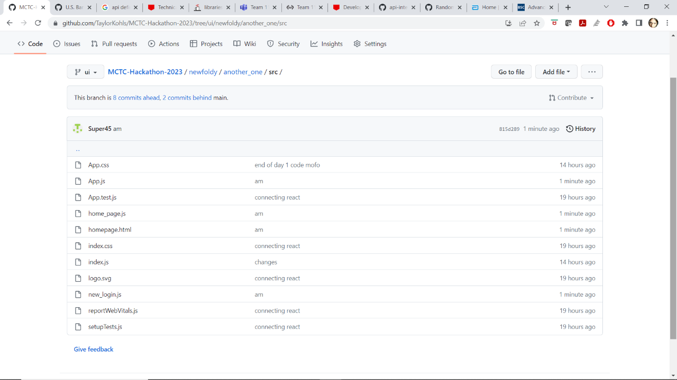
Commits

Slide 14
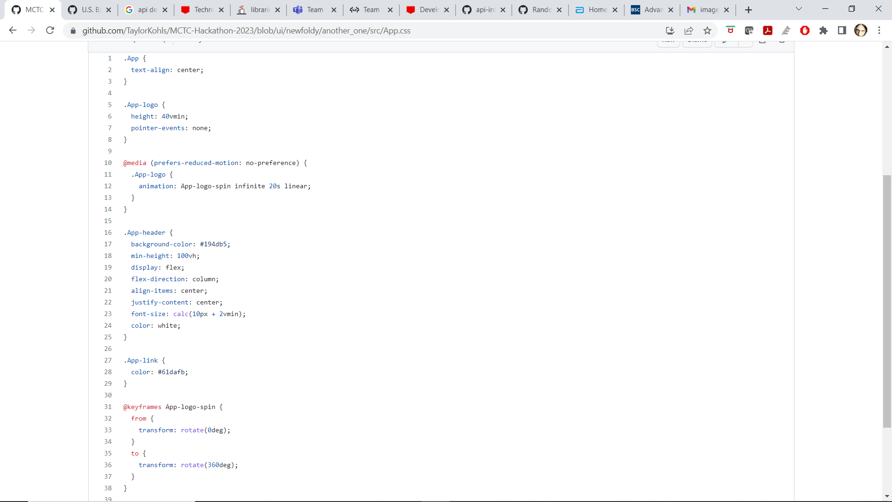
CSS

Slide 15
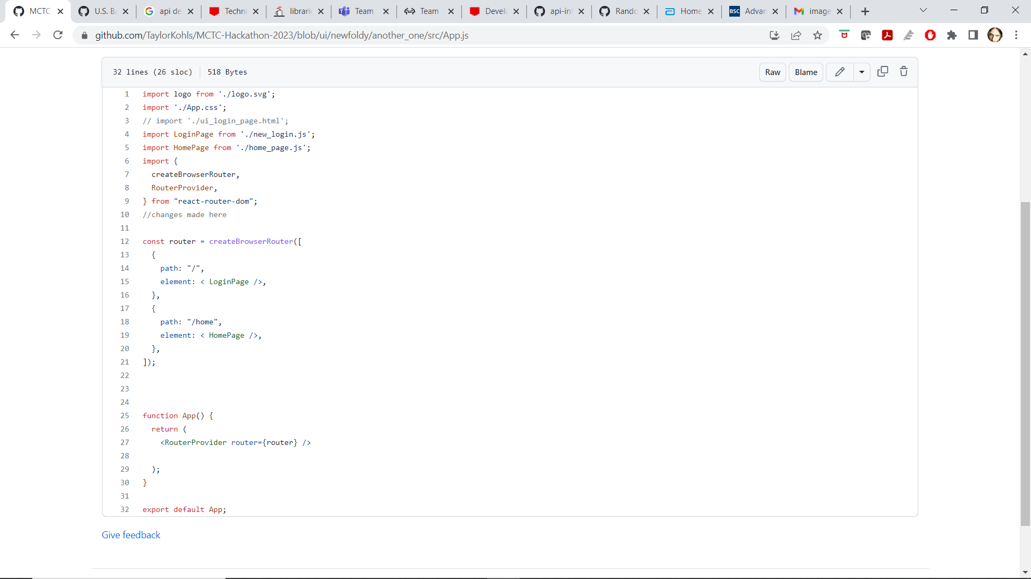
Login Page

Slide 16
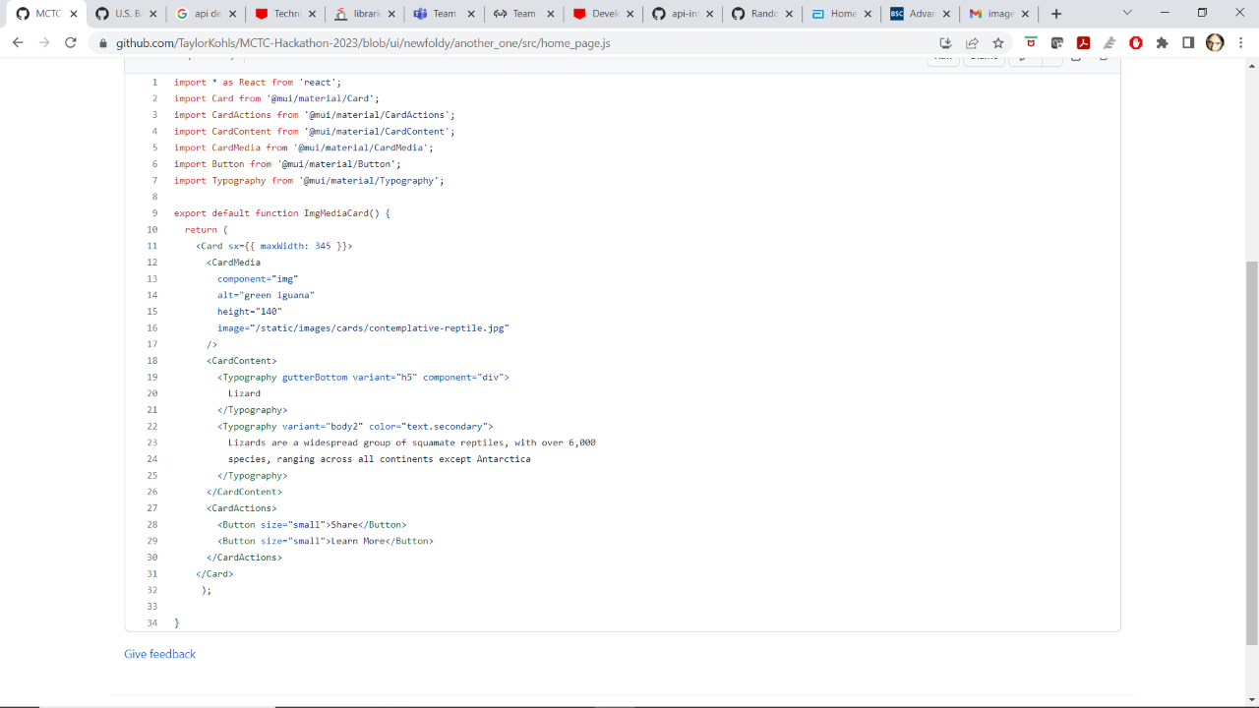
Pie Charts

Slide 17
Student Budget 1

Slide 18
Student Budget 2

Slide 19
Student Budget 3

Slide 20
Student Budget 4

Slide 21
Thank you!

