Slide 1
A comprehensive pipeline for the Analysis of drug , target and Tumor databases
Aditya Lahiri and Deanne Taylor

Slide 2
Background
FDA Pediatric Molecular Target List (FDA-PMTL) was created, containing over 400 pediatric cancer gene targets of interest.
Limited resources outline drugs tested in clinical trials for cancer for the PMTL genes.
Lack of publicly available comprehensive resources linking these drugs to the standardized tumor list curated by the World Health Organization (WHO).
Need to systematically integrate and analyze publicly available data to identify targets associated with drugs tested in pediatric cancers, especially drugs used in registered clinical trials.

Slide 3
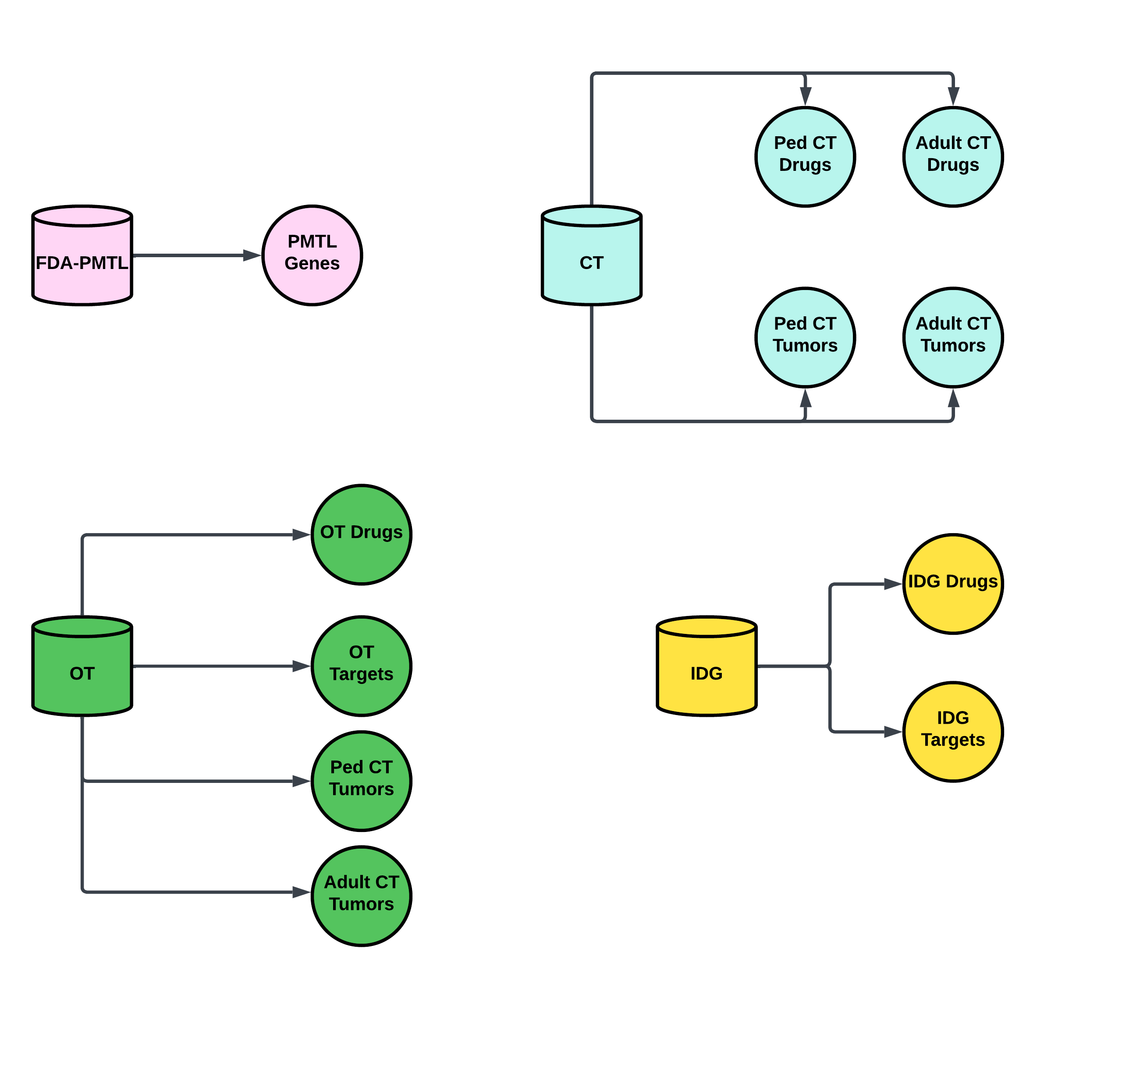
Primary Databases
Database | Content | Processing
FDA PMTL | PMTL Genes | Extraction Only
Clinical Trials (CT) | Drugs & Diseases | Filter drugs by age, and retain phase information. Manually filter tumors & classify as pediatric or adult
Open Targets (OT) | Drugs, Targets, & Diseases | Extraction and manually filter for tumors & classify as pediatric or adult
Illuminating the Druggable Genome (IDG) | Drugs and Drug Targets | Extraction only. No age filter for drugs.

Slide 4
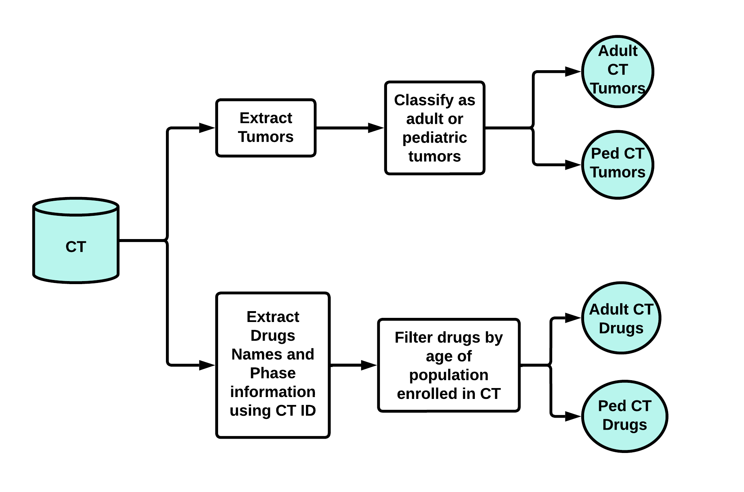
CT Data Processing Pipeline In Depth

Slide 5
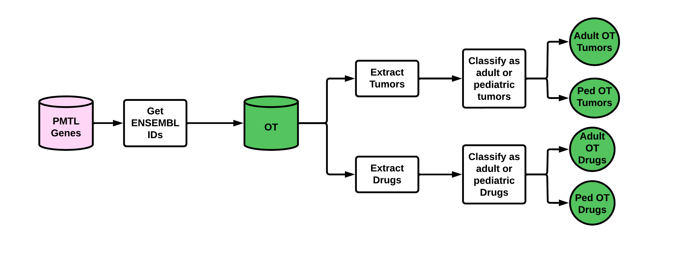
PMTL and OT Pipeline

Slide 6
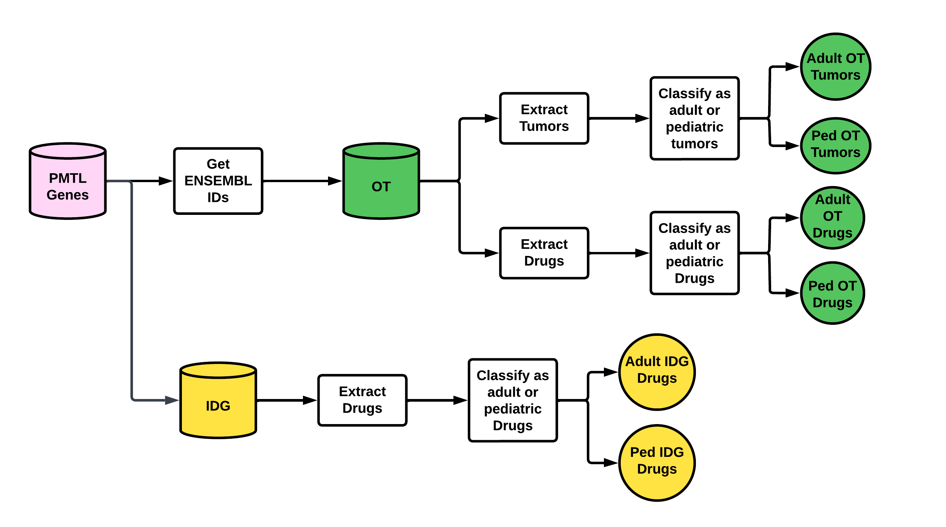
PMTL , OT, and IDG Pipeline

Slide 7
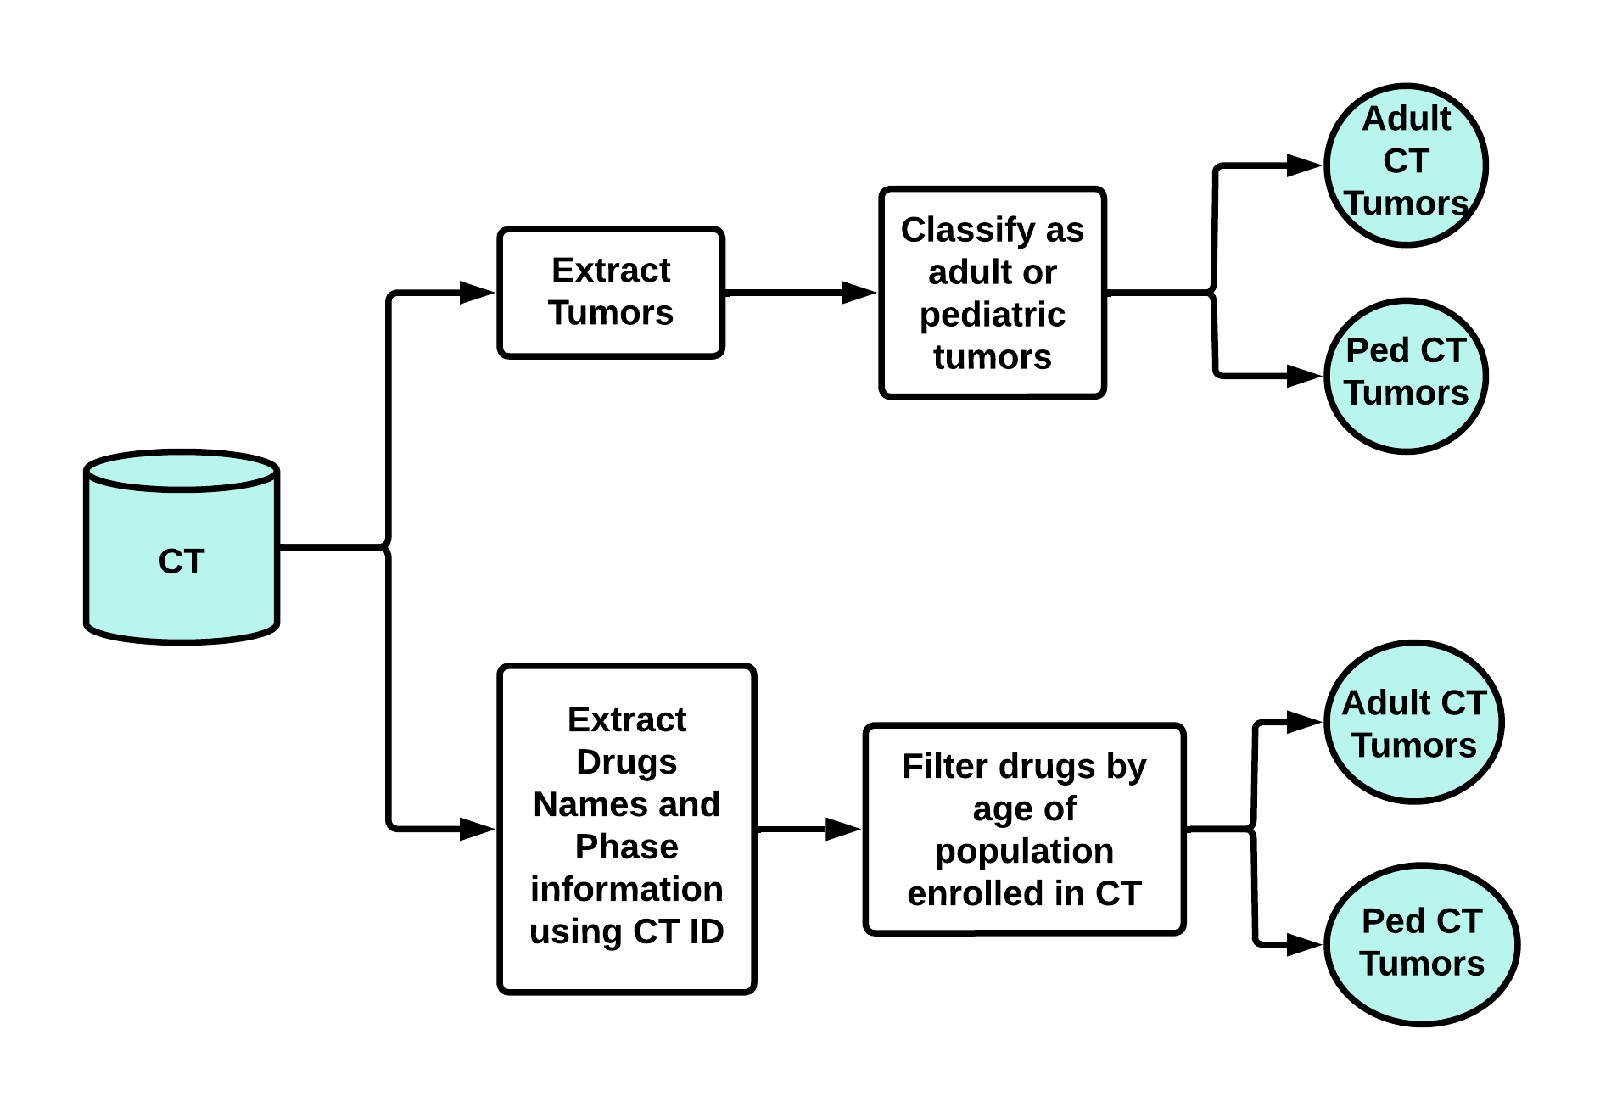
Pipeline for CT & PMTl-OT-IDG

Slide 8
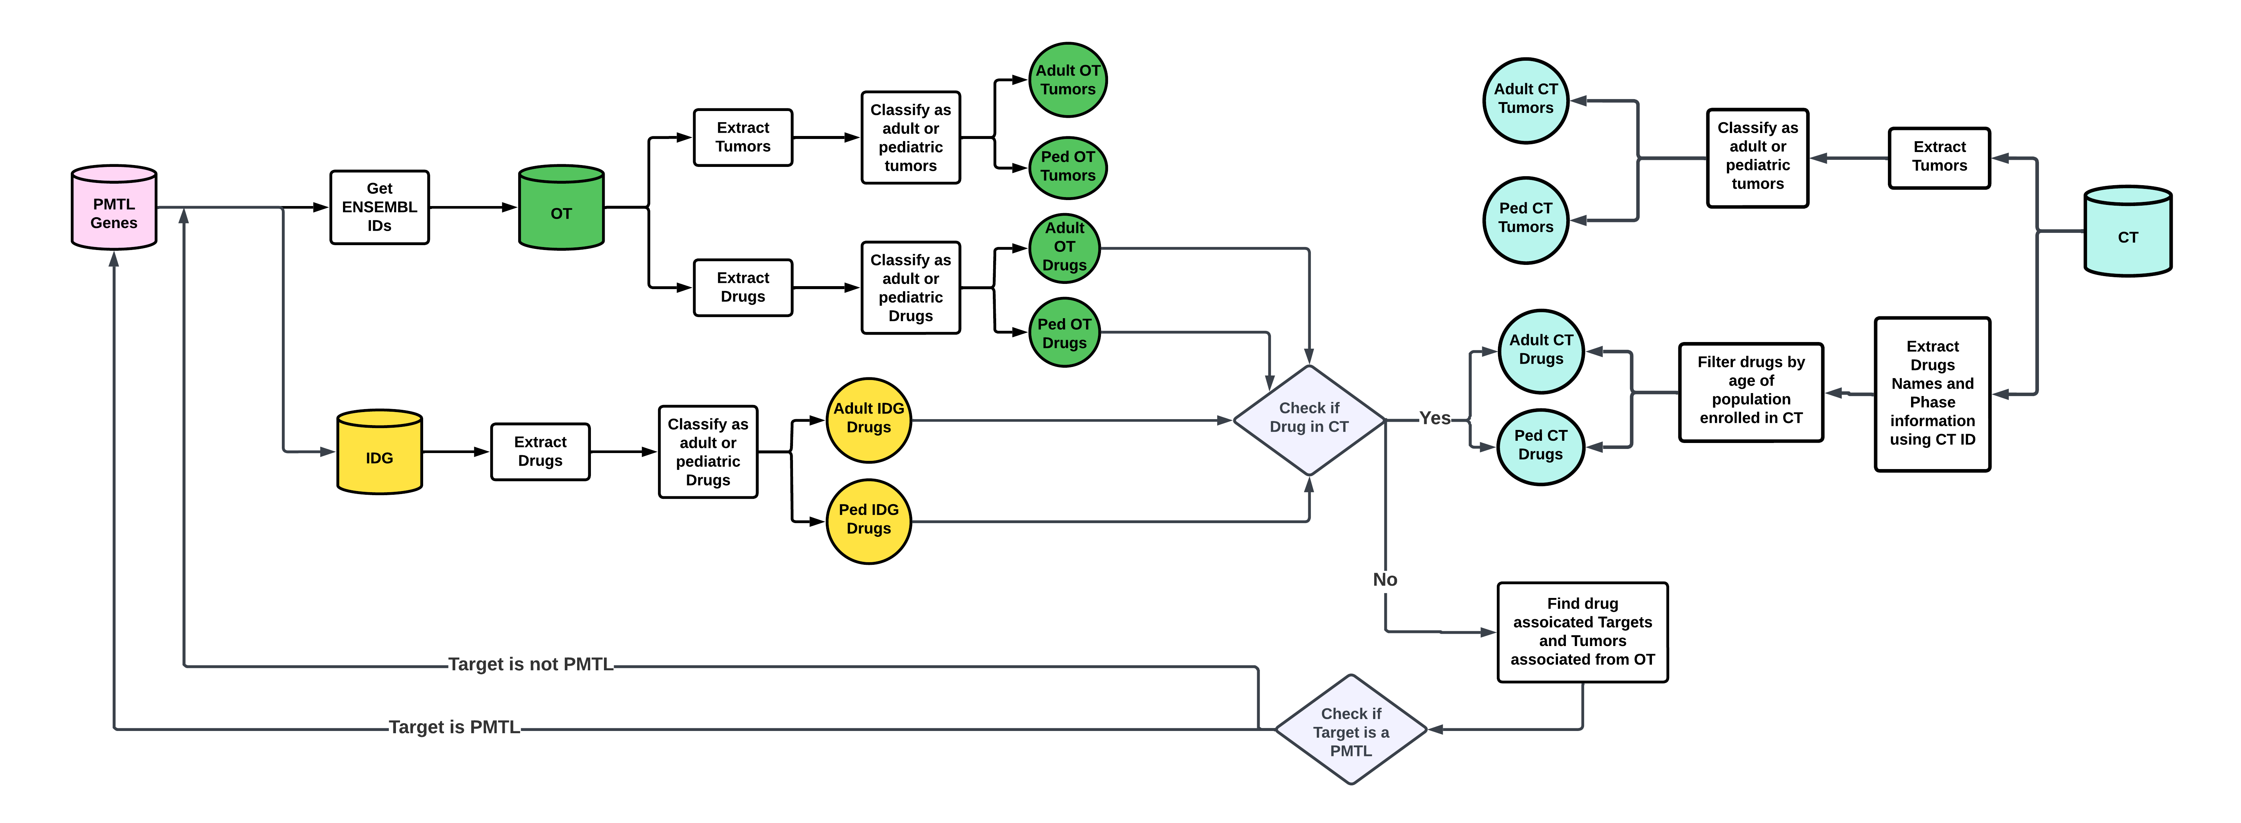
Integrated Pipeline Overview

Slide 9
Issues
Merging tumor names from CT, OT , and IDG is not trivial.
CT Tumor names are not standardized and contain typos and extraneous information e.g. :
CT Tumor Names | Issues | WHO Standard Names
acute myeloid leucaemia | Leukaemia not spelled correctly | acute myeloid leukaemia
glioblastoma or solid tumors, epidermal growth factor receptor (egfr) diagnosis | Has two types of tumor: glioblastoma and solid tumors, extra information on EGFR | glioblastoma, idh-wildtype
pathologic stage i merkel cell carcinoma ajcc v8 | extra information on staging | merkel cell carcinoma
adrenocortical carcinoma (part g) | Extra information in bracket | adrenal cortical carcinoma
ann arbor stage iii diffuse large b-cell lymphoma | extra information on staging | diffuse large b-cell lymphoma

Slide 10
CT Names need to be standardized
Approach 1 (Distance and Cluster) : Find the pairwise distance between every tumor in CT and WHO Tumors, establish a cut off distance and cluster the tumors that are close together. This approach matched a lot of unrelated tumors together, thus it is not a good approach.
Approach 2 (Embeddings and Cluster):
Generate embeddings (convert tumor names to numeric vectors) using Open AI’s ADA 2.0.
Embeddings are low dimensional representation of text data.
Embeddings generate by ADA have a maximum of 1536 dimensions. Apply PCA to reduce dimensions.
Cluster the tumor names using the embeddings.
Cost of generating embeddings for 15K diseases ~$6.00

Slide 11
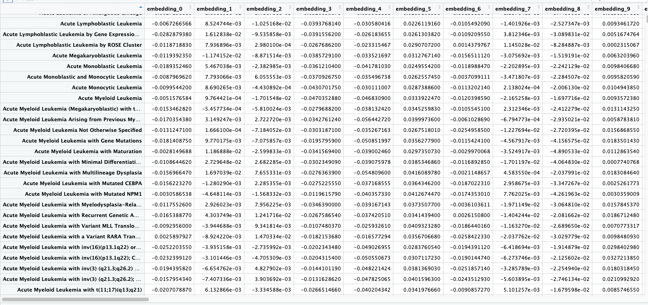
Embedding visualization
CT Tumors

Slide 12
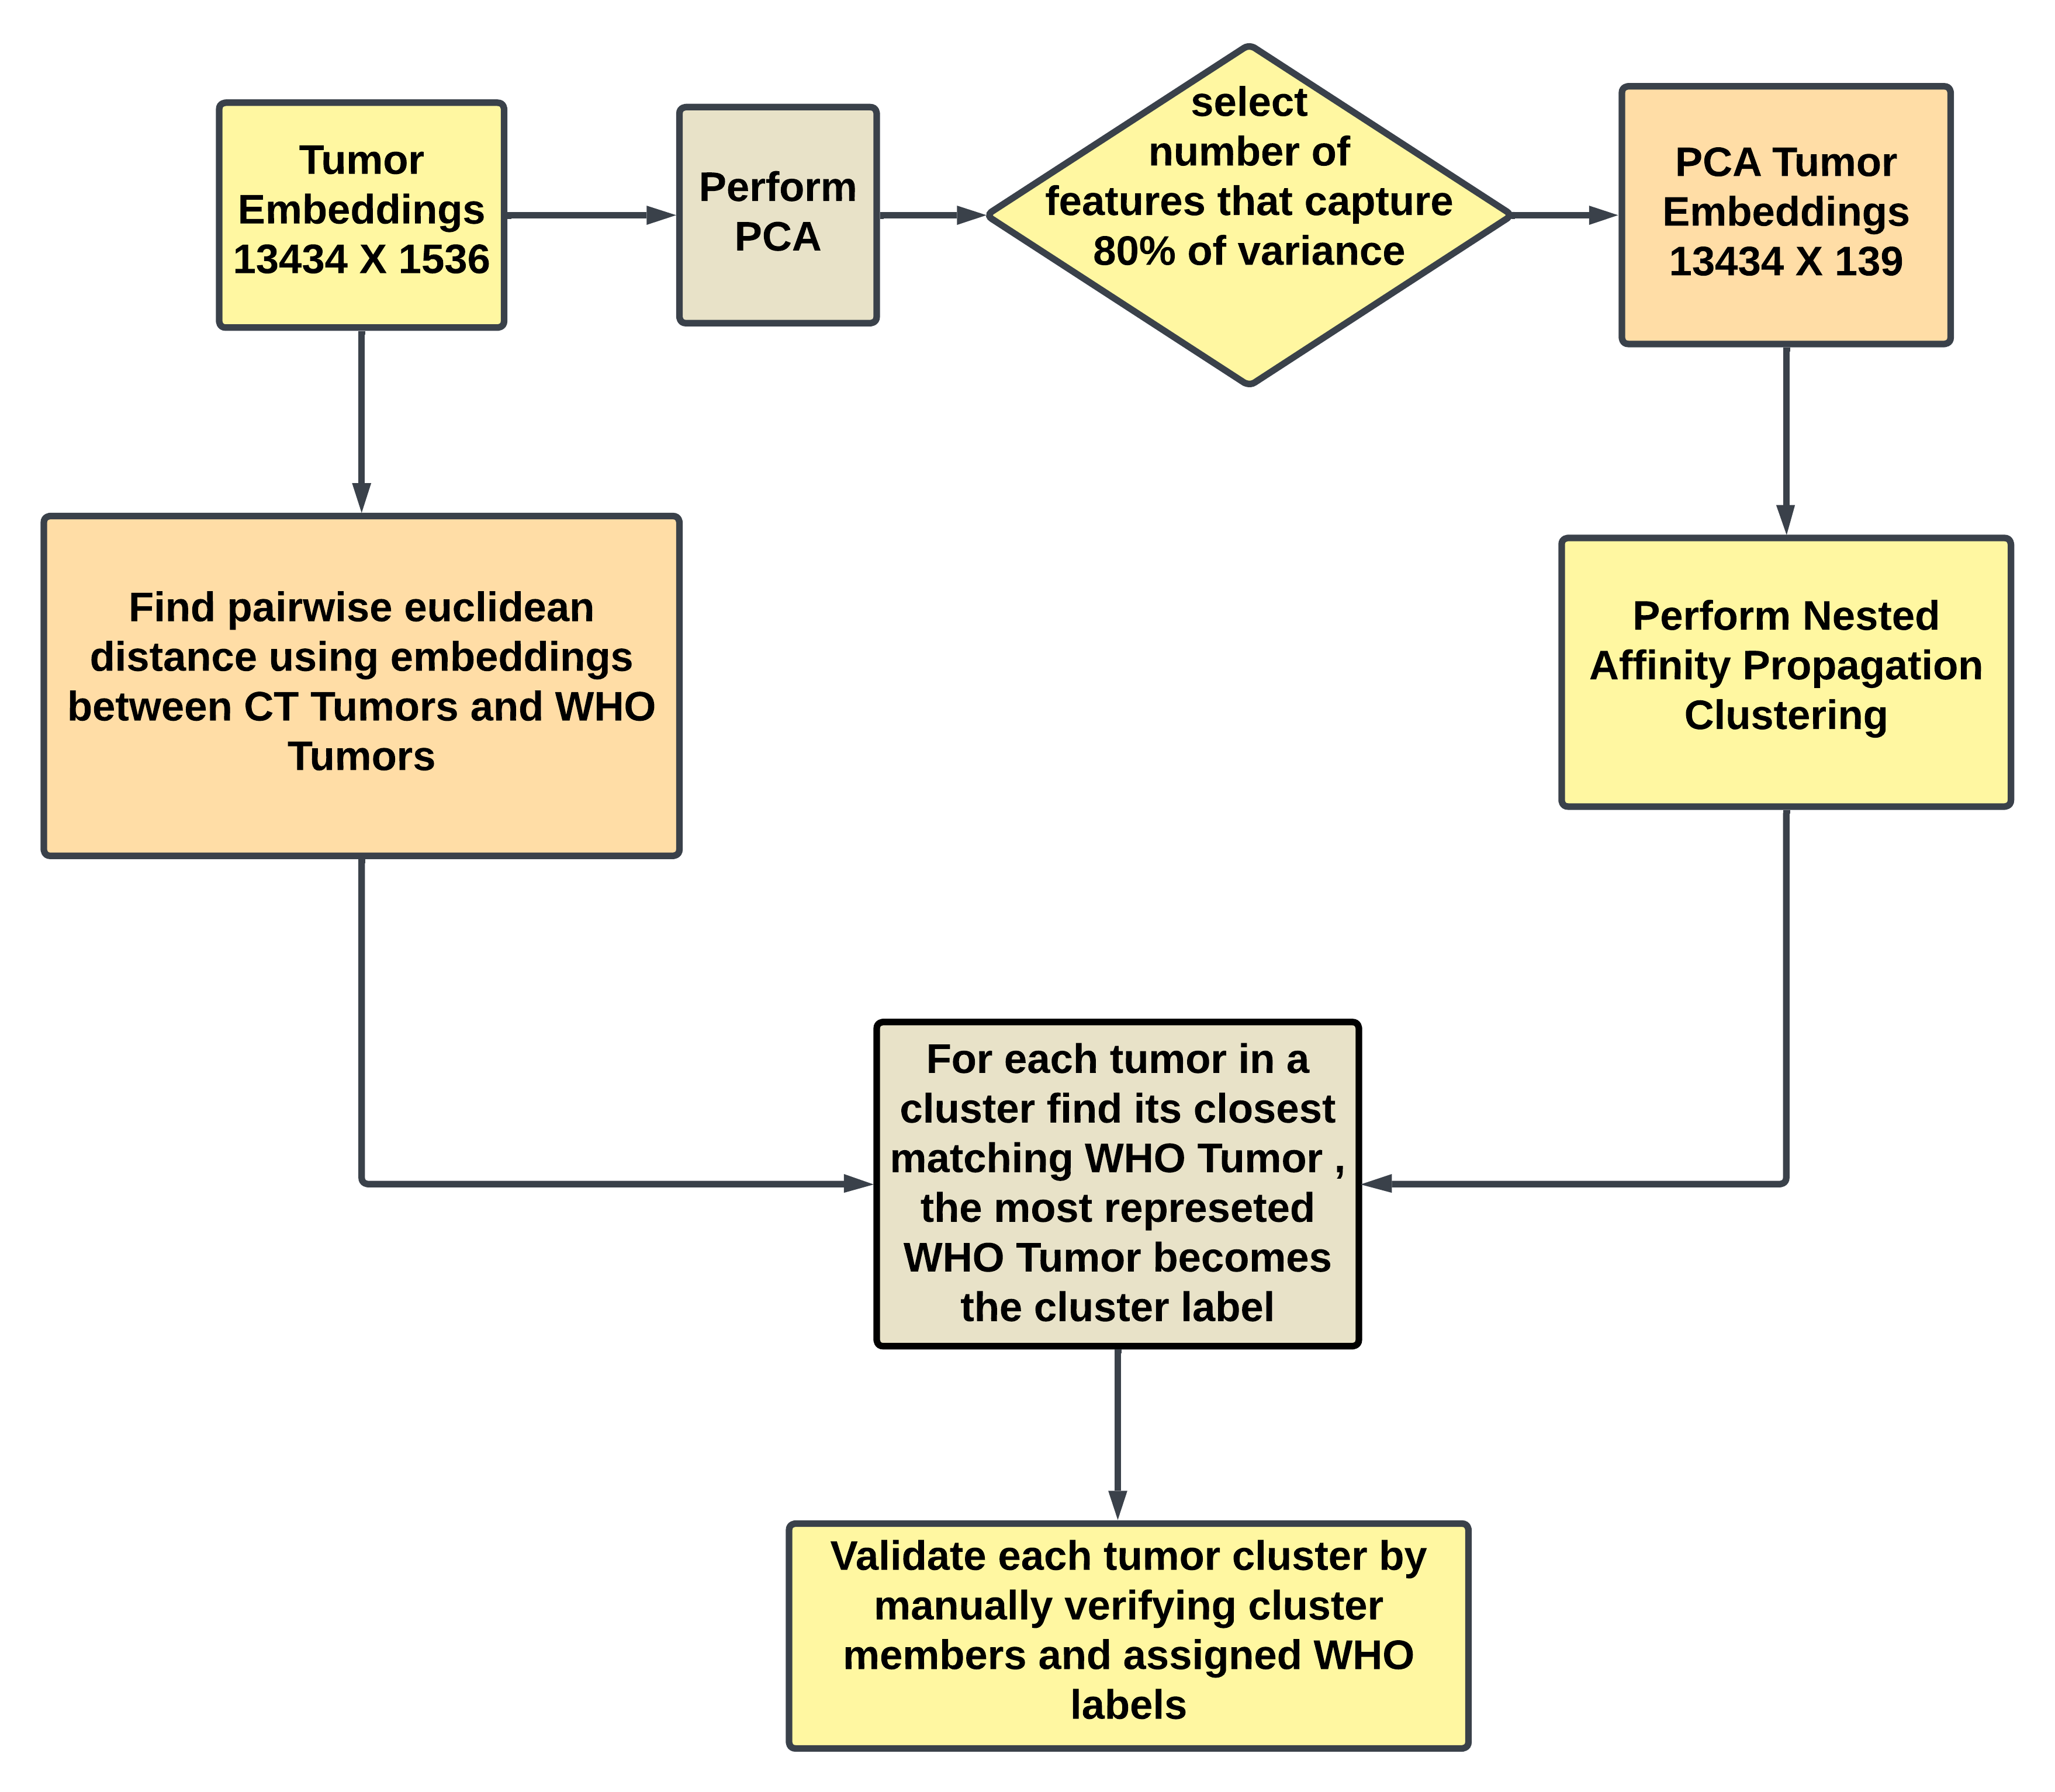
Pipeline for Processing embeddings

Slide 13
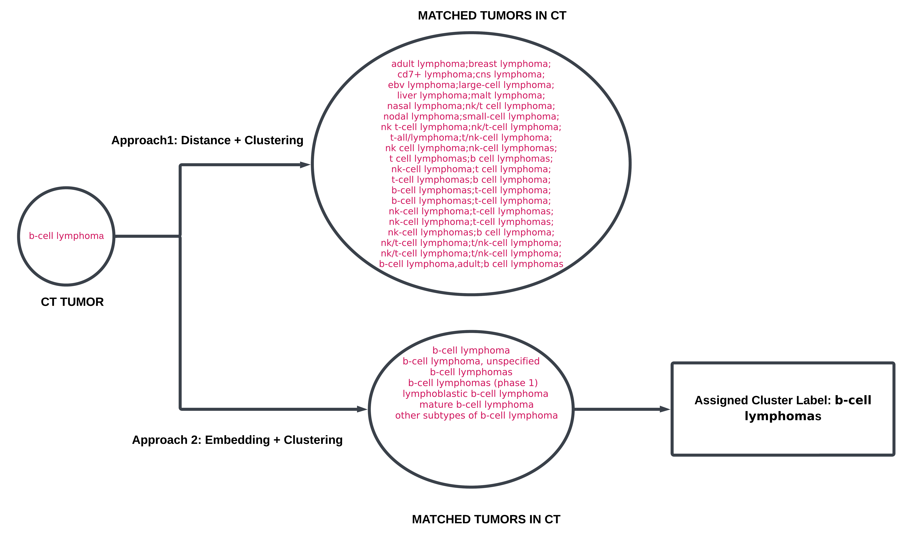
RESULTS: Example for b-cell Lymphoma
Conclusion: Embedding based clustering reduces the number of incorrect cluster members.

Slide 14
Next steps
Embedding Analysis:
Manually validate each cluster members and cluster label assignment.
Make a manuscript for just processing tumor names in CT and standardizing them.
PMTL Analysis:
Build the module to display and filter CT drugs by trial and phase. This information is there in the pipeline, but needs to be developed to display in the tables.
PMTL Manuscript will follow and refer to the work in Embedding Analysis.
Post PMTL Analysis:
Analyze the results from PMTL pipeline and the extensive cancer data from the OpenPedCan project to identify how well the FDA PMTL provides coverage across gene targets from clinical trials and molecular evidence and which gene targets are not currently in the PMTL.
Use pipeline results and data from the OpenPedCan project to build a Childhood Cancer Knowledge Graph (CCKG). Machine learning approaches will be used on the CCKG to predict pediatric cancer treatments.​​

