Slide 1
A comprehensive pipeline for the Analysis of drug , target and Tumor databases
Aditya Lahiri and Deanne Taylor

Slide 2
PART 1

Slide 3
Background
There are multiple publicly available databases that outline drug-target , drug-disease, and disease-target relationships.
However, there is a lack is a lack of publicly available resources that highlight these relationships for cancers , especially pediatric cancer.
Such a resource can help us understand the drug and target landscape for a particular cancer.
Furthermore, there are limited publicly available resources which elucidate these relationships for drug and disease (specifically cancers) registered in clinical trials database.
In particular, there is a need to identify these relationships for the FDA Pediatric Molecular Target List (FDA-PMTL) , which contains over 400 pediatric cancer gene targets of interest.
We propose to build a pipeline that ingests data from major public databases to highlight the relationship among drug, cancer, and drug targets.

Slide 4
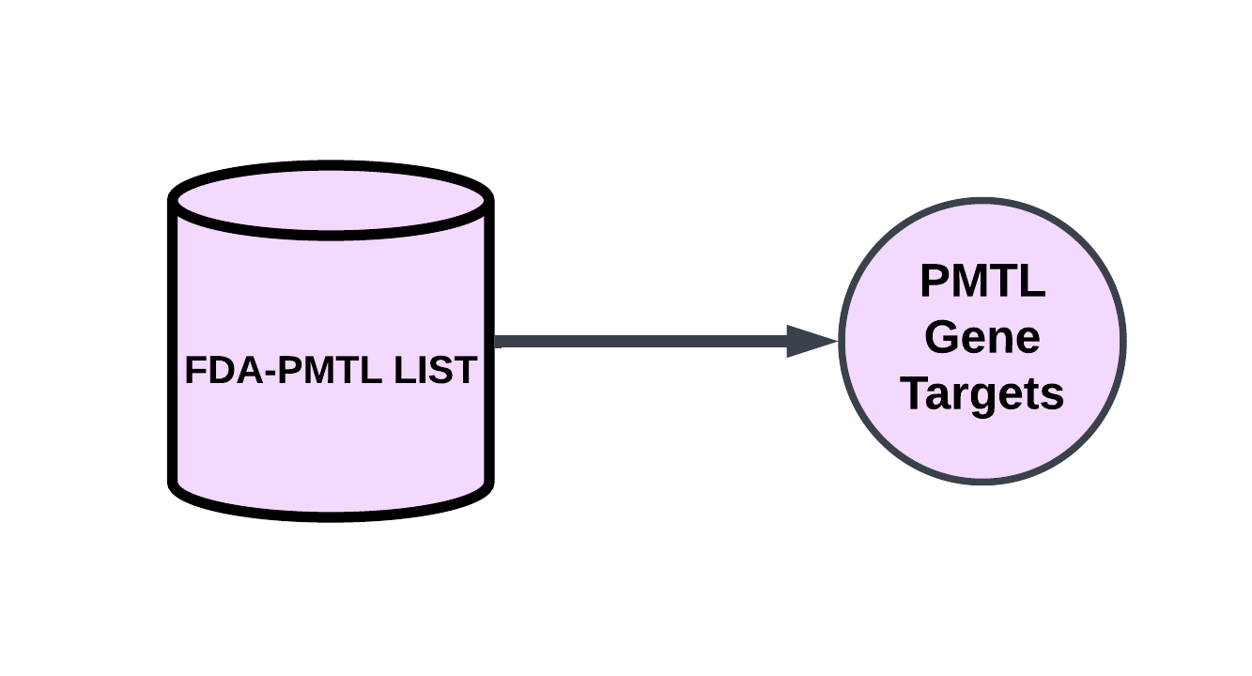
Primary Databases : FDA PMTL
Database | Relationships Available
FDA PMTL | PMTL Genes (Targets)

Slide 5
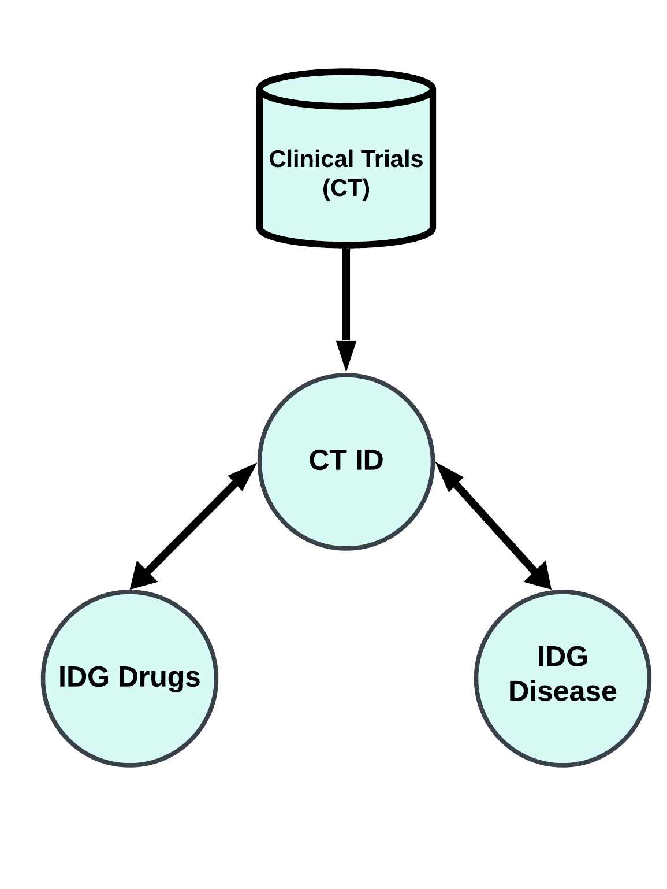
Primary Databases : Clinical Trials
Database | Relationships Available
Clinical Trials (CT) | Drugs associated with a clinical trial ID Diseases associated with a clinical trial ID

Slide 6
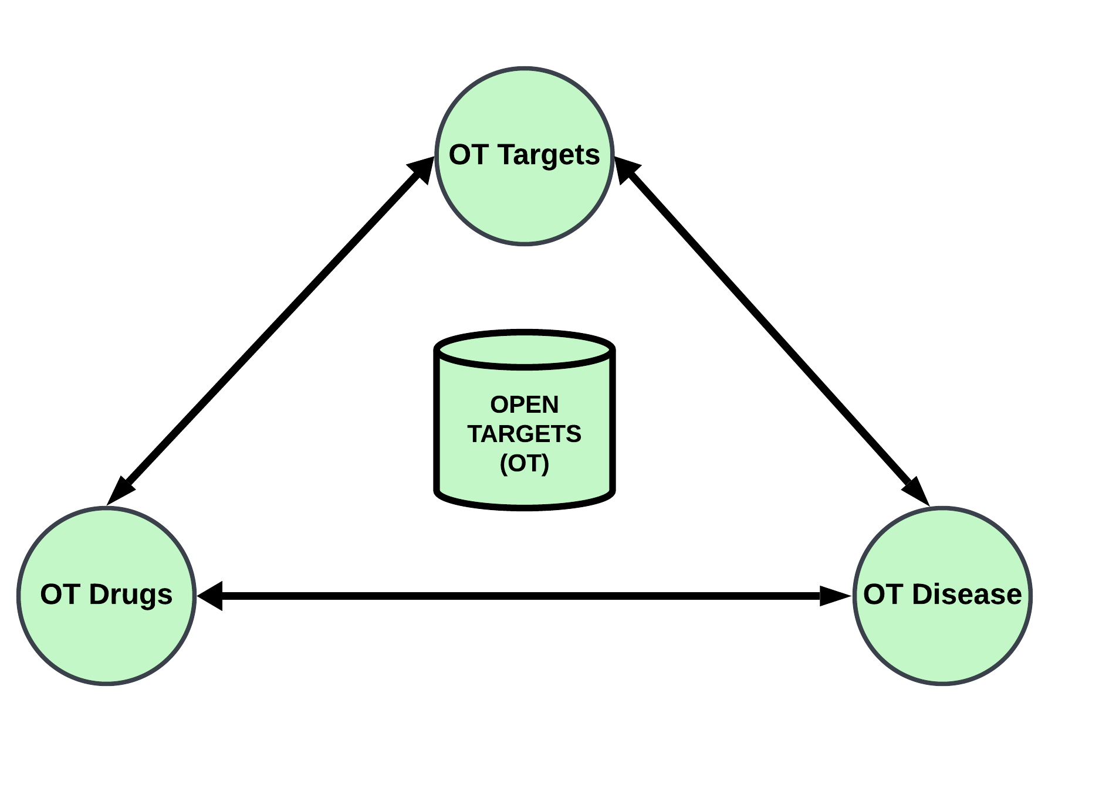
Primary Databases : Open Targets
Database | Relationships Available
Open Targets (OT) | Drug – Target relationship Drug – Disease relationship Disease – Target relationship

Slide 7
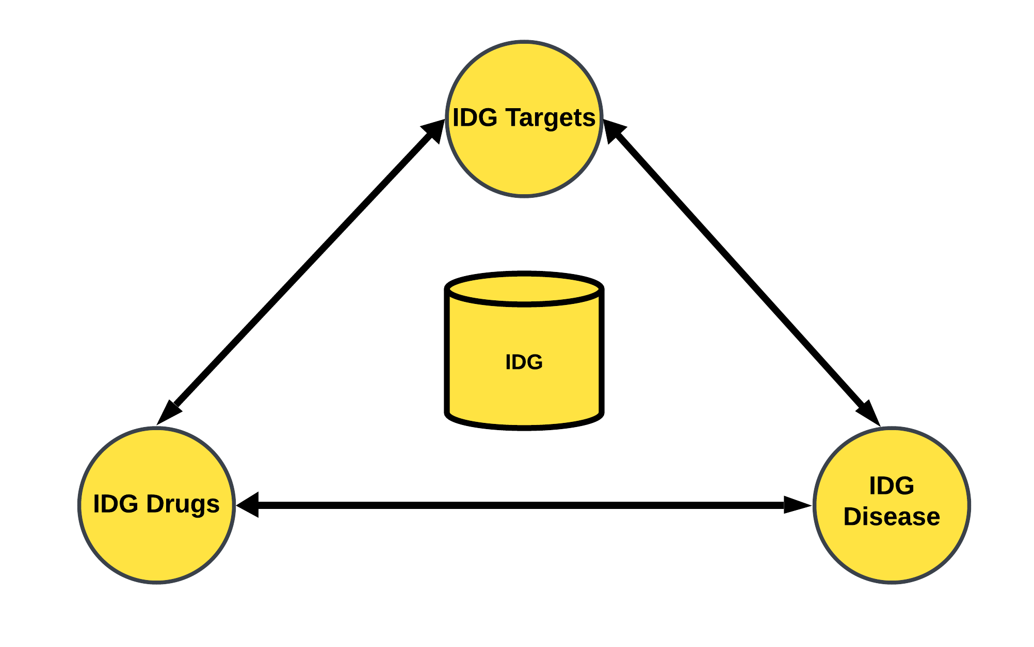
Primary Databases : Illuminating the Druggable Genome
Database | Relationships Available
Illuminating the Druggable Genome (IDG) | Drug – Target relationship Drug – Disease relationship Disease – Target relationship

Slide 8
ALL Primary Databases
Database | Relationships Available
FDA PMTL | PMTL Genes (Targets)
Clinical Trials (CT) | Drugs associated with a clinical trial ID Diseases associated with a clinical trial ID
Open Targets (OT) | Drug – Target relationship Drug – Disease relationship Disease – Target relationship
Illuminating the Druggable Genome (IDG) | Drug – Target relationship Drug – Disease relationship Disease – Target relationship

Slide 9
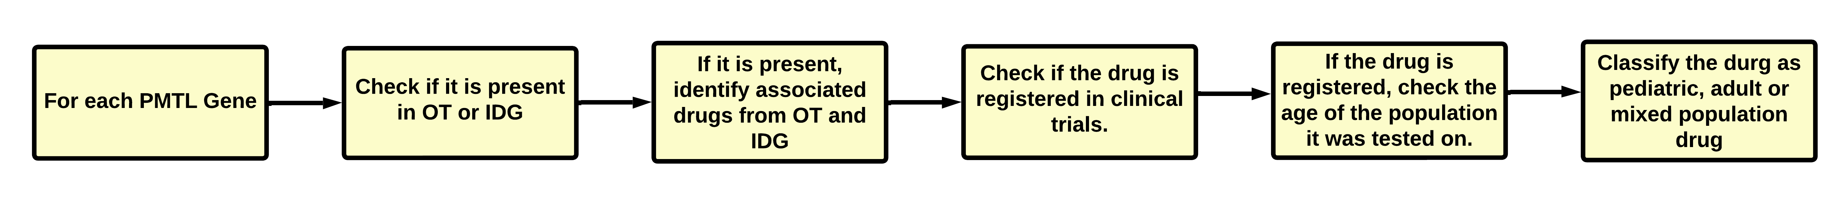
Pipeline summary: PMTL – Drug

Slide 10
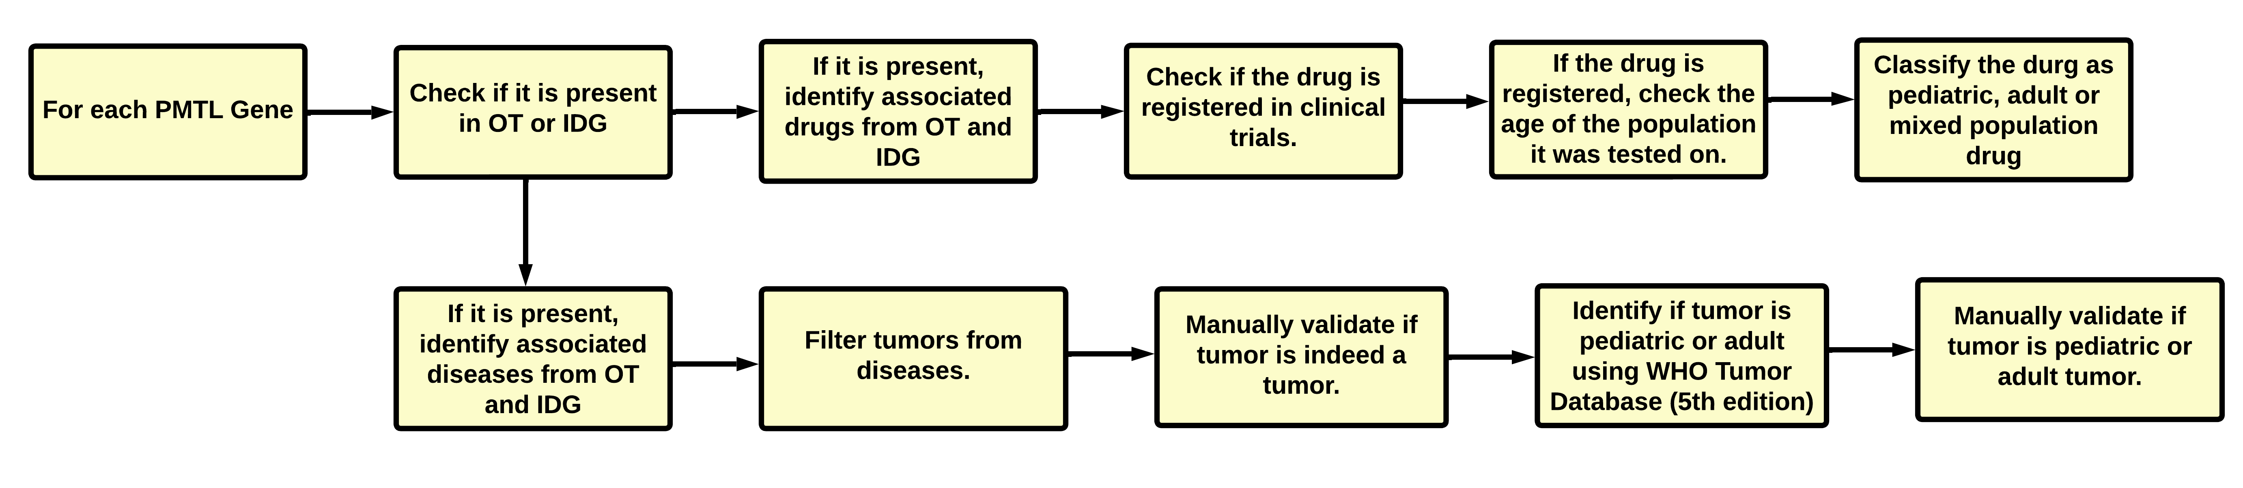
Pipeline summary: PMTL – Drug + PMTL -Tumor
The OT and IDG databases contain targets which are not part of the FDA-PMTL , we perform a similar pipeline-based analysis to identify their associated drugs and tumors.

Slide 11
PIPELINE Summary: What got left out ?
The OT and IDG databases contain drugs which could not be found in the clinical trials database, for these drugs we build an additional section of the pipeline to identify their associated targets and tumors.
For each of these targets we further determine if they are part of the FDA-PMTL
For each of these tumors we classify if these tumors are pediatric or adult tumors.
If no associated targets or tumors were found, these drugs are discarded by the pipeline.
Similarly, clinical trials database contains drugs that for which were not in OT or IDG. Thus, we could not find their associated targets or diseases in OT or IDG.
But CT database contains disease information for drugs used in certain clinical trials study. Searching the clinical trials database with the CT ID of these drugs can help us identify their associated diseases.
The diseases can be further be filtered for tumors and then be cross referenced with the OT and IDG databases.
ROAD BLOCK : Disease names in CT database are not standardized. Specifically, tumor names do not follow standard tumor naming convention developed by the WHO. Furthermore, tumor names contain multiple sources of variations due to typographical errors, extraneous information, disease names presented in different languages etc.
Solution: We develop a pipeline to standardize tumors from clinical trials, before they can be used to cross reference with databases such as IDG or OT. This is discussed in part 2 of this slide deck.

Slide 12
PIPELINE Results
For both PMTL and other targets (from OT and CT) we have generated tables that map their relationships to tumors and drugs. Following are the description of each table.

Slide 13
PIPELINE Results: PMTL Drug Table
PMTL-Drug table :For each PMTL , this table provides their Gene Symbol, associated drug name, if the drug was registered in clinical trials, the age type (pediatric, adult, or mixed) of population the drug was tested on in clinical trials, if the drug was present in IDG or OT databases, source of the PMTL-Target relationship, source where the PMTL was found.
Following is a snapshot of the results taken from the PMTL Drug table:
Gene_Symbol | Drug_Name | Drug_in_CT | Drug_Ped_CT | Drug_Adult_CT | Drug_Mixed_CT | Drug_in_OT | Drug_in_IDG | Drug_Target_Soruce | Target_Source
ABL1 | Axitinib | Yes | Yes | Yes | Yes | Yes | Yes | IDG | OT_IDG_PMTL
BCL2 | oblimersen | Yes | No | Yes | No | Yes | No | OT_CT | OT_IDG_PMTL
PARP10 | rucaparib | Yes | No | Yes | Yes | Yes | Yes | IDG | IDG_PMTL
MAP2K2 | bay86-9766 | Yes | No | Yes | No | No | No | CT | OT_IDG_PMTL
JAK2 | xl-019 | No | No | No | No | Yes | No | OT | OT_IDG_PMTL
Majority of the PMTLs have multiple drugs associated with them. This table has 6669 relationships (rows) between PMTLs and Drugs

Slide 14
PIPELINE Results: PMTL Tumor Table
PMTL-Tumor table :For each PMTL , this table provides the following: PMTL Gene Symbol , if the PMTL is targeted by at least one drug in CT, OT, or ID, sources where the PMTL was found, associated tumor name, if tumor is a pediatric cancer, reference for pediatric tumor, evidence count for the given PMTL-tumor relationship from OT , source of the relationship between PMTL and tumor.
Following is a snapshot of the results taken from the PMTL Tumor table:
Gene_Symbol | targeted_in_CT | targeted_in_OT | targeted_in_IDG | Target_Source | Tumor | Ped_Tumor | Ped_Tumor_Evidence | evidenceCount | Target_Disease_Relationship_Source
ABL1 | Yes | Yes | Yes | OT_IDG_PMTL | acral lentiginous melanoma | Yes | https://link.springer.com/article/10.1007/BF02303565 | 3 | OT
FOXO3 | No | No | No | IDG_PMTL | teratoma | No | NA | 1 | OT
JAK1 | Yes | Yes | Yes | OT_IDG_PMTL | pancreatic carcinoma | No | NA | 6 | OT
PTEN | No | No | No | IDG_PMTL | fibrosarcoma | Yes | Listed in WHO Ped Tumor | 6 | OT
STAT3 | Yes | Yes | Yes | OT_IDG_PMTL | olfactory neuroblastoma | Yes | https://www.mdpi.com/2077-0383/10/12/2685 | 1 | OT
Majority of the PMTLs have multiple tumors associated with them. This table has 36298 relationships (rows) between PMTLs and tumors.

Slide 15
PIPELINE Results: Target Drug Table
Target-Drug table :For each Target, this table provides the Gene Symbol, PMTL Status, associated drug name, if the drug was registered in clinical trials, the age type (pediatric, adult, or mixed) of population it was tested on in clinical trials, if the drug was present in IDG or OT databases, source of the Target-Drug relationship, source where the Target was found.
Following is a snapshot of the results taken from the Target Drug table:
Gene_Symbol | PMTL_Status | Drug_Name | Drug_in_CT | Drug_Ped_CT | Drug_Adult_CT | Drug_Mixed_CT | Drug_in_OT | Drug_in_IDG | Drug_Target_Soruce | Target_Source
ACE | No | accupril | Yes | No | Yes | No | No | No | CT | OT_IDG
EGFR | Yes | falnidamol | No | No | No | No | Yes | No | OT | OT_IDG_PMTL
SCN11A | No | phenytoin | Yes | Yes | Yes | Yes | Yes | Yes | OT_CT | OT_IDG
TYRP1 | No | imc-20d7s | Yes | No | Yes | No | No | No | CT | OT_IDG
ZAP70 | No | fostamatinib | Yes | No | Yes | No | Yes | Yes | IDG | IDG
Majority of the Targets have multiple drugs associated with them. This table has 26880 relationships (rows) between Targets and Drugs

Slide 16
PIPELINE Results: Target Tumor Table
Target-Tumor table :For each Target , this table provides the following: Gene Symbol , if these Targets are targeted by at least one drug in CT, OT, or ID, sources where the Target was found, tumor name, if the tumor is a pediatric tumor, reference for pediatric tumor, evidence count for the given target-tumor relationship from OT , source of the relationship between target and tumor.
Following is a snapshot of the results taken from the Target Tumor table:
Gene_Symbol | PMTL_Status | targeted_in_CT | targeted_in_OT | targeted_in_IDG | Target_Source | Tumor | Is_Valid_Ped_Tumor | Ped_Tumor_Evidence | evidenceCount | Target_Disease_Relationship_Source
ABAT | No | Yes | Yes | Yes | OT_IDG | neuroblastoma | Yes | Listed in WHO Ped Tumor | 2 | OT
BAX | Yes | No | No | No | IDG_PMTL | follicular lymphoma | Yes | https://www.ncbi.nlm.nih.gov/pmc/articles/PMC3566339/ | 1 | OT
MAPRE3 | No | No | No | No | IDG | lung carcinoma | No | NA | NA | OT_IDG
STXBP6 | No | No | No | No | IDG | subependymal giant cell astrocytoma | Yes | Listed in WHO Ped Tumor | NA | IDG
UTF1 | No | No | No | No | IDG | atypical teratoid rhabdoid tumor | Yes | Listed in WHO Ped Tumor | NA | IDG
Majority of the targets have multiple tumors associated with them. This table has 127506 relationships (rows) between targets and tumors.

Slide 17
PART 2: Pipeline to standardize tumors from clinical trials

Slide 18
Background
There are limited public resources linking diseases from CT database to FDA-PMTLs or targets and drugs in OT and IDG.
There are over 800,000 disease records (as of Aug 31, 2023) in the CT database. We are interested in extracting the tumors from these diseases.
However, integrating extracted tumors with other public databases is not trivial as tumor names are not standardized and contain multiple sources of variation.
CT Tumor Names | Issues | WHO Standard Names
acute myeloid leucaemia | Leukaemia not spelled correctly | acute myeloid leukaemia
glioblastoma or solid tumors, epidermal growth factor receptor (egfr) diagnosis | Has two types of tumor: glioblastoma and solid tumors, extra information on EGFR | glioblastoma, idh-wildtype
pathologic stage i merkel cell carcinoma ajcc v8 | extra information on staging | merkel cell carcinoma
adrenocortical carcinoma (part g) | Extra information in bracket | adrenal cortical carcinoma
ann arbor stage iii diffuse large b-cell lymphoma | extra information on staging | diffuse large b-cell lymphoma

Slide 19
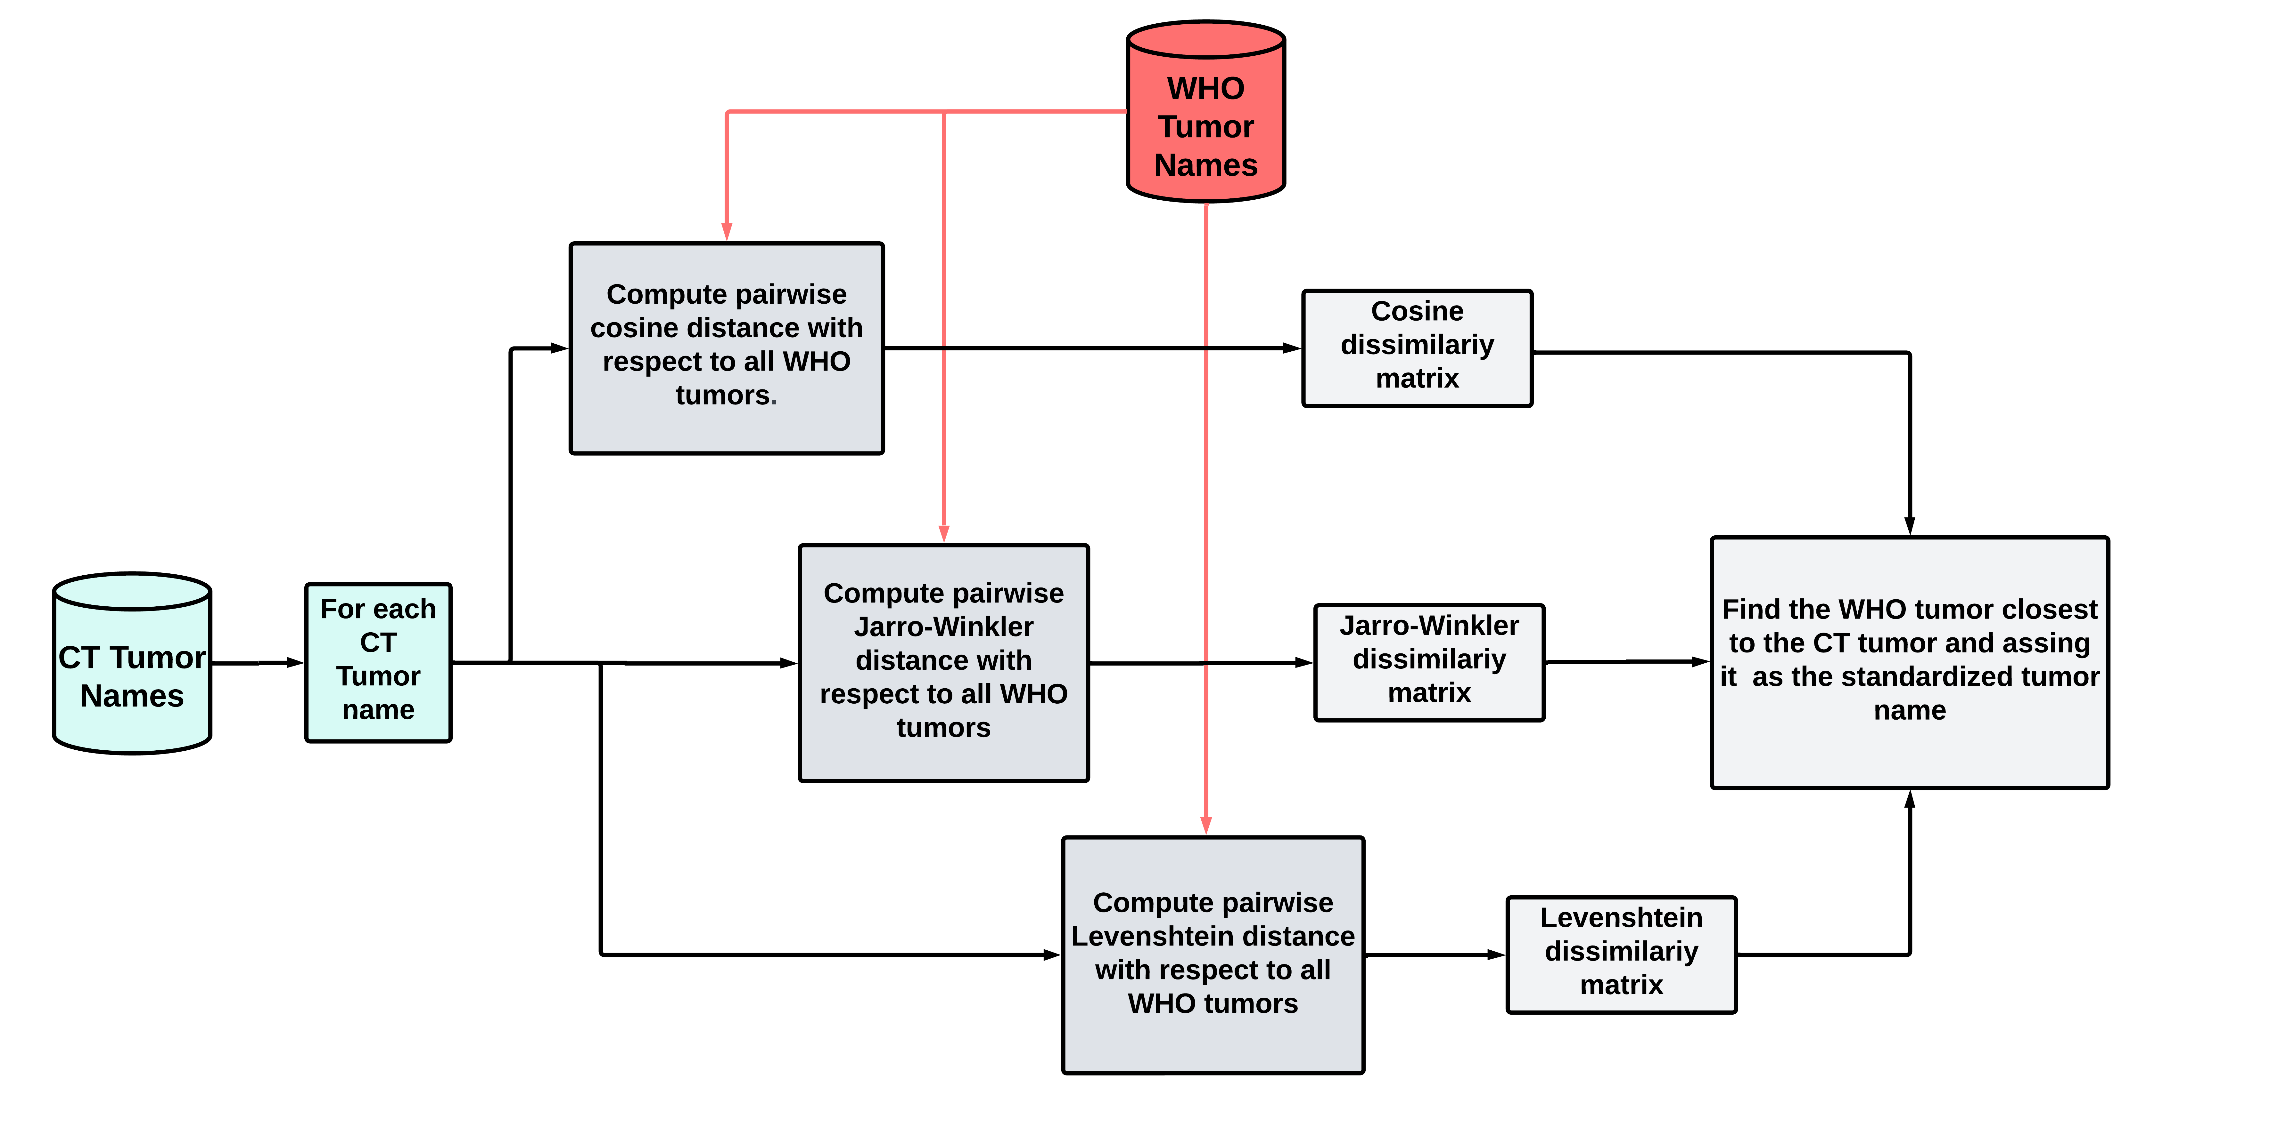
Standardizing CT tumor names Method 1
Method 1 (Edit Distance) : Find the pairwise edit distance between every tumor in CT and WHO Tumors, and find the closest WHO tumor.

Slide 20
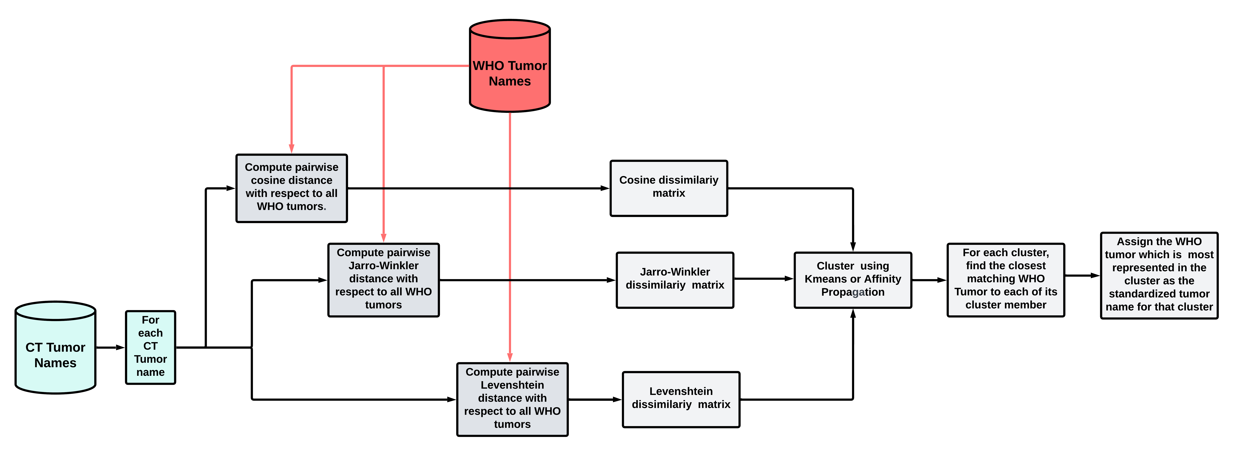
Standardizing CT tumor names Method 2
Method 2 (Edit Distance + Clustering): Use the edit distances as dissimilarity matrix in clustering algorithms and cluster similar tumors together. For each cluster member in a given cluster, find the closest matching WHO tumor, the WHO tumor which is represented the most in the cluster is established as the standardized tumor name for that cluster of tumors.

Slide 21
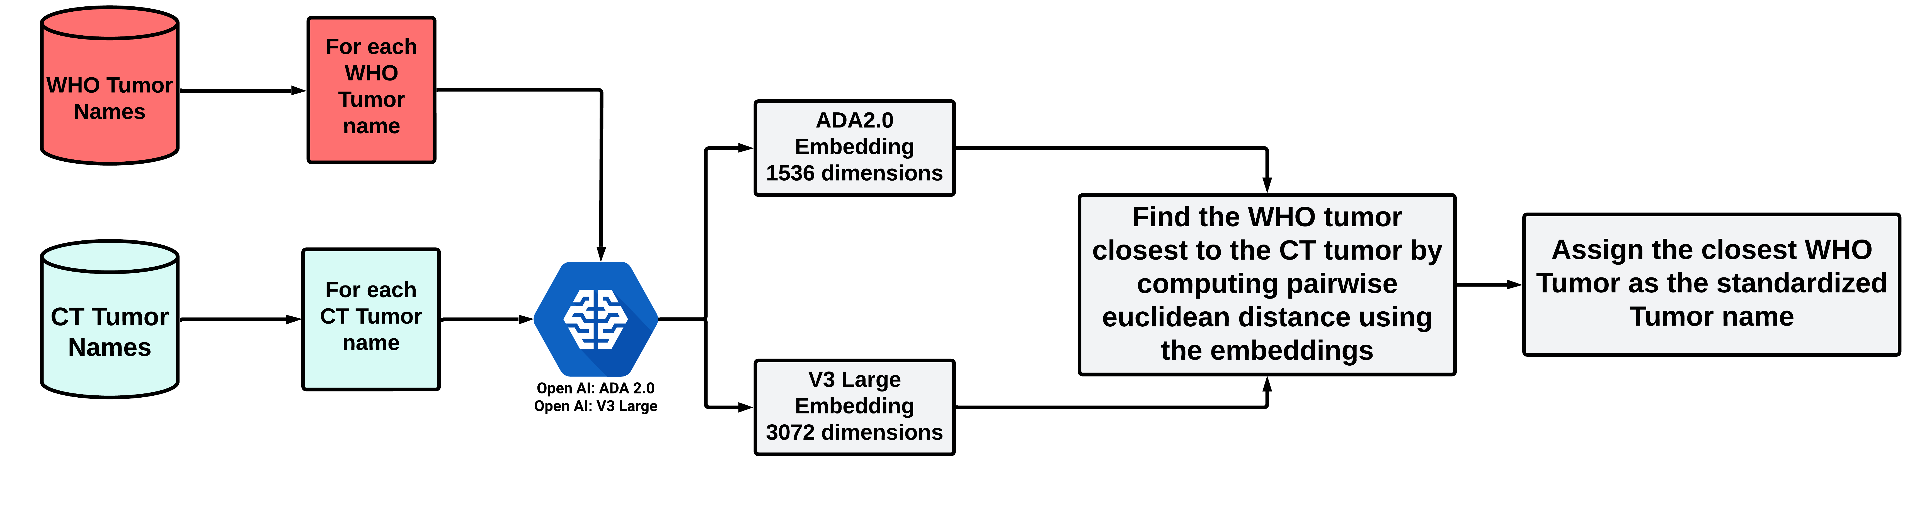
Standardizing CT tumor names Method 3
Method 3 (Embedding and compute embedding distance ):
Generate embeddings (convert tumor names to numeric vectors) using Open AI’s ADA 2.0 and V-3 Large.
Embeddings are low dimensional representation of text data.
Embeddings generated by ADA 2.0 has 1536 dimensions and V-3 has 3072 dimensions.
Cost of generating embeddings for 15K diseases ~$6.00 for ADA 2.0.
For each CT tumor compute the closest matching WHO tumor by computing the pairwise Euclidean distance.

Slide 22
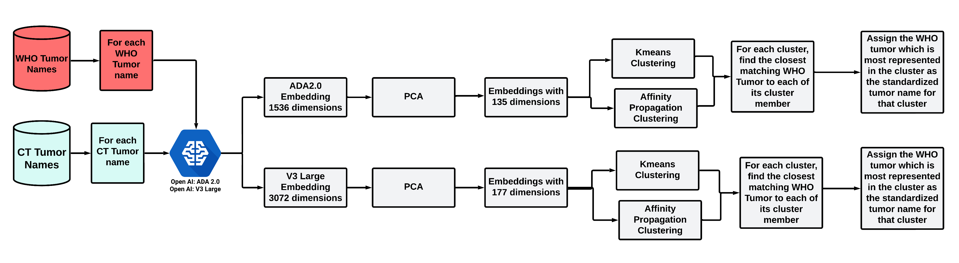
Standardizing CT tumor names Method 4
Method 4 (Embedding and Clustering ):
Generate embeddings (convert tumor names to numeric vectors) using Open AI’s ADA 2.0 and V-3 Large.
Embeddings generated by ADA 2.0 has 1536 dimensions and V-3 has 3072 dimensions.
Apply PCA to reduce dimensions and Cluster the tumor names using Kmeans and Affinity propagation.
For each cluster compute the closest WHO tumor by computing pairwise Euclidean distance for each cluster member. Assign the WHO tumor which is most represented in the cluster as the standardized tumor name.

Slide 23
Method Evaluation
We went over the 800,000 diseases in CT databases, and selected the diseases which were associated with a drug registered in clinical trials,and removed instances of duplicate diseases.
After filtering the diseases, we identified 13K unique tumors in the CT database .
We randomly selected 1600 tumors from the CT database to evaluate the performance of our methods. Out of which 578 tumors had a viable ground truth , i.e., they could be mapped to tumor name in the WHO database. There many tumor in the CT database which cannot be mapped to a WHO Tumor. For instance, consider the CT tumor : “Triple Negative Breast Cancer”, this term is not present in the WHO Tumor database (5th Edition). Thus, for such tumors our methods cannot be expected to perform.
In the next slide we present the accuracy of each method with respect to the 578 tumors in for which we identified a viable tumor name (ground truth) from the WHO database.

Slide 24
Standardization method Accuracy
Methods | Accuracy
Cosine Distance | 0.3408304
Jarro Winkler Distance | 0.3944637
Levenshtein Distance | 0.4965398
Cosine + Affinity Propagation | 0.3252595
Jarro Winkler + Affinity Propagation | 0.3754325
Levenshtein+ Affinity Propagation | 0.4532872
Embedding ADA 2.0 Euclidean Distance | 0.8235294
Embedding V3 Euclidean Distance | 0.8217993
Embedding ADA 2.0 + KMeans | 0.7906574
Embedding ADA 2.0 + Affinity Propagation | 0.8183391
Embedding V3 Large + KMeans | 0.7941176
Embedding V3 Large + Affinity Propagation | 0.8131488
Results for 578 CT tumors

Slide 25
Standardization method Example
CT Tumor: melanoma (excluding uveal melanoma)
Methods | WHO Standardized Name | Acceptable Standardization
Cosine Distance | uveal melanoma | No
Jarro Winkler Distance | melanoma involving the lacrimal drainage system | No
Levenshtein Distance | pecoma, including angiomyolipoma | No
Cosine + Affinity Propagation | uveal melanoma | No
Jarro Winkler + Affinity Propagation | melanoma involving the lacrimal drainage system | No
Levenshtein+ Affinity Propagation | pecoma, including angiomyolipoma | No
Embedding ADA 2.0 Euclidean Distance | melanoma | Yes
Embedding V3 Euclidean Distance | melanoma | Yes
Embedding ADA 2.0 + KMeans | melanoma | Yes
Embedding ADA 2.0 + Affinity Propagation | melanoma | Yes
Embedding V3 Large + KMeans | uveal melanoma | No
Embedding V3 Large + Affinity Propagation | melanoma | Yes

