Slide 1
A comprehensive pipeline for the Analysis of drug , target and Tumor databases
Aditya Lahiri and Deanne Taylor

Slide 2
Background
FDA Pediatric Molecular Target List (FDA-PMTL) was created, containing over 400 pediatric cancer gene targets of interest.
Limited resources outline drugs tested in clinical trials for cancer for the PMTL genes.
Lack of publicly available comprehensive resources linking these drugs to the standardized tumor list curated by the World Health Organization (WHO).
Need to systematically integrate and analyze publicly available data to identify targets associated with drugs tested in pediatric cancers, especially drugs used in registered clinical trials.

Slide 3
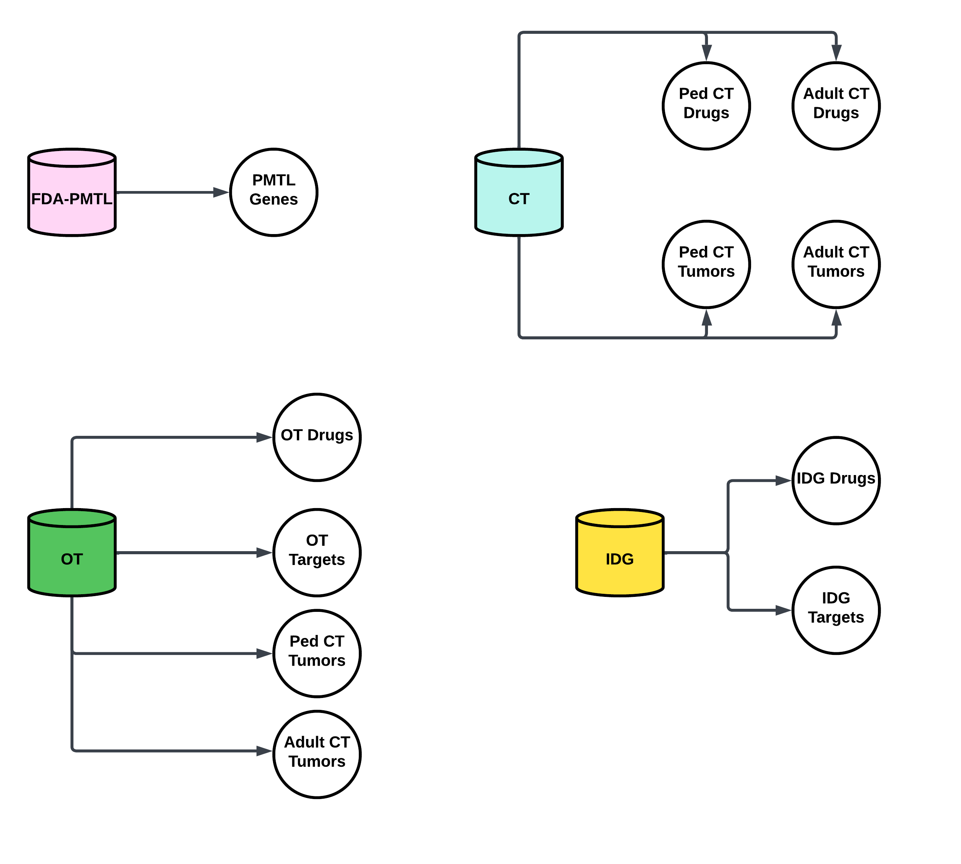
Primary Databases
Database | Content | Processing
FDA PMTL | PMTL Genes | Extraction Only
Clinical Trials (CT) | Drugs & Diseases | Filter drugs by age, and retain phase information. Manually filter tumors & classify as pediatric or adult
Open Targets (OT) | Drugs, Targets, & Diseases | Extraction and manually filter for tumors & classify as pediatric or adult
Illuminating the Druggable Genome (IDG) | Drugs and Drug Targets | Extraction only. No age filter for drugs.

Slide 4
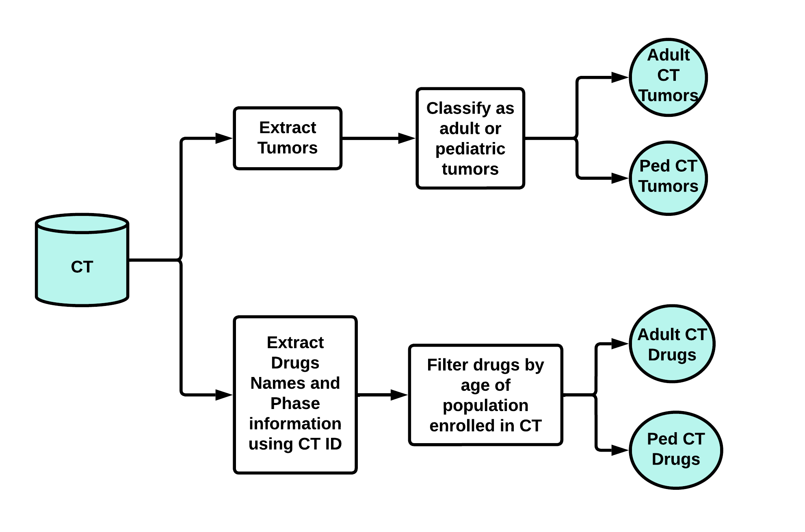
CT Data Processing Pipeline In Depth

Slide 5
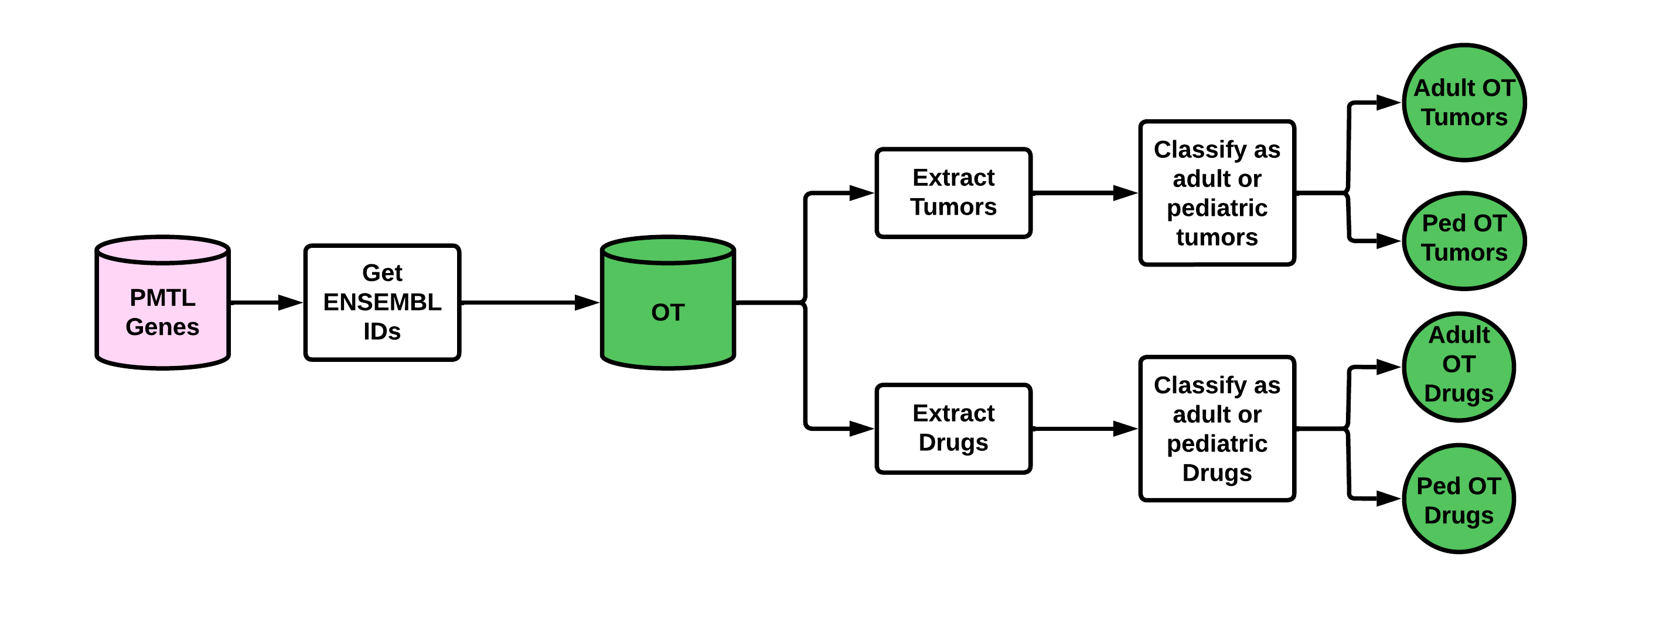
PMTL and OT Pipeline

Slide 6
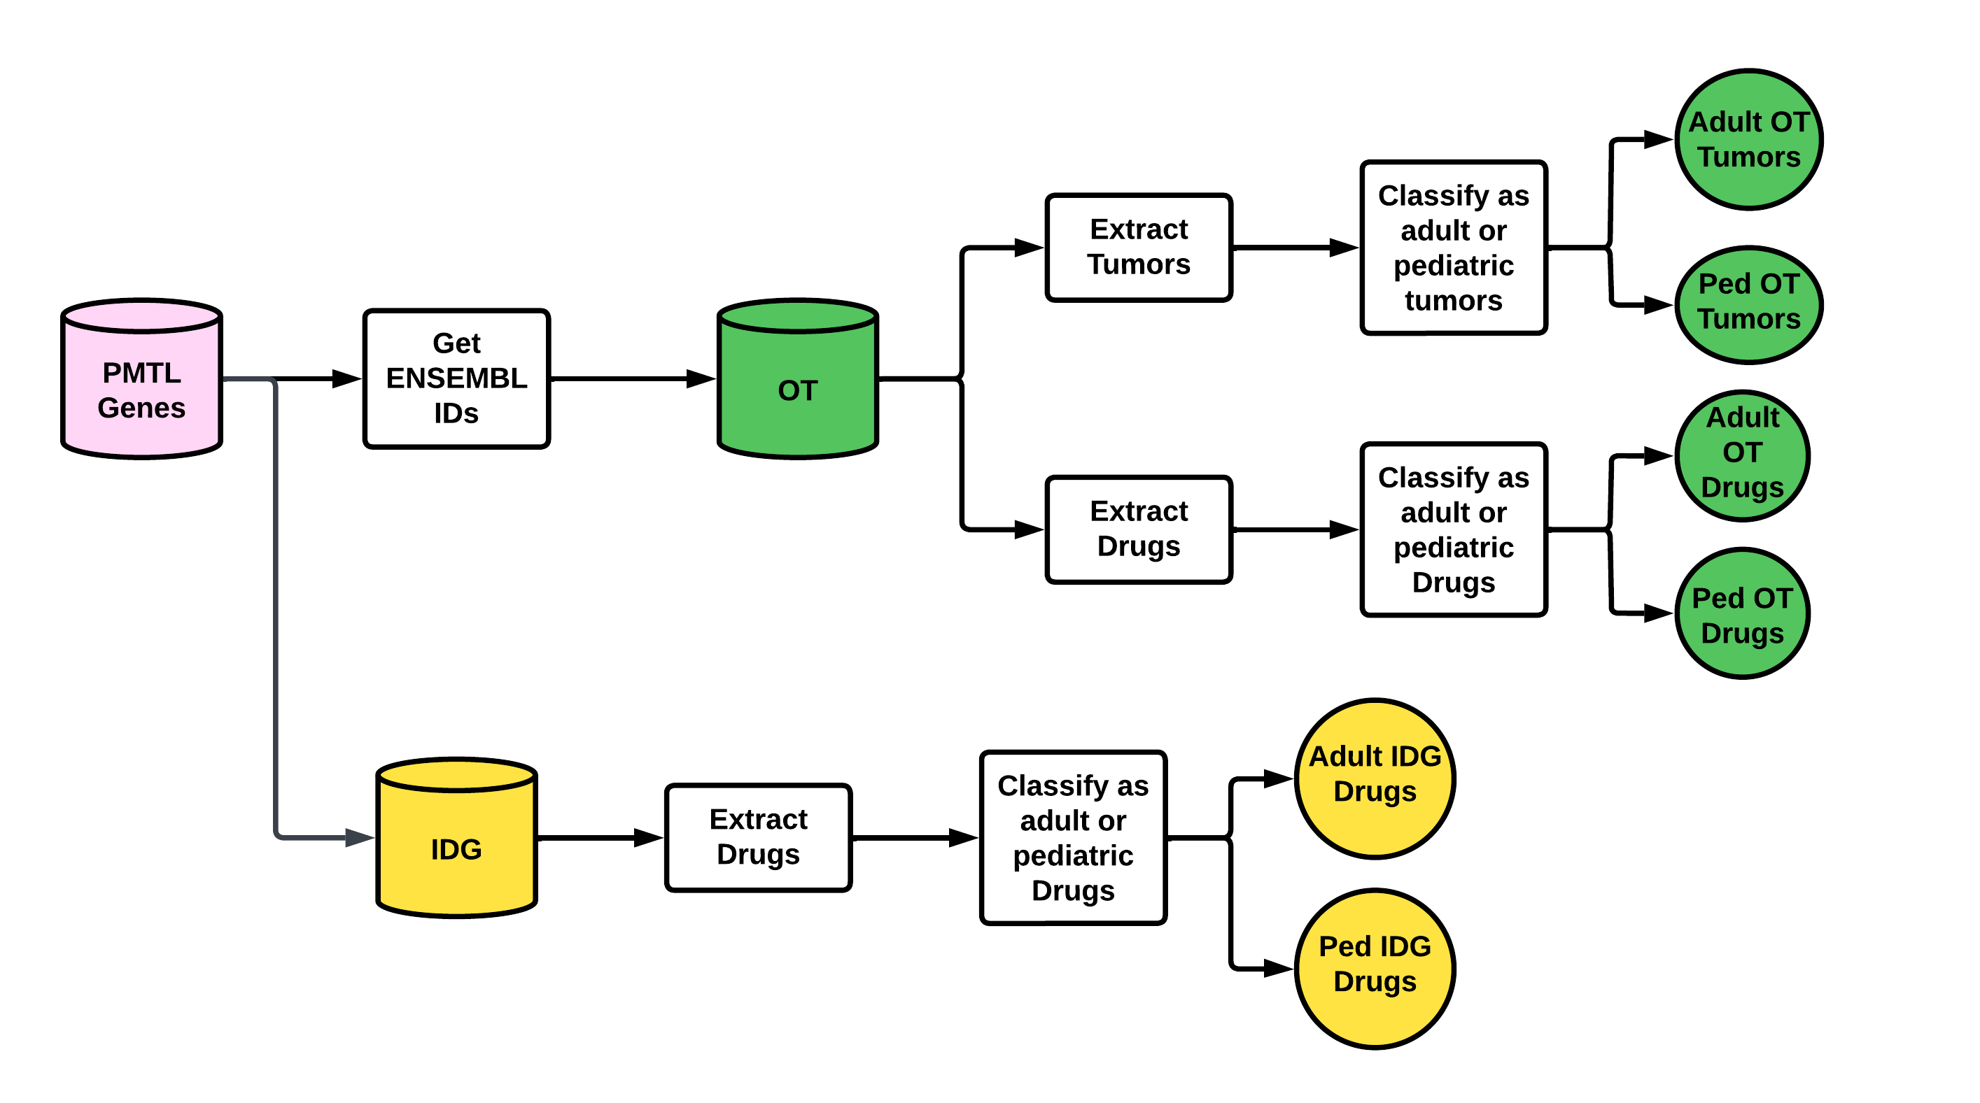
PMTL , OT, and IDG Pipeline

Slide 7
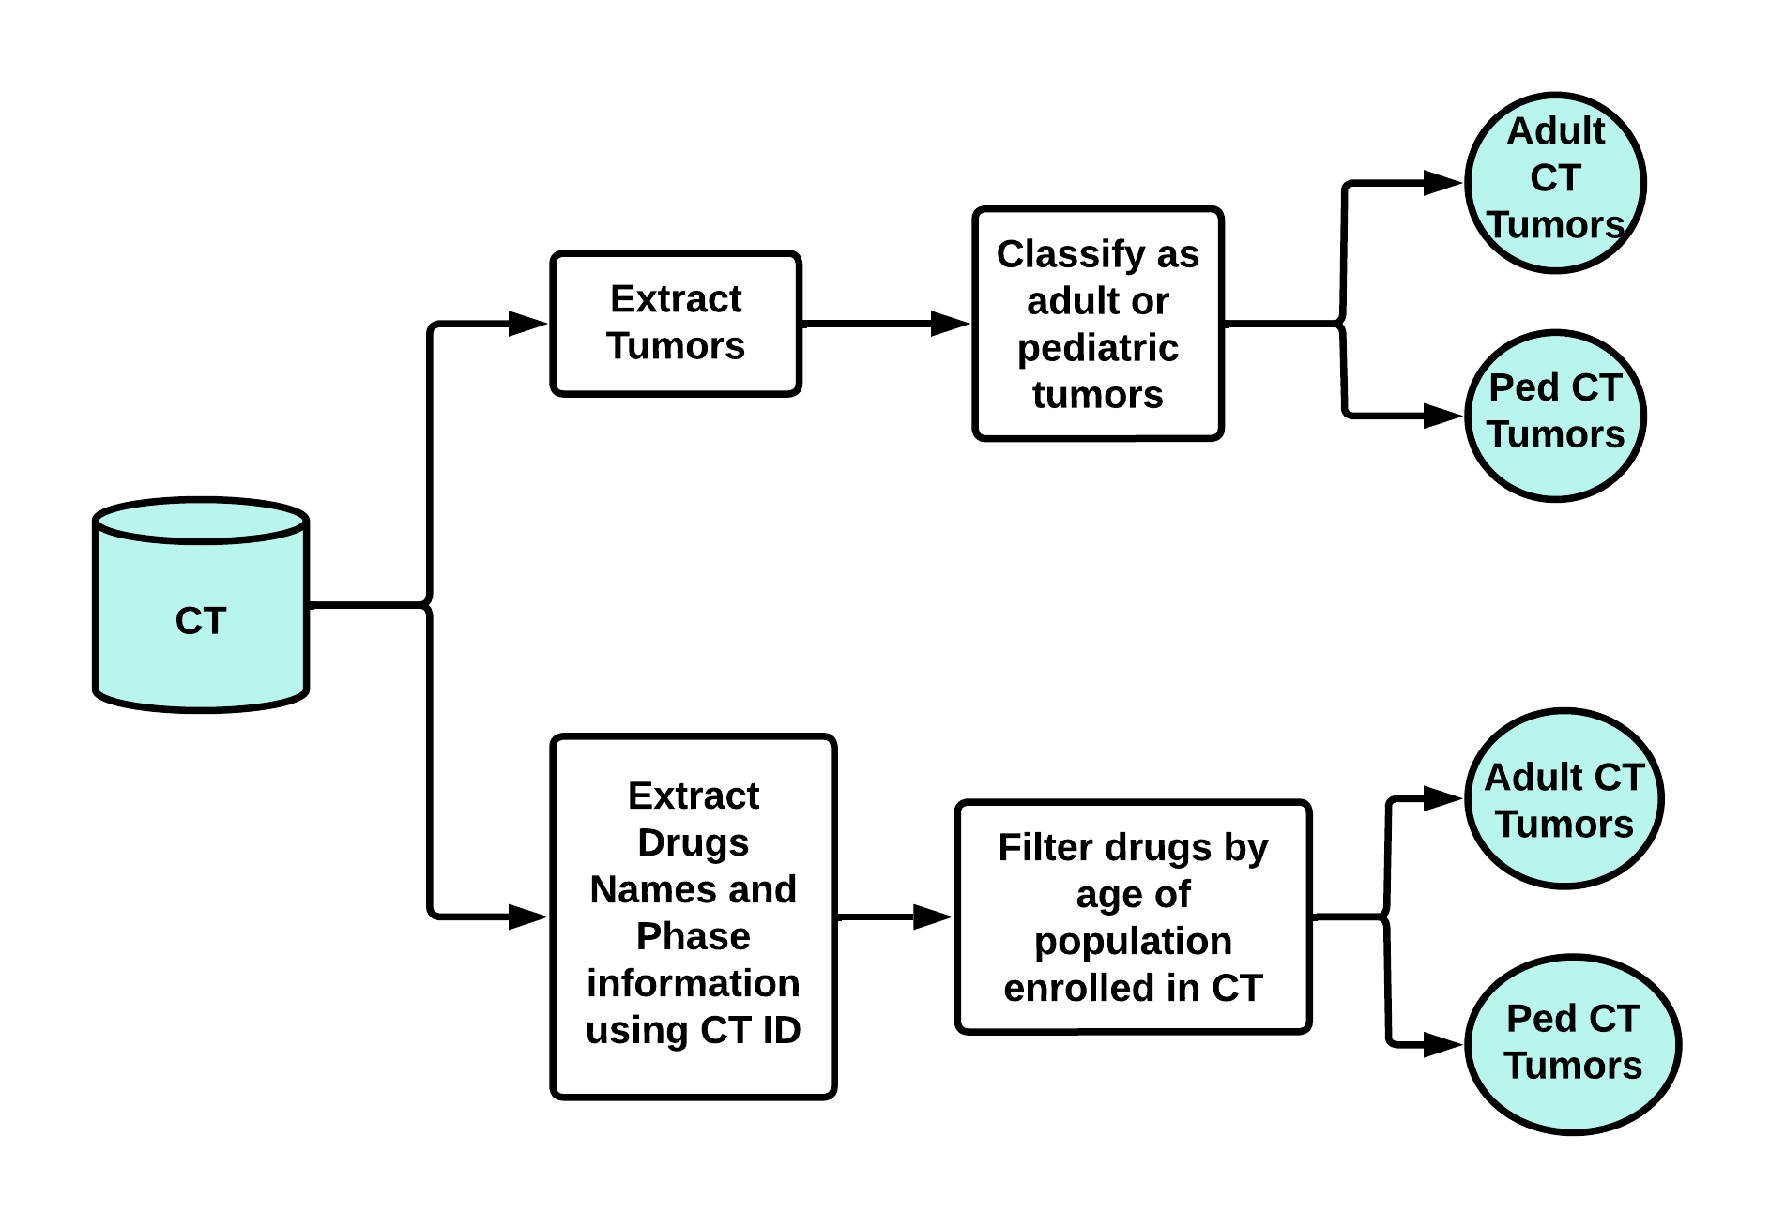
Pipeline for CT & PMTl-OT-IDG

Slide 8
Integrated Pipeline Overview

