Slide 1
Embedding Analysis

Slide 2
Background
Objective: To group similar tumors from clinical trials together.
Method 1: Create tumor clusters using distance metrics: Levenshtein distance, Jarro Winkler distance.
Method 2: Cluster using embeddings.

Slide 3
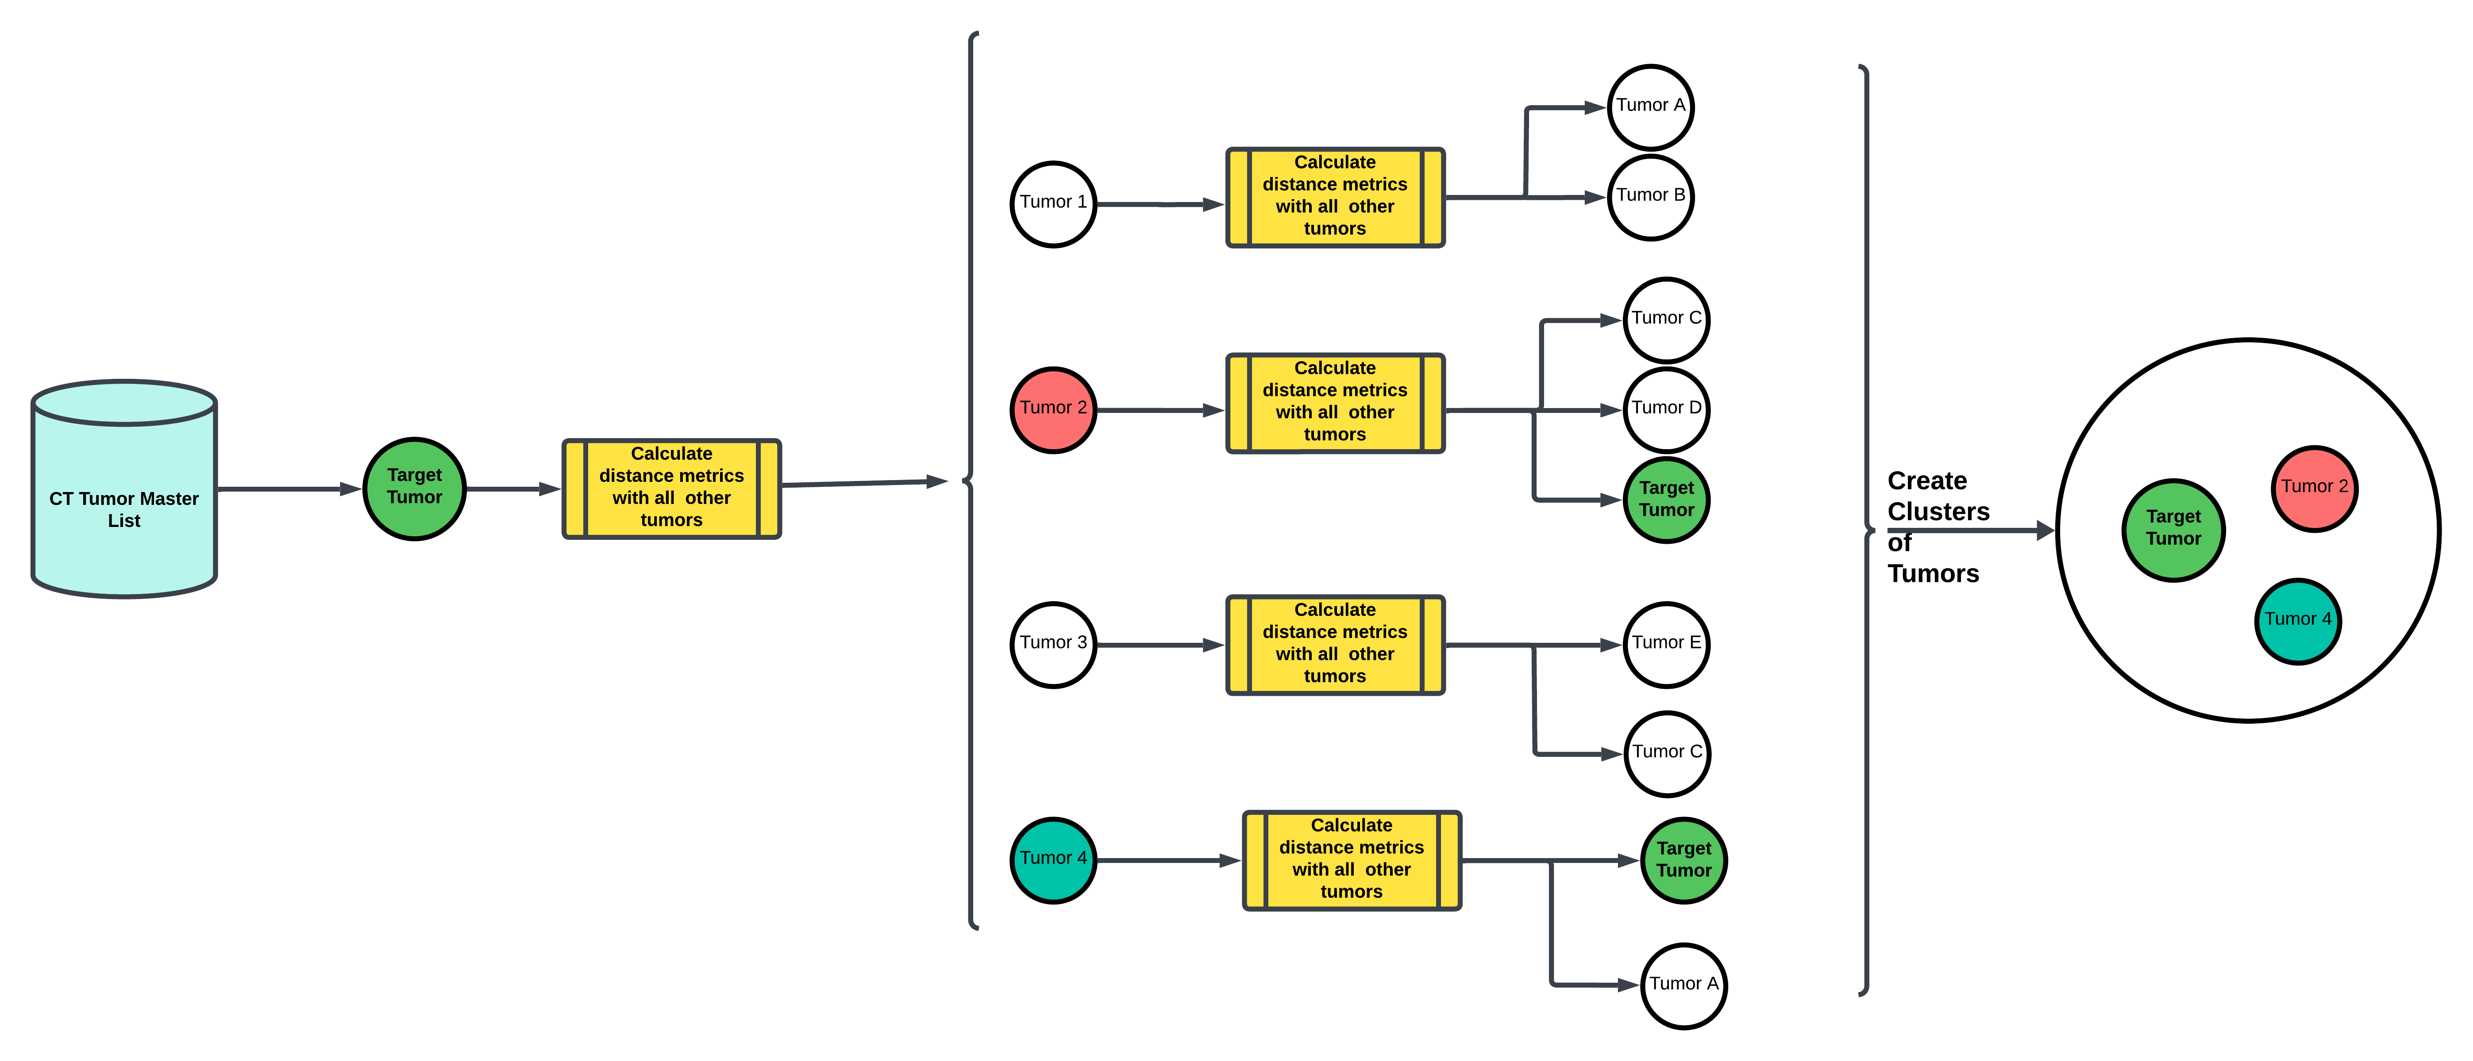
Method 1: Cluster using Distances

Slide 4
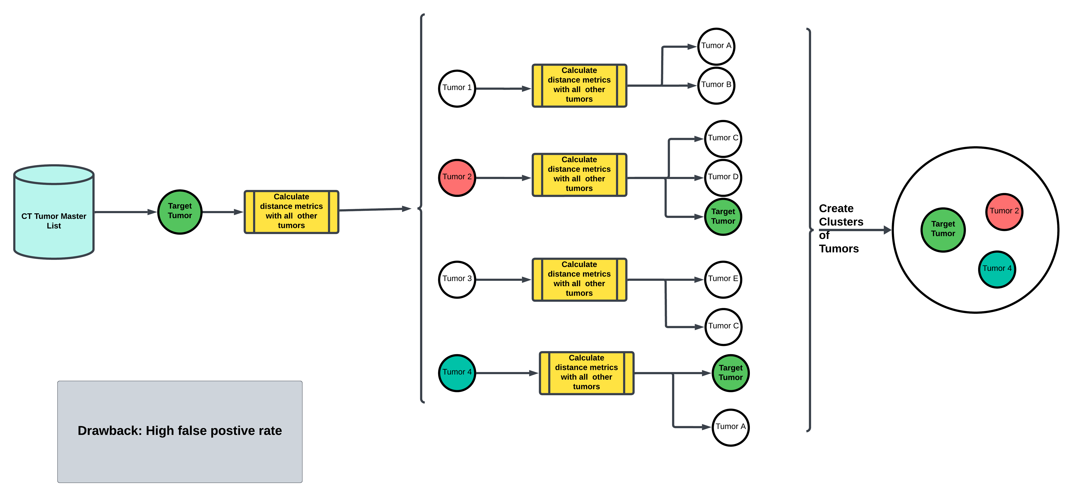
Method 1: Cluster using Distances

Slide 5
Method 2: Cluster using embeddings
What are embeddings ?
Word embedding is a learned representation for text where words (group of words: Phrases/sentences) that have the same meaning have a similar representation.
Essentially, we are representing high dimensional text data into relatively low dimensional space.
Methods for generating embeddings: BERT, Word2Vec, ADA

Slide 6
Method 2: Example for generating Embeddings
Bag of words embedding: “It is a dog eat dog world”
Embedding:
 | It | is | a | dog | eat | world
It | 1 | 0 | 0 | 0 | 0 | 0
is | 0 | 1 | 0 | 0 | 0 | 0
a | 0 | 0 | 1 | 0 | 0 | 0
dog | 0 | 0 | 0 | 1 | 0 | 0
eat | 0 | 0 | 0 | 0 | 1 | 0
dog | 0 | 0 | 0 | 1 | 0 | 0
world | 0 | 0 | 0 | 0 | 0 | 1
1 | 1 | 1 | 2 | 1 | 1

Slide 7
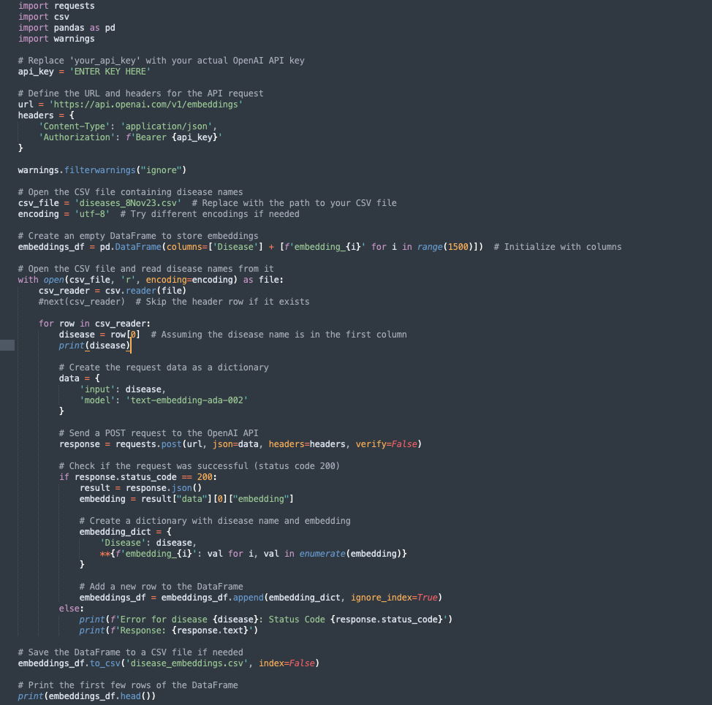
Method 2: Generate embeddings using ADA

Slide 8
Method 2: Generate embeddings using ADA
ADA generated embeddings for 13434 unique tumors in CT.
Each embedding has 1536 dimensions (Max Dims in ADA).
Cost for generating embedding ~ $6.00

Slide 9
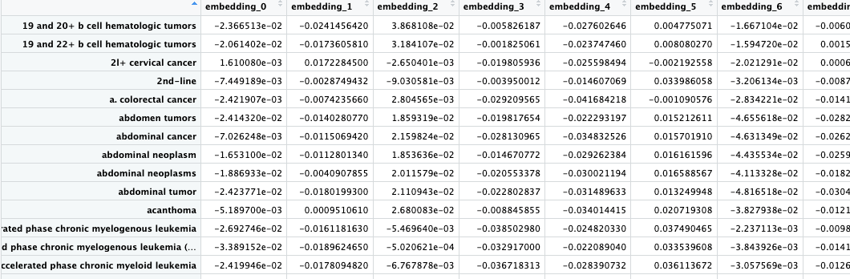
Method 2: Generate embeddings using ADA

Slide 10
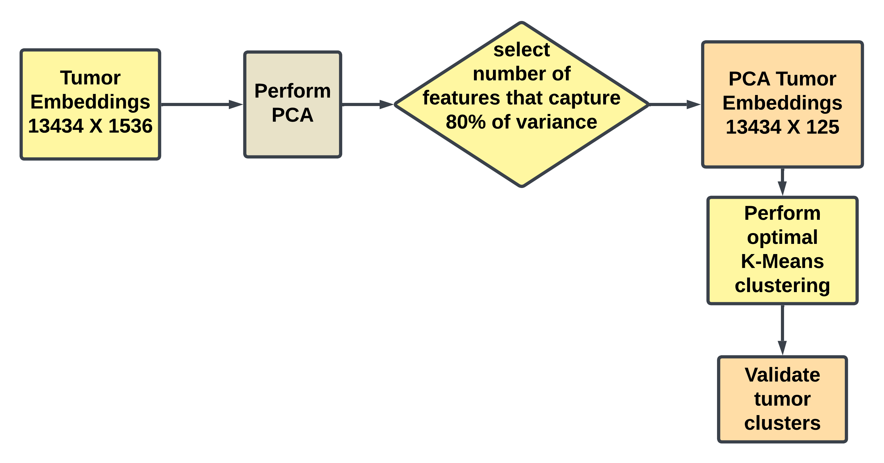
Processing embeddings

Slide 11
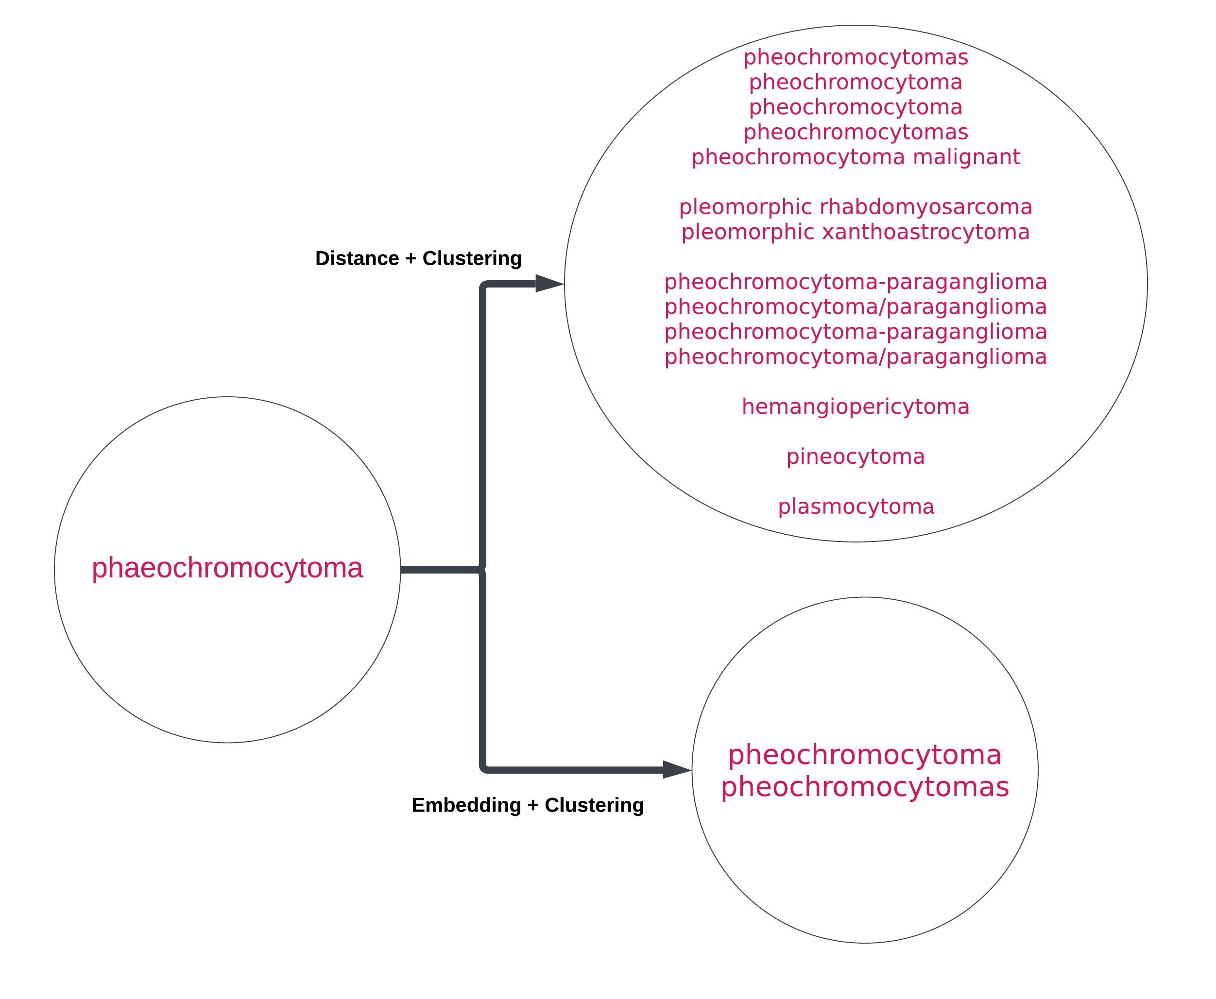
Results

Slide 12
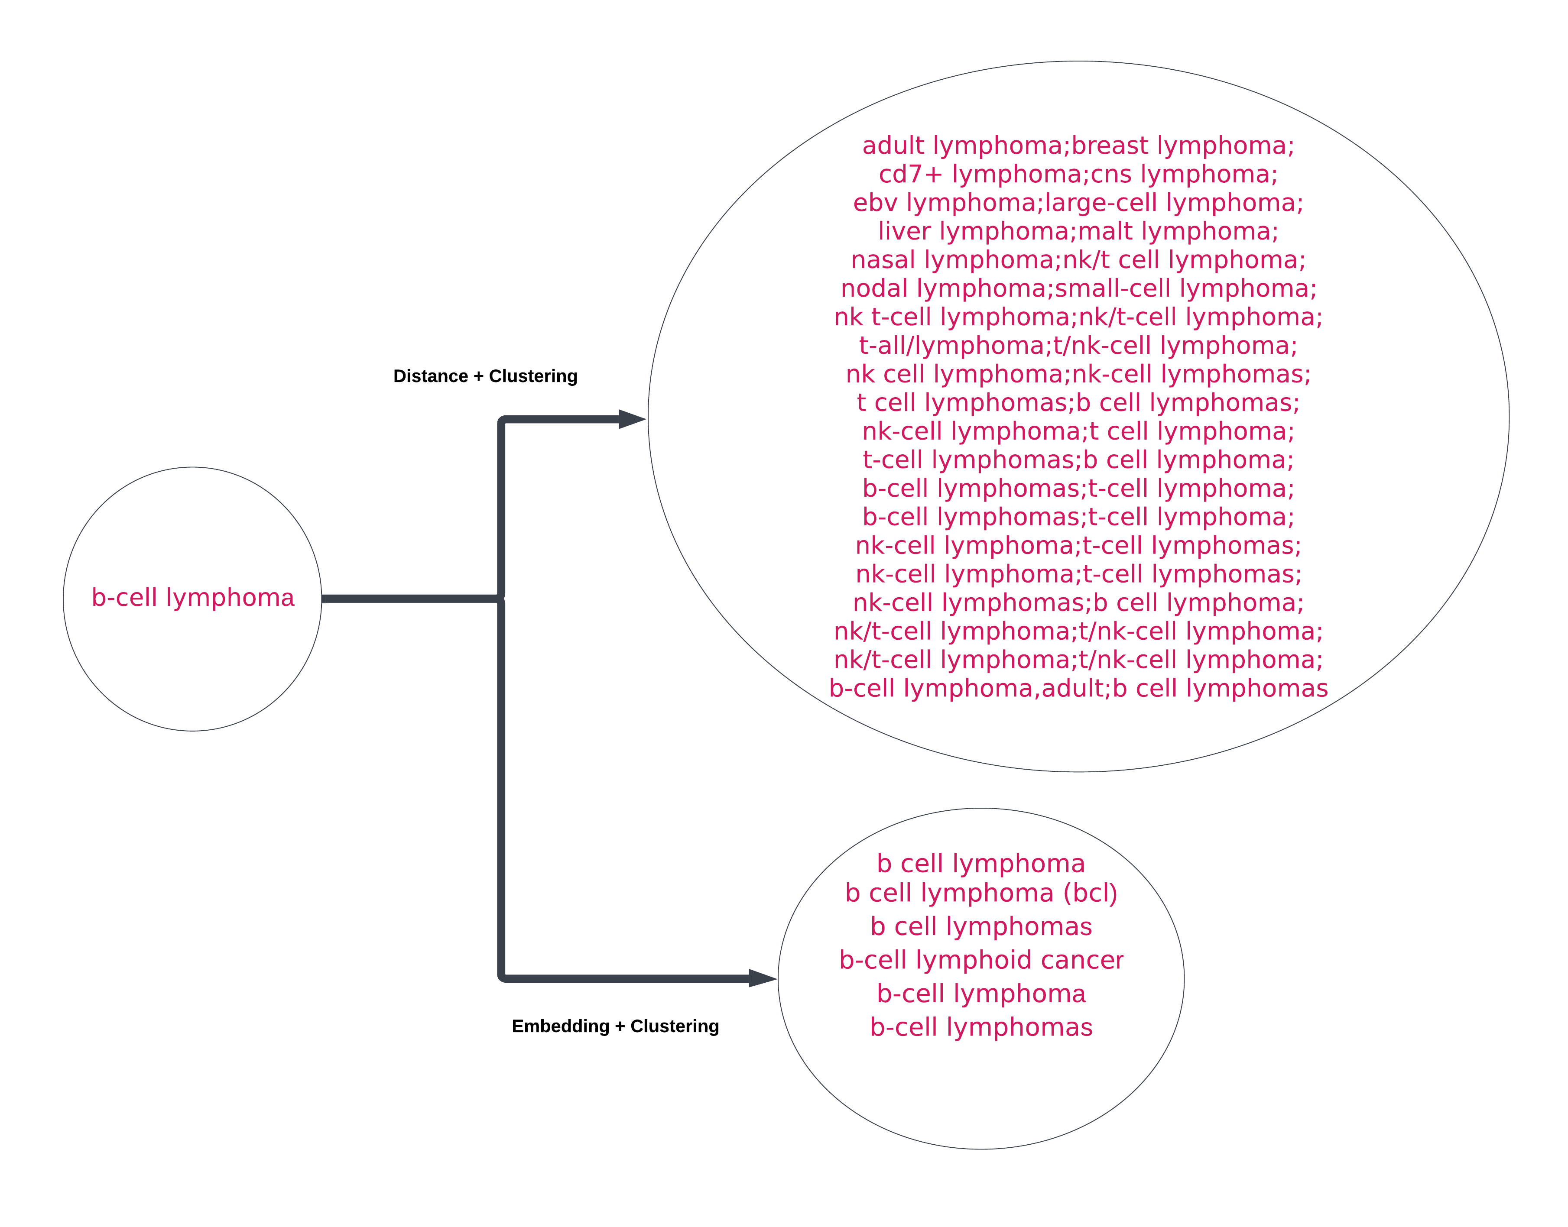
Results

Slide 13
Next Steps
Currently optimal clusters for K-means was tested for a maximum of 5000 clusters, with the optimum being 4800. Test it further for 13434 clusters.
Evaluate DBSCAN and Hierarchical Cluster methods. Need to optimize DBSCAN parameters.
Validate cluster memberships.

Slide 14
References
https://machinelearningmastery.com/what-are-word-embeddings/

