Slide 1
Embedding analysis of CT Tumors
Aditya Lahiri, Deanne Taylor

Slide 2
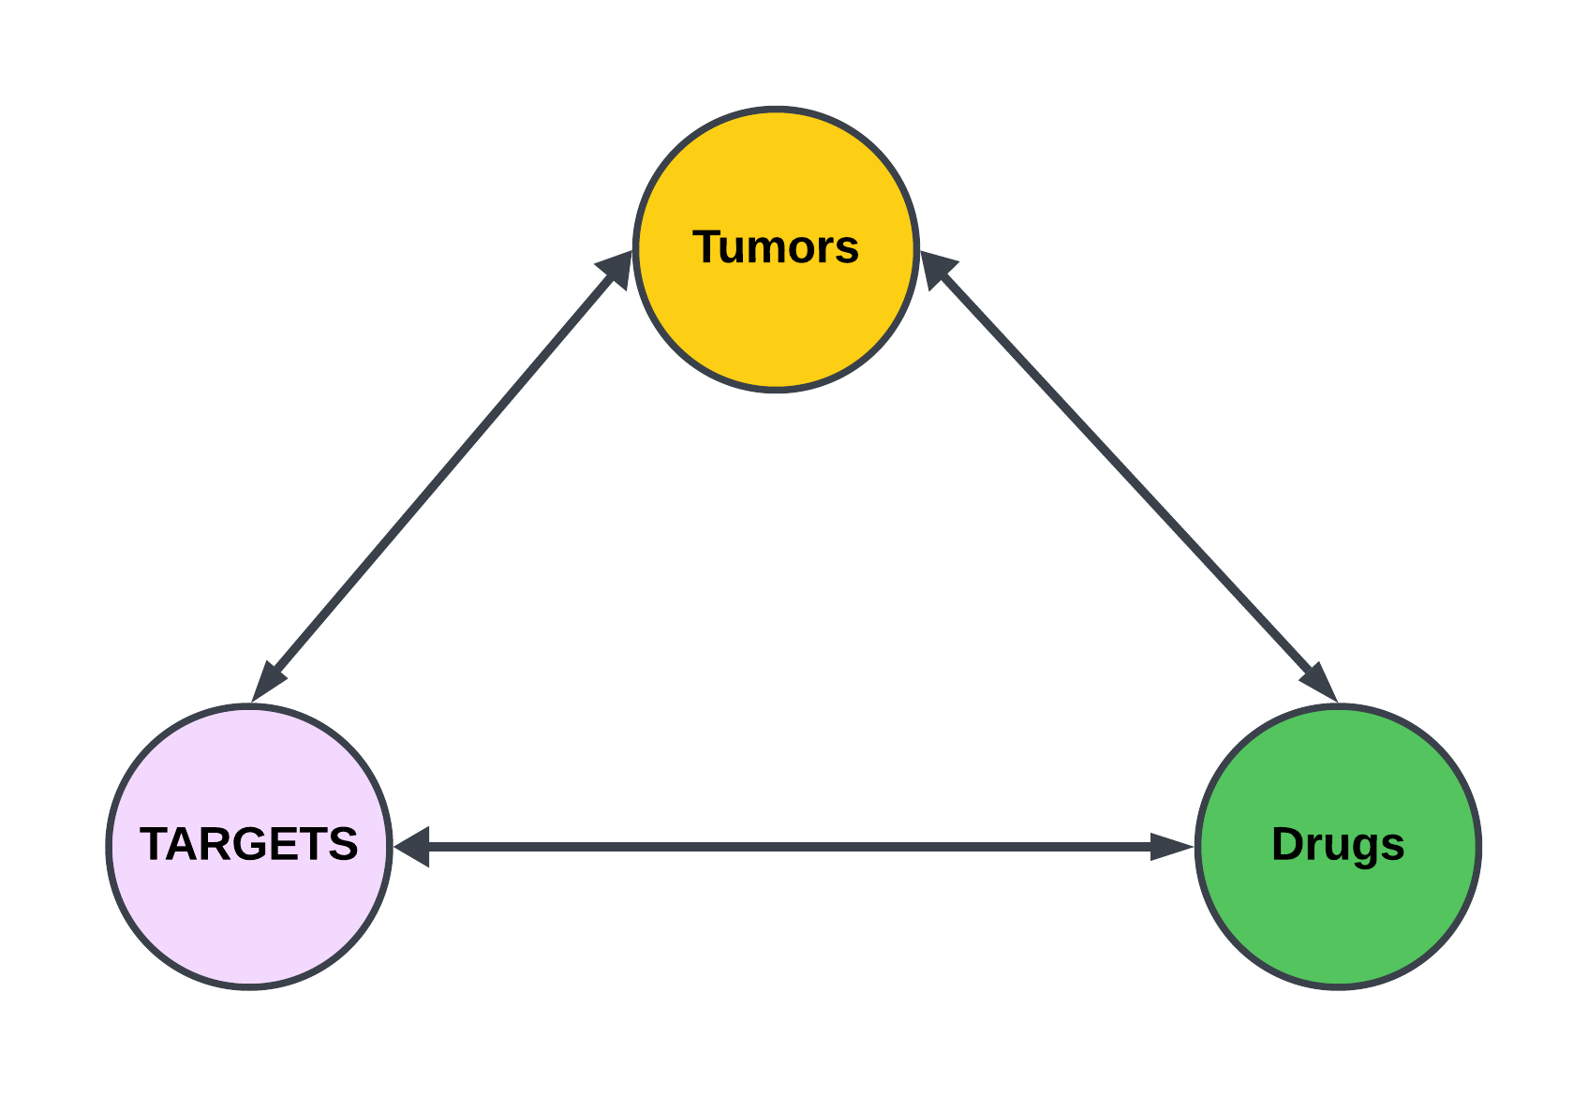
BACKGROUND

Slide 3
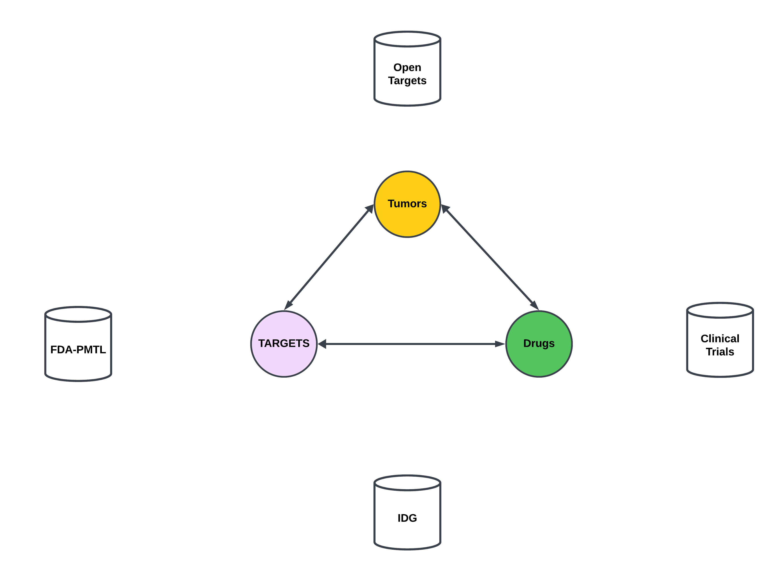
BACKGROUND

Slide 4
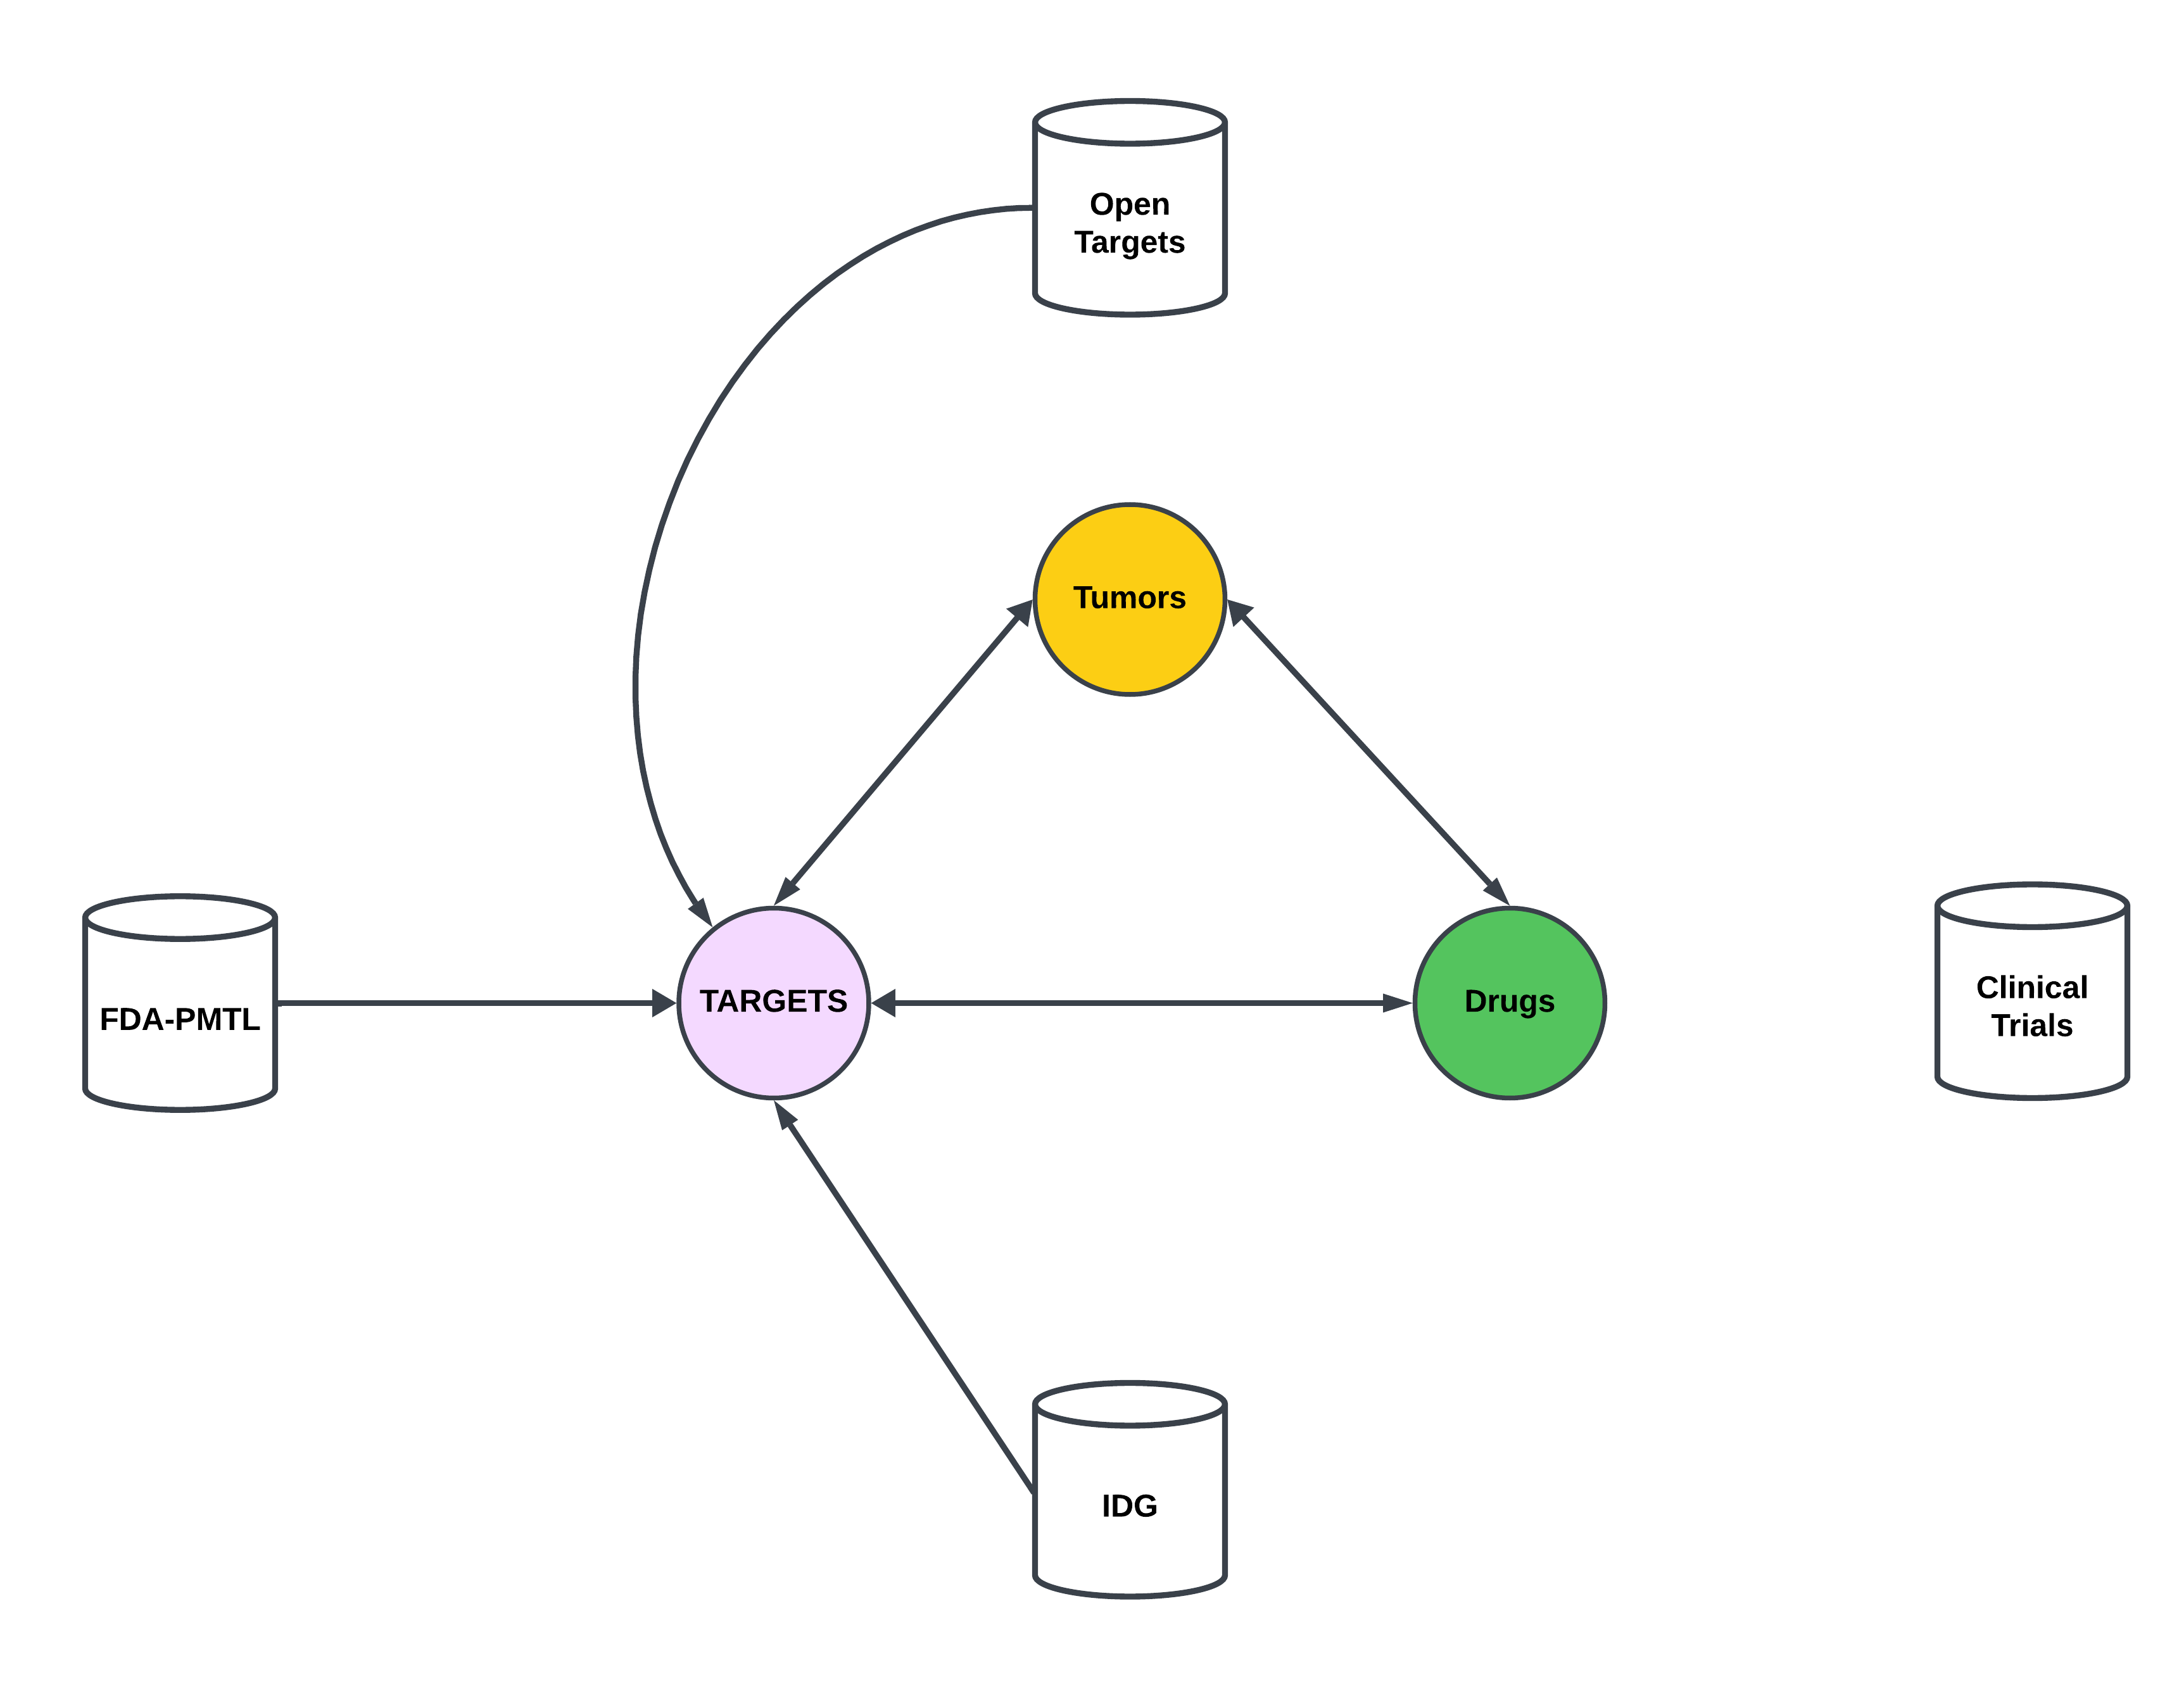
BACKGROUND

Slide 5
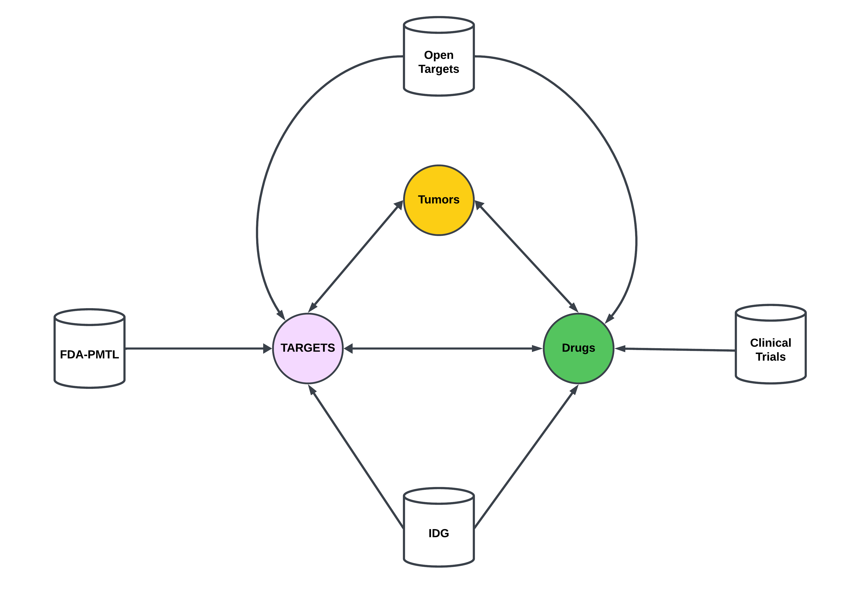
BACKGROUND

Slide 6
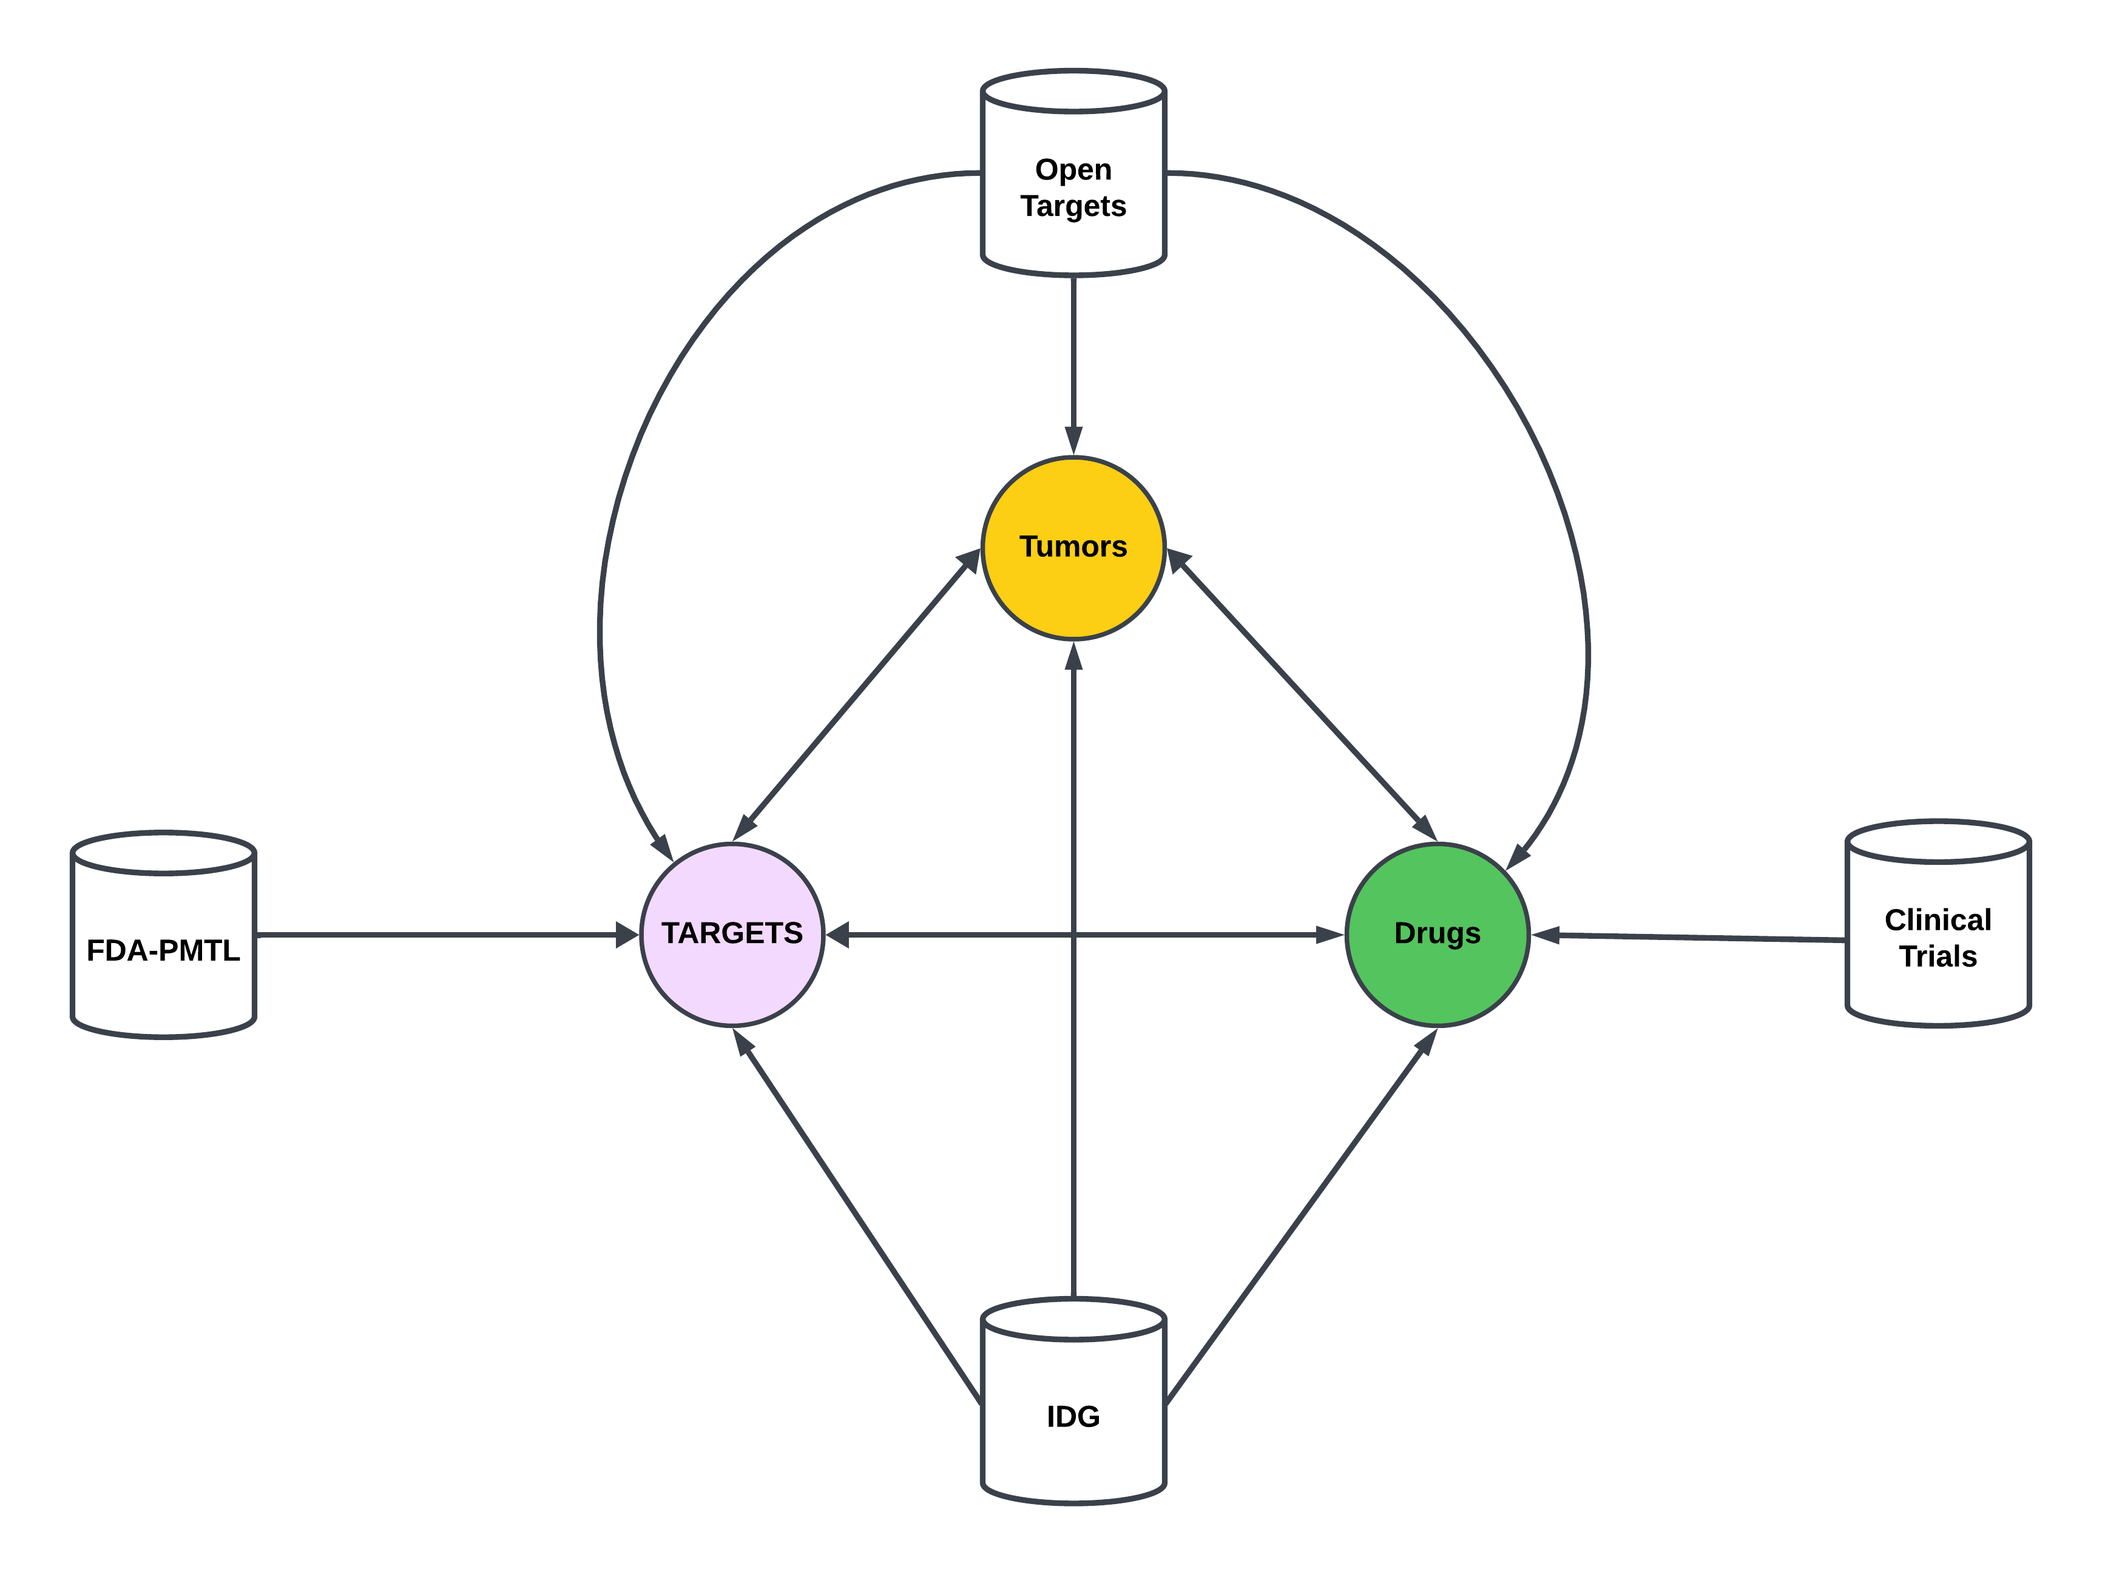
BACKGROUND

Slide 7
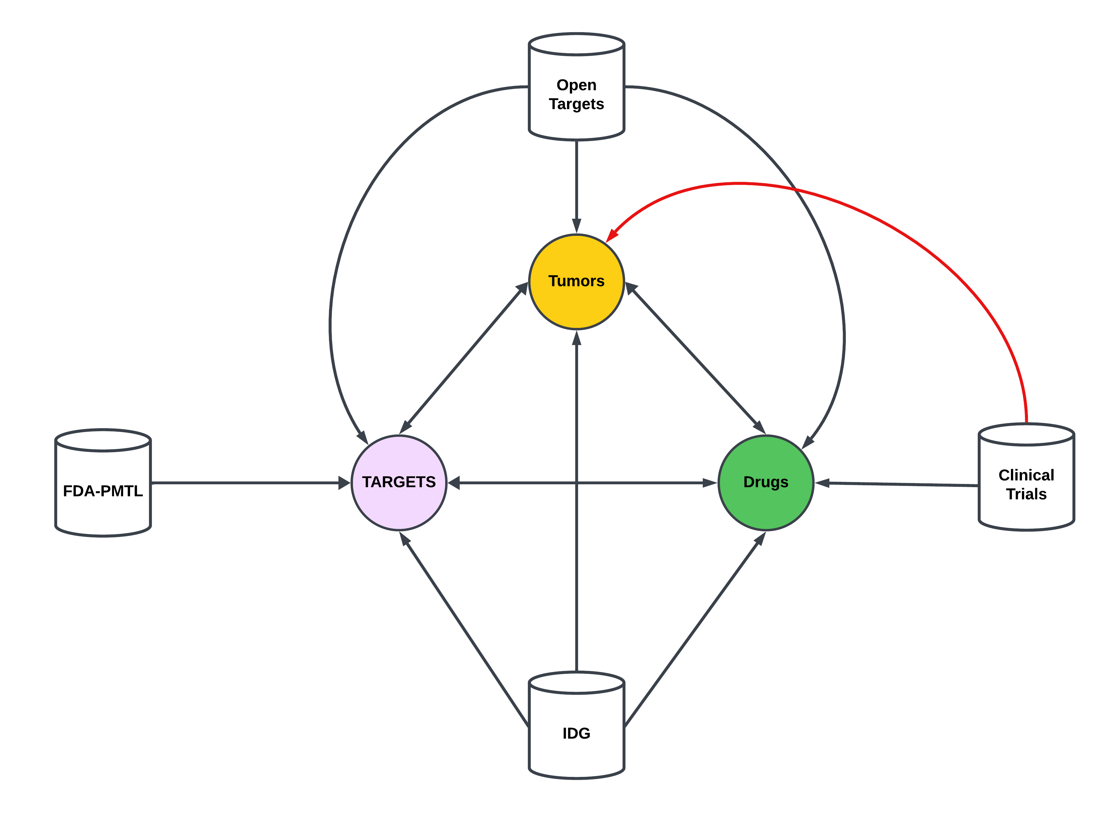
BACKGROUND

Slide 8
Clinical Trials: Conditions to Tumors
Tumors in clinical trials can be obtains from the “conditions” table.
Table is provided in a tab separated text file containing NCT IDs and condition names in down case.
Downloaded data on Aug 22, 2023. Data is updated monthly.
Retrieved 107257 unique conditions.

Slide 9
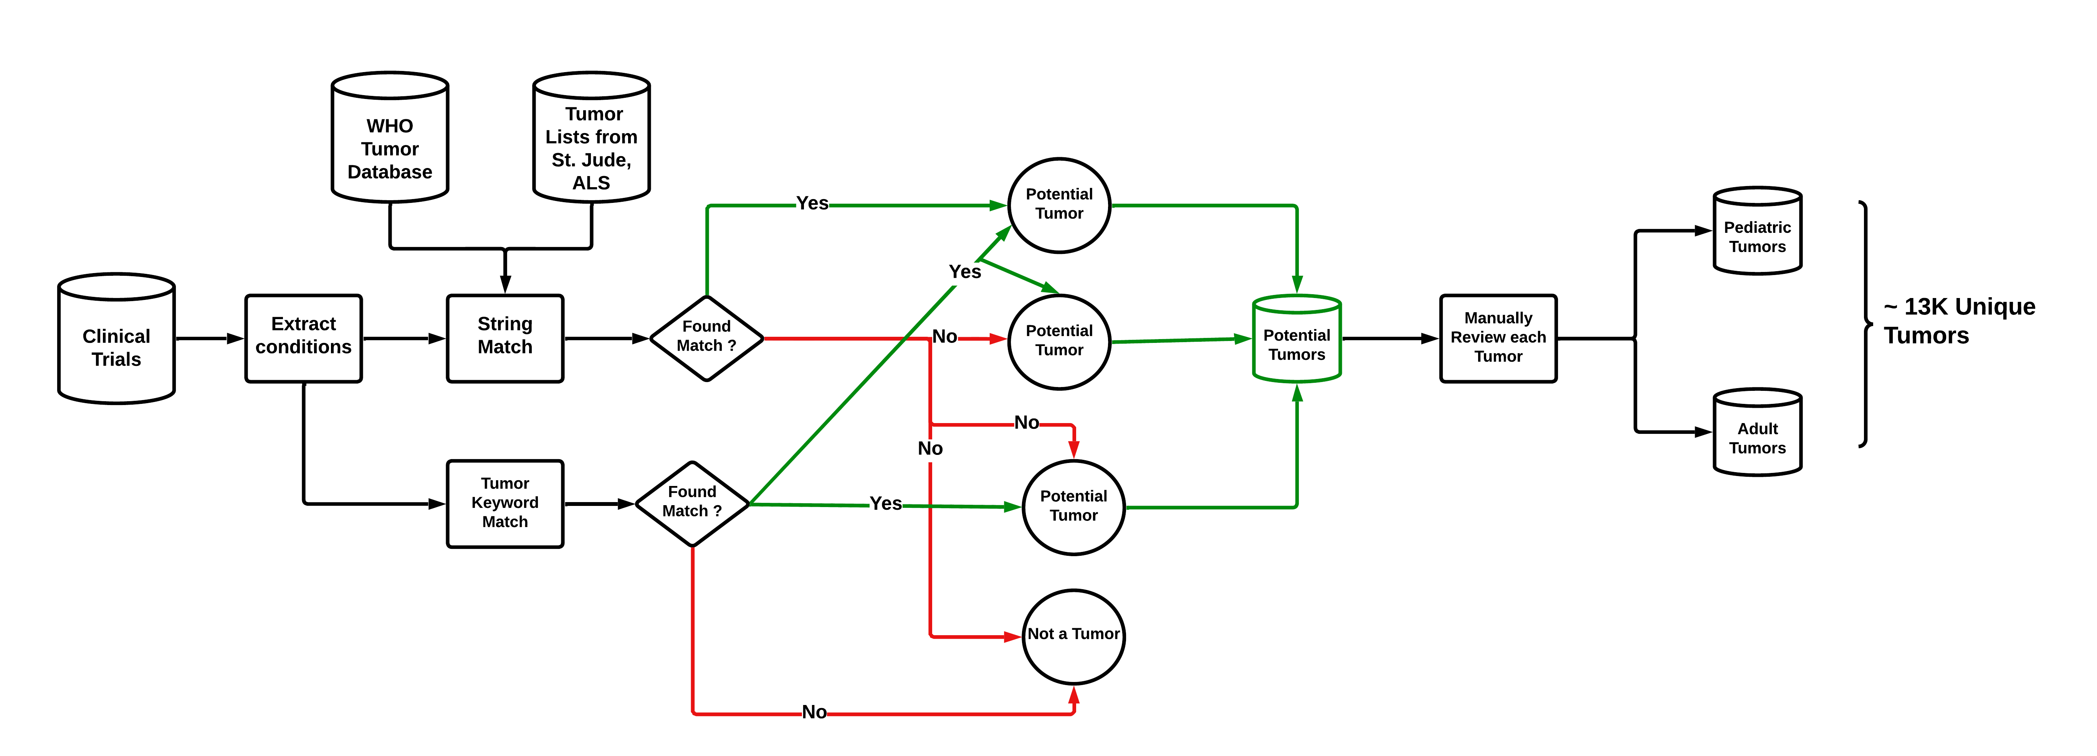
Clinical Trials: Conditions to Tumors

Slide 10
Clinical Trials: unstandardized Tumor Names
Tumors in clinical trials can be obtains from the “conditions” table.

Slide 11
Clinical Trials: Edit Distances
Tumors in clinical trials can be obtains from the “conditions” table.

Slide 12
Clinical Trials: Embeddings with ADA
Tumors in clinical trials can be obtains from the “conditions” table.

