Slide 1
A comprehensive pipeline for the Analysis of drug , target and Tumor databases
Aditya Lahiri and Deanne Taylor

Slide 2
Background
FDA Pediatric Molecular Target List (FDA-PMTL) was created, containing over 400 pediatric cancer gene targets of interest.
Limited resources outline drugs tested in clinical trials for cancer for the PMTL genes.
Lack of publicly available comprehensive resources linking these drugs to the standardized tumor list curated by the World Health Organization (WHO).
Need to systematically integrate and analyze publicly available data to identify targets associated with drugs tested in pediatric cancers, especially drugs used in registered clinical trials.

Slide 3
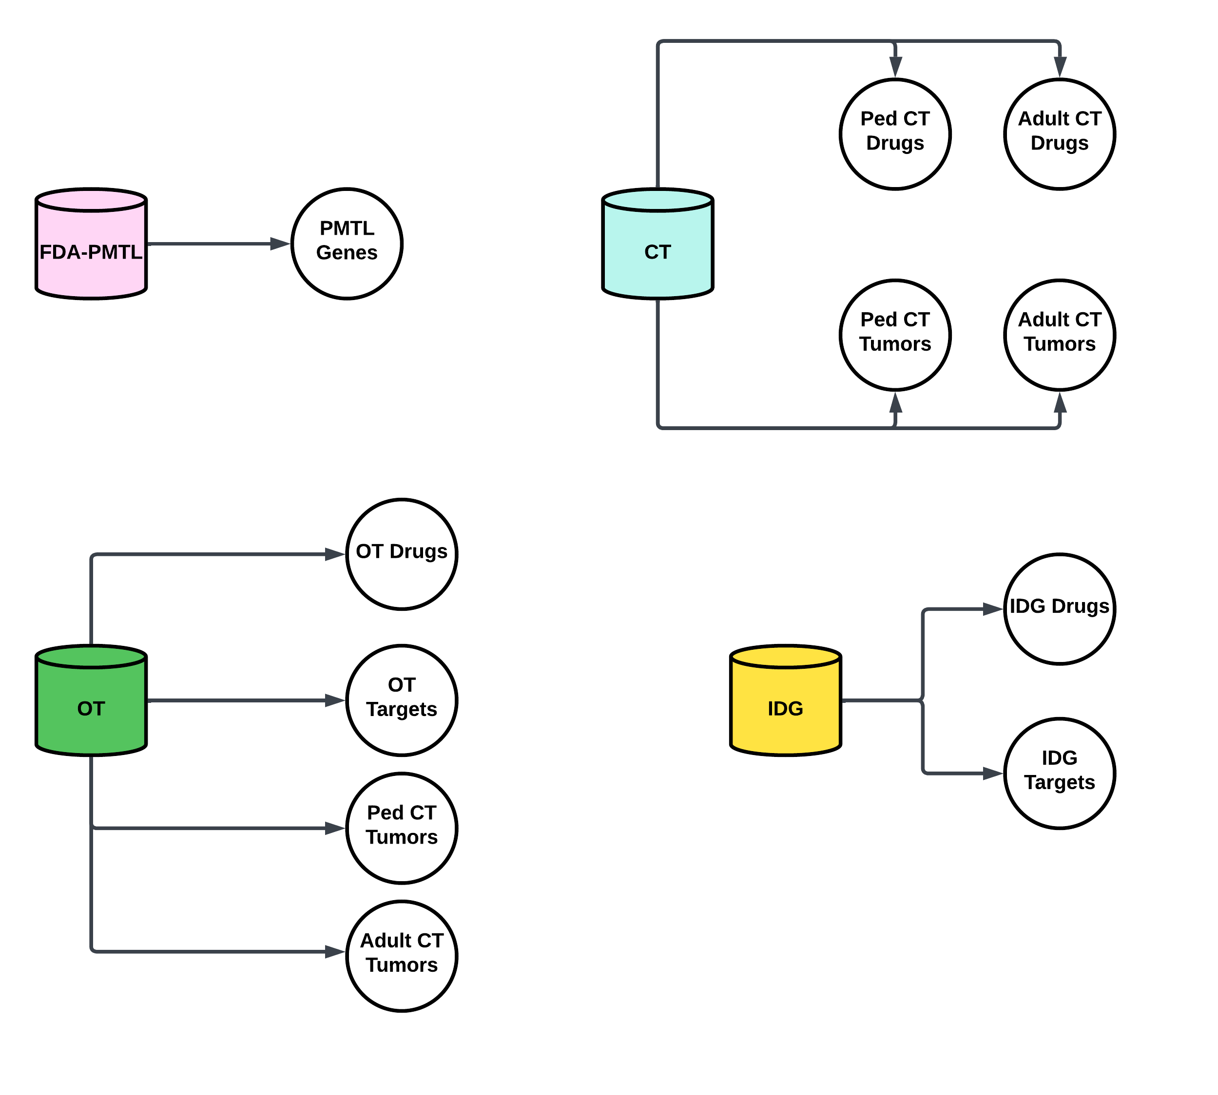
Primary Databases

