Slide 1
A comprehensive pipeline for the Analysis of drug , target and Tumor databases
Aditya Lahiri and Deanne Taylor

Slide 2
Background
There are multiple publicly available databases that outline drug-target , drug-disease, and disease-target relationships.
However, there is a lack is a lack of publicly available resources that highlight these relationships for cancers , especially pediatric cancer.
Such a resource can help us understand the drug and target landscape for a particular cancer.
Furthermore, there are limited publicly available resources which elucidate these relationships for drug and disease (specifically cancers) registered in clinical trials database.
In particular, there is a need to identify these relationships for the FDA Pediatric Molecular Target List (FDA-PMTL) , which contains over 400 pediatric cancer gene targets of interest.
We propose to build a pipeline that ingests data from major public databases to highlight the relationship among drug, cancer, and drug targets.

Slide 3
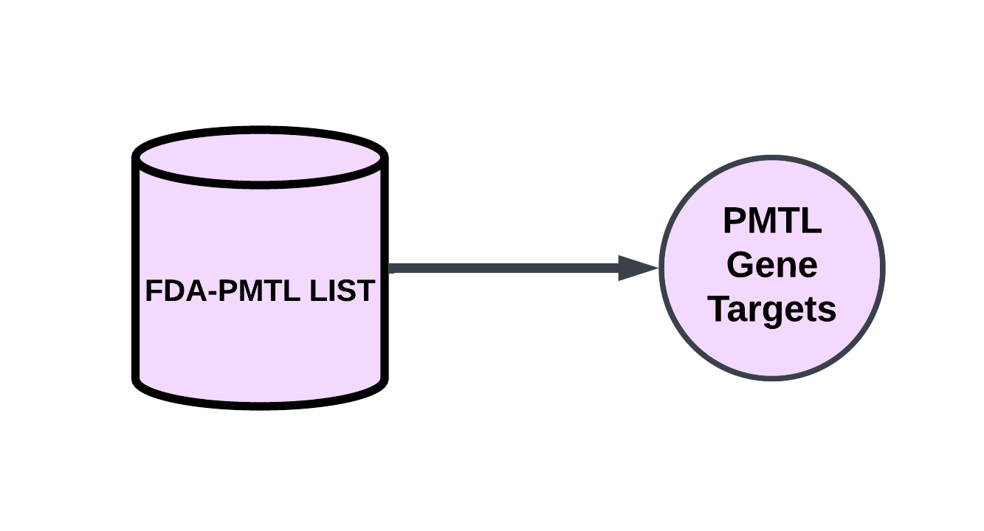
Primary Databases : FDA PMTL
Database | Relationships Available
FDA PMTL | PMTL Genes (Targets)

Slide 4
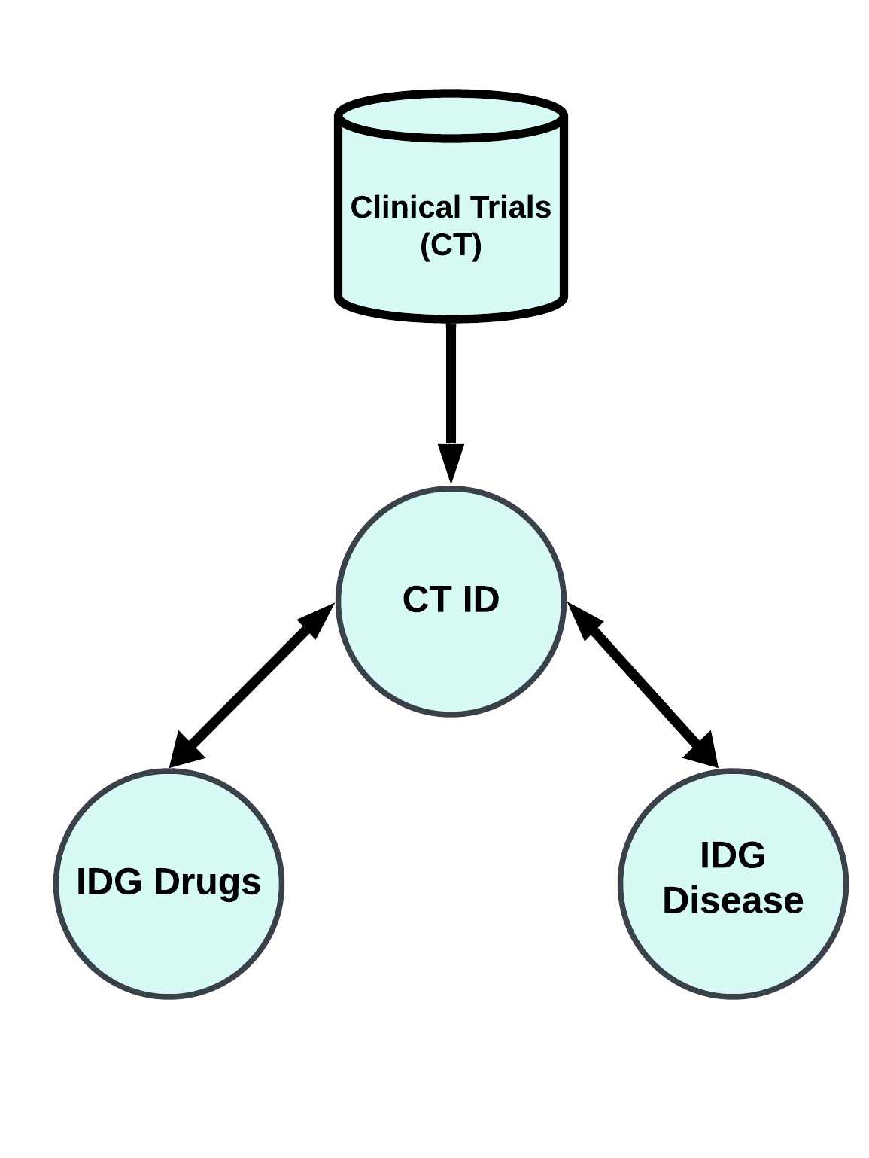
Primary Databases : Clinical Trials
Database | Relationships Available
Clinical Trials (CT) | Drugs associated with a clinical trial ID Diseases associated with a clinical trial ID

Slide 5
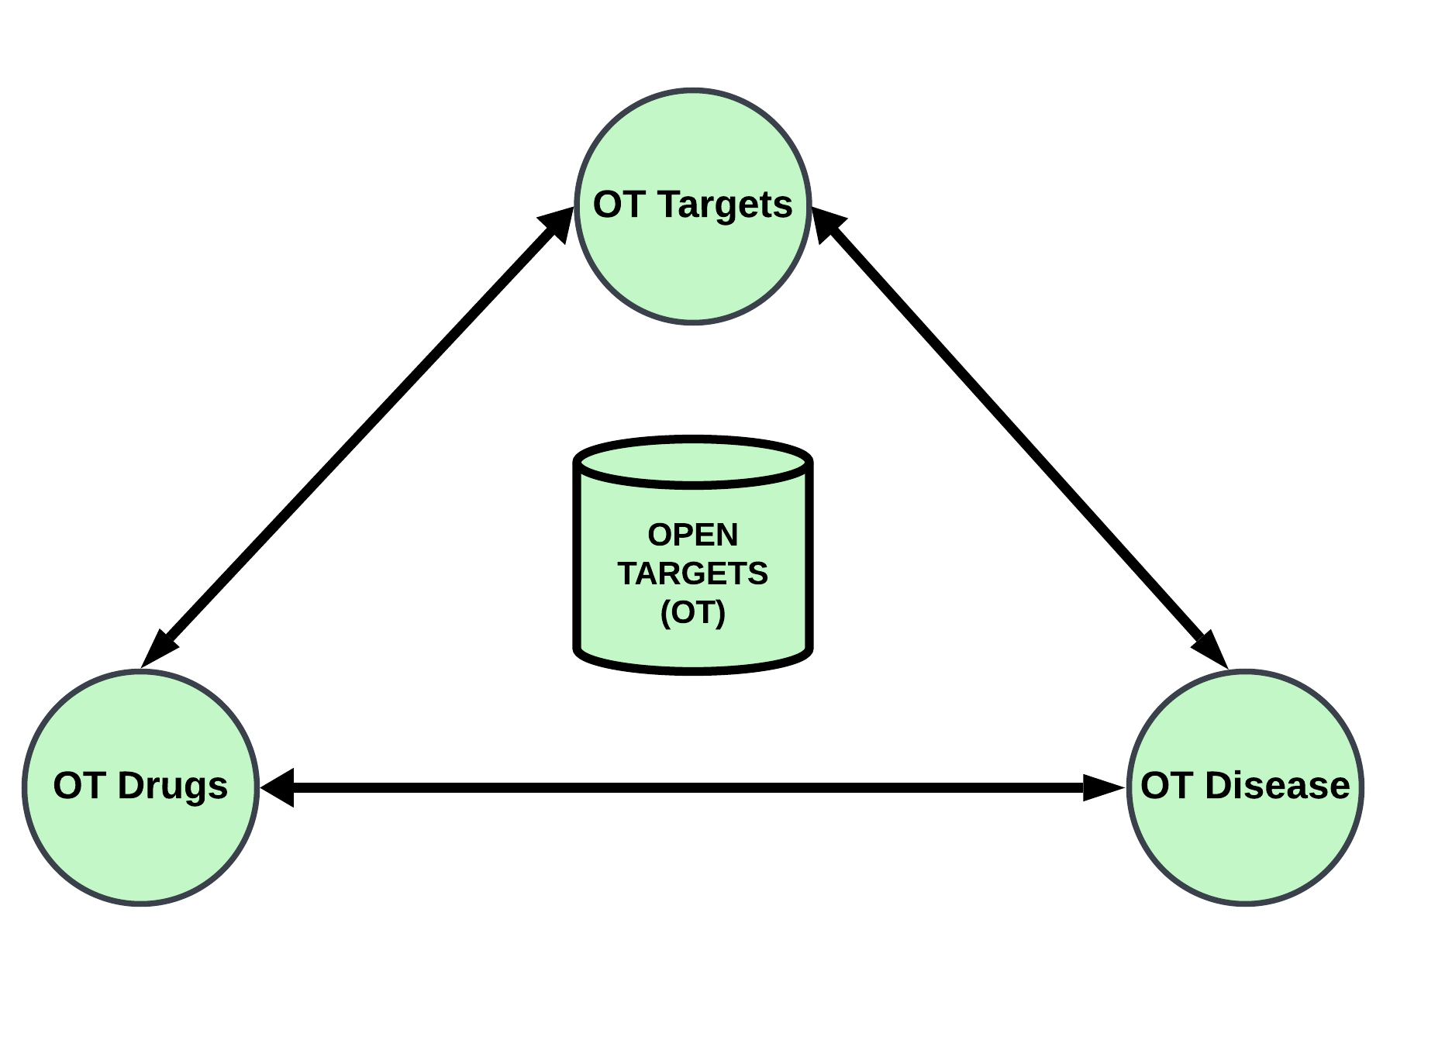
Primary Databases : Open Targets
Database | Relationships Available
Open Targets (OT) | Drug – Target relationship Drug – Disease relationship Disease – Target relationship

Slide 6
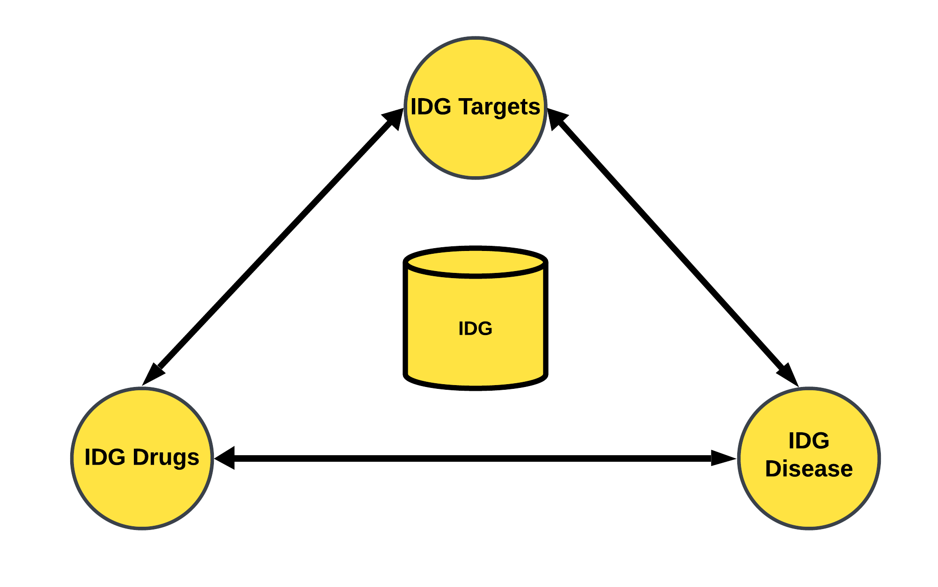
Primary Databases : Illuminating the Druggable Genome
Database | Relationships Available
Illuminating the Druggable Genome (IDG) | Drug – Target relationship Drug – Disease relationship Disease – Target relationship

Slide 7
ALL Primary Databases
Database | Relationships Available
FDA PMTL | PMTL Genes (Targets)
Clinical Trials (CT) | Drugs associated with a clinical trial ID Diseases associated with a clinical trial ID
Open Targets (OT) | Drug – Target relationship Drug – Disease relationship Disease – Target relationship
Illuminating the Druggable Genome (IDG) | Drug – Target relationship Drug – Disease relationship Disease – Target relationship

Slide 8
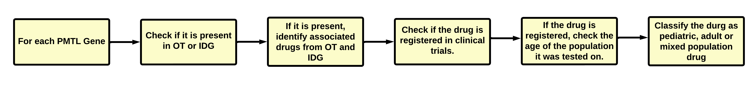
Pipeline summary: PMTL – Drug

Slide 9
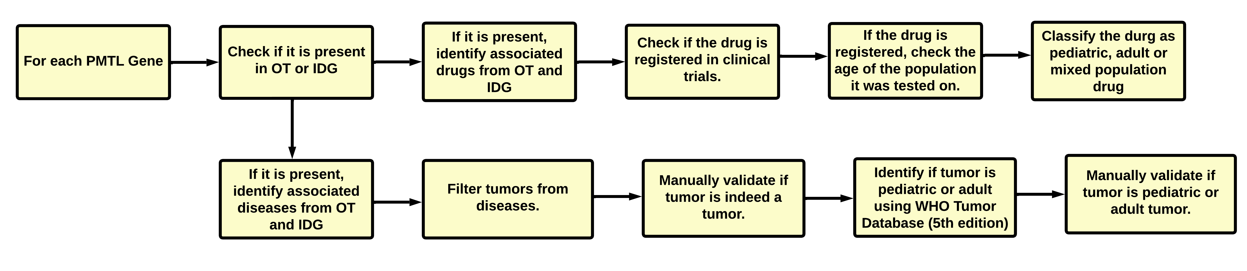
Pipeline summary: PMTL – Drug + PMTL -Tumor

Slide 10
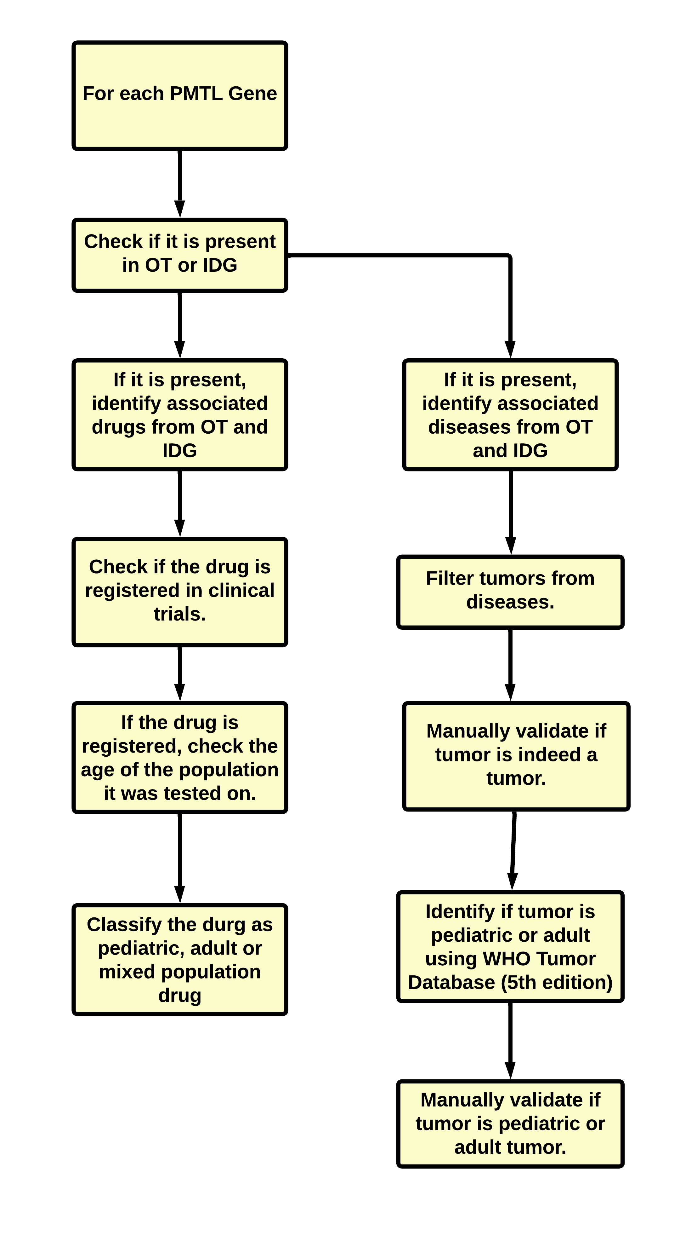
Pipeline summary: PMTLS

