Slide 1
Embedding analysis of CT Tumors
Aditya Lahiri, Deanne Taylor

Slide 2
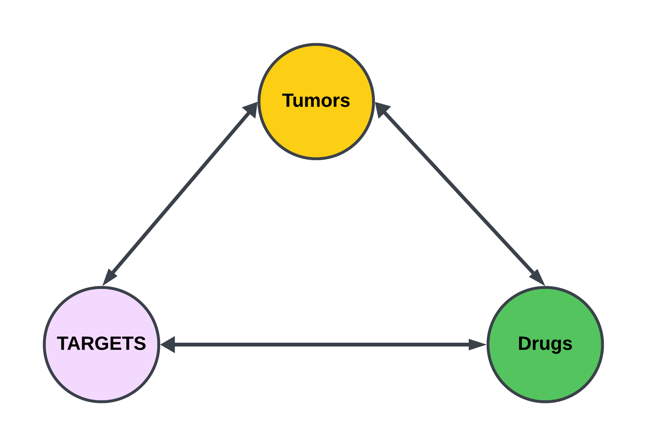
BACKGROUND

Slide 3
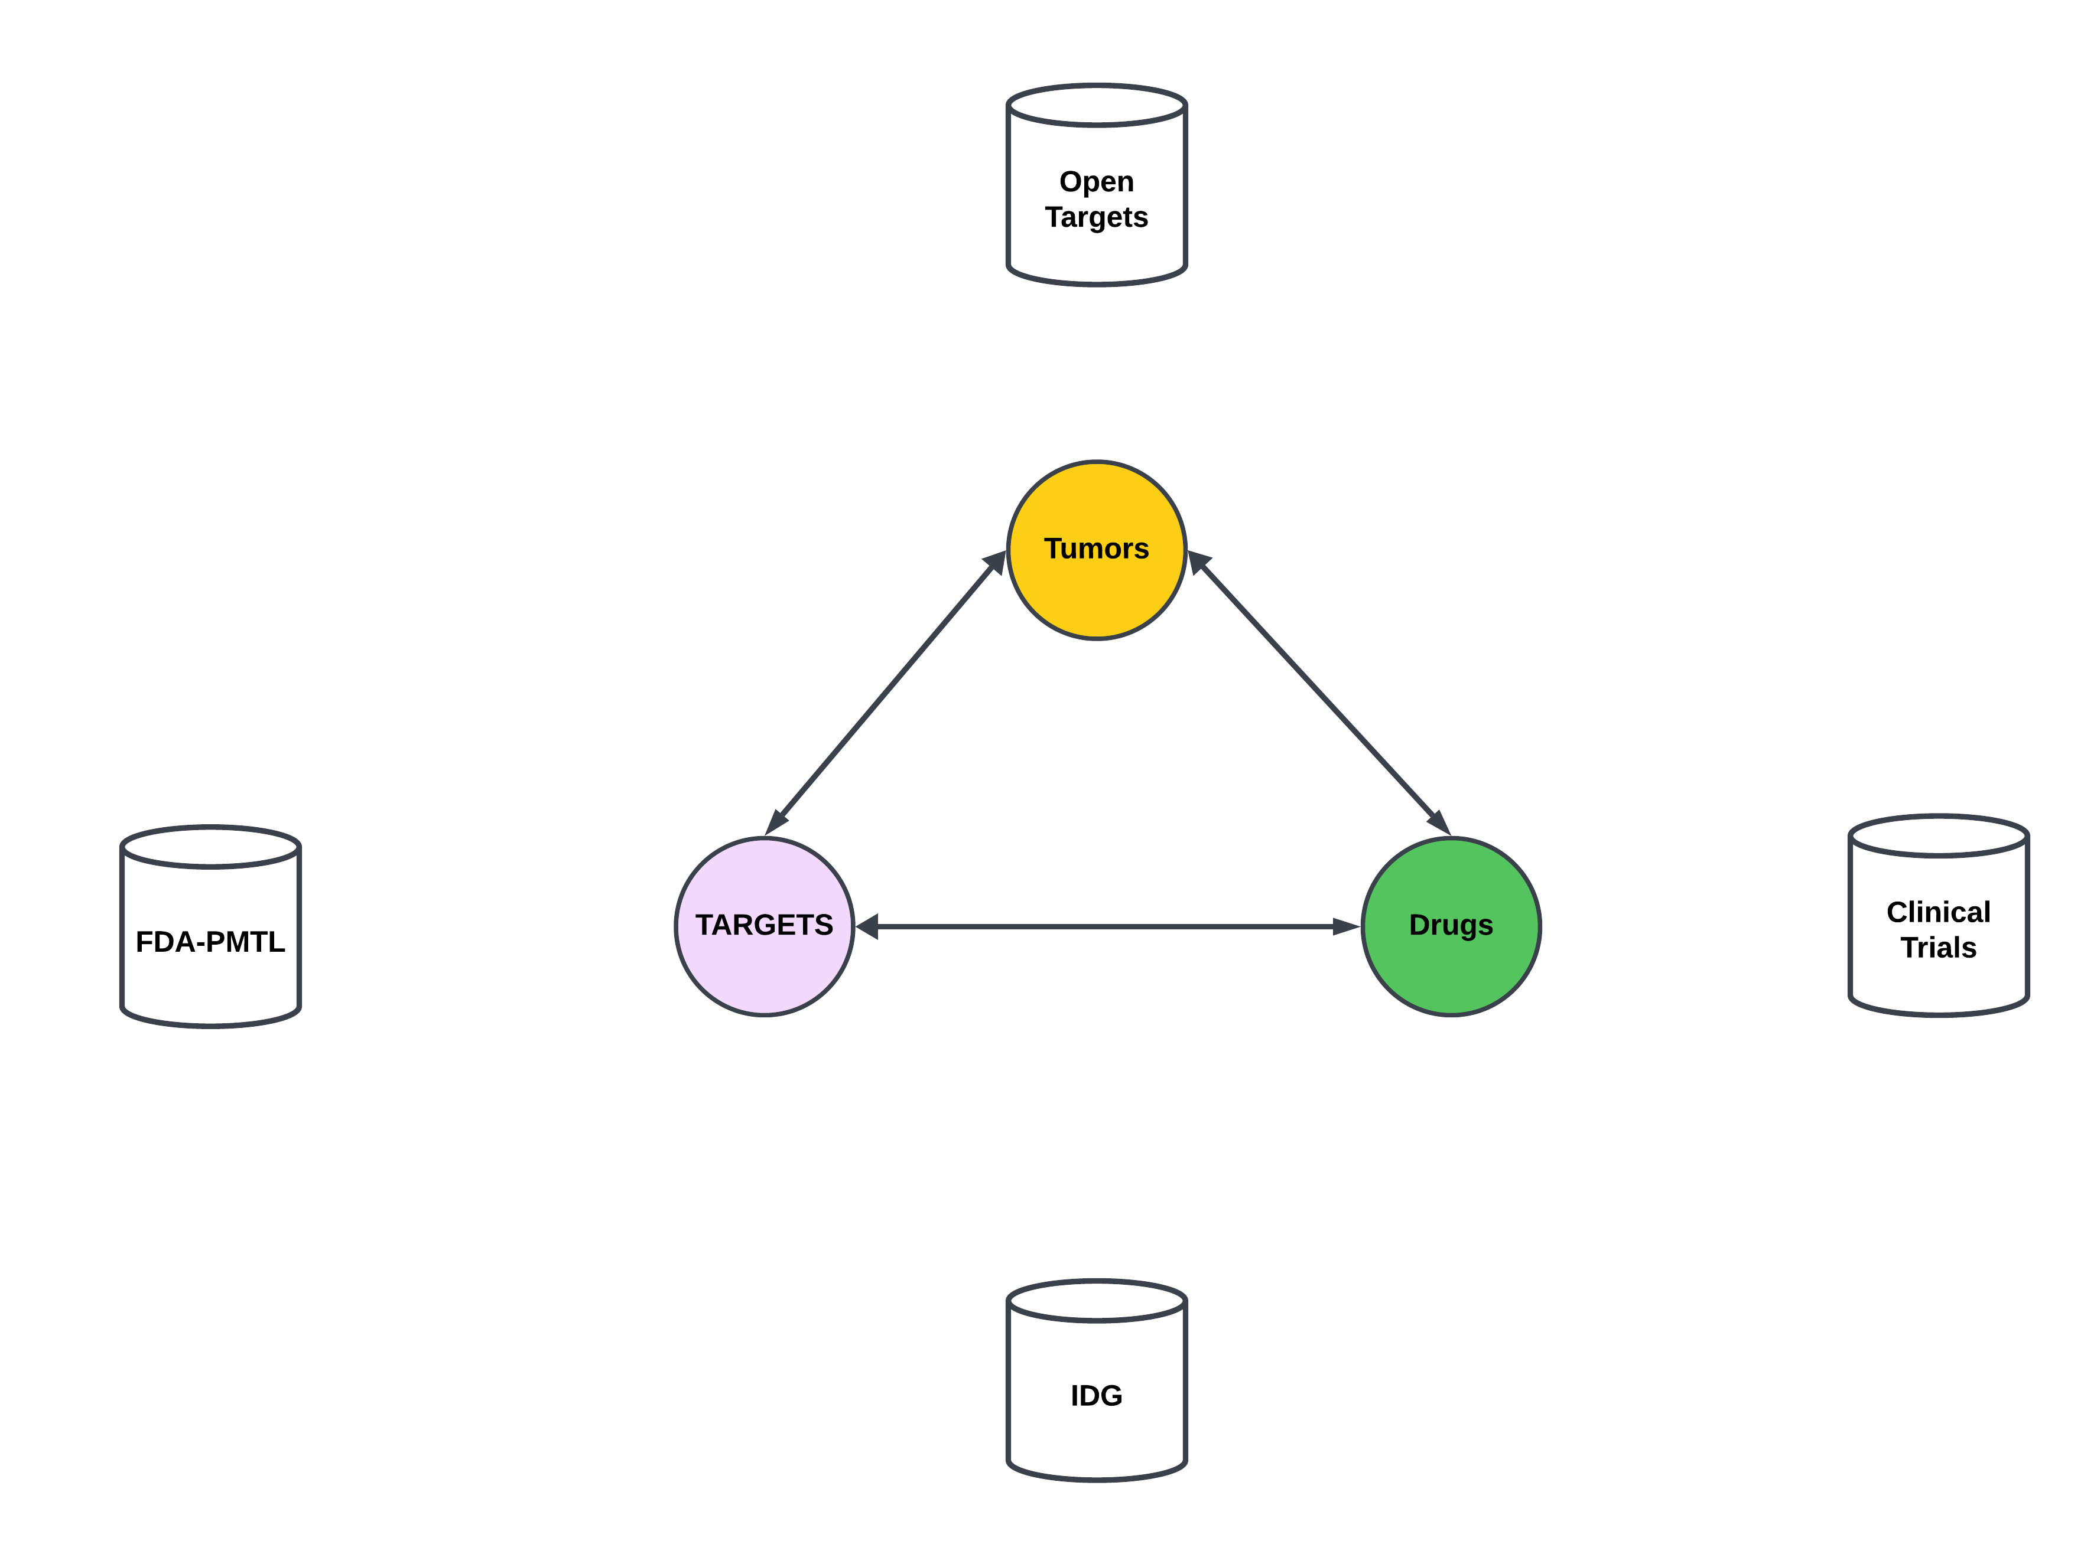
BACKGROUND

Slide 4
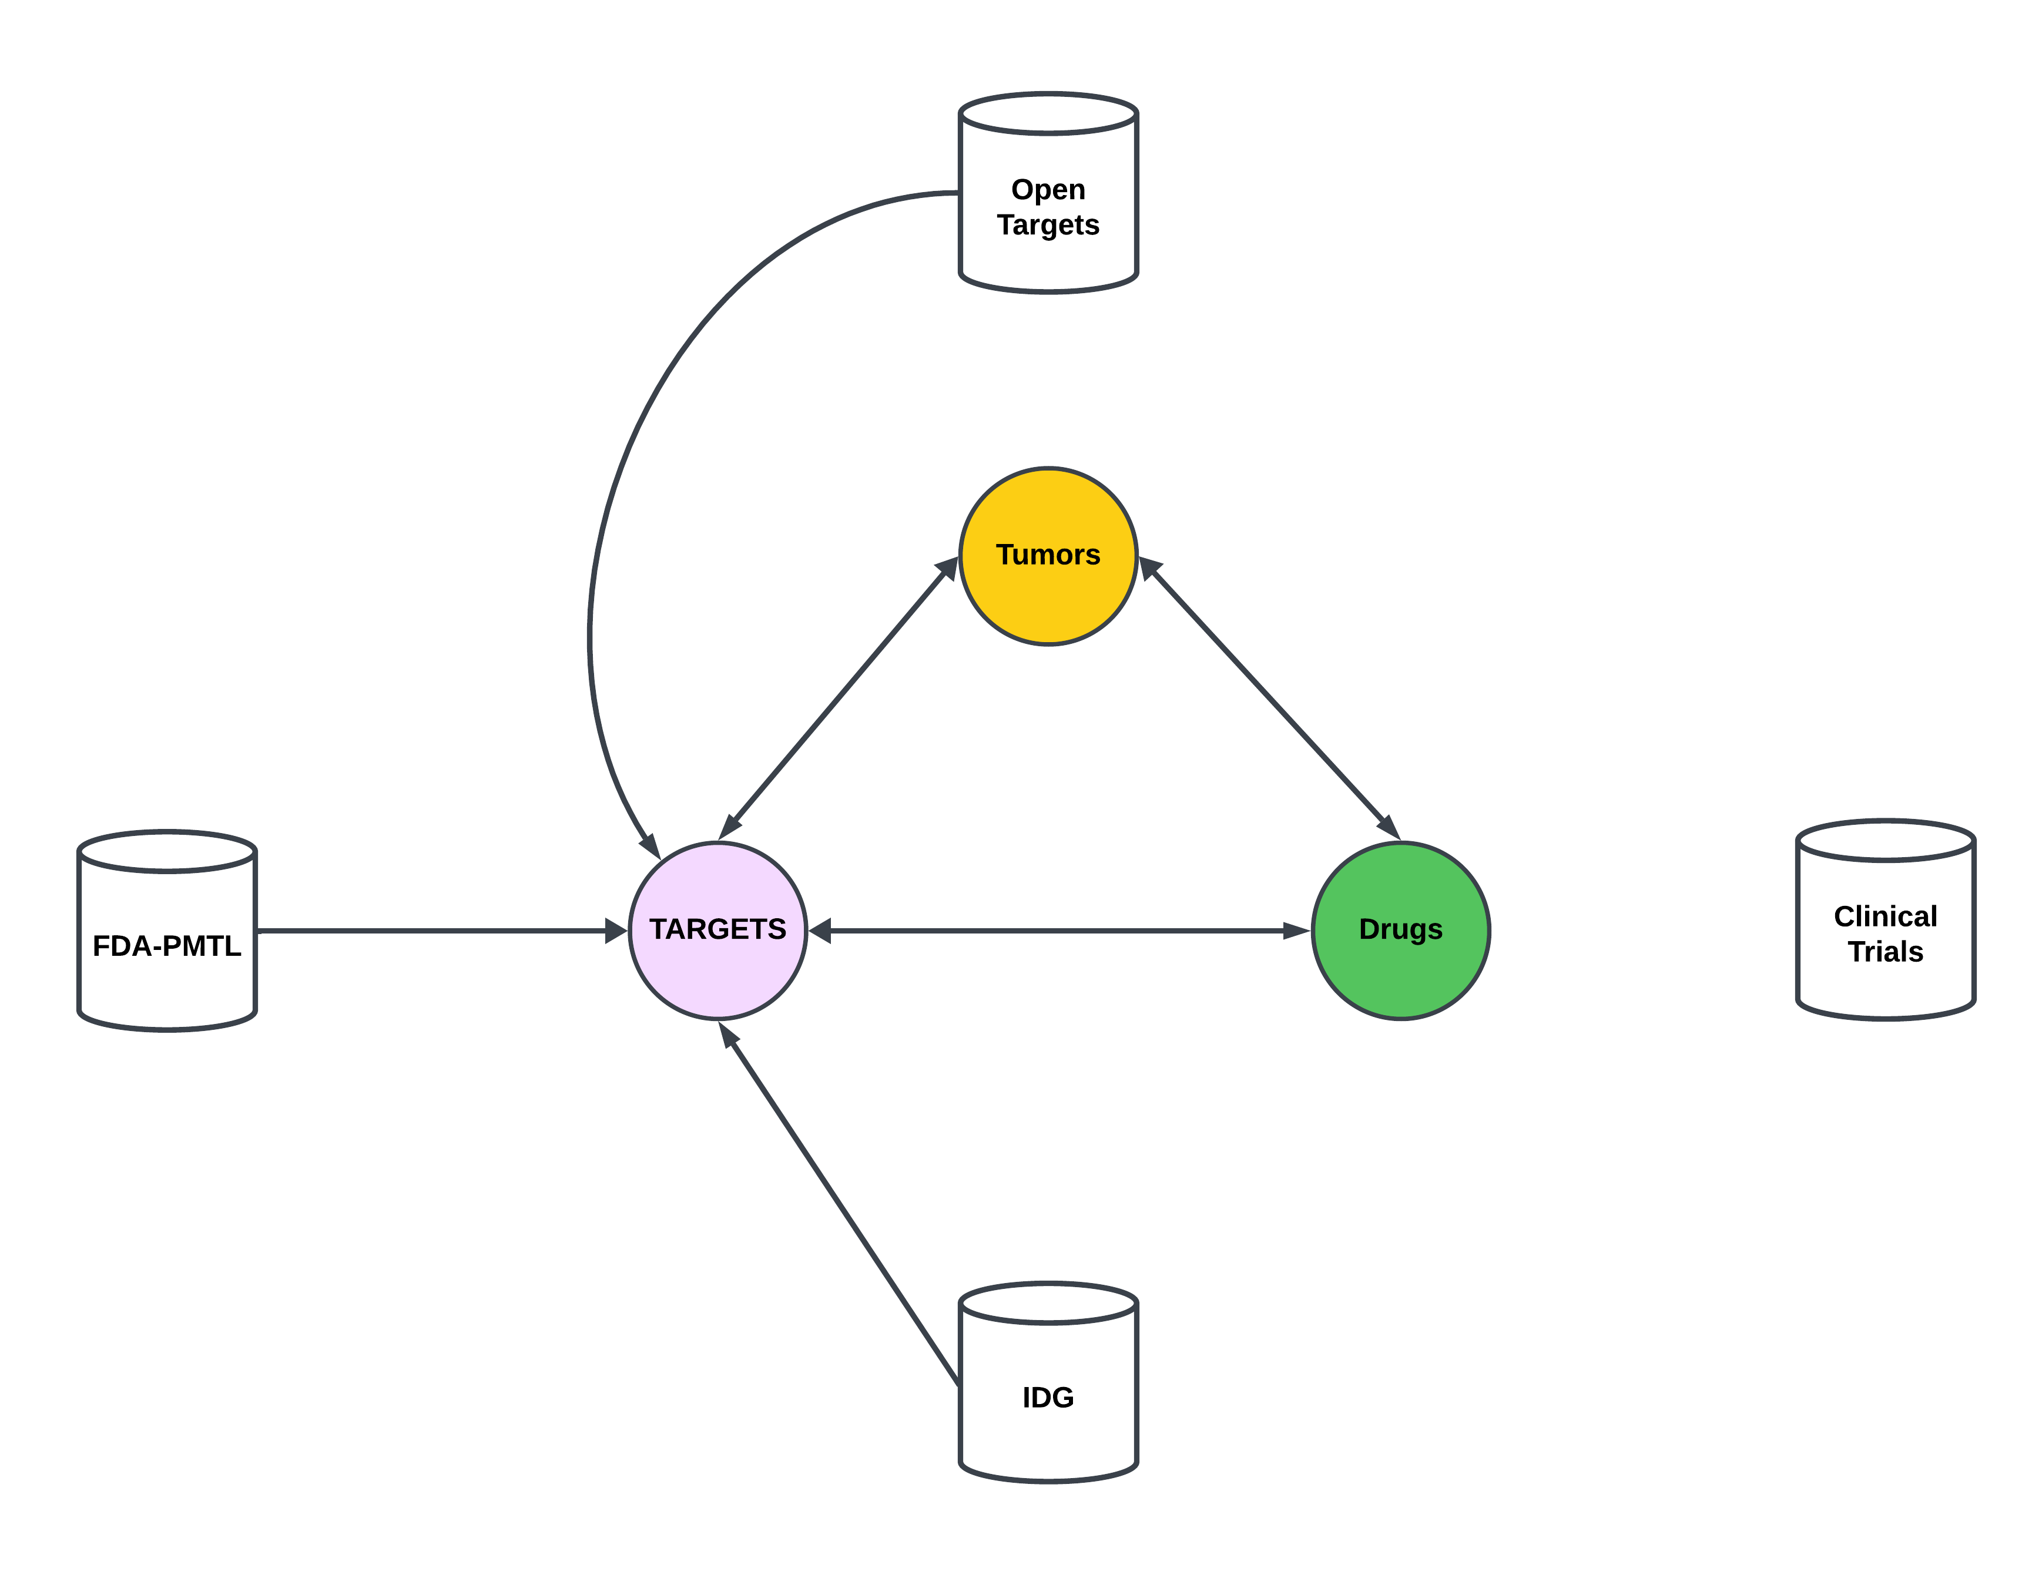
BACKGROUND

Slide 5
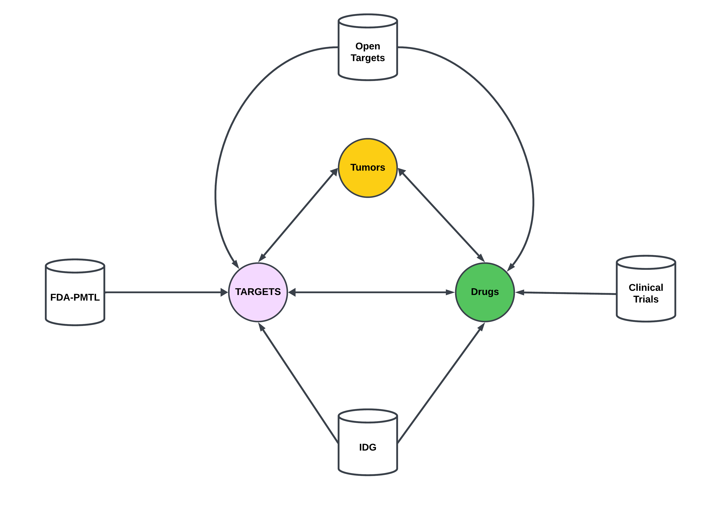
BACKGROUND

Slide 6
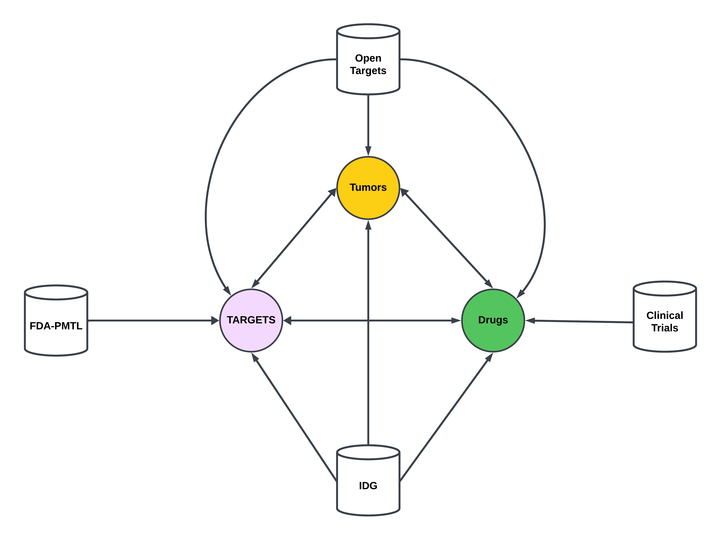
BACKGROUND

Slide 7
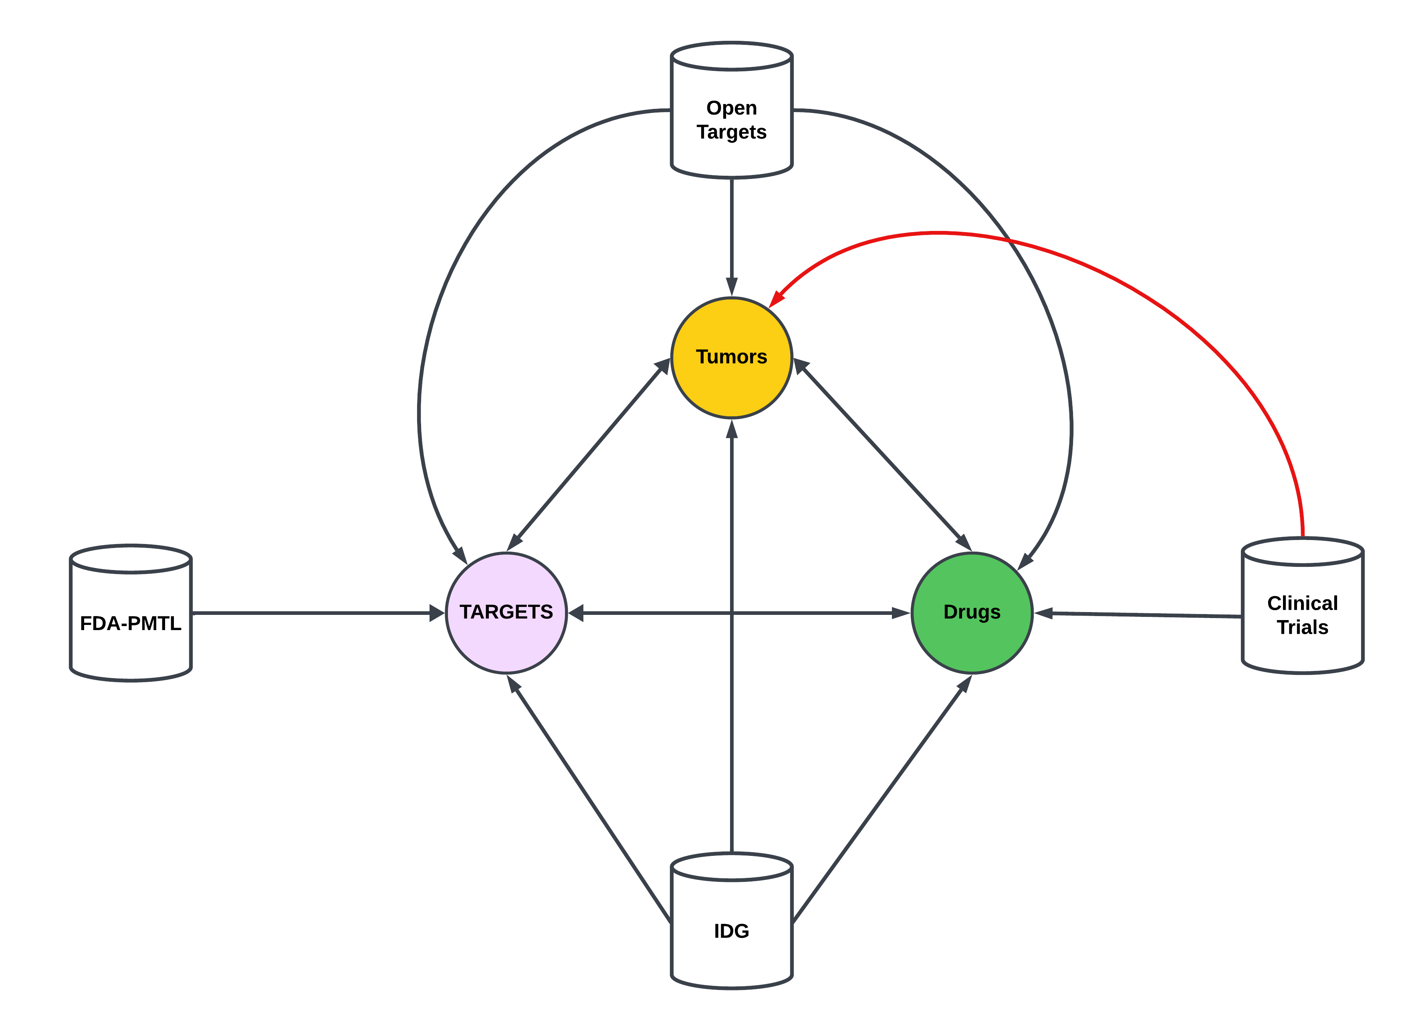
BACKGROUND

Slide 8
Clinical Trials: Conditions to Tumors
Tumors in clinical trials can be obtains from the “conditions” table.
Table is provided in a tab separated text file containing NCT IDs and condition names in down case.
Downloaded data on Aug 22, 2023. Data is updated monthly.
Retrieved 107257 unique conditions.

Slide 9
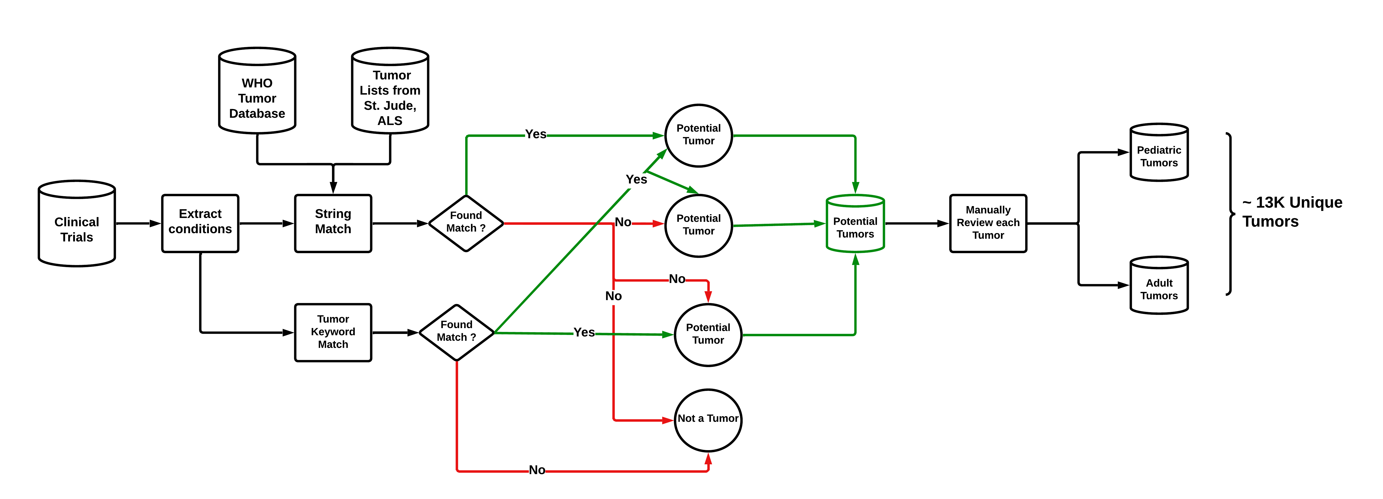
Clinical Trials: Conditions to Tumors

Slide 10
Clinical Trials: unstandardized Tumor Names
ID | NCT ID | Condition | Issues
54148559 | NCT05806385 | triple negative breast cancer | None
54158880 | NCT04529772 | diffuse large b-cell lymphoma | None
4159811 | NCT03449069 | crohn disease | None
54174814 | NCT04317313 | lymphoma, large b-cell, diffuse | Comma
54159226 | NCT04139304 | ann arbor stage II diffuse large b-cell lymphoma | Staging Info provided
54160394 | NCT01365169 | stage iv colorectal cancer ajcc v7 | Staging Info provided and abbreviation added
54167219 | NCT00005799 | waldenstr√∂m macroglobulinemia | Square root typographical error
53807459 | NCT05667415 | chemotherapyÔºõadvanced gastric cancerÔºõcisplatin | Special character typographical error ,
53785094 | NCT01127841 | follicular non-hodgking¬¥s lymphoma refractory or relapsed after treatment with r-chemotherapy in first line | Special character typographical error , treatment name and details
53878247 | NCT02172768 | acute myeloid leucaemia | Name of disease spelled unconventionally.
54168238 | NCT05587556 | liver transplant, liver cancer, immunosuppressant | Disease name with other procedure and medicine
53573690 | NCT03452657 | ranibizumab | Name of drug instead of disease
53574738 | NCT04669496 | lenvatinib | Name of drug instead of disease
53756631 | NCT01227746 | asian patients with advanced gastro-intestinal stromal tumors (gist) treated with imatinib | Demographics of patient cohoty, and medicine name provided.

Slide 11
Clinical Trials: Standardizing Tumor Names
Retrieved ~ 13k unique tumors form clinical trials database.
WHO tumor database (5th edition) contains 2390 standardized unique tumors.
NCIT tumor database contains 1395 standardized unique tumors.
Objective: Map unstandardized clinical trials tumors to WHO or NCIT tumors.

Slide 12
Clinical Trials: Embeddings with ADA
Tumors in clinical trials can be obtains from the “conditions” table.

Slide 13
Clinical Trials: Standardization Method
Tumors in clinical trials can be obtains from the “conditions” table.

