Slide 1
Embedding analysis of CT Tumors
Aditya Lahiri, Deanne Taylor

Slide 2
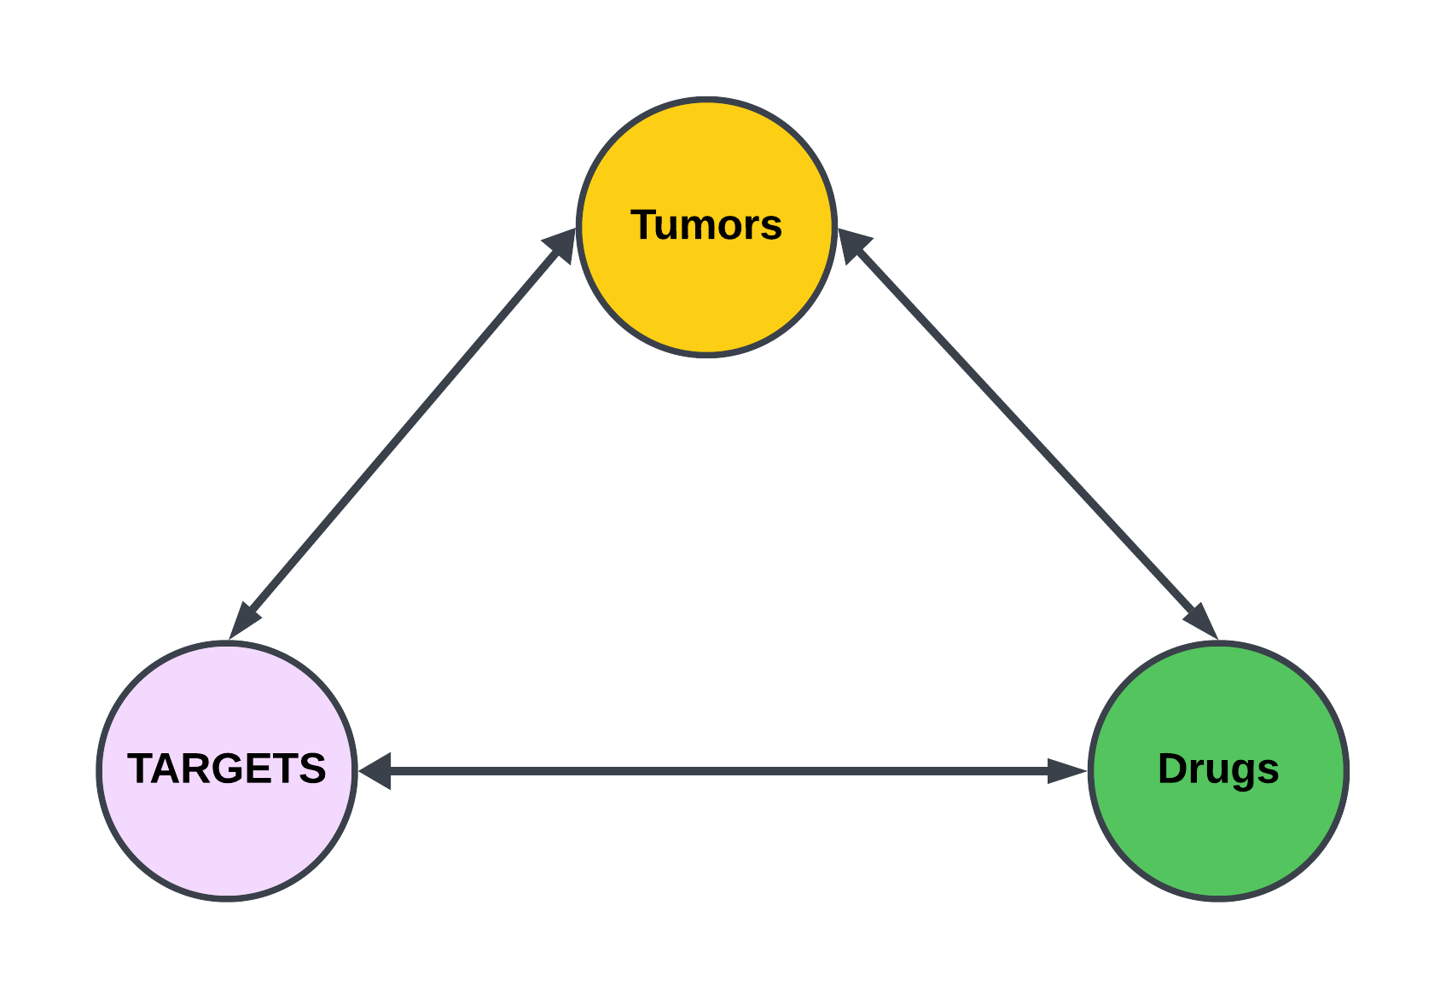
BACKGROUND

Slide 3
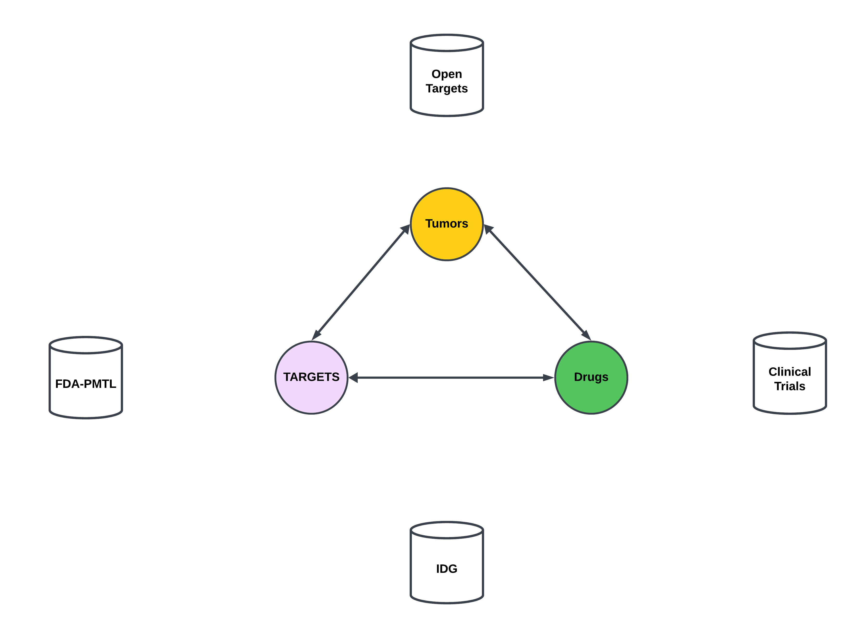
BACKGROUND

Slide 4
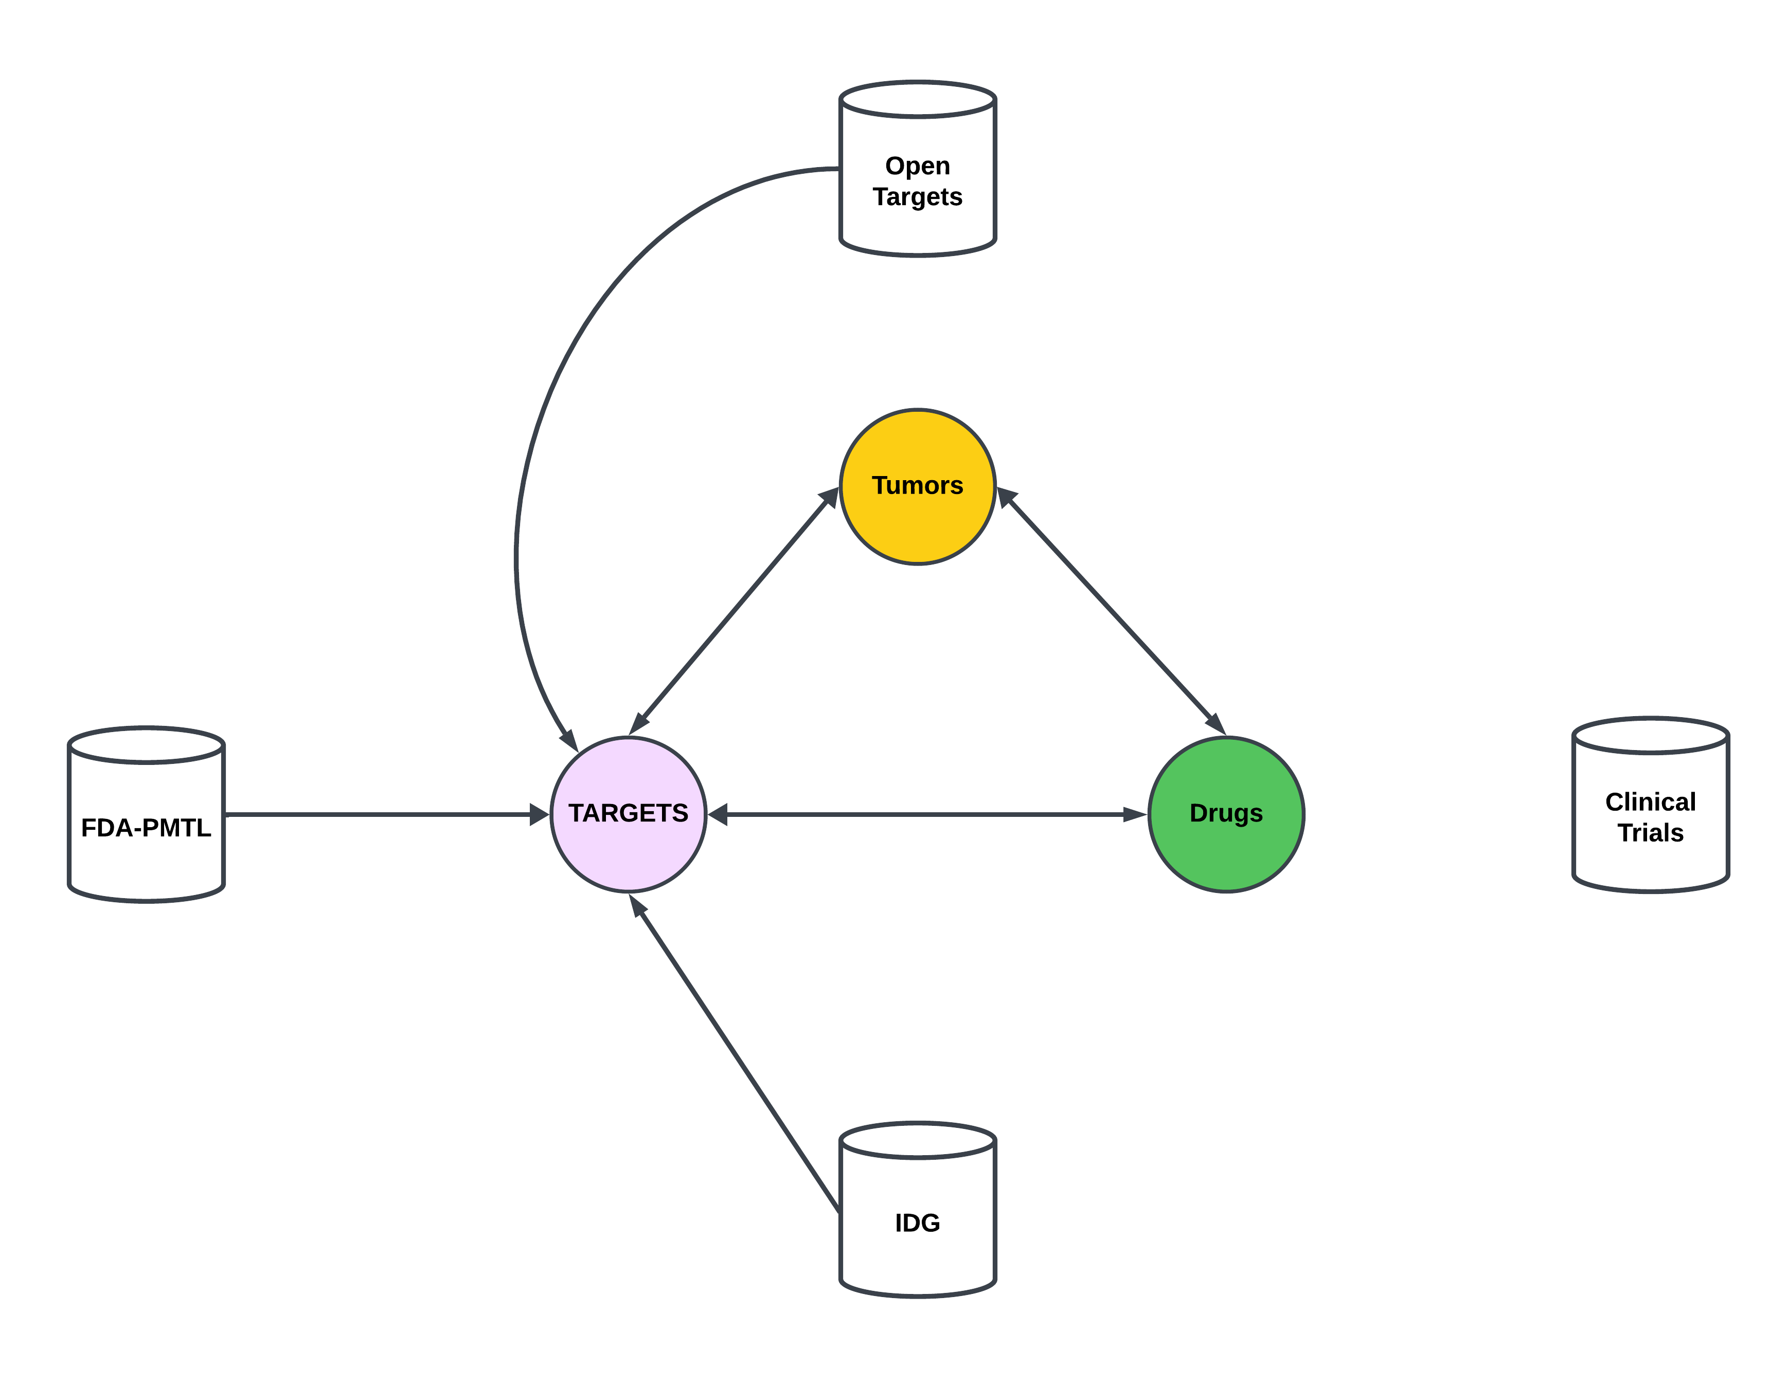
BACKGROUND

Slide 5
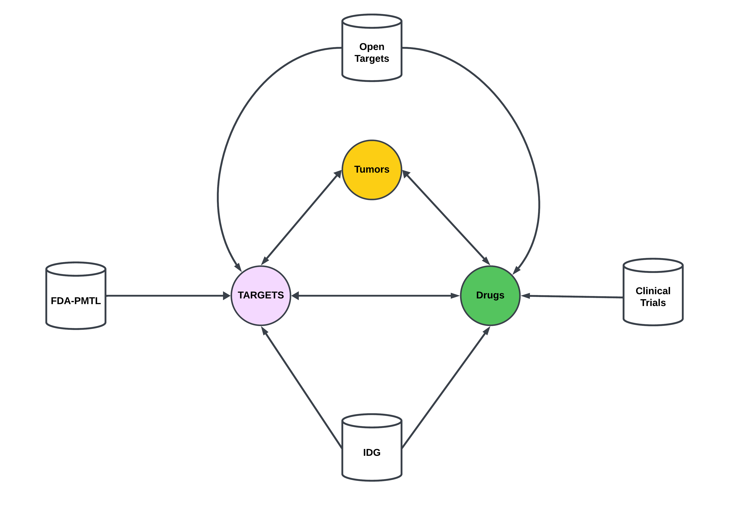
BACKGROUND

Slide 6
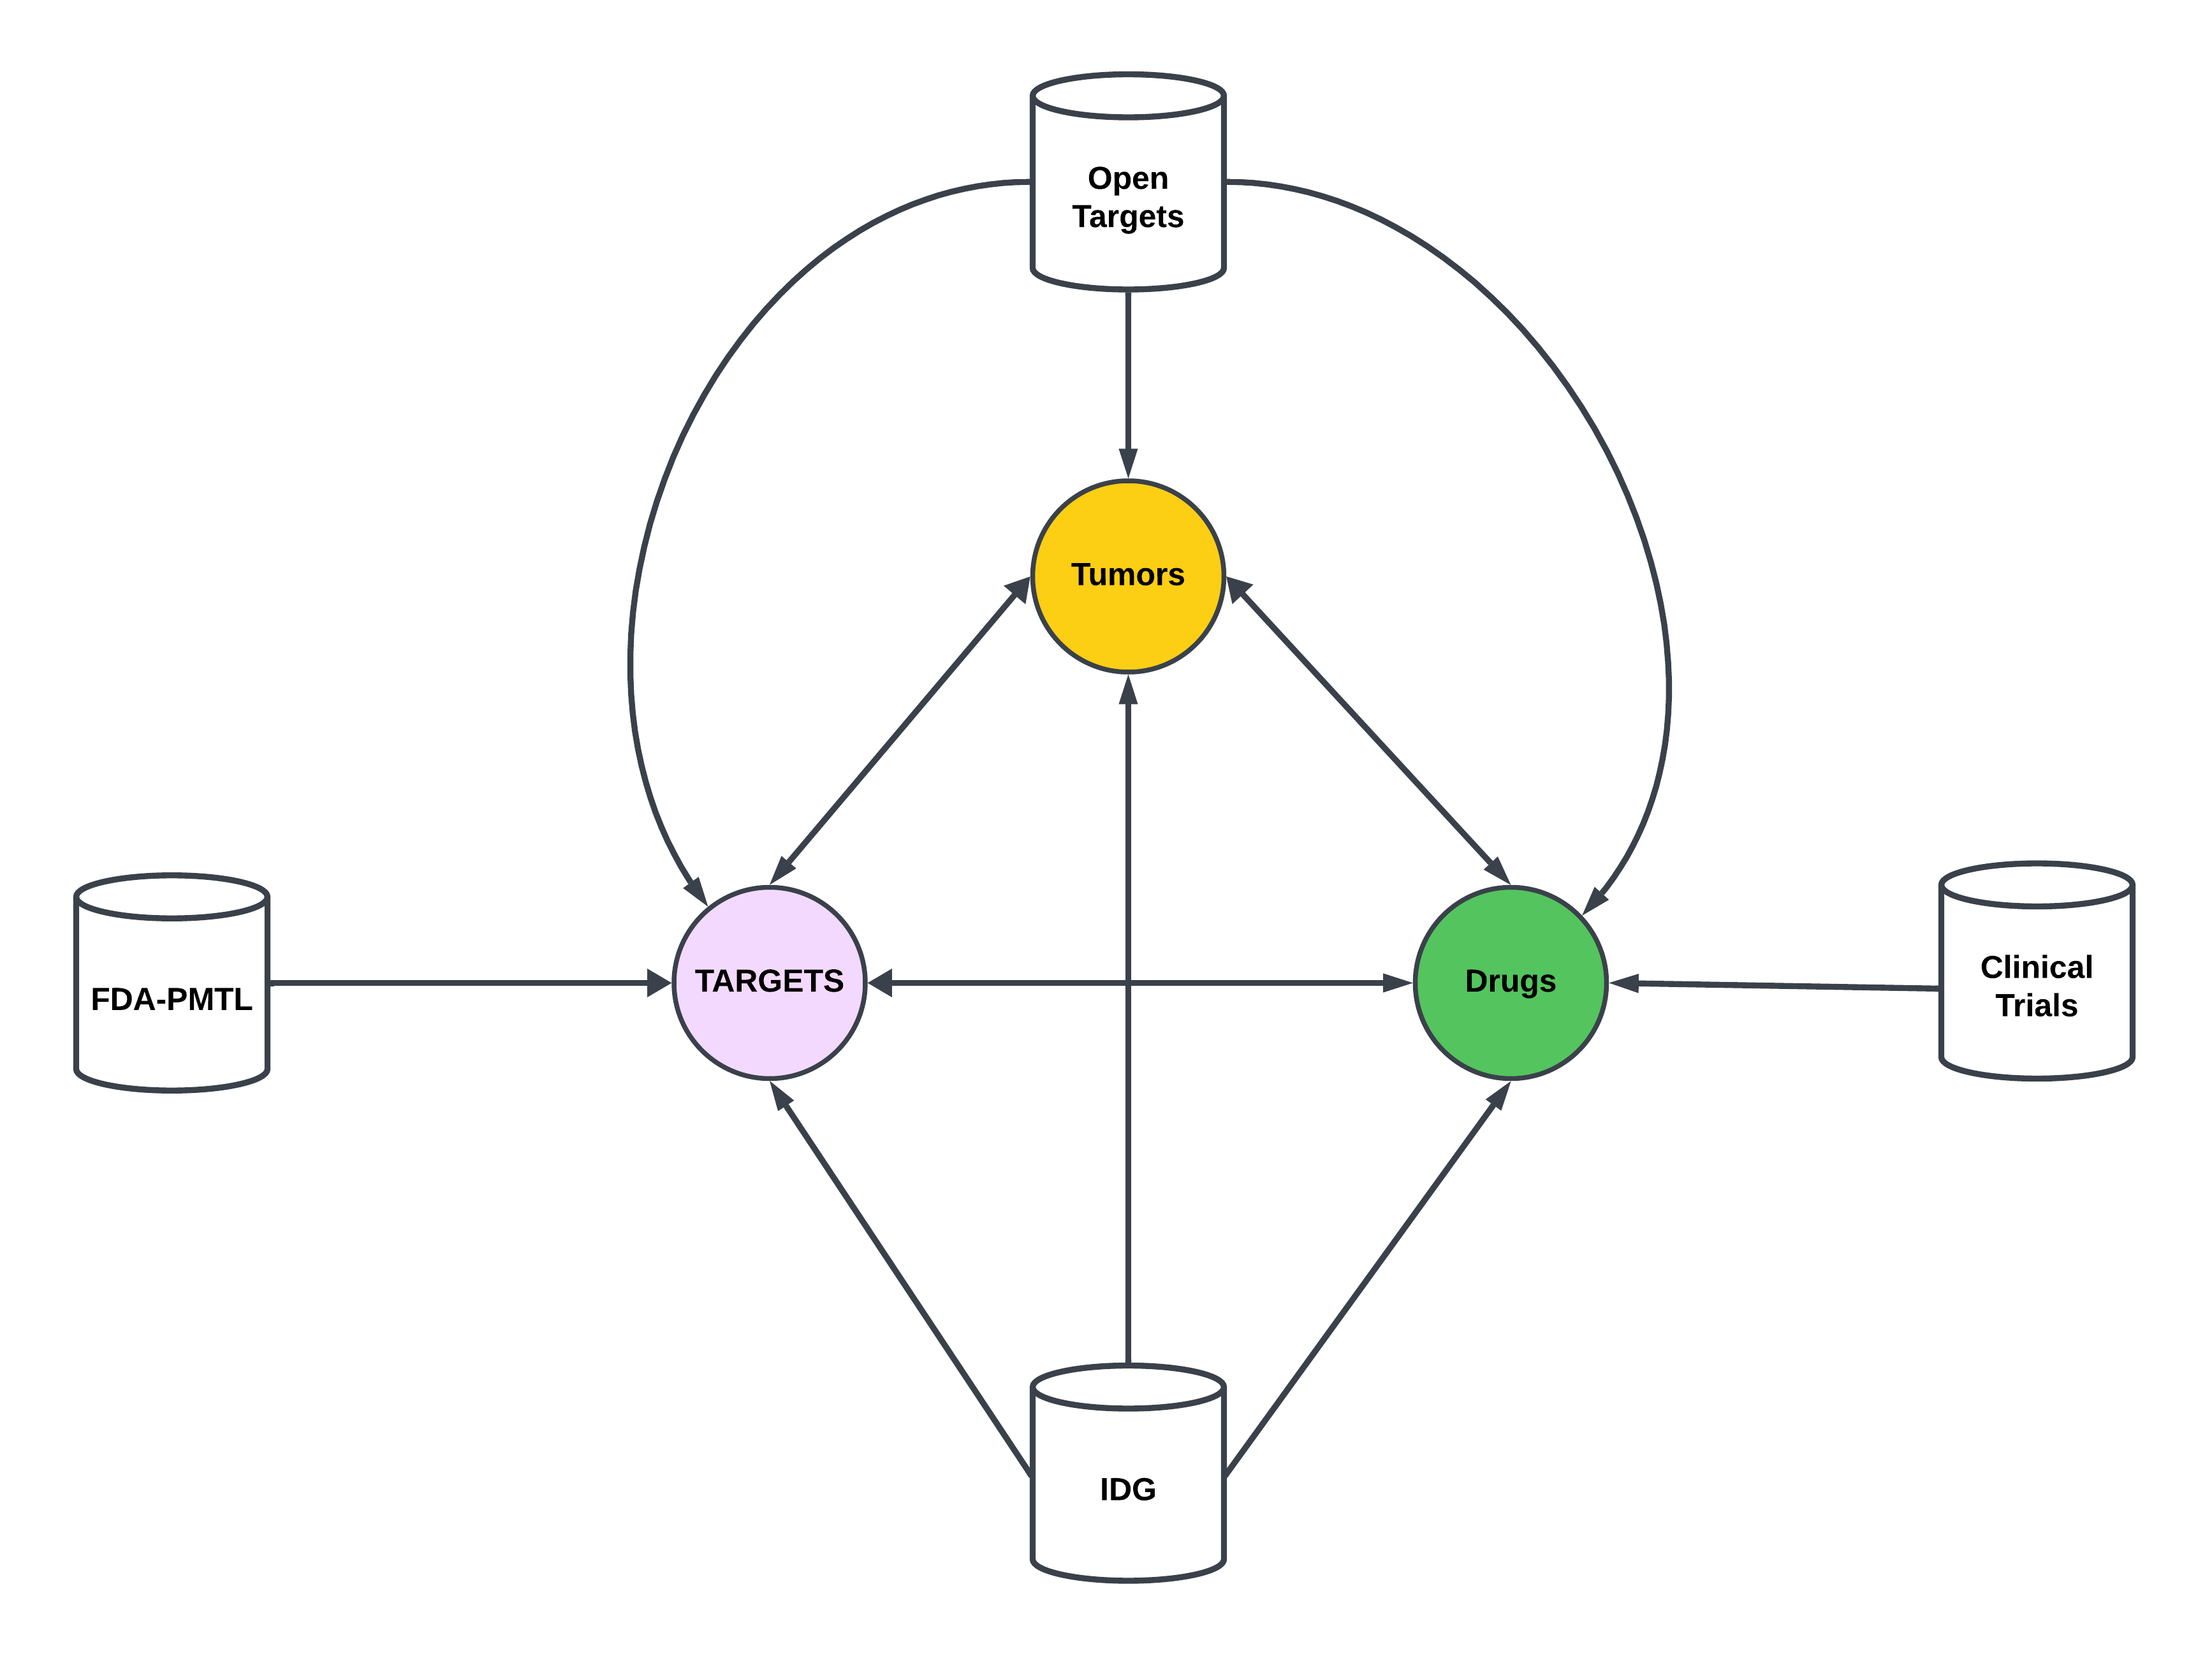
BACKGROUND

Slide 7
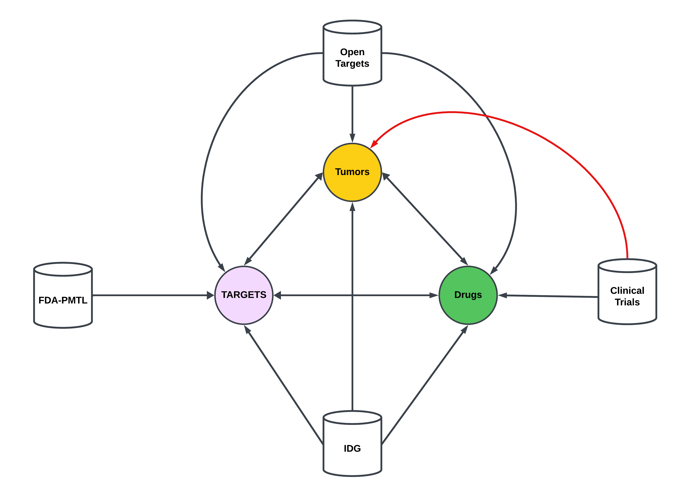
BACKGROUND

Slide 8
Clinical Trials: Conditions to Tumors
Tumors in clinical trials can be obtains from the “conditions” table.
Table is provided in a tab separated text file containing NCT IDs and condition names in down case.
Downloaded data on Aug 22, 2023. Data is updated monthly.
Retrieved 107257 unique conditions.

Slide 9
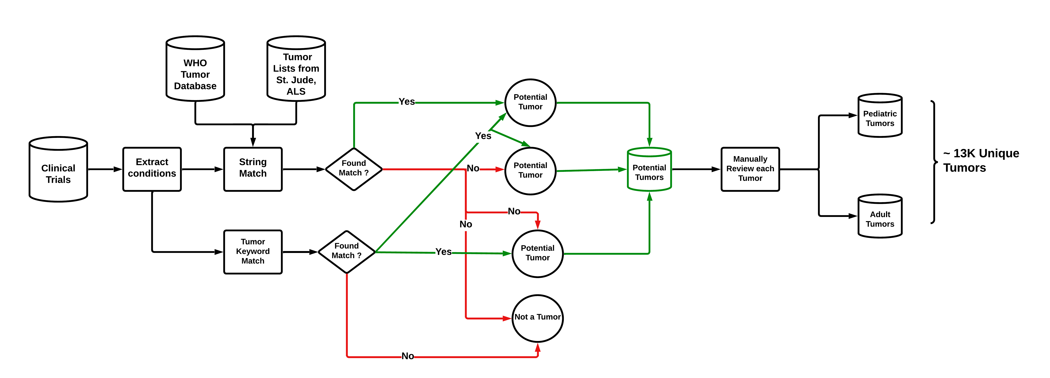
Clinical Trials: Conditions to Tumors

Slide 10
Clinical Trials: unstandardized Tumor Names
ID | NCT ID | Condition | Issues
54148559 | NCT05806385 | triple negative breast cancer | None
54158880 | NCT04529772 | diffuse large b-cell lymphoma | None
4159811 | NCT03449069 | crohn disease | None
54174814 | NCT04317313 | lymphoma, large b-cell, diffuse | Comma
54159226 | NCT04139304 | ann arbor stage II diffuse large b-cell lymphoma | Staging Info provided
54160394 | NCT01365169 | stage iv colorectal cancer ajcc v7 | Staging Info provided and abbreviation added
54167219 | NCT00005799 | waldenstr√∂m macroglobulinemia | Square root typographical error
53807459 | NCT05667415 | chemotherapyÔºõadvanced gastric cancerÔºõcisplatin | Special character typographical error ,
53785094 | NCT01127841 | follicular non-hodgking¬¥s lymphoma refractory or relapsed after treatment with r-chemotherapy in first line | Special character typographical error , treatment name and details
53878247 | NCT02172768 | acute myeloid leucaemia | Name of disease spelled unconventionally.
54168238 | NCT05587556 | liver transplant, liver cancer, immunosuppressant | Disease name with other procedure and medicine
53573690 | NCT03452657 | ranibizumab | Name of drug instead of disease
53574738 | NCT04669496 | lenvatinib | Name of drug instead of disease
53756631 | NCT01227746 | asian patients with advanced gastro-intestinal stromal tumors (gist) treated with imatinib | Demographics of patient cohoty, and medicine name provided.

Slide 11
Clinical Trials: Standardizing Tumor Names
Retrieved ~ 13k unique tumors form clinical trials database.
WHO tumor database (5th edition) contains 2390 standardized unique tumors.
NCIT tumor database contains 1395 standardized unique tumors.
Objective: Map unstandardized clinical trials tumors to WHO or NCIT tumors.

Slide 12
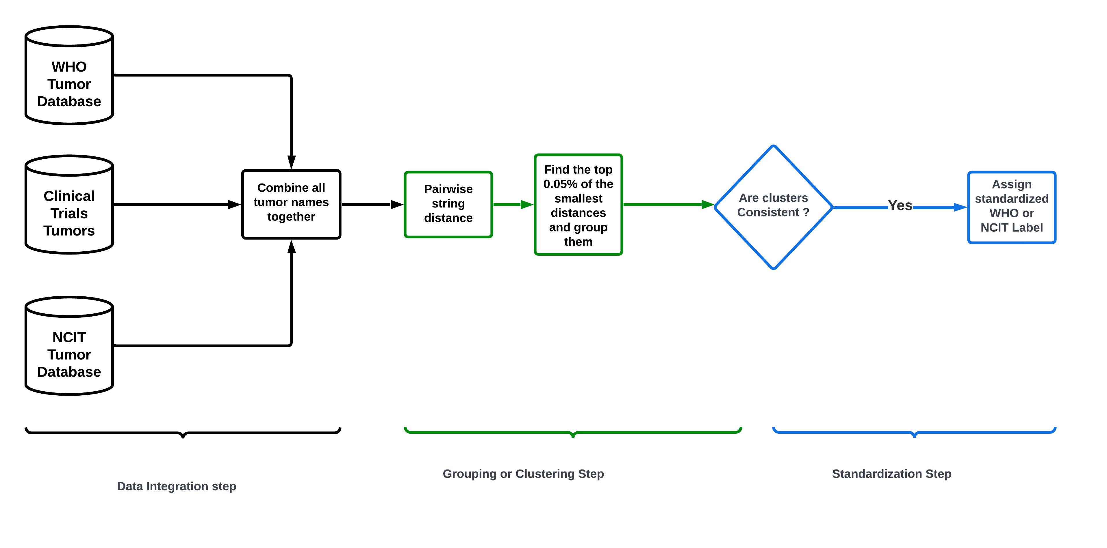
Standardization Method 1 : Edit distance

Slide 13
Standardization Method 1 : Edit distance
Distance Metrics used: 1. Levenshtein distance
2. Jarro-Winkler distance
3. Cosine distance

Slide 14
Standardization Method : Edit distance Benchmark Results
Tumors | Levenshtein | Jarro Winkler | Cosine
b cell lymphoma | b-cell lymphomas;b cell lymphoma;b-cell lymphoma;t cell lymphoma;b cell lymphomas;t-cell lymphoma;nk cell lymphoma;t cell lymphomas | b cell lymphoma;b-cell lymphoma;t cell lymphoma;b cell lymphomas;nk/t cell lymphoma;nk cell lymphoma;nk t-cell lymphoma;b cell lymphoma (bcl);t cell lymphomas | b cell lymphoma;b-cell lymphoma;t cell lymphoma;b cell lymphomas;lymphoma, b cell;b-cell small lymphocytic lymphoma;b cell lymphoma (bcl);large b cell lymphoma;lymphoblastic b-cell lymphoma
unresectable lung carcinoma | unresectable nut carcinoma;unresectable lung carcinoma;unresectable carcinoma | unresectable nut carcinoma;unresectable vaginal carcinoma;unresectable lung carcinoma;resectable carcinoma;unresectable carcinoma;unresectable sarcoma;unresectable lung small cell carcinoma;unresectable lung carcinoid tumor;unresectable ewing sarcoma | unresectable acral lentiginous melanoma;unresectable nut carcinoma;unresectable fallopian tube carcinoma;unresectable renal cell carcinoma;unresectable laryngeal squamous cell carcinoma;unresectable vaginal carcinoma;unresectable lung carcinoma;unresectable carcinoma
liposarcoma | liposarcoma;fibrosarcoma;gliosarcoma; myosarcoma;liposarcomas | liposarcoma;epithelioid sarcoma;gliosarcoma;liposarcoma, myxoid;myosarcoma;liposarcoma,myxoid; mixed liposarcoma;liposarcomas | liposarcoma;gliosarcoma;pleomorphic liposarcoma;micropapillary serous carcinoma;macroprolactinoma;advanced liposarcoma or leiomyosarcoma;leiomyosarcoma or carcinosarcoma;pilomatricoma;liposarcomas
cancer of the liver | cancer of the bladder;cancer of the ovary;cancer of the lung;cancer of liver;cancer of the liver;cancer of the bone;cancer of the ureter;cancer of the kidney | cancer of the bladder;cancer of the ovary;cancer of the larynx;cancer of liver; cancer of the liver;cancer of the cervix; cancer of the kidney | cancer of the uterine cervix;cancer of liver;cancer of the liver;recurrent epithelial cancer of ovary;cancer of the cervix;stage iv cancer of the cervix;long-term adverse effects of radiotherapy for pelvic cancer;recurrent urothelial carcinoma of the renal pelvis and ureter;clear cell carcinoma of the uterine corpus
smoldering myeloma | multiple myeloma;multiple myelomas;smoldering myeloma;smoldering multiple myeloma;second-line melanoma;smouldering myeloma;multiple mieloma;ovarian myxoma | relapsed hodgkin lymphoma;marginal lymphoma;smoldering myeloma;smoldering multiple myeloma;smoldering plasma cell myeloma;smoldering multiple myeloma (smm);smoldering waldenstrom macroglobulinemia;relapsed hodgkin's lymphoma;smouldering myeloma | myeloid neoplasm;smoldering myeloma;smoldering multiple myeloma;smoldering plasma cell myeloma;smoldering multiple myeloma (smm);smoldering waldenstrom macroglobulinemia;smouldering myeloma;mesectodermal leiomyoma;myeloid neoplasms

Slide 15
Standardization Method 1 : Benchmark Results
Tumors | Levenshtein | Jarro Winkler | Cosine
b cell lymphoma | b-cell lymphomas;b cell lymphoma;b-cell lymphoma;t cell lymphoma;b cell lymphomas;t-cell lymphoma;nk cell lymphoma;t cell lymphomas | b cell lymphoma;b-cell lymphoma;t cell lymphoma;b cell lymphomas;nk/t cell lymphoma;nk cell lymphoma;nk t-cell lymphoma;b cell lymphoma (bcl);t cell lymphomas | b cell lymphoma;b-cell lymphoma;t cell lymphoma;b cell lymphomas;lymphoma, b cell;b-cell small lymphocytic lymphoma;b cell lymphoma (bcl);large b cell lymphoma;lymphoblastic b-cell lymphoma
unresectable lung carcinoma | unresectable nut carcinoma;unresectable lung carcinoma;unresectable carcinoma | unresectable nut carcinoma;unresectable vaginal carcinoma;unresectable lung carcinoma;resectable carcinoma;unresectable carcinoma;unresectable sarcoma;unresectable lung small cell carcinoma;unresectable lung carcinoid tumor;unresectable ewing sarcoma | unresectable acral lentiginous melanoma;unresectable nut carcinoma;unresectable fallopian tube carcinoma;unresectable renal cell carcinoma;unresectable laryngeal squamous cell carcinoma;unresectable vaginal carcinoma;unresectable lung carcinoma;unresectable carcinoma
liposarcoma | liposarcoma;fibrosarcoma;gliosarcoma; myosarcoma;liposarcomas | liposarcoma;epithelioid sarcoma;gliosarcoma;liposarcoma, myxoid;myosarcoma;liposarcoma,myxoid; mixed liposarcoma;liposarcomas | liposarcoma;gliosarcoma;pleomorphic liposarcoma;micropapillary serous carcinoma;macroprolactinoma;advanced liposarcoma or leiomyosarcoma;leiomyosarcoma or carcinosarcoma;pilomatricoma;liposarcomas
cancer of the liver | cancer of the bladder;cancer of the ovary;cancer of the lung;cancer of liver;cancer of the liver;cancer of the bone;cancer of the ureter;cancer of the kidney | cancer of the bladder;cancer of the ovary;cancer of the larynx;cancer of liver; cancer of the liver;cancer of the cervix; cancer of the kidney | cancer of the uterine cervix;cancer of liver;cancer of the liver;recurrent epithelial cancer of ovary;cancer of the cervix;stage iv cancer of the cervix;long-term adverse effects of radiotherapy for pelvic cancer;recurrent urothelial carcinoma of the renal pelvis and ureter;clear cell carcinoma of the uterine corpus
smoldering myeloma | multiple myeloma;multiple myelomas;smoldering myeloma;smoldering multiple myeloma;second-line melanoma;smouldering myeloma;multiple mieloma;ovarian myxoma | relapsed hodgkin lymphoma;marginal lymphoma;smoldering myeloma;smoldering multiple myeloma;smoldering plasma cell myeloma;smoldering multiple myeloma (smm);smoldering waldenstrom macroglobulinemia;relapsed hodgkin's lymphoma;smouldering myeloma | myeloid neoplasm;smoldering myeloma;smoldering multiple myeloma;smoldering plasma cell myeloma;smoldering multiple myeloma (smm);smoldering waldenstrom macroglobulinemia;smouldering myeloma;mesectodermal leiomyoma;myeloid neoplasms
Too Many False Positive Matches !!

Slide 16
Standardization Method 1 : Edit distance

Slide 17
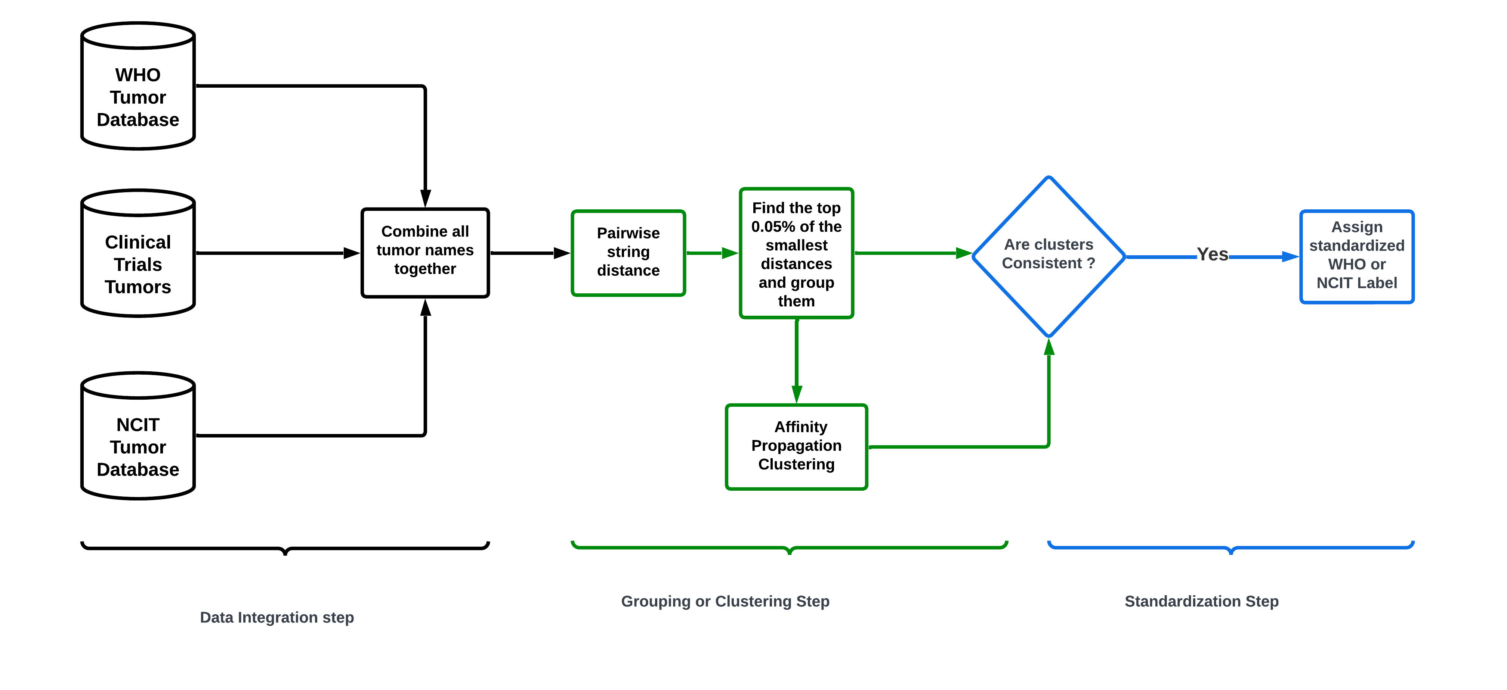
Standardization Method 2 : Edit distance + Clustering

Slide 18
Standardization Method 2 : Benchmark Results
LV + AF | MSS | JW +AF | MSS | Cosine + AF | MSS
b-cell lymphomas; b cell lymphoma; b cell lymphomas; t cell lymphomas | 0.17460317 | b cell lymphoma; b cell lymphomas | 0.61032389 | b cell lymphoma; b cell lymphomas; lymphoma, b cell | 0.4127977
unresectable lung carcinoma; prostate carcinoma; unresectable melanoma; unresectable nut carcinoma ;unresectable paraganglioma; resectable carcinoma; unresectable carcinoma; resectable sarcoma; unresectable sarcoma; unresectable cancer; intraductal carcinoma | -0.1950234 | unresectable lung carcinoma; unresectable nut carcinoma; unresectable vaginal carcinoma;unresectable lung carcinoid tumor | 0.19074195 | unresectable lung carcinoma | 0
liposarcoma ;fibrosarcoma; gliosarcoma; myosarcoma; liposarcomas | 0.3225 | Liposarcoma; Gliosarcoma; Myosarcoma; liposarcoma, round cell; gliosarcoma, adult; mixed liposarcoma; liposarcomas | -0.1295667 | liposarcoma;synovial sarcoma;choroidal melanoma;myeloid sarcoma;advanced leiomyosarcoma;leiomyosarcoma of ovary;adenocarcinoma of ovary;solid alveolar rhabdomyosarcoma;rhabdomyosarcoma, pelvic;sarcoma, myeloid;localized osteosarcoma;advanced liposarcoma or leiomyosarcoma;locally advanced myxofibrosarcoma; leiomyosarcoma or carcinosarcoma;advanced or metastatic liposarcoma or leiomyosarcoma;fusion-negative alveolar rhabdomyosarcoma ;cardiac leiomyosarcoma;pleomorphic dermal sarcoma | -0.4821895
cancer of the liver; cancer of the ureter; cancer of the kidney | 0.09780815 | cancer of the liver;cancer of the ovary; cancer of the larynx;cancer of the salivary gland; cancer of the oral cavity; cancer of head; cancer, other; cancer of ovary; cancer of the pharynx; cancer of the biliary tract | -0.1121348 | cancer of the liver; cancer of cervix;cancer of the rectum;cancer of the cervix ;stage iv cancer of the cervix | -0.3244073
smoldering myeloma; smouldering myeloma | 0.88235294 | smoldering myeloma; smoldering multiple myeloma; smoldering plasma cell myeloma; smoldering multiple myeloma (smm) | -0.062071 | smoldering myeloma; smouldering myeloma | 0.78520413

Slide 19
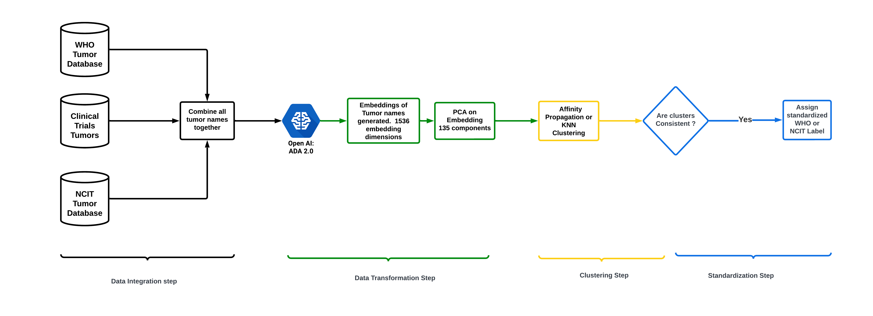
Standardization Method 3 : Embedding + Clustering

Slide 20
Standardization Method 3 : Benchmark Results
AF Clusters | MSS | Kmeans (K=6000) | MSS
 |  | b cell lymphoma;b cell lymphoma (bcl) ;b cell lymphomas;b-cell lymphoid cancer;b-cell lymphoma;b-cell lymphomas | 0.23489899
 |  | Liposarcoma ;adult liposarcoma; liposarcomas | 0.1441252
 |  | unresectable lung carcinoma; unresectable lung small cell carcinoma | 0.05125004
 |  | cancer of liver; cancer of the liver ; liver cancer | 0.38949709
 |  | smoldering myeloma;smoldering multiple myeloma;smoldering multiple myeloma (smm); smouldering myeloma; high risk smoldering multiple myeloma; high-risk smoldering multiple myeloma | 0.25361543

