Slide 1
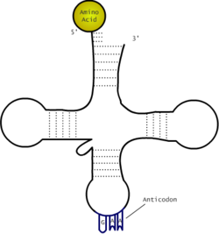
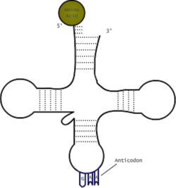
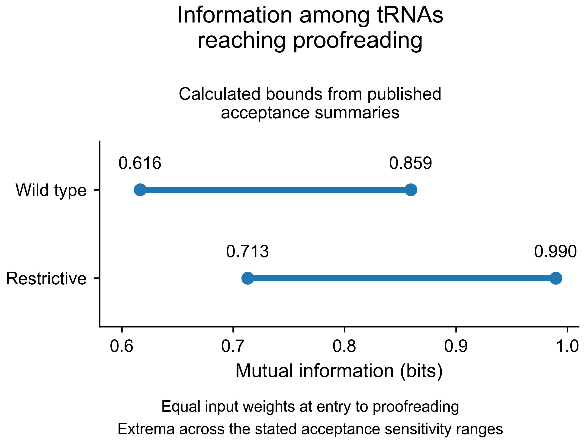
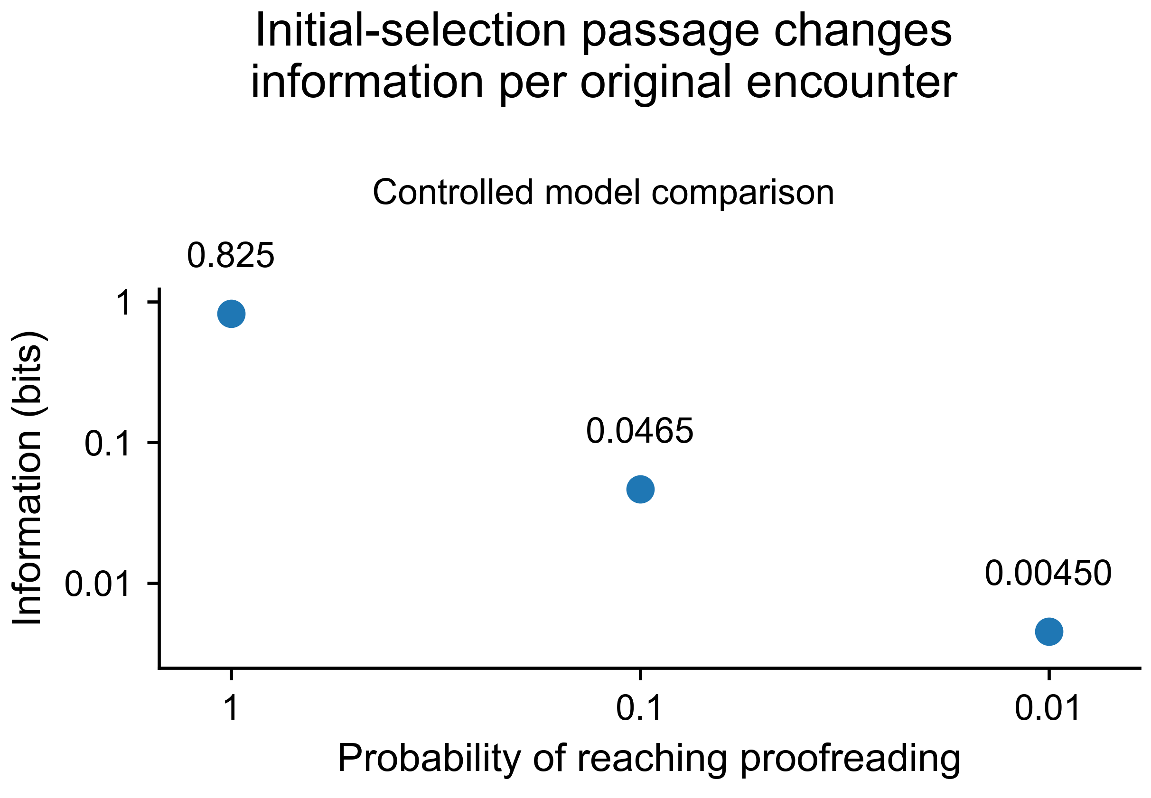
A
Original tRNA encounter
Initial selection
Proofreading
Accepted peptide product
Accept
Reject
Sets which tRNAs
reach proofreading
Published acceptance
measurements define local
information bounds
Final output depends
on both stages
Many tRNAs compete
for the ribosome.
Cognate Phe-tRNA
Near-cognate Leu-tRNA
B
C
Notes:
Slide 1 is the complete editable source for BICS Figure 2. Panel A is composed entirely of native PowerPoint shapes. Panel B values: WT 0.616-0.859; Restrictive 0.713-0.990. Panel C points: (1,0.825), (0.1,0.0465), (0.01,0.00450). Product comparison: restrictive ratio remains lower when U < 3.6.

