Slide 1
The Scala Programming Language
presented by Donna Malayeri

Slide 2
Why a new language?
Goal was to create a language with better support for component software
Two hypotheses:
  Programming language for component software should be scalable
    The same concepts describe small and large parts
    Rather than adding lots of primitives, focus is on abstraction, composition, and decomposition
  Language that unifies OOP and functional programming can provide scalable support for components
Adoption is key for testing this hypothesis
  Scala interoperates with Java and .NET

Slide 3
Features of Scala
Scala is both functional and object-oriented
  every value is an object
  every function is a value--including methods
Scala is statically typed
  includes a local type inference system:
  in Java 1.5:
  Pair p = new Pair<Integer, String>(1, "Scala");
  in Scala:
  val p = new MyPair(1, "scala");

Slide 4
More features
Supports lightweight syntax for anonymous functions, higher-order functions, nested functions, currying
ML-style pattern matching
Integration with XML
  can write XML directly in Scala program
  can convert XML DTD into Scala class definitions
Support for regular expression patterns

Slide 5
Other features
Allows defining new control structures without using macros, and while maintaining static typing
Any function can be used as an infix or postfix operator
Can define methods named +, <= or ::

Slide 6
Automatic Closure Construction
Allows programmers to make their own control structures
Can tag the parameters of methods with the modifier def.
When method is called, the actual def parameters are not evaluated and a no-argument function is passed

Slide 7
While loop example
object TargetTest1 with Application {
def loopWhile(def cond: Boolean)(def body: Unit): Unit =
if (cond) {
body;
loopWhile(cond)(body);
}
var i = 10;
loopWhile (i > 0) {
Console.println(i);
i = i - 1
}
}
Define loopWhile method
Use it with nice syntax

Slide 8
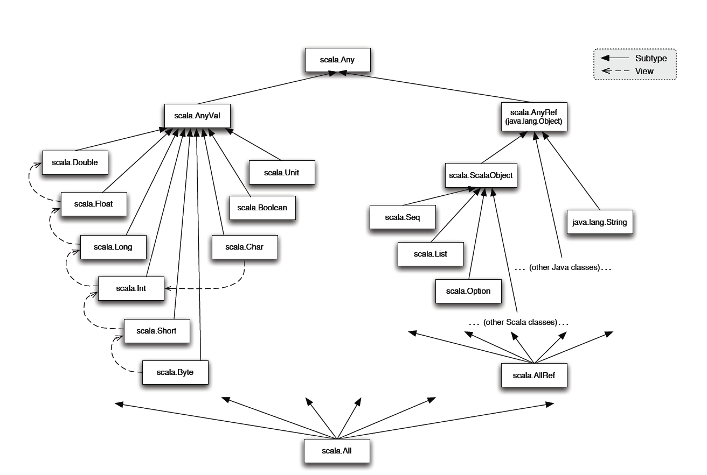
Scala class hierarchy

Slide 9
Scala object system
Class-based
Single inheritance
Can define singleton objects easily
Subtyping is nominal
Traits, compound types, and views allow for more flexibility
Notes:
Since traits do not encapsulate state, inheriting twice from a trait is legal in Scala.

Slide 10
Classes and Objects
  trait Nat;
  object Zero extends Nat {
  def isZero: boolean = true;
  def pred: Nat =
  throw new Error("Zero.pred");
  }
  class Succ(n: Nat) extends Nat {
  def isZero: boolean = false;
  def pred: Nat = n;
  }
Notes:
Traits are similar to interfaces in Java.
Nat defines a trait that’s just a placeholder. Zero has only one instance, so it’s an object rather than a class.

Slide 11
Traits
Similar to interfaces in Java
They may have implementations of methods
But can’t contain state
Can be multiply inherited from

Slide 12
Example of traits
trait Similarity {
def isSimilar(x: Any): Boolean;
def isNotSimilar(x: Any): Boolean = !isSimilar(x);
}
class Point(xc: Int, yc: Int) with Similarity {
var x: Int = xc;
var y: Int = yc;
def isSimilar(obj: Any) =
obj.isInstanceOf[Point] &&
obj.asInstanceOf[Point].x == x;
}
Notes:
Traits can have code, unlike Java interfaces, but can’t have any state associated with them.
Scala allows multiple inheritance of traits

Slide 13
Mixin class composition
Basic inheritance model is single inheritance
But mixin classes allow more flexibility
class Point2D(xc: Int, yc: Int) {
val x = xc;
val y = yc;
// methods for manipulating Point2Ds
}
class ColoredPoint2D(u: Int, v: Int, c: String)
extends Point2D(u, v) {
var color = c;
def setColor(newCol: String): Unit = color = newCol;
}

Slide 14
Mixin class composition example
Point2D
ColoredPoint2D
Point3D
ColoredPoint3D
ColoredPoint2D
class Point3D(xc: Int, yc: Int, zc: Int)
extends Point2D(xc, yc) {
val z = zc;
// code for manipulating Point3Ds
}
class ColoredPoint3D(xc: Int, yc: Int, zc: Int, col: String)
extends Point3D(xc, yc, zc)
with ColoredPoint2D(xc, yc, col);

Slide 15
Mixin class composition
Mixin composition adds members explicitly defined in ColoredPoint2D
(members that weren’t inherited)
Mixing a class C into another class D is legal only as long as D’s superclass is a subclass of C’s superclass.
  i.e., D must inherit at least everything that C inherited
Why?

Slide 16
Mixin class composition
Remember that only members explicitly defined in ColoredPoint2D are mixin inherited
So, if those members refer to definitions that were inherited from Point2D, they had better exist in ColoredPoint3D
  They do, since
  ColoredPoint3D extends Point3D
  which extends Point2D

Slide 17
Views
Defines a coercion from one type to another
Similar to conversion operators in C++/C#
  trait Set {
  def include(x: int): Set;
  def contains(x: int): boolean
  }
  def view(list: List) : Set = new Set {
  def include(x: int): Set = x prepend xs;
  def contains(x: int): boolean =
  !isEmpty &&
  (list.head == x || list.tail contains x)
  }

Slide 18
Views
Views are inserted automatically by the Scala compiler
If e is of type T then a view is applied to e if:
  expected type of e is not T (or a supertype)
  a member selected from e is not a member of T
Compiler uses only views in scope
Suppose xs : List and view above is in scope
val s: Set = xs;
xs contains x
val s: Set = view(xs);
view(xs) contains x
Notes:
Note that changes to the result returned by ‘view’ are not reflected in the original function.

Slide 19
Compound types motivation
trait Cloneable {
def clone();
}
trait Resetable {
def reset: Unit;
}
def cloneAndReset(obj: ?): Cloneable = {
val cloned = obj.clone();
obj.reset;
cloned
}

Slide 20
Compound types
In Java, the “solution” is:
  interface CloneableAndResetable extends Cloneable, Resetable
But if the original object did not use the CloneableAndResetable interface, it won’t work
Scala solution: use compound types (also called intersection types)
def cloneAndReset(obj: Cloneable with Resetable): Cloneable = {
...
}

Slide 21
Variance annotations
class Array[a] {
def get(index: int): a
def set(index: int, elem: a): unit;
}
Array[String] is not a subtype of Array[Any]
If it were, we could do this:
val x = new Array[String](1);
val y : Array[Any] = x;
y.set(0, new FooBar());
// just stored a FooBar in a String array!

Slide 22
Variance Annotations
Covariance is ok with functional data structures
trait GenList[+T] {
def isEmpty: boolean;
def head: T;
def tail: GenList[T]
}
object Empty extends GenList[All] {
def isEmpty: boolean = true;
def head: All = throw new Error("Empty.head");
def tail: List[All] = throw new Error("Empty.tail");
}
class Cons[+T](x: T, xs: GenList[T]) extends GenList[T] {
def isEmpty: boolean = false;
def head: T = x;
def tail: GenList[T] = xs
}

Slide 23
Variance Annotations
Can also have contravariant type parameters
  Useful for an object that can only be written to
Scala checks that variance annotations are sound
  covariant positions: immutable field types, method results
  contravariant: method argument types
  Type system ensures that covariant parameters are only used covariant positions
  (similar for contravariant)

Slide 24
Types as members
abstract class AbsCell {
type T;
val init: T;
private var value: T = init;
def get: T = value;
def set(x: T): unit = { value = x }
}
def createCell : AbsCell {
new AbsCell { type T = int; val init = 1 }
}
Clients of createCell cannot rely on the fact that T is int, since this information is hidden from them

Slide 25
Discussion/Critiques
Scala has nominal subtyping. Is this good?
Inheritance and subtyping are conflated in Scala. Shouldn’t they be separated?
Mixins in MzScheme vs. Scala – MzScheme allows a class to parameterize its supertype, while Scala does not
Type system does not distinguish null references from non-null references

