Slide 1

Team: Cloud-MSU
CMPS 5153 Advanced Software Engineering
Tuesday, October 18th

Slide 2
Cloud-MSU
Democratic Decentralized
Mounika Mannam – Graduate, Design, Elected Secretary
Scott Gordon – Graduate, Documentation, Presentation
Taylor Kirk – Undergraduate, Programmer
Tejaswi Singam –Graduate, Analysis, Testing
Vishnu Mandalapu –Graduate, Elected Leader, Lead Programmer

Slide 3

Cloud Services!
Real Time Transaction Based Processing System (RTTPS)
Hardware infrastructure as a service (IAAS)
Software platforms as a service (PAAS)
Digital Ocean

Slide 4
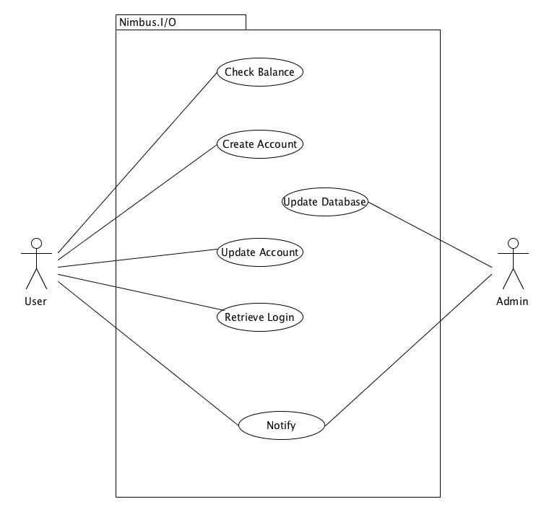
Use Cases

Slide 5
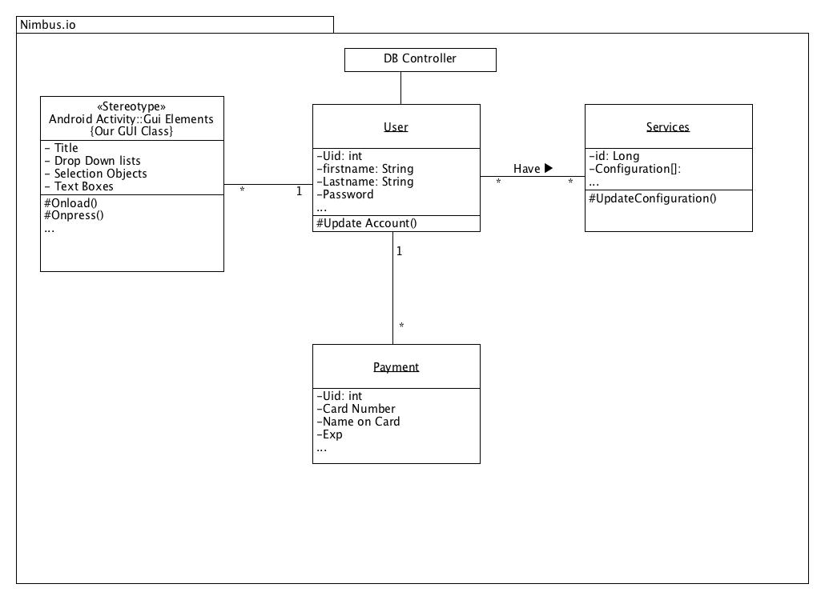
Class Diagram

Slide 6
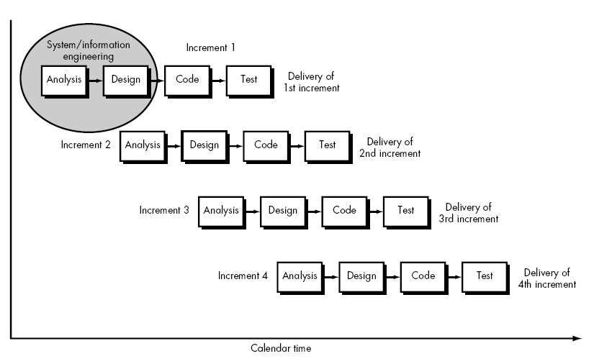
Incremental Process
Satisfies need for Through Requirements
Provides quick delivery of initial product

Slide 7
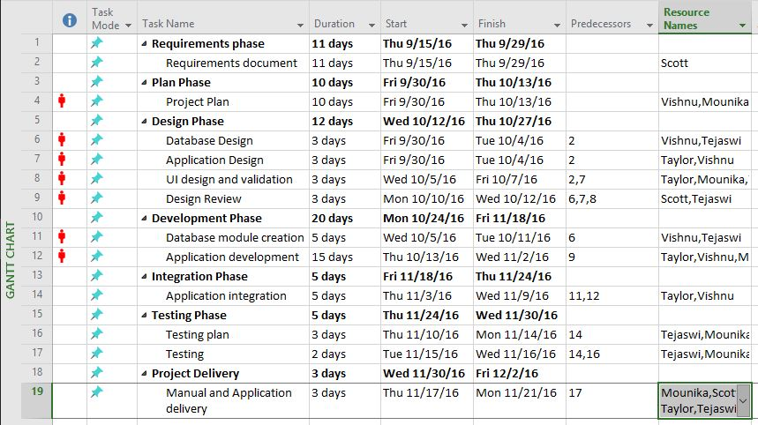
The Plan
Bi-Weekly Face to Face Meetings / Work Review
Team Based Development

Slide 8
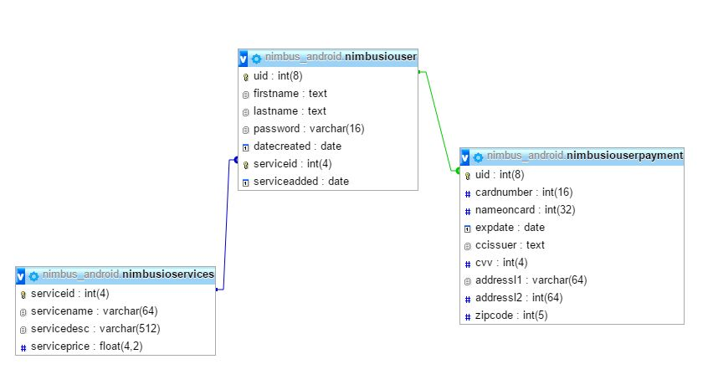
Database Structure

Slide 9
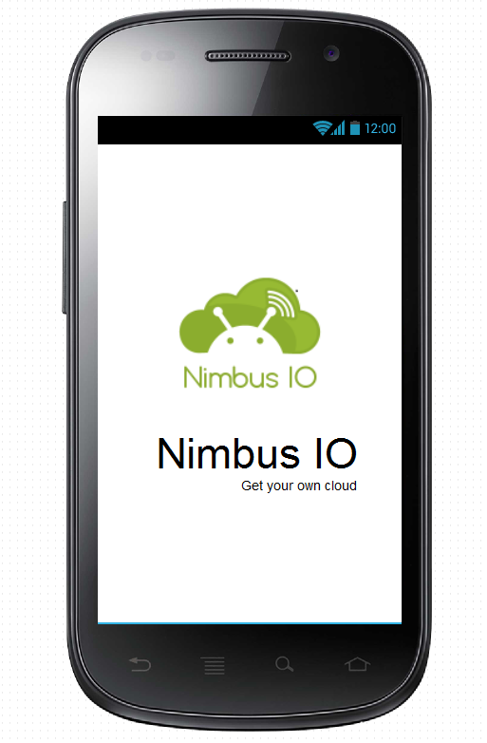
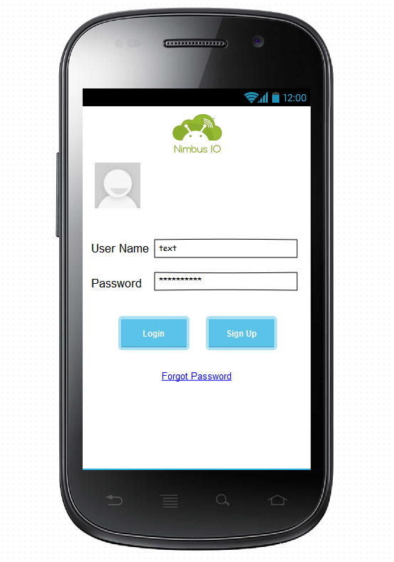
System Interface

Slide 10
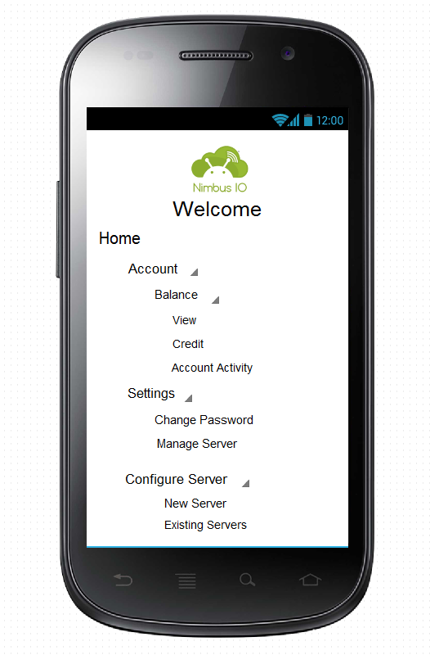
Home Activity (Preview)

Slide 11
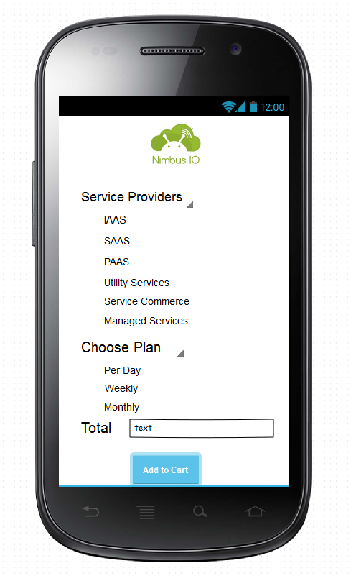
Configure New (Preview)

Slide 12
Tools
Pencil (Wire-framing)
UMLET (Modeling)
Android Studio (Development Environment)
Microsoft Word & Project (Documentation)
Git & Github (Process Control)

Slide 13
Upcoming Tasks
Application Development (Currently Underway!)
Integration & Development
Testing & Code Review
Google Play Store Documentation
Increment 1 Deployment (delivery, feedback)
Discussion of Increment 2 (Communication Phase)

Slide 14
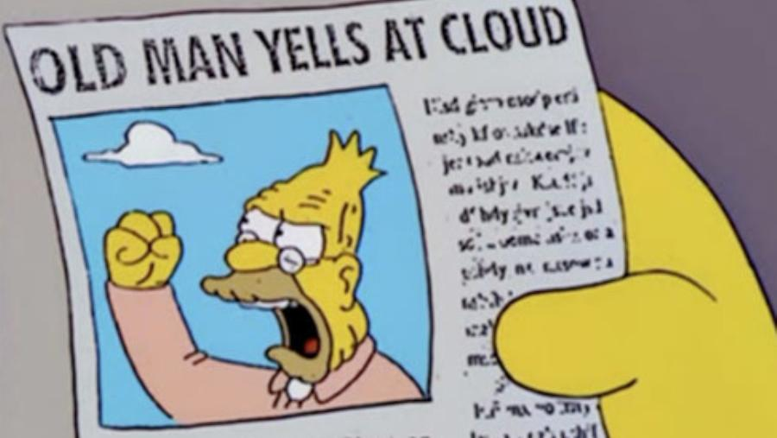
Stay Tuned For More,
From Cloud – MSU
Thanks!!

