Slide 1

Team: Cloud-MSU
CMPS 5153 Advanced Software Engineering
Tuesday, December 6th 2016

Slide 2
Introduction/Overview
Who We Are
Process Model Followed
Brief System Design Overview
Product Demo!
Test Report
Discussion Open Issues
Lessons Learned

Slide 3
Cloud-MSU
Mounika Mannam – Graduate, Designer, Elected Secretary
Scott Gordon – Graduate, Documentation, Designer
Taylor Kirk – Undergraduate, Database Programmer
Tejaswi Singam –Graduate, Analysis, Testing
Vishnu Mandalapu –Graduate, Elected Leader, Android Programmer

Slide 4
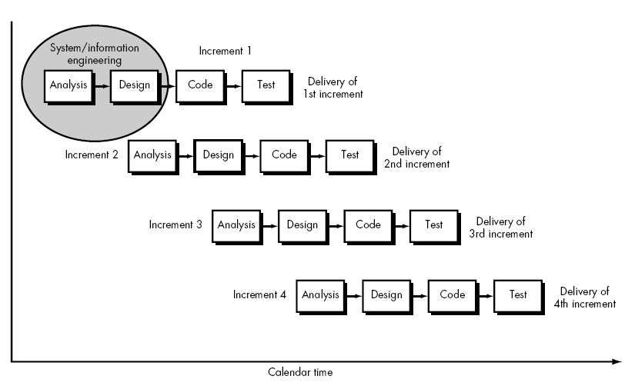
Incremental Process
Satisfied the team need for through Requirements and Documentation
Provided “quick” delivery of initial product

Slide 5
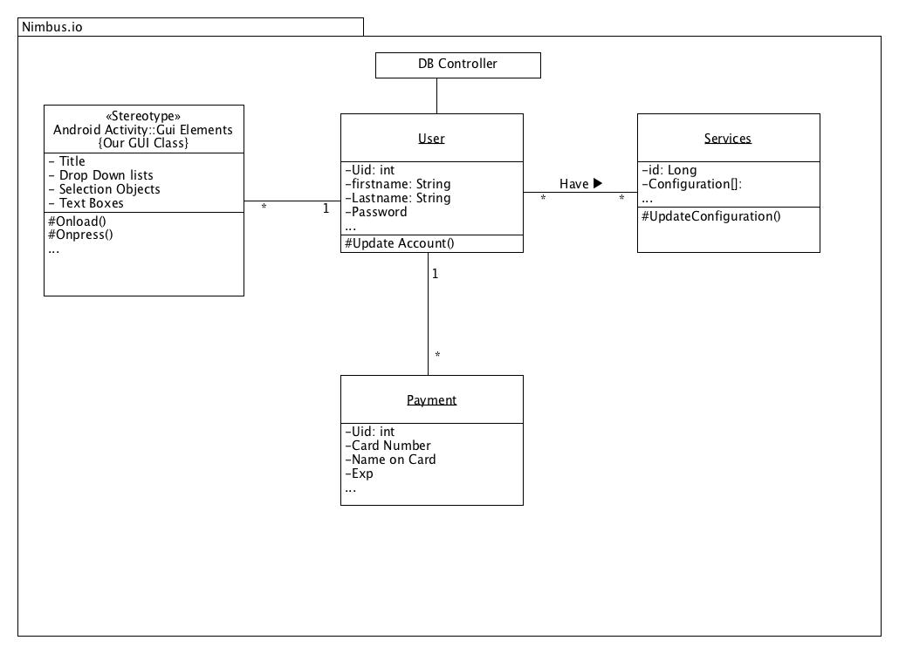
Class Diagram

Slide 6
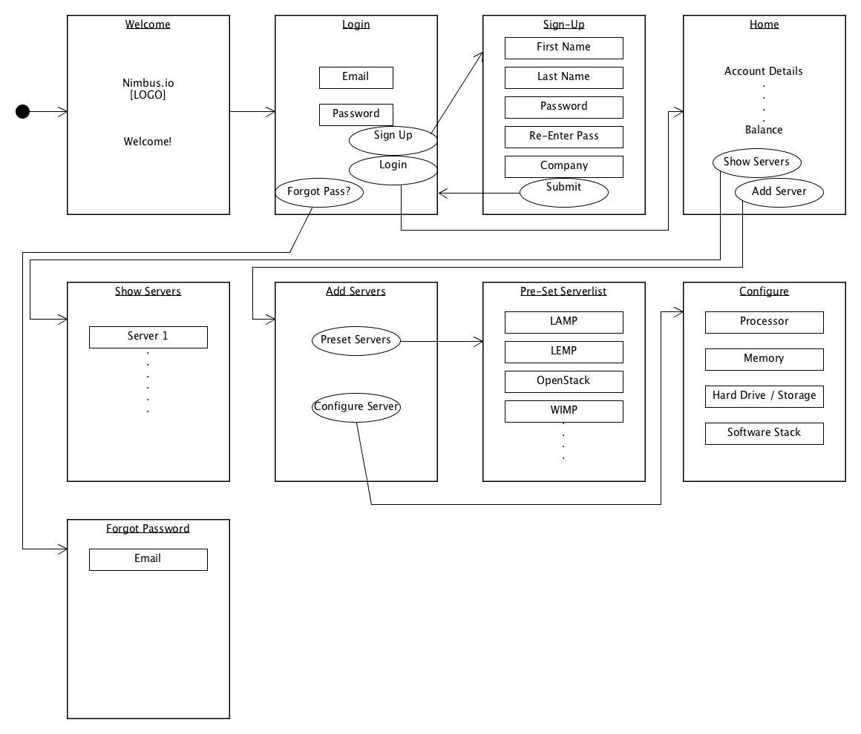
System Design
User Interface Design Diagram

Slide 7
Product Demonstration

Slide 8
Overview
Who We Are
Process Model Followed
Brief System Design Overview
Product Demo!
Testing Report
Discussion of Open Issues
Lessons Learned

Slide 9
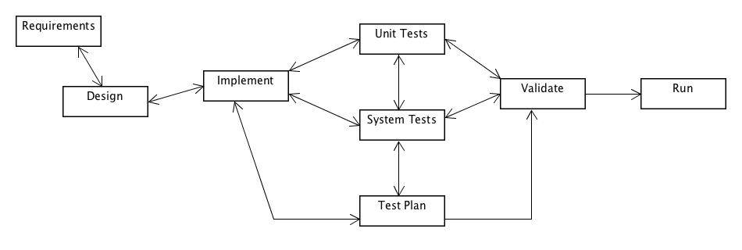
Testing Report / Issues
Comments needed improvement (Validation : Code Review : Corrected)
Database wasn’t effectively organized (System Tests : Corrected)
Not Enough Information on Add Servers Page (Validation : Outstanding)
Pricing Does Not work Correctly (Validation : Corrected)
Special Characters, Numbers accepted in First Name, Last name (Validation : Outstanding)
Testing Cycle

Slide 10
Deployment Issues
Database Required Redesign during Time Critical implementation phase
Underestimation of Database complexity caused delay
Utilized a disproportionate amount of time
In turn, Delayed creation of some unit tests
Slowed Testing Cycle and Deployment Overall

Slide 11
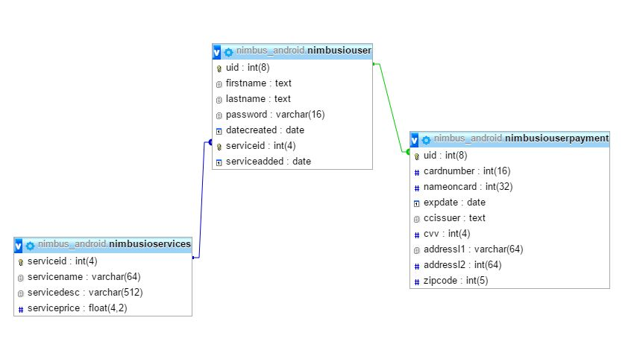
Deviations
Underestimated Database Functionality and Complexity During Design Phase
Original Database Design

Slide 12
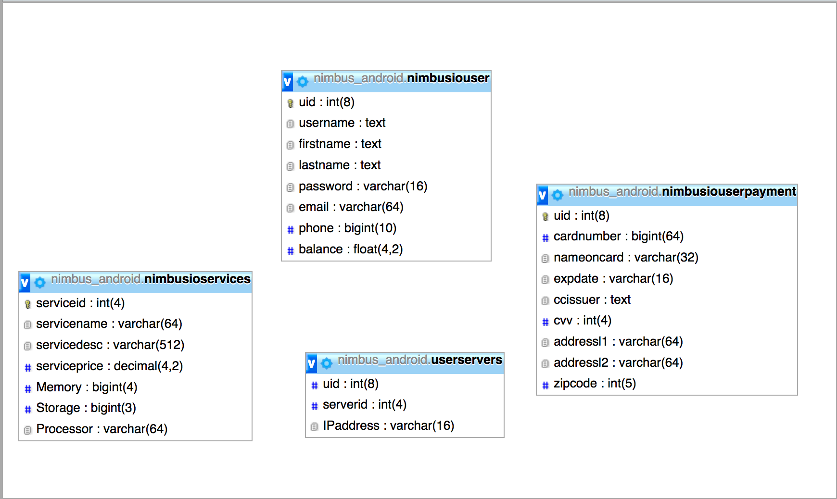
Changes
Current Database Design

Slide 13
Lessons Learned
Android Development Isn’t Easy
Implementation takes More Time then you’d think
Good planning and documentation from Analysis and Design phases Help during implementation and Testing
Pair programming can be Helpful for problem solving
Working with a team is interesting

Slide 14
If there was more time…
We would do another Increment!
Removal of Redundancies, DB
“Look and Feel” Improvements
Notify Use Cases
Encryption of Data
Payment Services
Open Issues

Slide 15
If we could do it Over?
We would focus more on Database Design
Structure and function of the Team wouldn’t Change
We would play to each other’s Strengths
Look and Feel
Allocate more time for Implementation

Slide 16
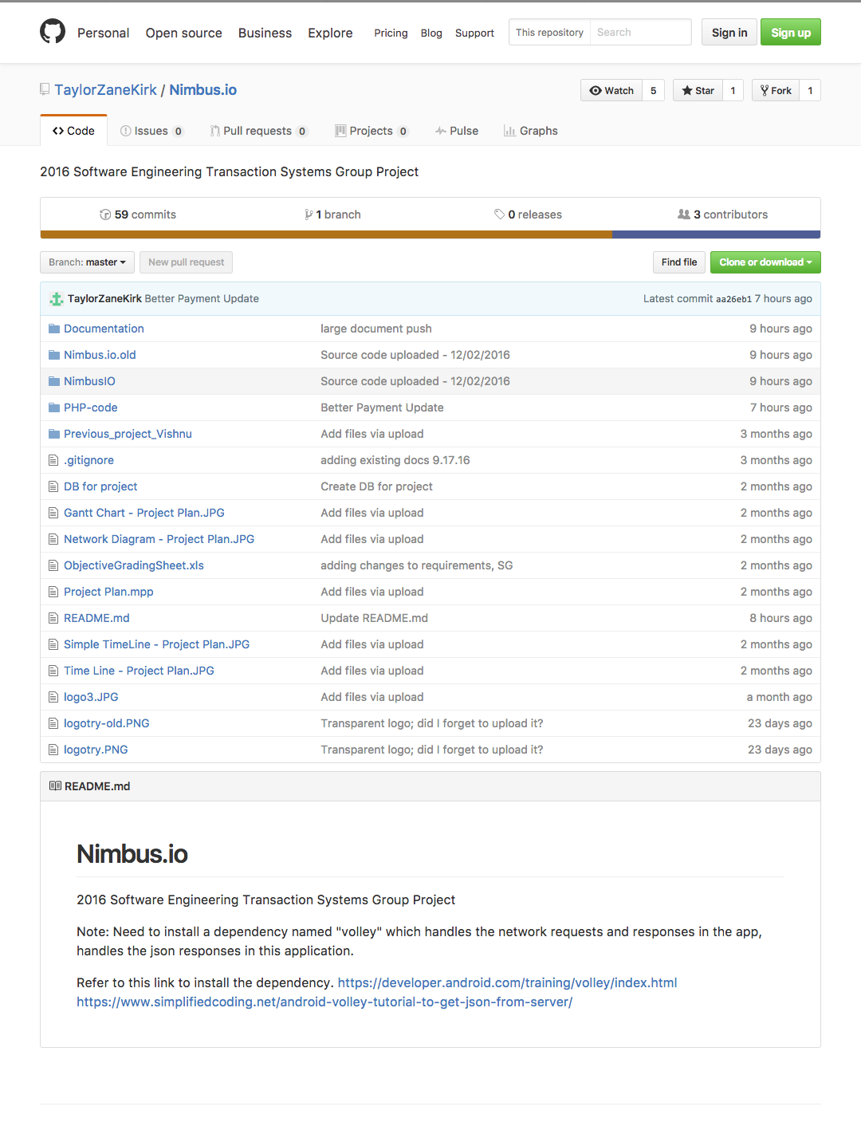
Our Github Repo
https://github.com/TaylorZaneKirk/Nimbus.io

Slide 17
Questions & Answers
Question
Answer
Query
Reply
Response
Inquiry

Slide 18

That’s all from:
Cloud – MSU

