Slide 1

Team: Cloud-MSU
CMPS 5153 Advanced Software Engineering
Tuesday, December 6th 2016

Slide 2
Introduction/Overview
Who We Are
Process Model Followed
System Design Overview, Including changes
Product Demo!
Test Report
Discussion Open Issues
Lessons Learned

Slide 3
Cloud-MSU
Mounika Mannam – Graduate, Designer, Elected Secretary
Scott Gordon – Graduate, Documentation, Designer
Taylor Kirk – Undergraduate, Database Programmer
Tejaswi Singam –Graduate, Analysis, Testing
Vishnu Mandalapu –Graduate, Elected Leader, Android Programmer

Slide 4
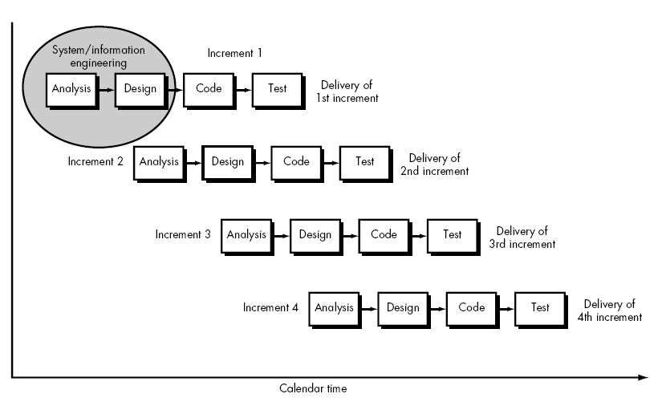
Incremental Process
Satisfied our teams need for through Requirements and Documentation
Provided “quick” delivery of initial product

Slide 5
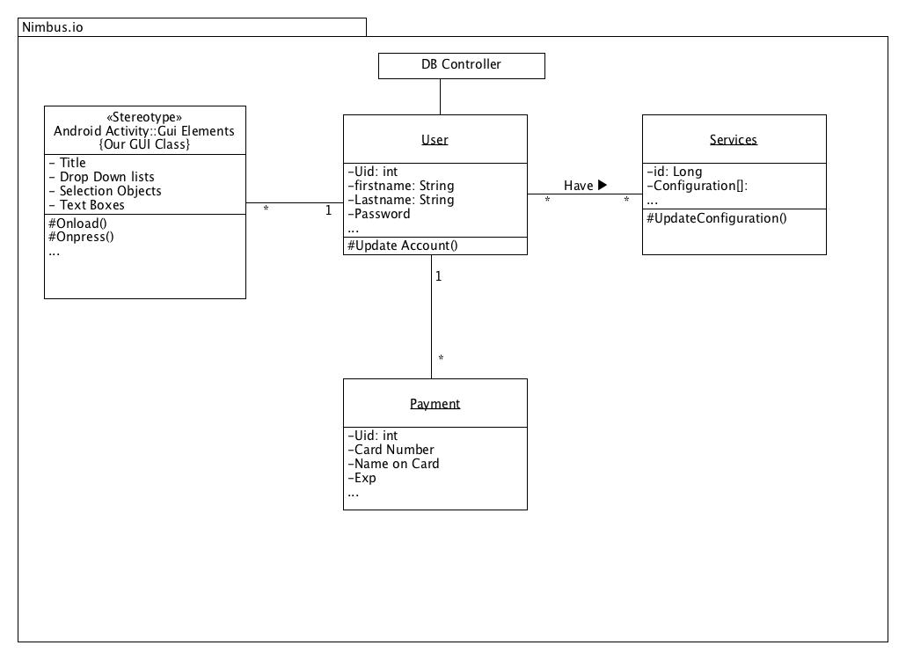
Class Diagram

Slide 6
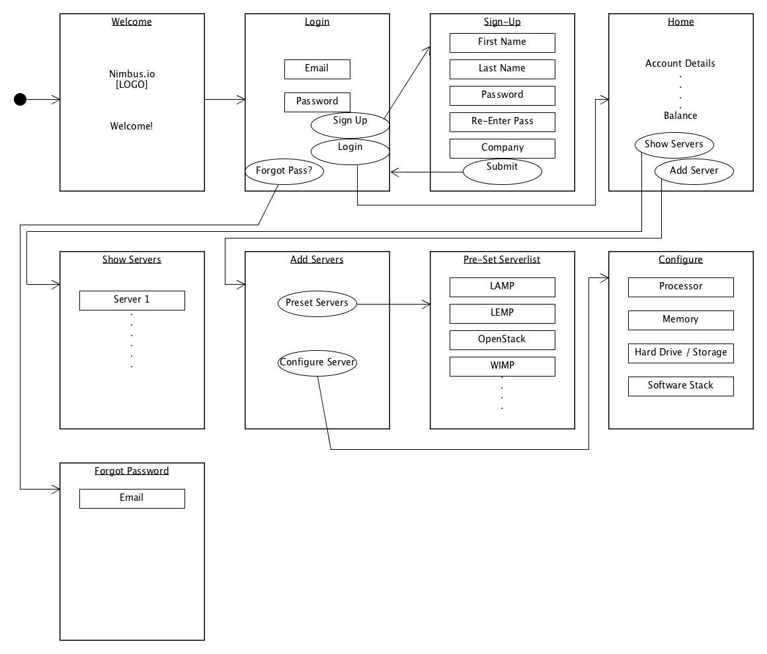
System Design
User Interface Design Diagram

Slide 7
Product Demonstration

Slide 8
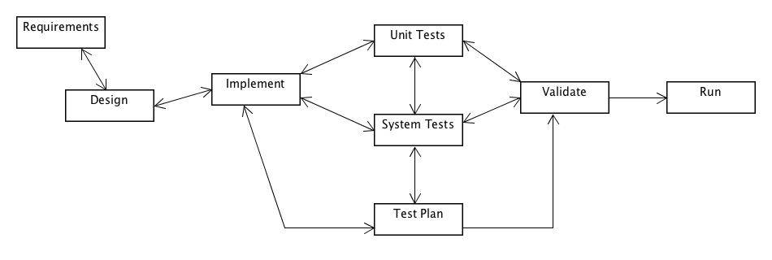
Testing Report / Issues
Comments needed improvement (Validation: Code Review : Corrected)
Database wasn’t effectively organized (System Tests : Corrected)
4 (Validation : Outstanding)
5 (Validation : Outstanding)
Testing Cycle

Slide 9
Deployment Issues
Database Required Redesign during Time Critical implementation phase
Underestimation of Database complexity caused delay
In turn, Delayed creation of some unit tests

Slide 10
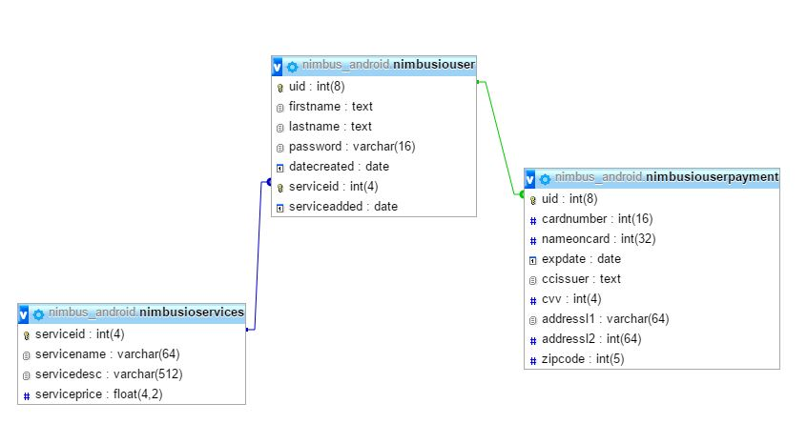
Deviations
Underestimated Database Functionality and Complexity During Design Phase
Original Database Design

Slide 11
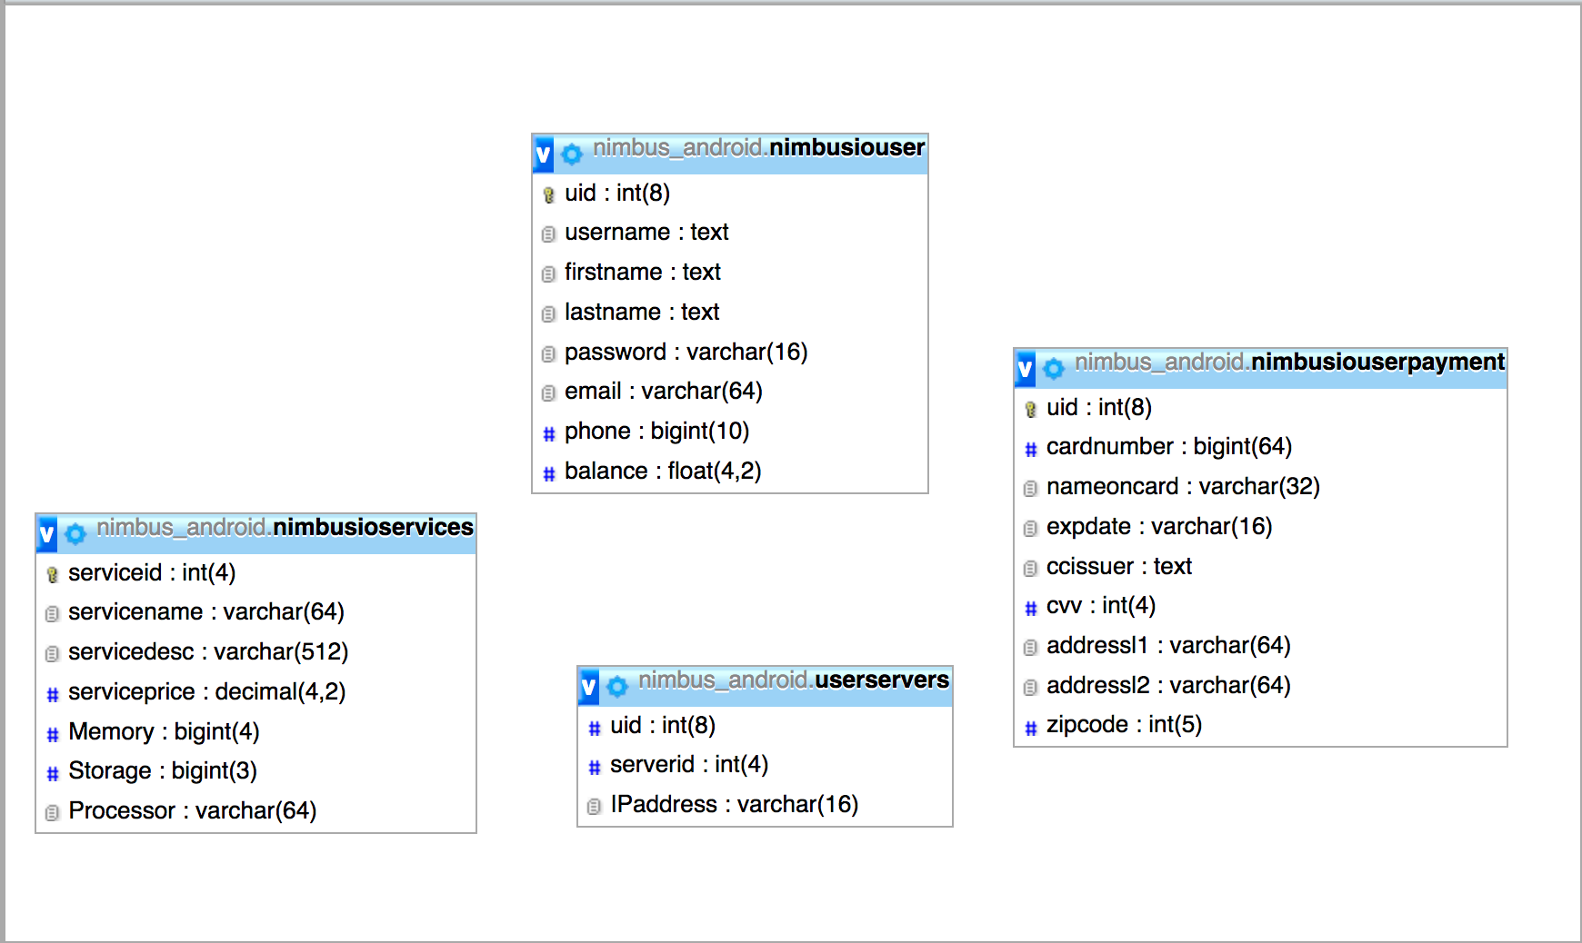
Changes
Current Database Design

Slide 12
Lessons Learned
Android Development Isn’t Easy
Implementation takes More Time then you’d think
Good planning and documentation from Analysis and Design phases Help during implementation and Testing
Pair programming can be Helpful for problem solving
Working with a team is interesting

Slide 13
We had to do it over?
We would do another Increment!
Removal of Redundancies, DB
“Look and Feel” Improvements
Administrator Accounts & Notification Use Cases
Encryption of Data
Payment Services

Slide 14
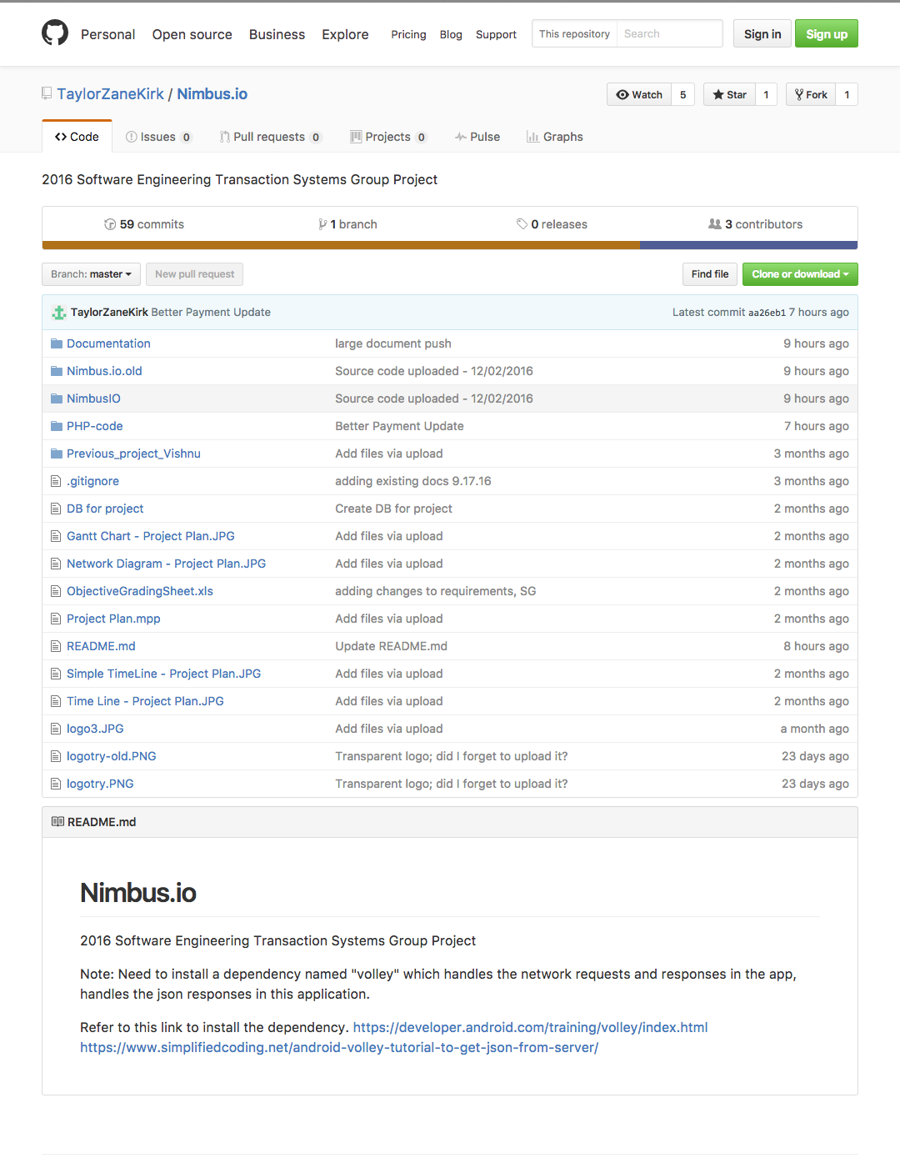
Our Github Repo
https://github.com/TaylorZaneKirk/Nimbus.io

Slide 15
Questions & Answers
Question
Answer
Query
Reply
Response
Inquiry

Slide 16

That’s all from:
Cloud – MSU

