Slide 1

Digital to Analog Converter (DAC), COMP and OPAMP
ECE433/ECC533/CS456

Slide 2
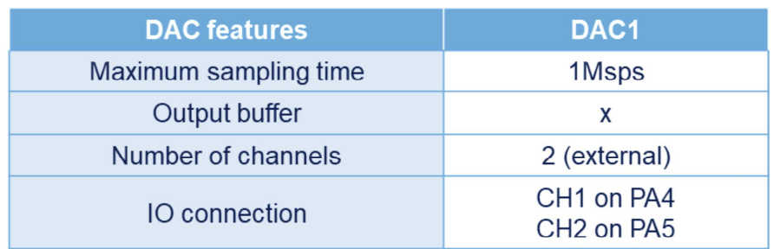
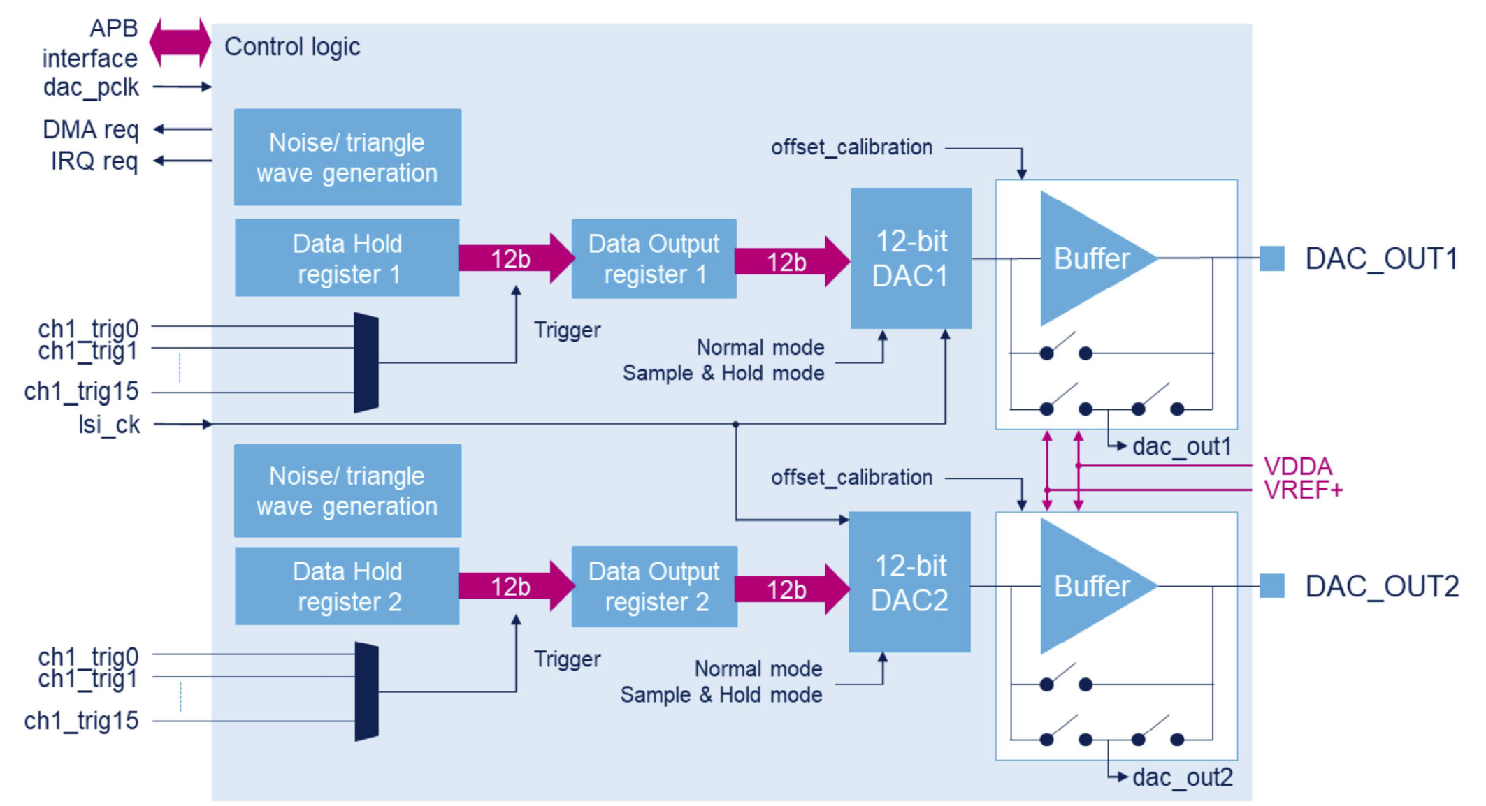
Digital Analog Converter (DAC)
STM32L5 DAC
https://www.youtube.com/watch?v=zGoTCO020ec

Slide 3
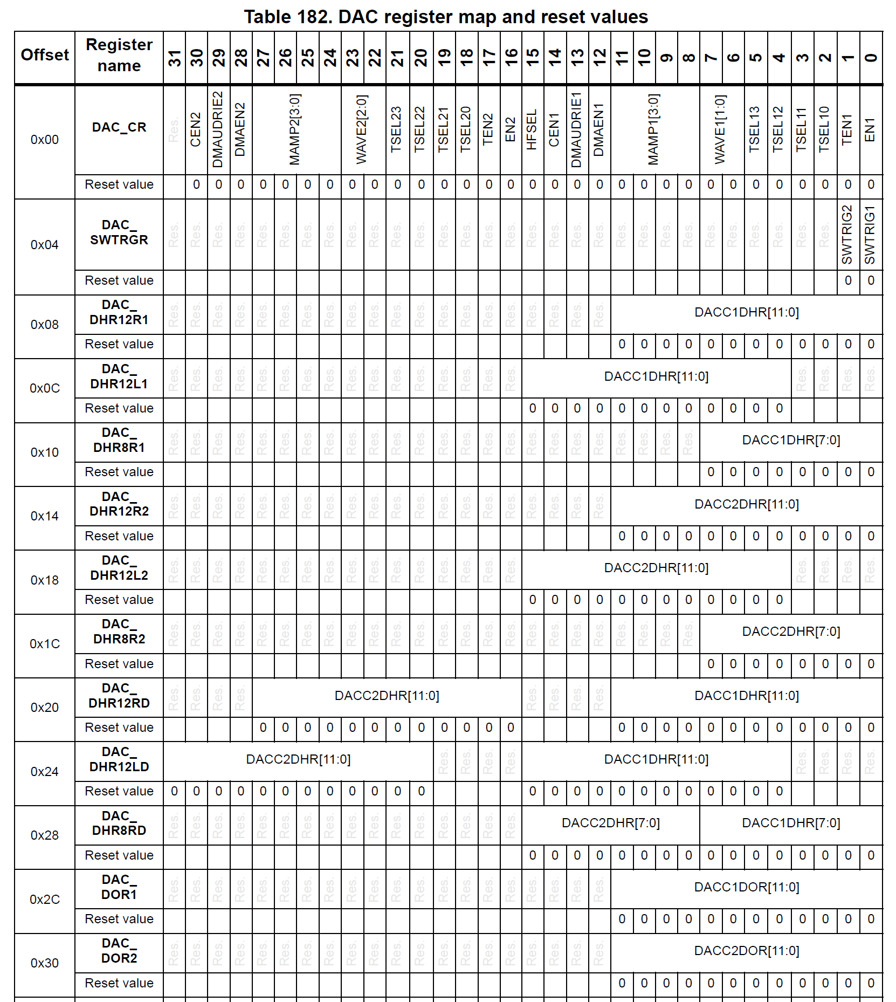

Slide 4
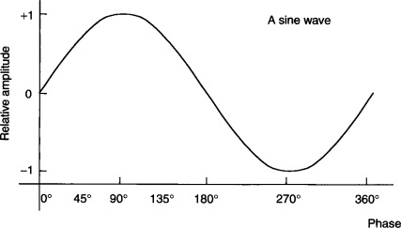
LAB 6 Tips (DAC Application)
Enable DAC1 RCC
Enable GPIO in analog mode
Configure & Enable DAC
Enable Timer RCC
Configure timer to interrupt every 10usec (to give you 100 samples per 1msec for 1KHz sinewave)
In the timer IRQHandler, set DAC to dac_val_12b using DHR12R1 register and re-enable it

Slide 5
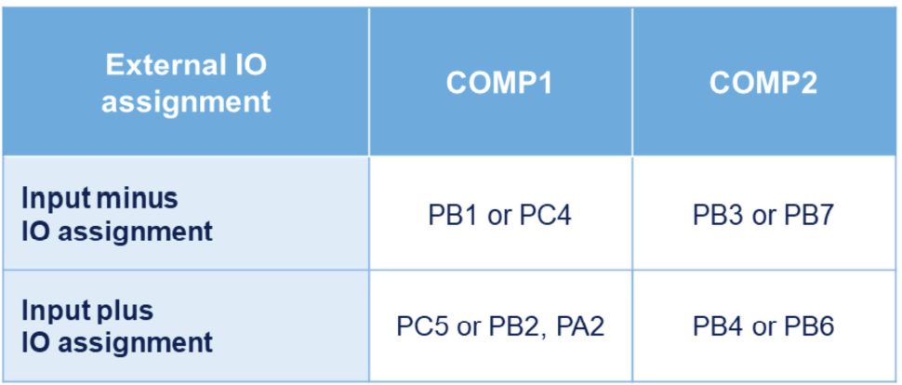
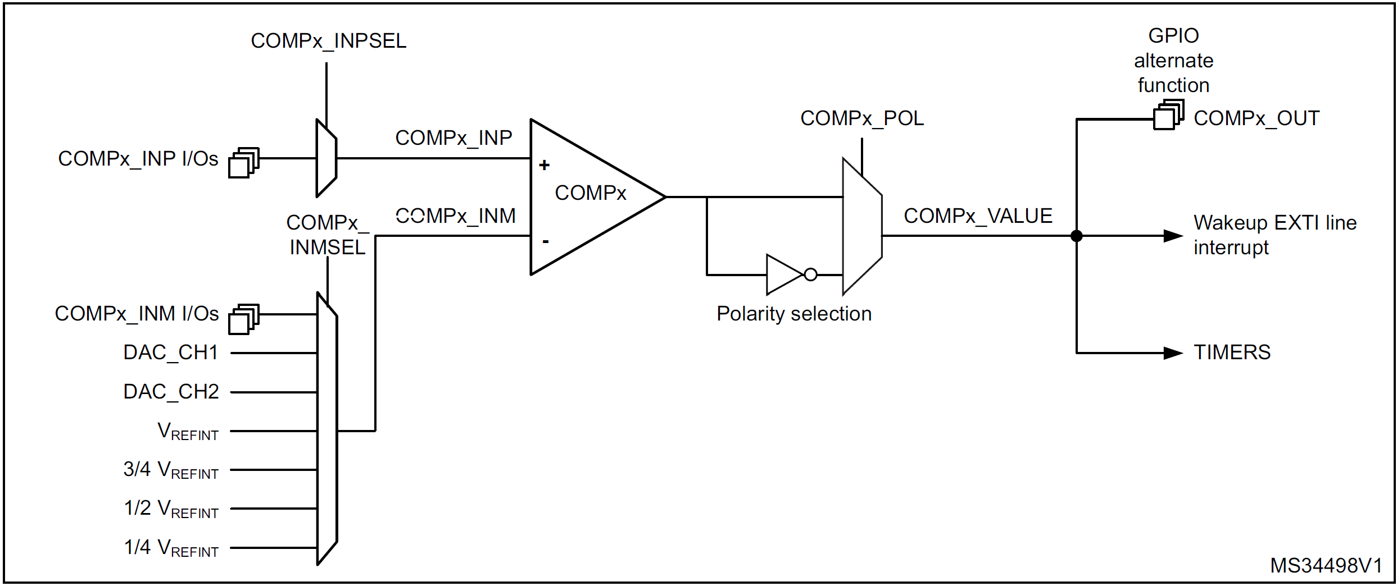
Comparator (COMP)
STM32L5 COMP
https://www.youtube.com/watch?v=C3vDEClilwM

Slide 6
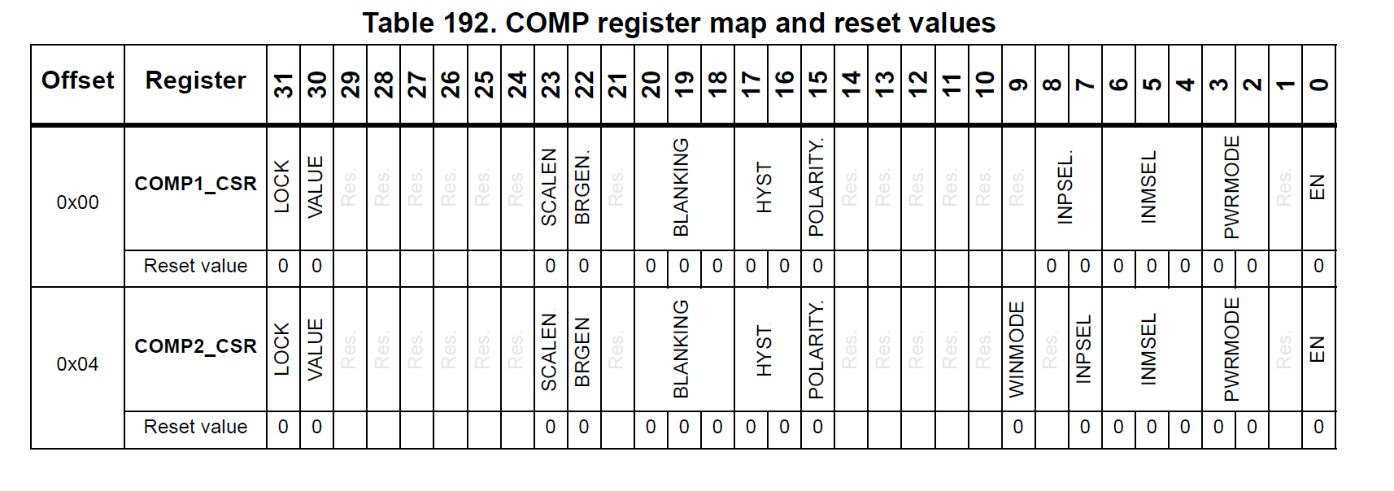

Slide 7
LAB 6 Tips (COMP Application)
Read the voltage of temp sensor at ambient (called V_{T0})
Enable DAC1 RCC
Set DAC1 to a value a little higher than V_{T0} (called V_{T+})
Configure DAC1 so its output is connected to chip peripherals internally (MCR register)
Enable DAC1
Enable COMP1 RCC
Enable GPIO in analog mode
Configure COMP1 inputs in CSR
Enable COMP1
Check COMP1 output in reg CSR and turn LED on if temp sensor voltage is higher than V_{T+}

Slide 8
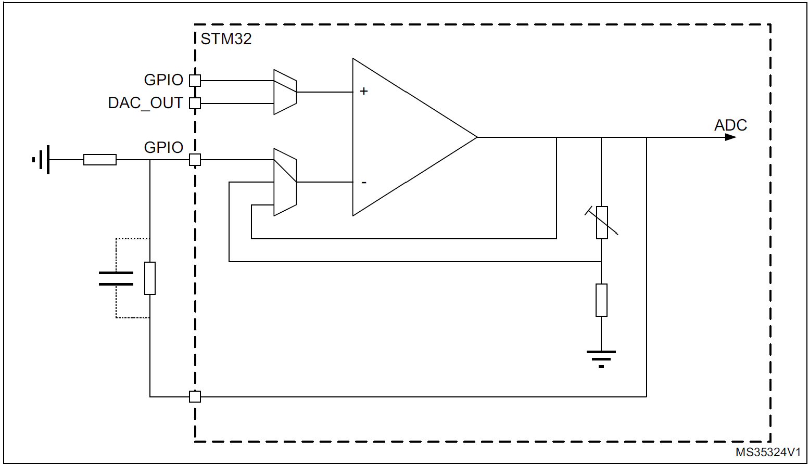
Operational Amplifier (OPAMP)
STM32L5 OPAMP
https://www.youtube.com/watch?v=FT22Yi8L4Wc

Slide 9
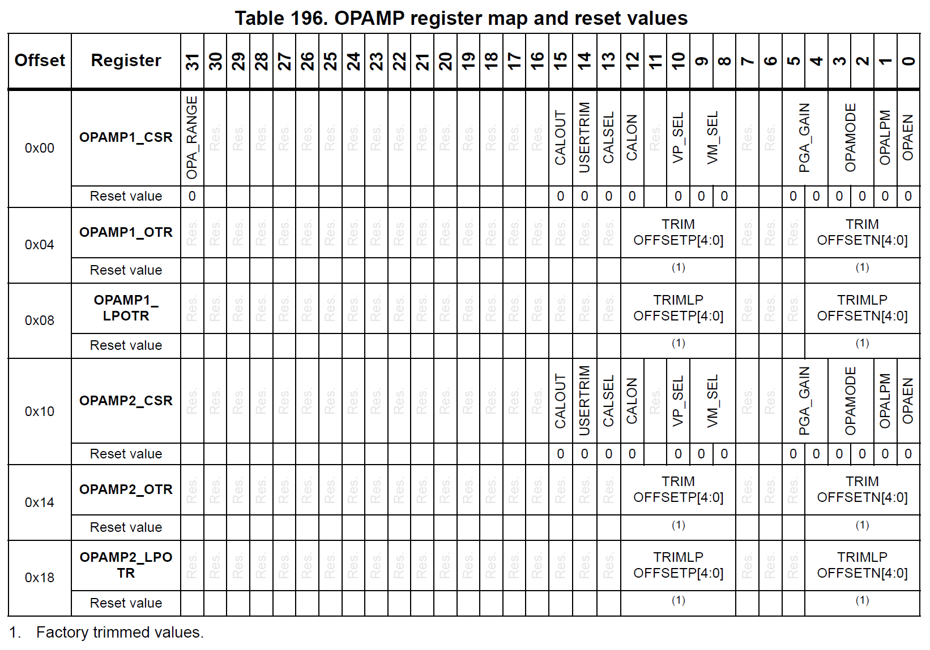

Slide 10
LAB 6 Tips (OPAMP Application)
Enable OPAMP1 RCC
Configure OPAMP1 to run in internal PGA mode with gain of 2 (CSR register)
Enable GPIO
Configure GPIO to analog
Configure GPIO connection to VINP (CSR[10])
Enable OPAMP
Enable ADC1 RCC
Enable ADC1 and connect it to OPAMP1 internally (SQR1)
ADC value will be twice of what you have seen in previous lab!

