Slide 1

Embedded & Portable Computing Systems (ECE433/ECC533)
GPIOs & Power/Clock Domain

Slide 2
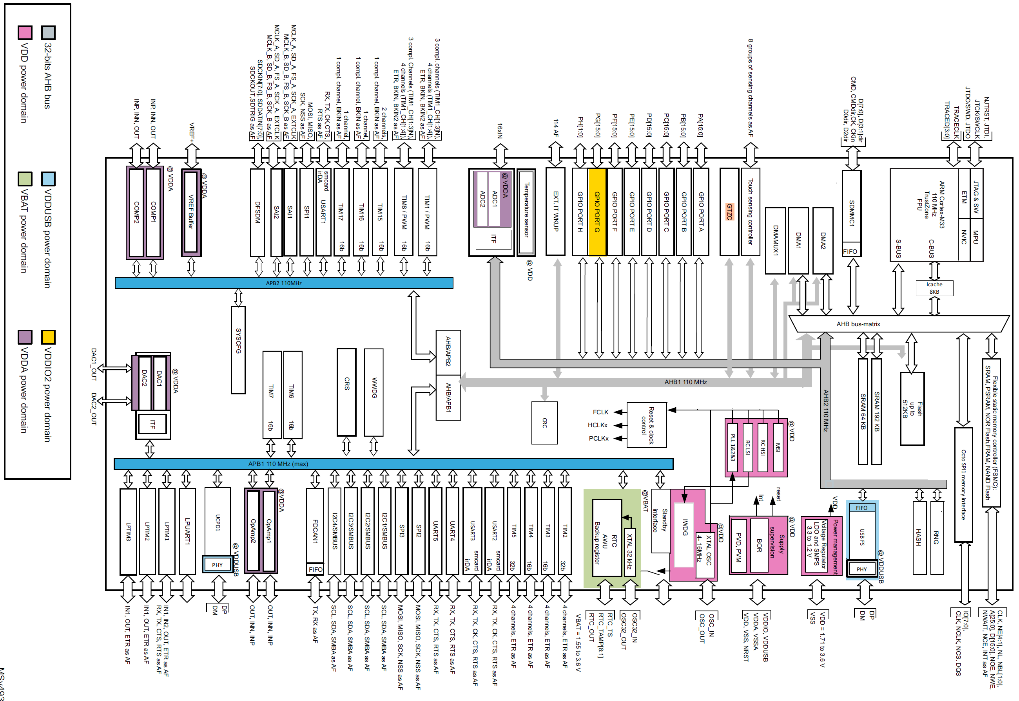
Clock Domain

Slide 3
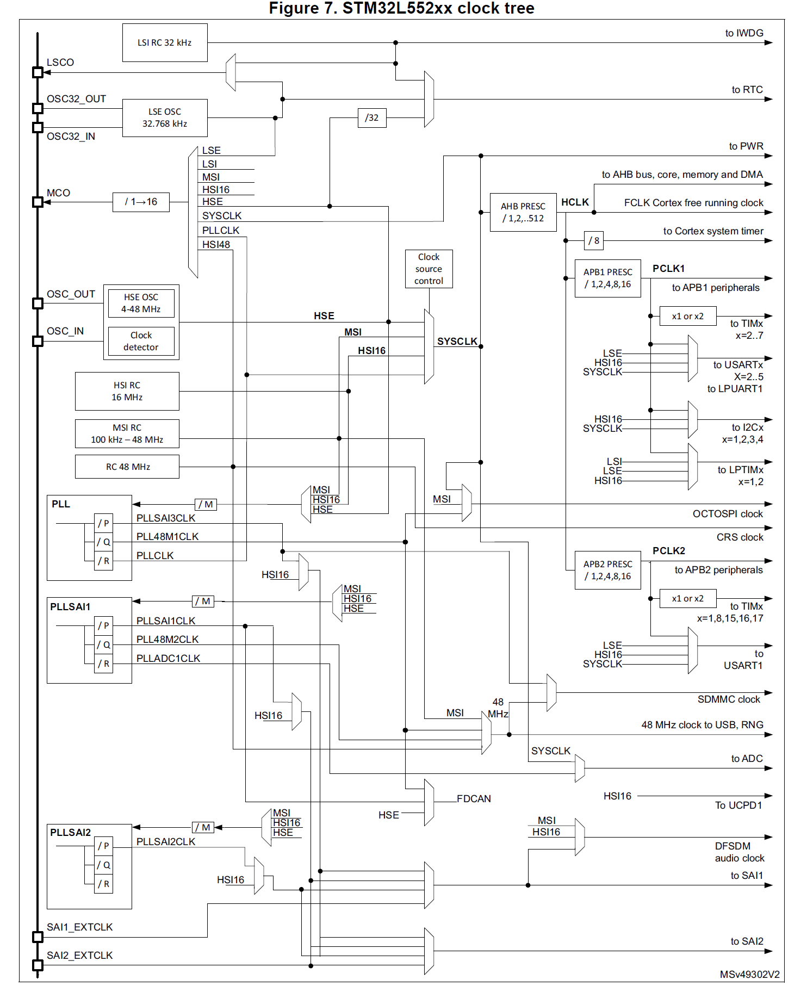

Slide 4
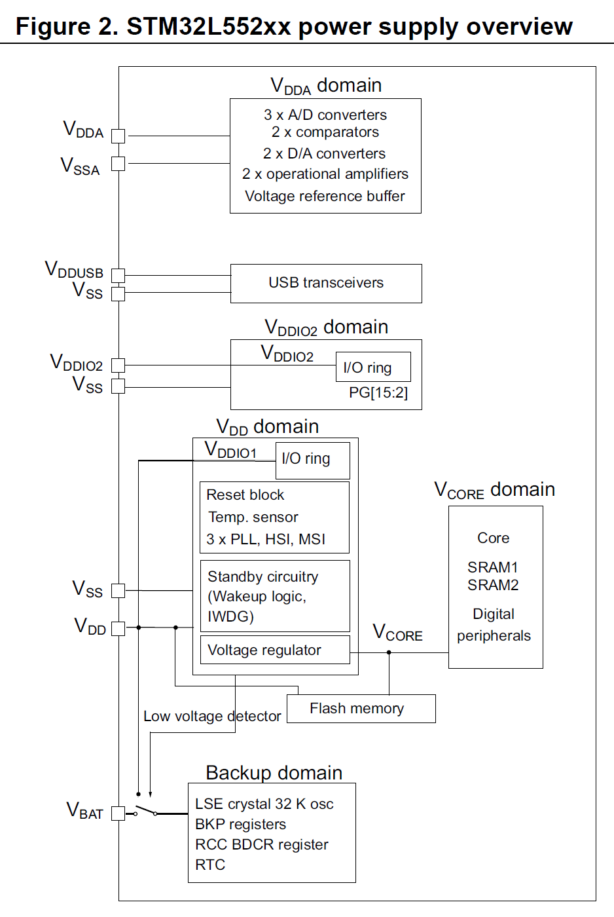
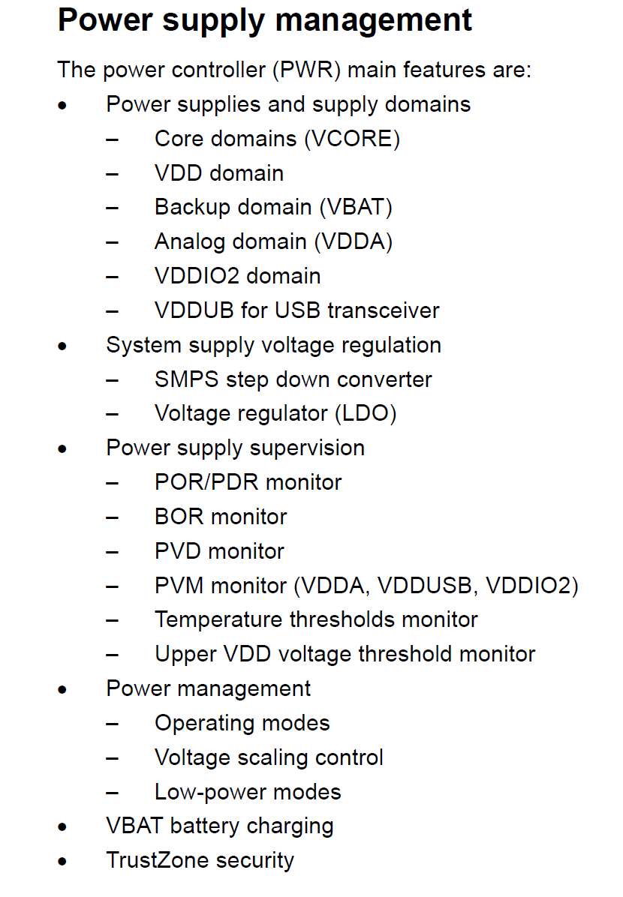
Power Domain

Slide 5
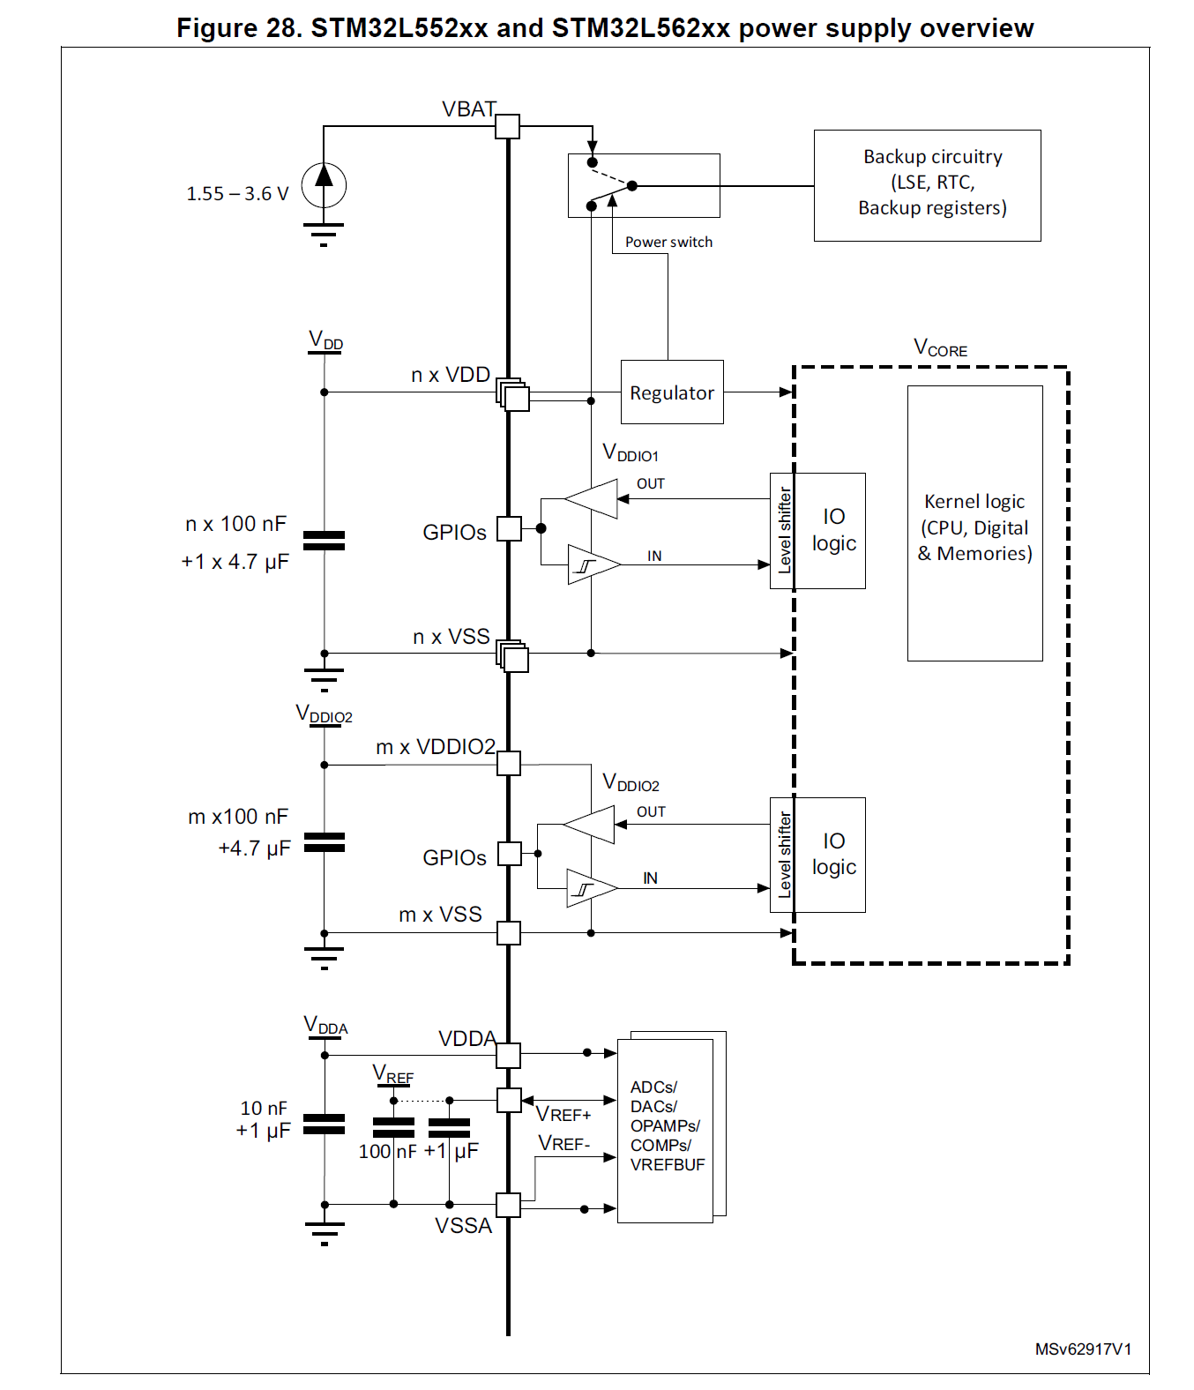
Power Supply Overview

Slide 6
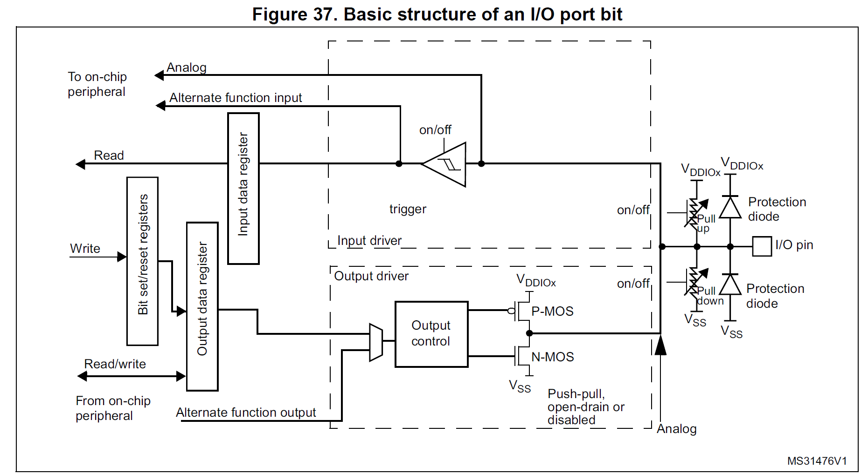
GPIO

Slide 7
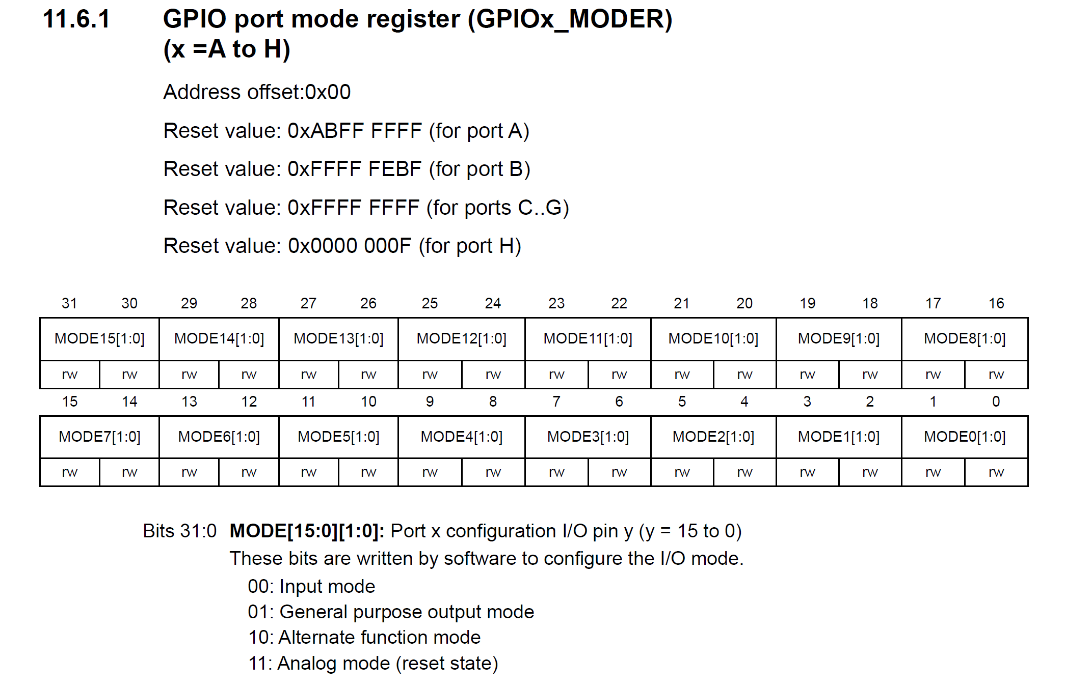
GPIO MODE Register (MODER)

Slide 8
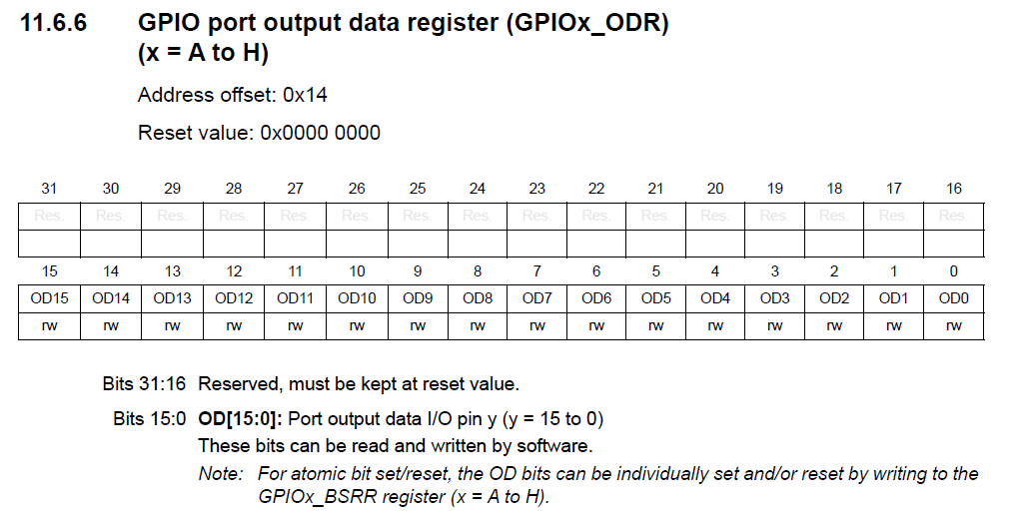
GPIO Port Output Data Register (ODR)

Slide 9
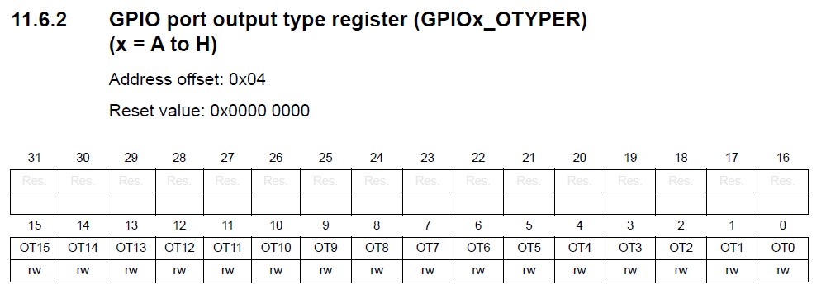
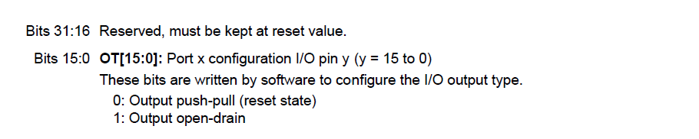
GPIO Output Type Register (OTYPER)

Slide 10
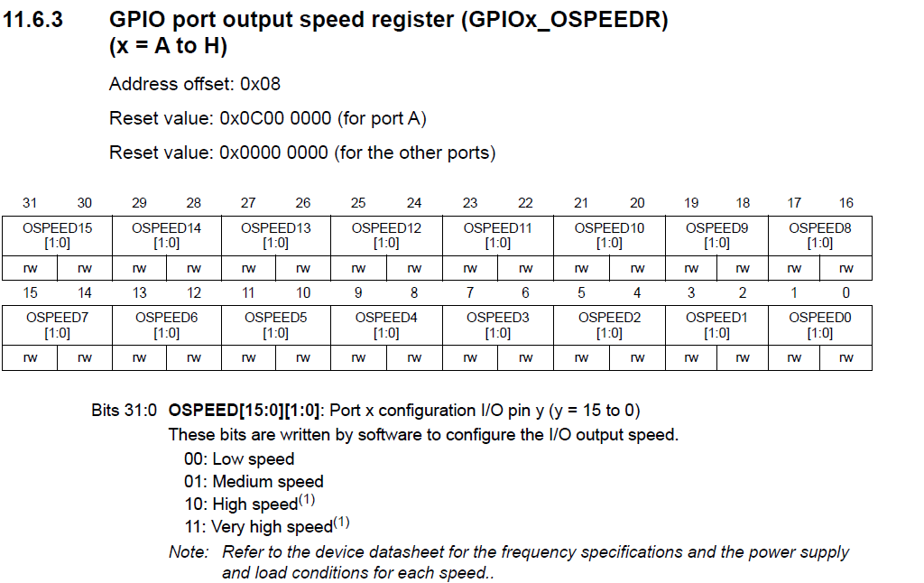
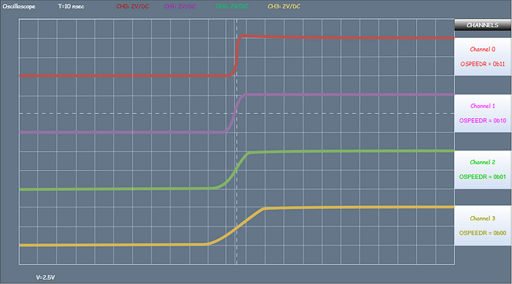
GPIO Port Output Speed
https://medium.com/@aliaksandr.kavalchuk/the-gpio-output-speed-whats-behind-this-parameter-dcceaa351875

Slide 11
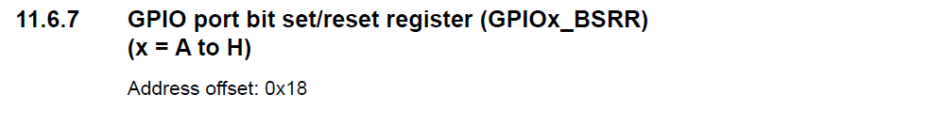
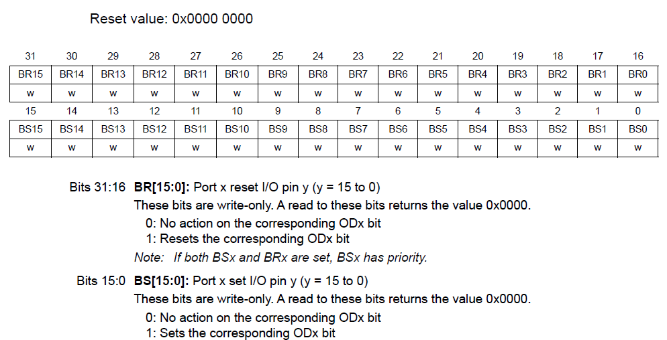
GPIO Port Bit Set/Reset Register (BSRR)

Slide 12
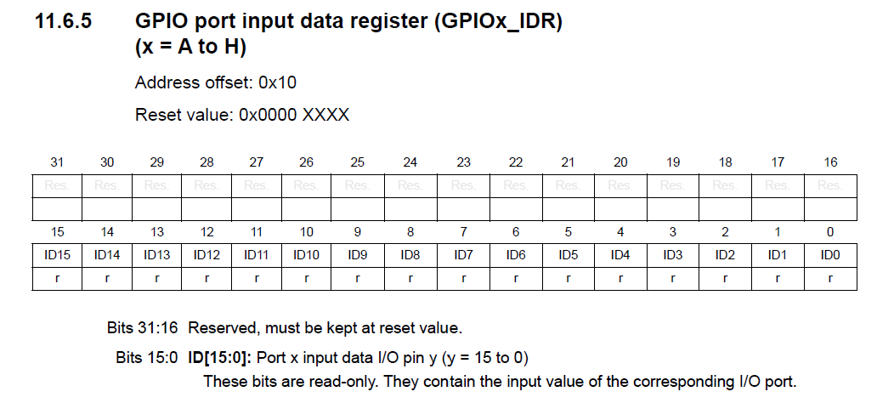
GPIO Port Input Data Register (IDR)

Slide 13
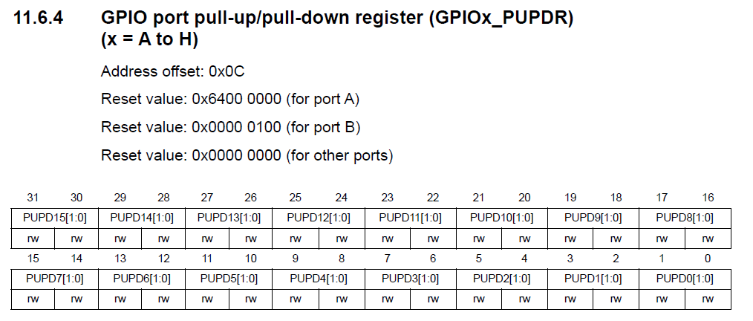
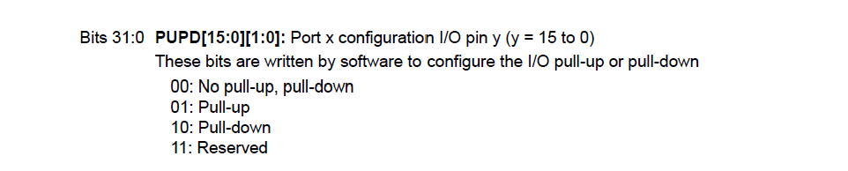
GPIO Port Pull-Up/Pull-Down Register (PUPDR)

Slide 14
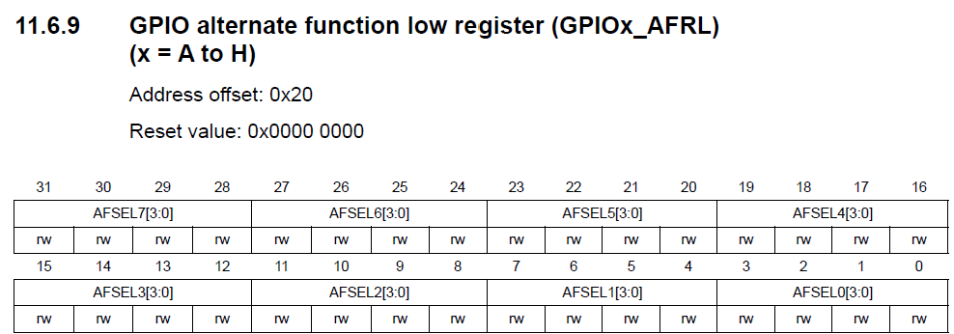
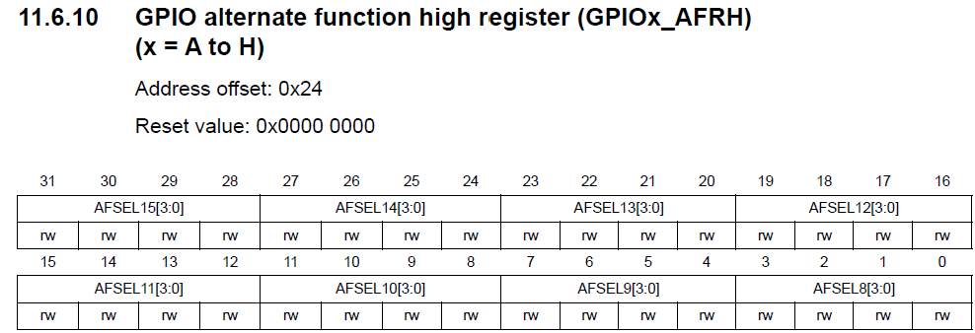
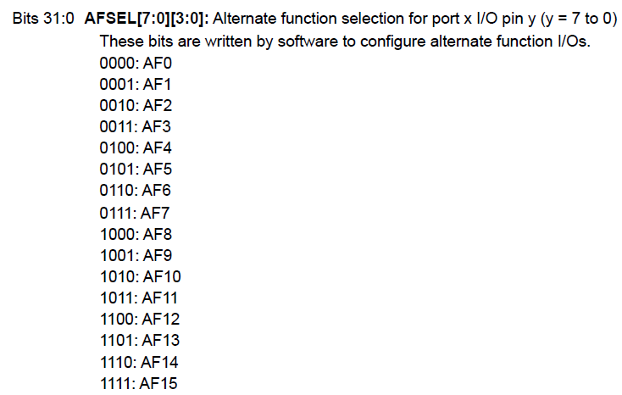
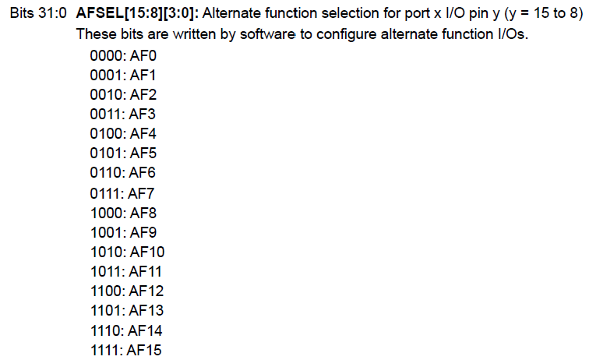
GPIO Alternate Function Registers (AFR[0] & AFR[1])

Slide 15
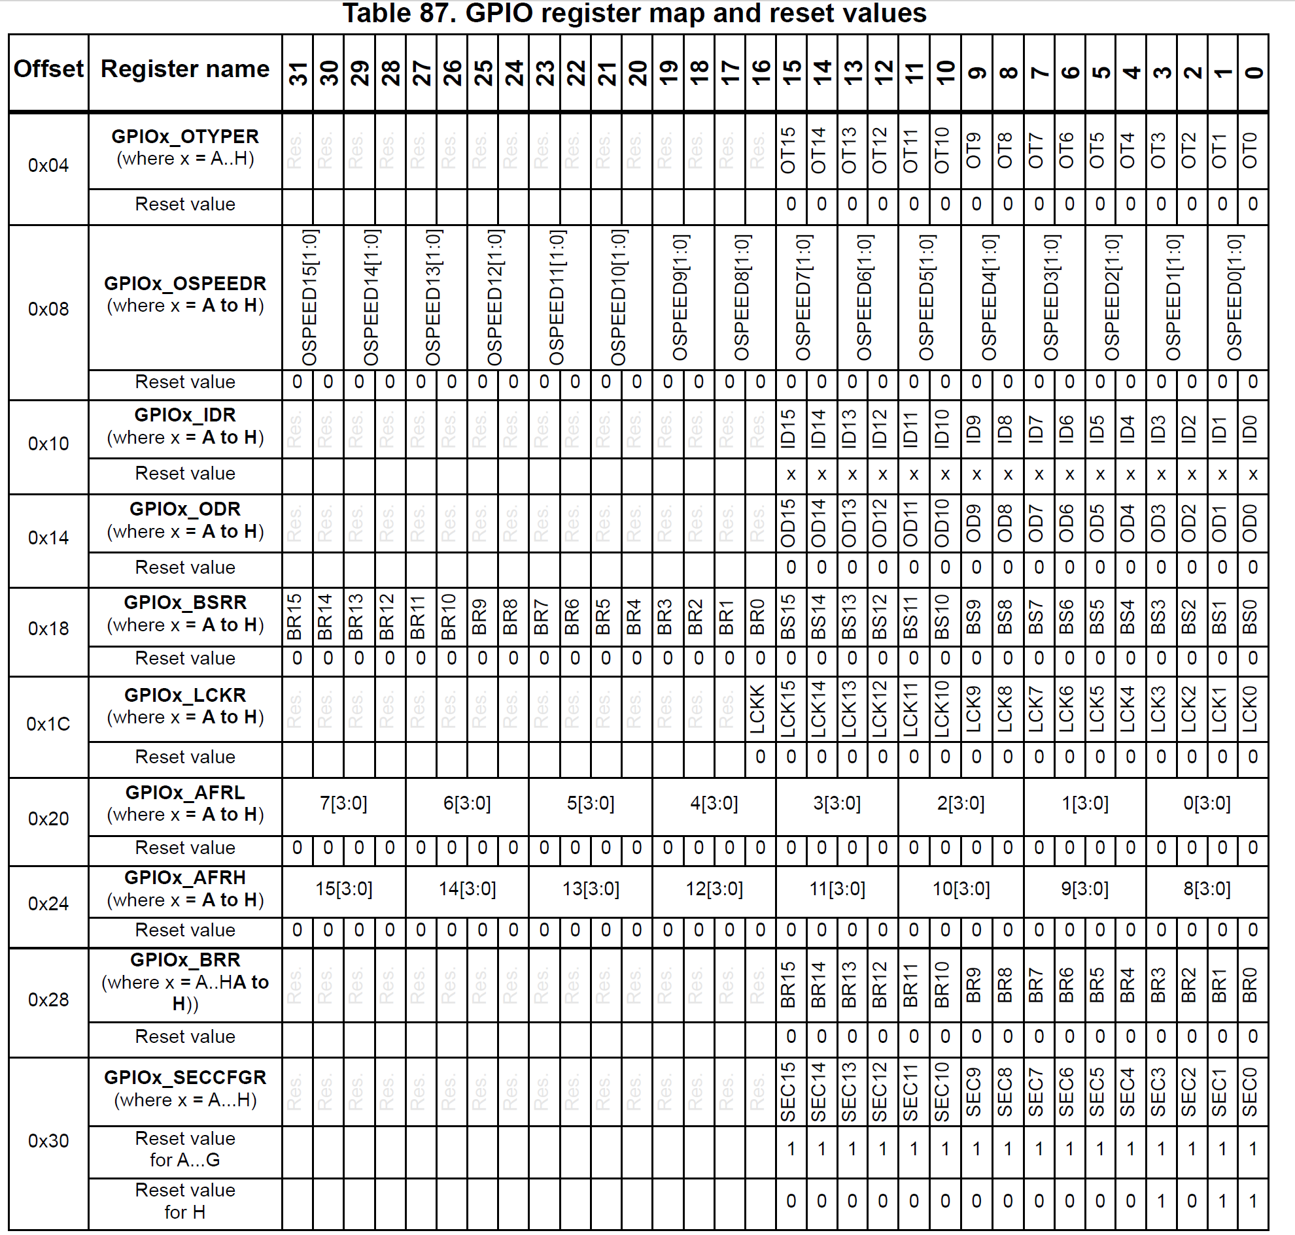
GPIO Register Map

