Slide 1

Interrupts
ECE433/ECC533

Slide 2
External slides by STM
Slides link

Slide 3
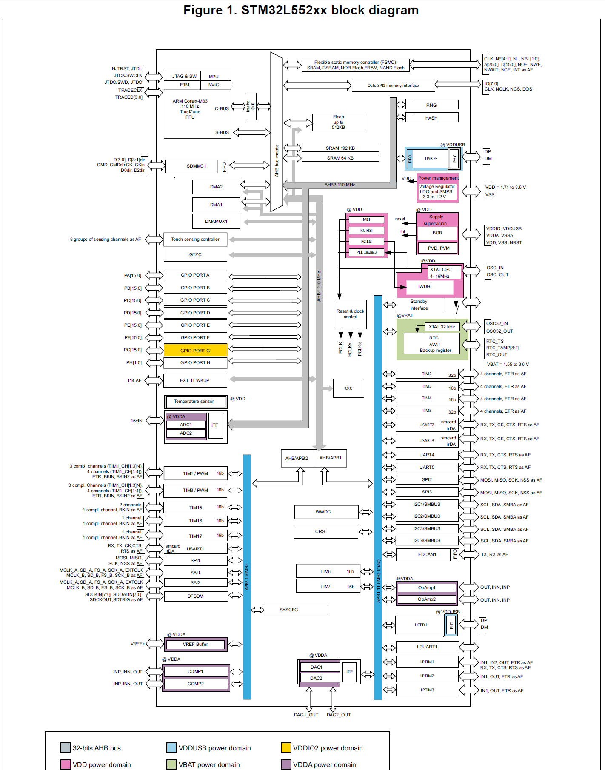
Interrupt Blocks
Nested Vectored Interrupt Controller (NVIC)
System Configuration Controller (SYSCFG)
Extended Interrupt (EXTI)

Slide 4
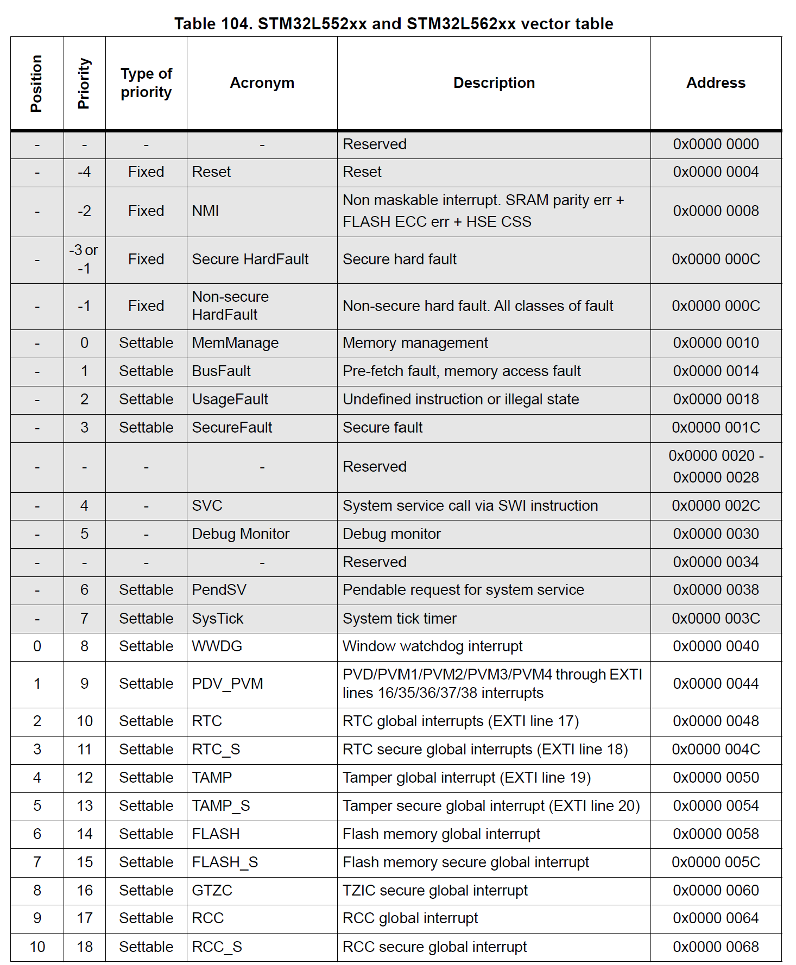
Interrupt Vector Table (1/4)

Slide 5
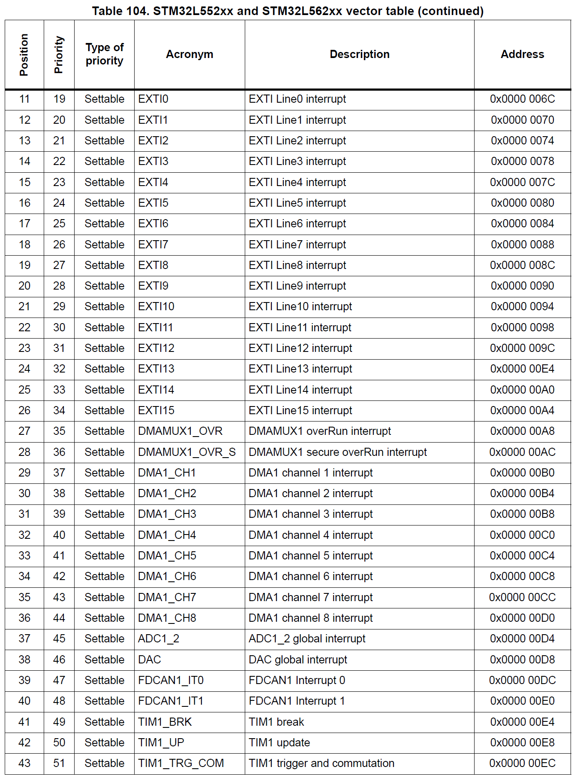
Interrupt Vector Table (2/4)

Slide 6
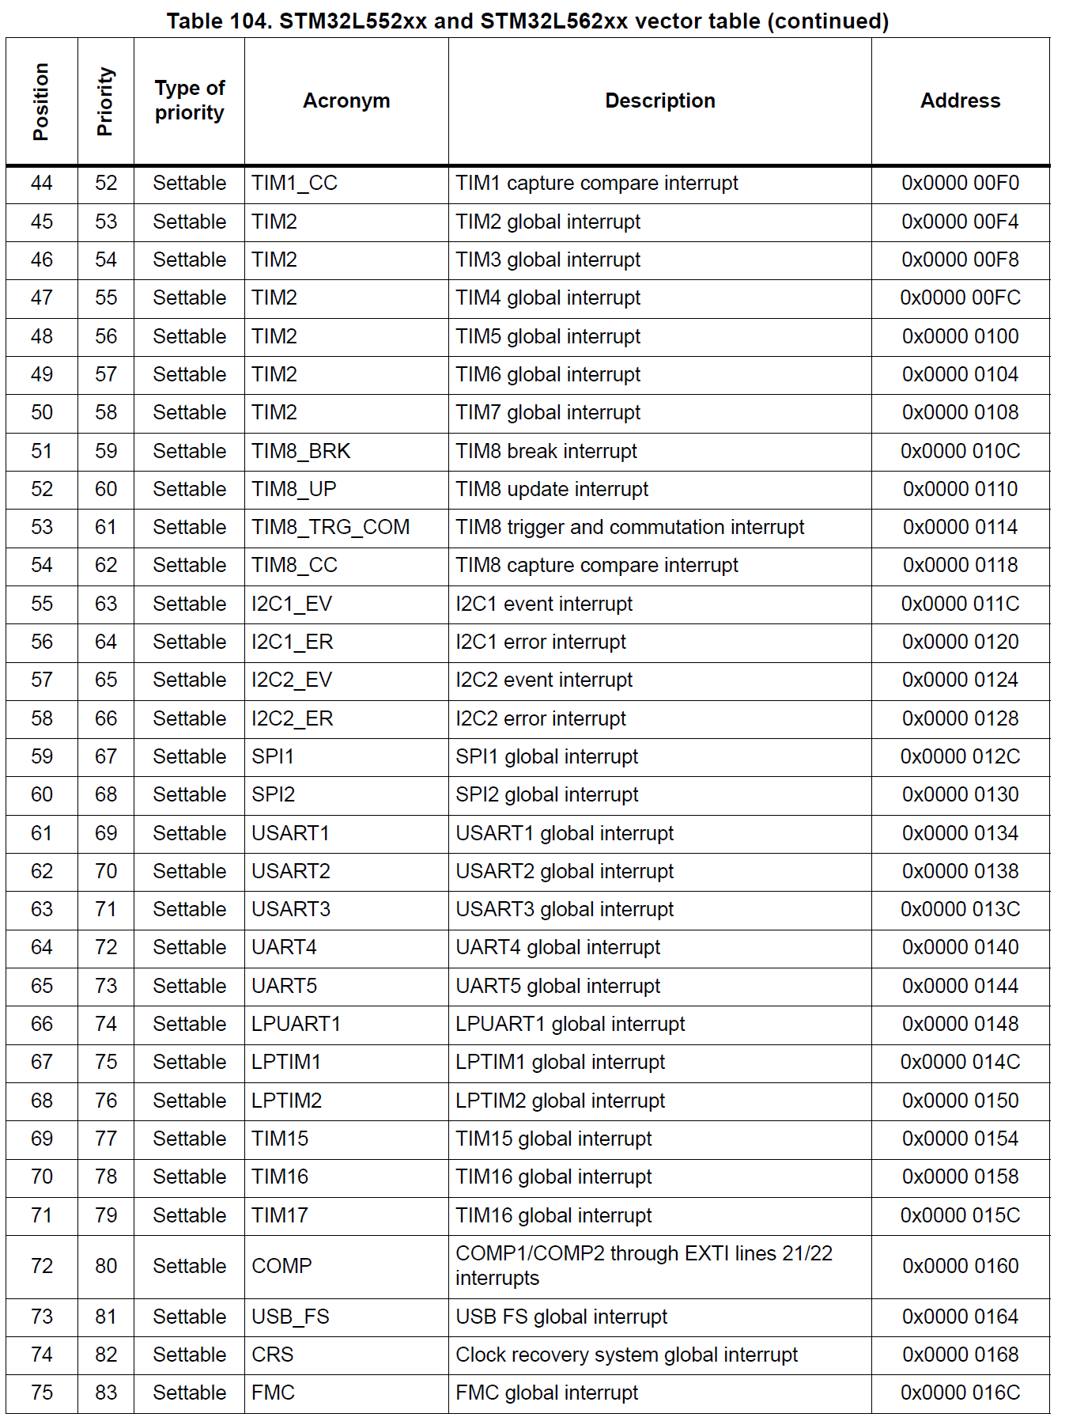
Interrupt Vector Table (3/4)

Slide 7
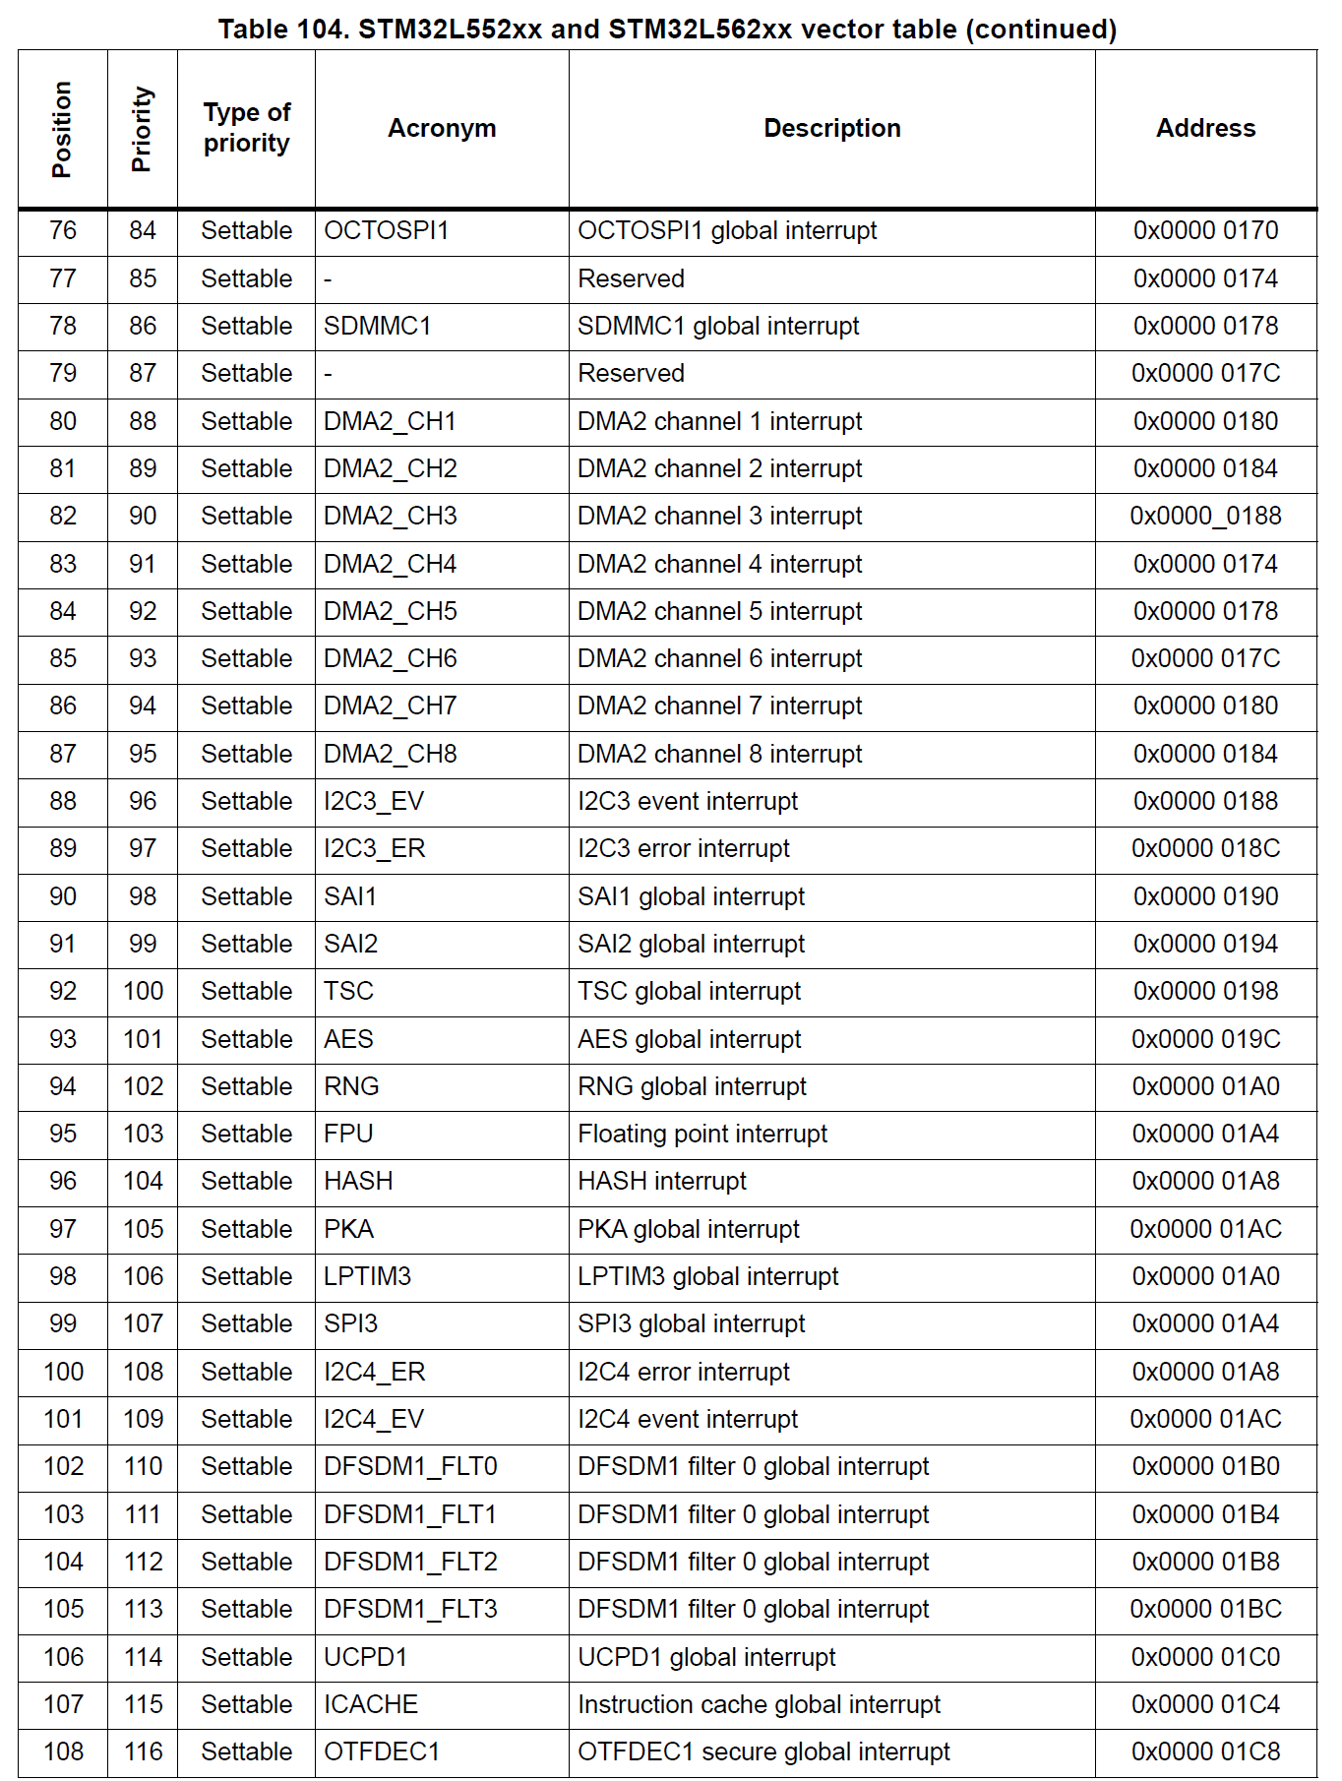
Interrupt Vector Table (4/4)

Slide 8
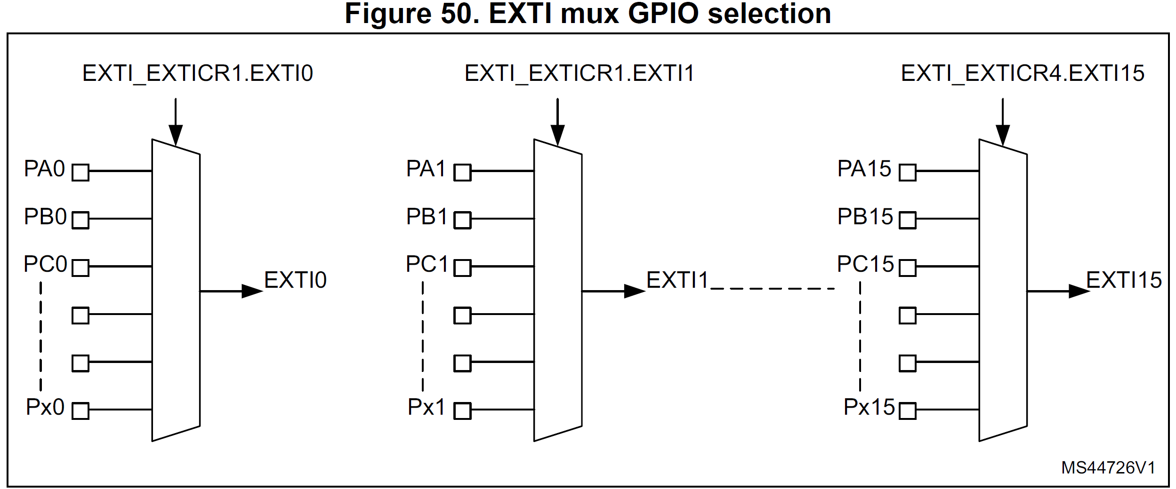
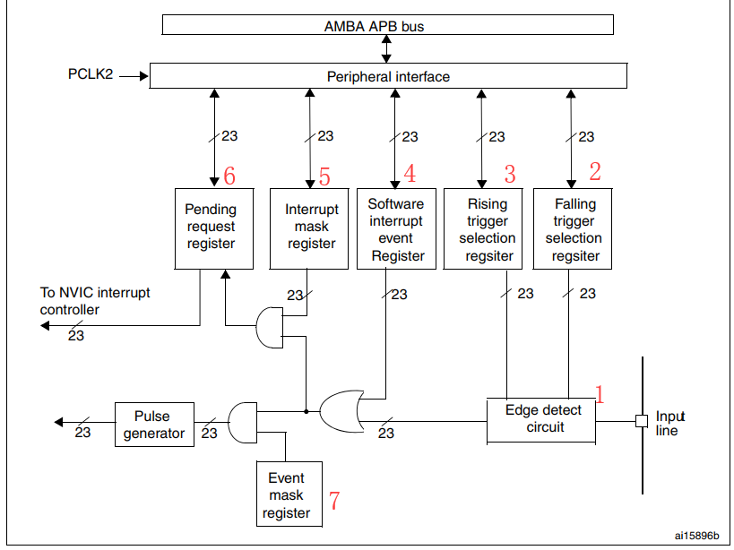
Using External Interrupt (EXTI)
Enable GPIO as input
Enable Clock to SYSCFG
Select Input Using EXTI->EXTICR[x]
Select Trigger type (Failing or Raising Edge)
Disable Interrupt Mask
Setup Interrupt Priority
Enable IRQ in NVIC
Enable Global Interrupt Flag
Define Interrupt Service Routine (ISR)
In ISR, clear flag in Falling/Raising Pending Register by writing 1 to it.

Slide 9
Notes:
Priority field has 8 bit but only 3 MSB are used.
Global interrupt flag seems to be enabled by default (I bit in xPSR)
EXTI interrupt must be manually cleared after ISR is called (by writing 1 to the Falling/Raising Pending Register, e.g., EXTI->FPRx)
One Interrupt handler could serve more than one flag (event), hence it is a good practice to verify the event that cause the ISR to be called.

Slide 10
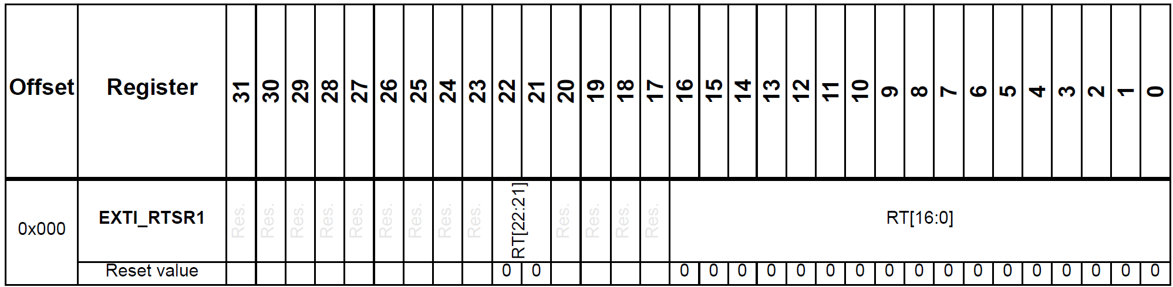
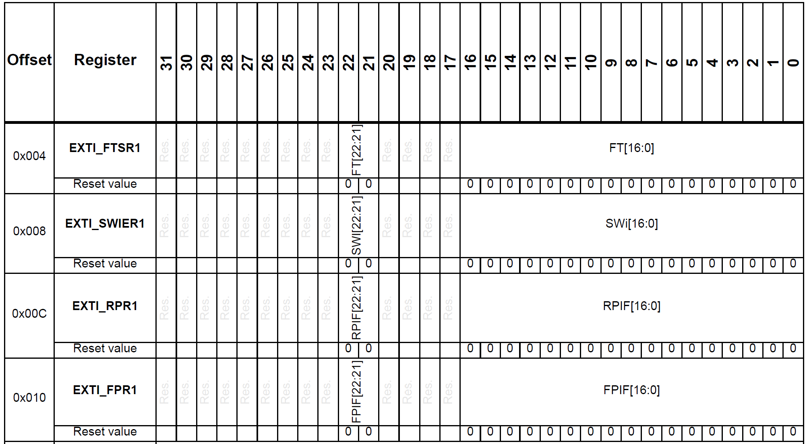
EXTI Reg Map:

Slide 11
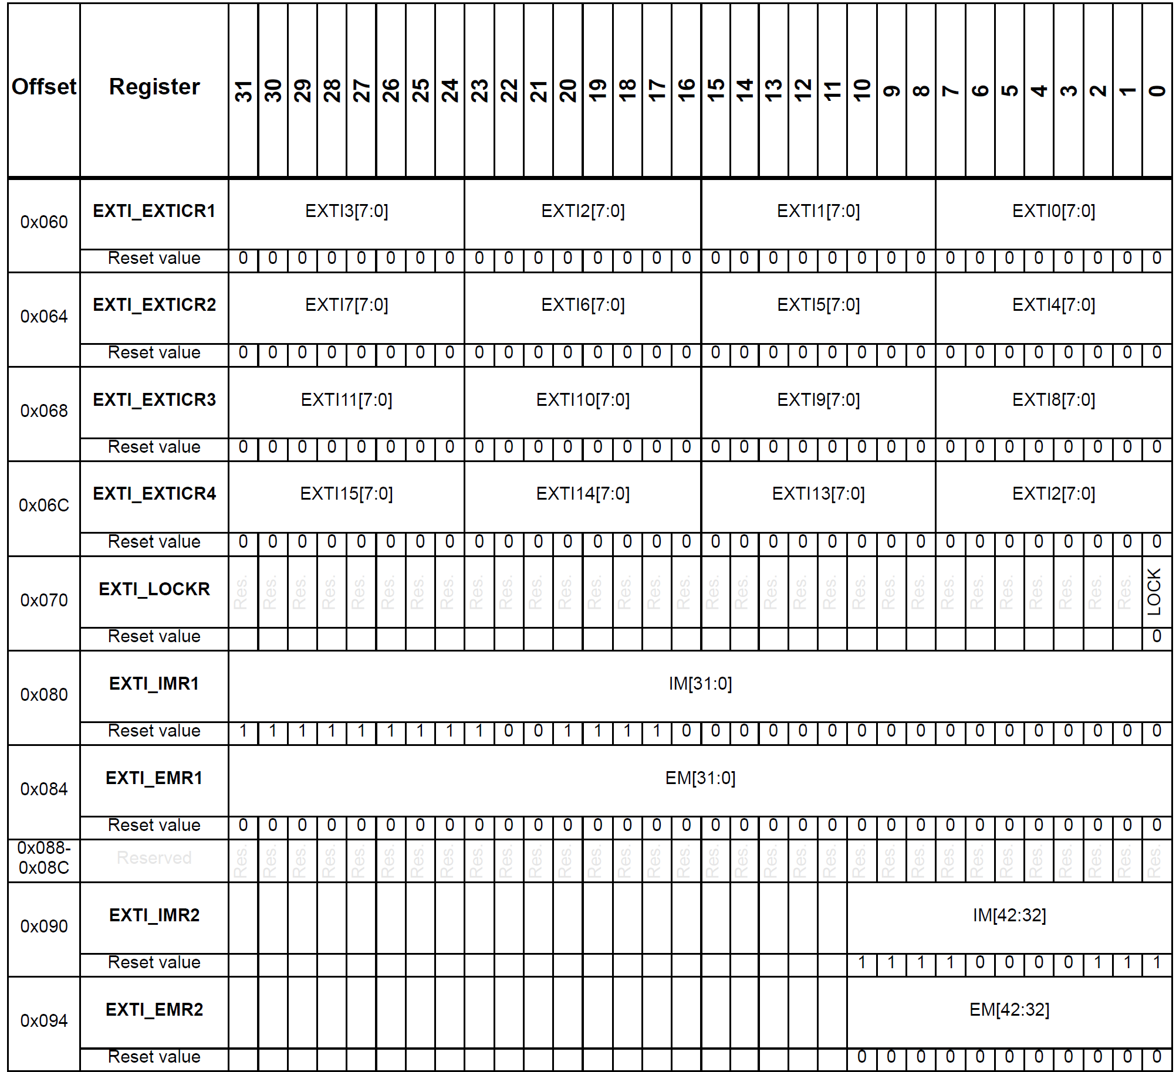
EXTI Reg Map:

