Slide 1
20220503
Tianlong Zhou

Slide 2
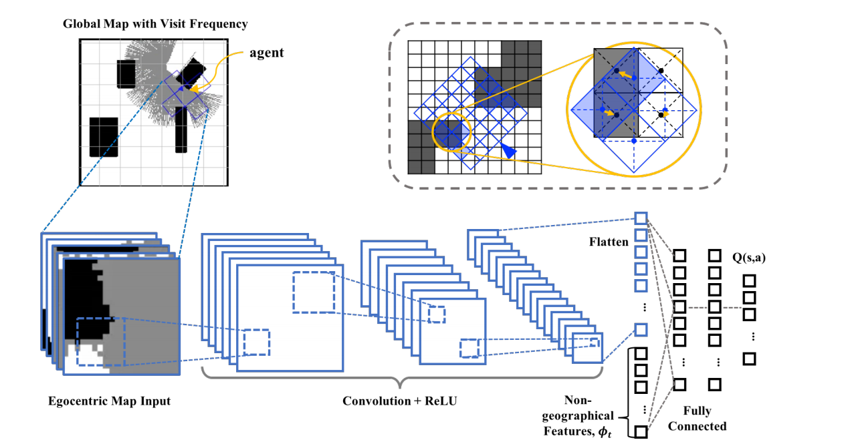
Local Visit Map
Target States
Self-Attention
Non-geographical:

