Slide 1
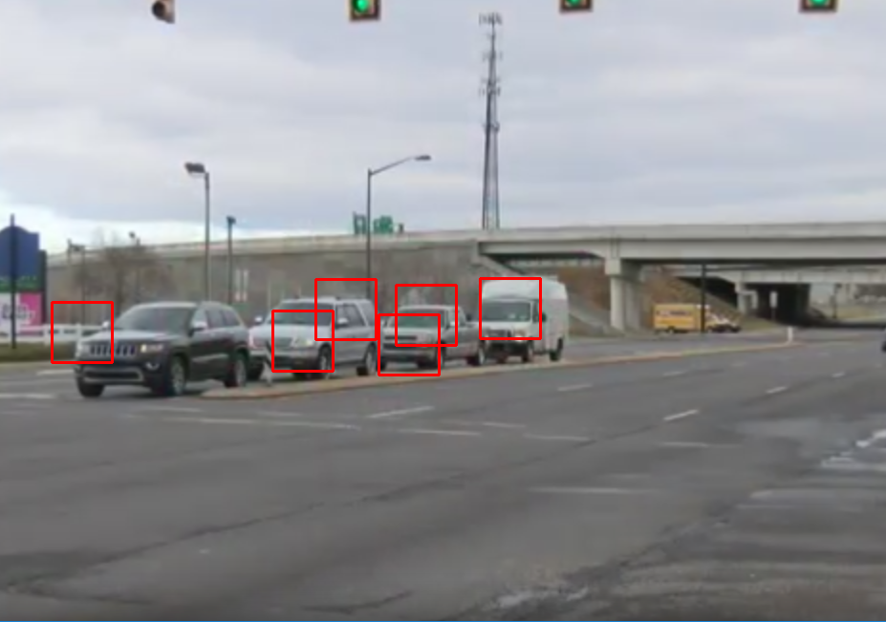

Vehicle Detect
Adam Ali, Taylor Brady
CSS 487 A
December 3, 2018

Slide 2


Project Goal
Object recognition to locate vehicles in images.
Purely C++ using OpenCV.
Computer vision meets machine learning!
Techniques:
Histogram of Oriented Gradients
Support Vector Machine

Slide 3

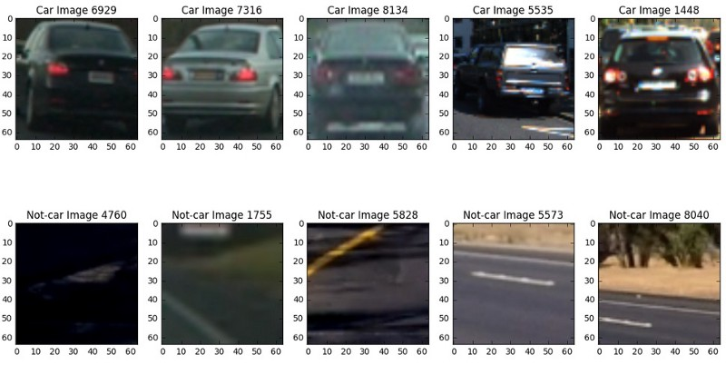
Dataset
9K labeled images from Udacity.
2-class classification:
“car”
“non-car”
Each image is 64x64 pixels.
[3]

Slide 4
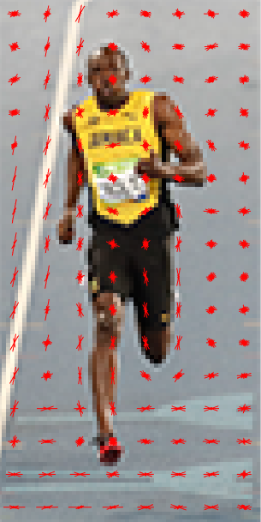
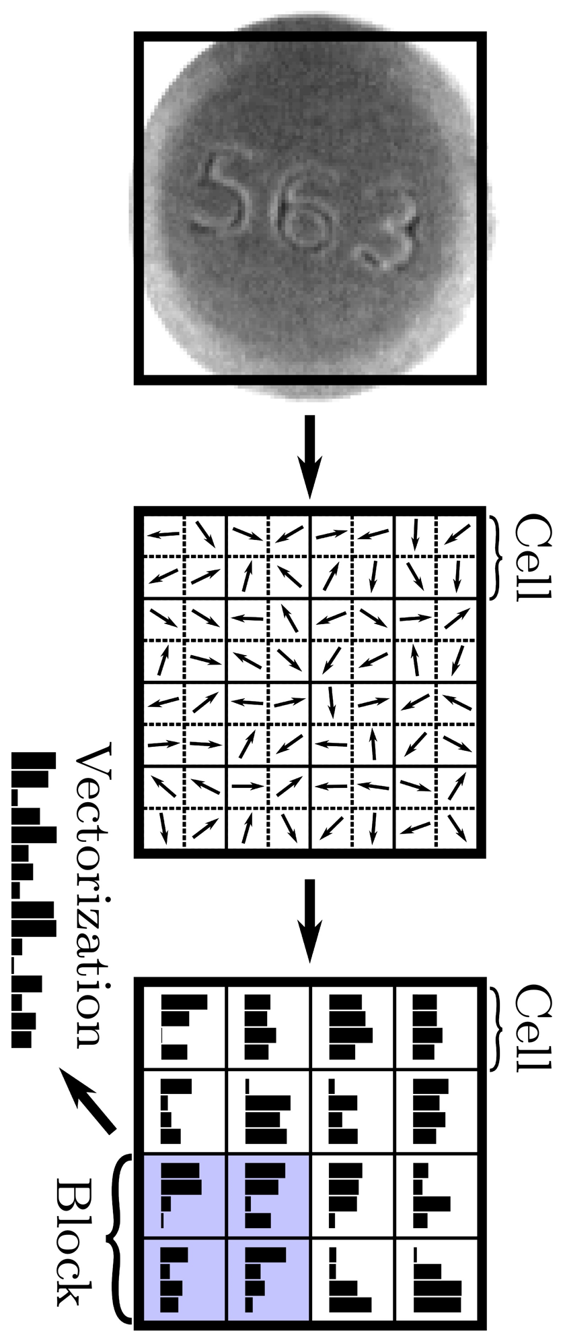
Histogram of Oriented Gradients
Feature Descriptor: minimal set of image data that describes nature of object.
e.g. banana versus scene.
Image patches have:
Intensity at pixels.
Gradient Magnitude
Gradient Orientation
[7]
[0]

Slide 5
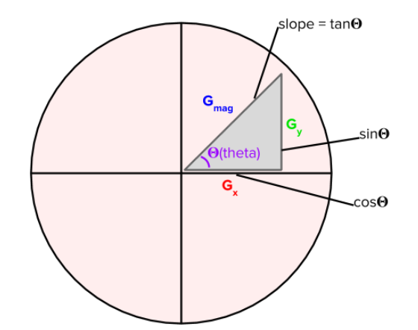


The Gradient Unit Circle
Gradient Magnitude
Gradient Orientation

Slide 6

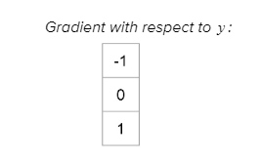

Kernel Convolution
Images are matrices of values.
Kernels are filters that modify image values via convolution.
Can be used to blur, sharpen.
Used to calculate Gradients.

Slide 7
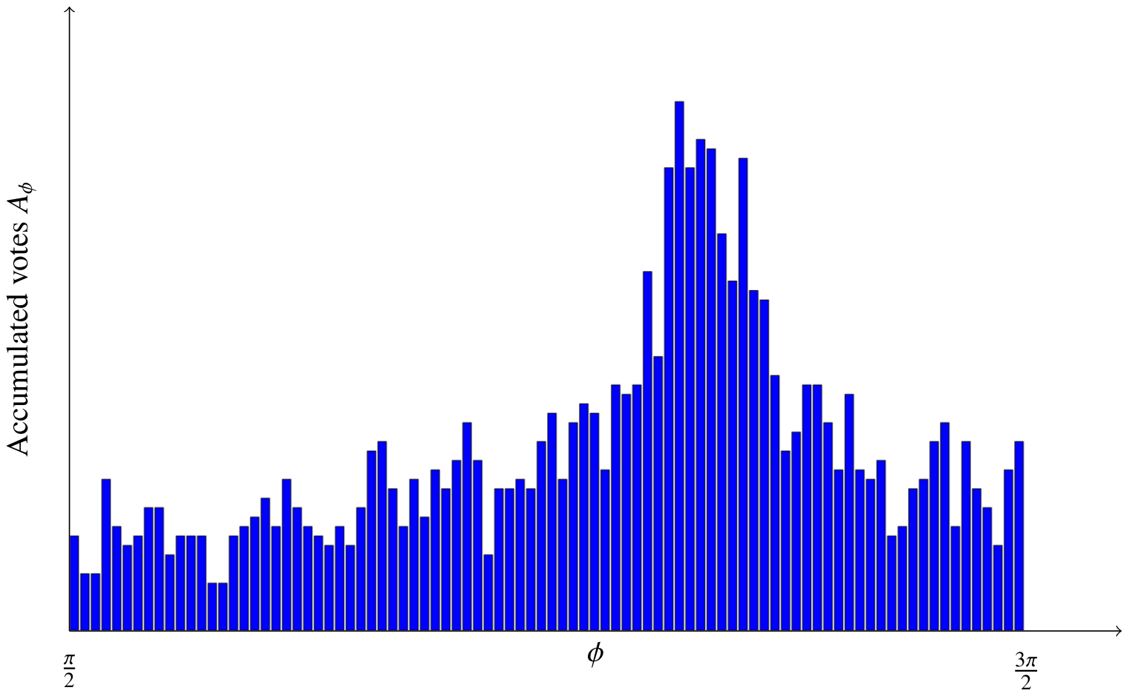
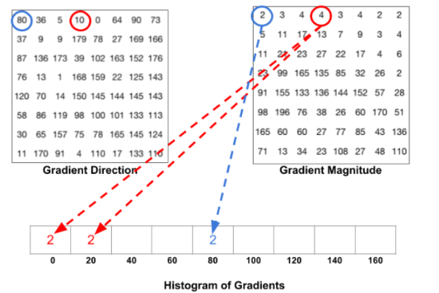
Populating the Histogram
Each pixel has corresponding Gradient Direction and Gradient Magnitude.
Use 9D vector to capture HOG. Each dimension is an increment of 𝚯 (theta).
Use weight/bias for imprecise Gradient Directions.
[0]
[7]

Slide 8
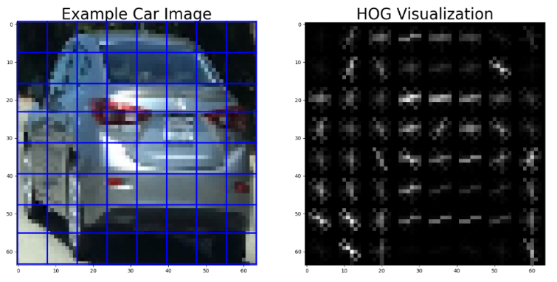
Using Patches
Instead of building 9D vector from entire image:
Divide into 8x8 patches.
Find HOG for each patch.
Concatenate into 1x8n vector, n = # of patches.
Captures fine detail. 8x8 empirically shown ideal (Dalal)^{[8]}.
[2]

Slide 9


Normalization
Images sensitive to lighting.
Data varies throughout times of day.
Set HOG values relative to vector length.

Slide 10
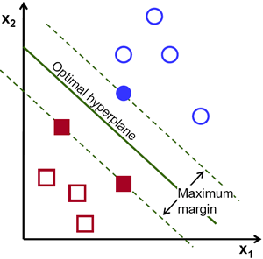
Support Vector Machine
A discriminative classifier.
Relies on the Optimal Hyperplane.
Scales with high dimensions.
Maximizes the minimum distance to any one data point.
[4]

Slide 11
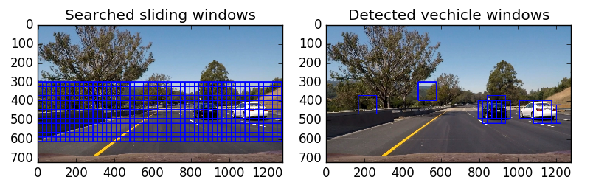
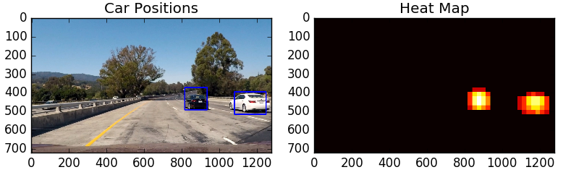
Sliding Window Search / Heatmap
Training data were convenient 64x64 images.
Test images are typically scenes of unspecified size.
Simulate training data parameters:
Slide 64x64 patch in raster order
Find HOG
Input to SVM
[1]
[1]

Slide 12
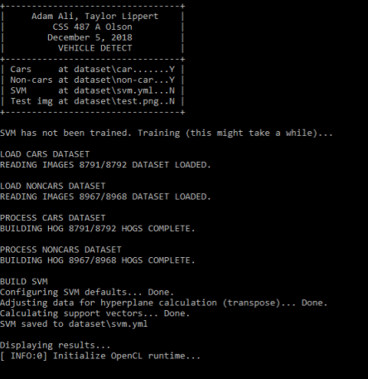
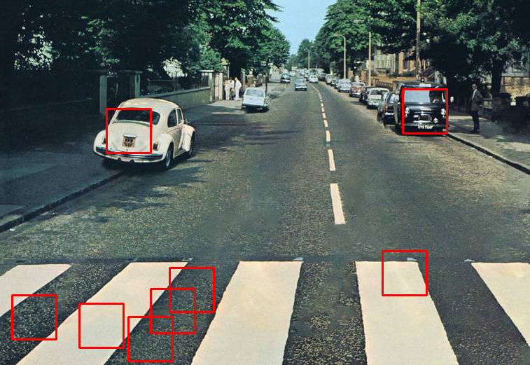
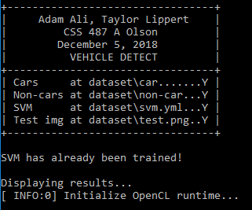
Results

Slide 13
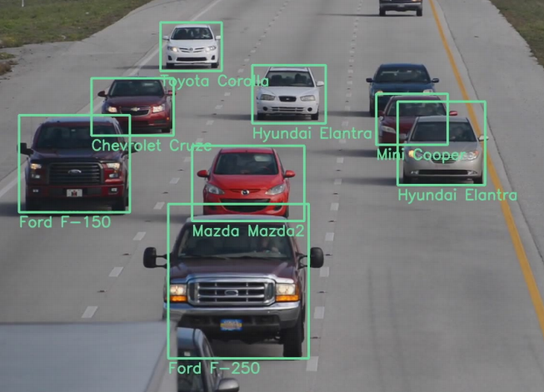
Going Forward
Brand recognition:
Analyze individual features (design language)
Lamps
Grilles
Bumpers
Rooflines
Useful for APBs.
[2]

Slide 14
References
[0] Bratanič, Blaž, et al. “Real-Time Rotation Estimation Using Histograms of Oriented Gradients.” PLOS ONE, Public
Library of Science, www.journals.plos.org/plosone/article?id=10.1371/journal.pone.0092137.
[1] Claudiu. “Vehicle Detection Using OpenCV and SVM Classifier.” Cold Vision, 23 Mar. 2017,
www.coldvision.io/2017/03/23/vehicle-detection-using-opencv-svm-classifier/.
[2] Dehghan, et al. “View Independent Vehicle Make, Model and Color Recognition Using Convolutional Neural Network.”
Computer Vision Lab, Sighthound Inc., 6 Feb. 2017, https://arxiv.org/pdf/1702.01721.pdf.
[3] Fu, Junsheng. “Vehicle Detection for Autonomous Driving.” Github, 28 Mar. 2018,
junshengfu.github.io/vehicle-detection/.
[4] Gunzi, Arnaldo. “Vehicle Detection and Tracking Using Computer Vision.” Chatbots Life, 7 Mar. 2017,
www.chatbotslife.com/vehicle-detection-and-tracking-using-computer-vision-baea4df65906.
[5] “Introduction to Support Vector Machines.” OpenCV 2.4.13.7 Documentation, 2 Dec. 2018,
www.docs.opencv.org/2.4/doc/tutorials/ml/introduction_to_svm/introduction_to_svm.html.
[6] Kowalczyk, Alexandre. “SVM - Understanding the Math - Part 2.” SVM Tutorial, 14 Nov. 2018,
www.svm-tutorial.com/2014/11/svm-understanding-math-part-2/.
[7] Kowalczyk, Alexandre. “SVM - Understanding the Math - Part 3.” SVM Tutorial, 14 Nov. 2018,
www.svm-tutorial.com/2014/11/svm-understanding-math-part-3/.
[8] Mallick, Satya. “Histogram of Oriented Gradients.” Learn OpenCV, 6 Dec. 2016,
www.learnopencv.com/histogram-of-oriented-gradients/.
[9] N. Dalal and B. Triggs, "Histograms of oriented gradients for human detection," 2005 IEEE Computer Society
Conference on Computer Vision and Pattern Recognition (CVPR'05), San Diego, CA, USA, 2005, pp. 886-893 vol. 1.

