Slide 1




XPMatch
Taste-matched travel planning. A stay, three things to do and three places to eat that fit you, on a map, in
Presenter
Date
Pre-launch Company
September 2026
Notes:
Welcome everyone to this pre-launch overview of XPMatch. We are excited to introduce our innovative travel planning service. XPMatch is designed to provide users with a personalized travel experience by matching their tastes with the perfect place to stay, activities to do, and dining options, all seamlessly integrated into a map. Moreover, this can all be done in under a minute, making travel planning quick and convenient. As we delve into the details, we'll explore how XPMatch is set to change

Slide 2




What XPMatch is
One product, two buyers.
The traveller — $49/year. Adults 28 to 45 taking two to four trips
The advisor — $49 per seat/month. Travel advisors with 0-3 years
The difference — Verified Google place links, scored against model
Page
2
Notes:
This slide introduces the XPMatch product and highlights its dual target customer base: travellers and travel advisors. The traveller category includes adults aged 28 to 45 who typically take between two to four leisure trips yearly. They often resort to using multiple tabs and tools like Google Maps to organize their travel plans. On the other hand, the advisor category targets independent travel advisors with up to three years of experience, who often have to repeatedly build client proposals.

Slide 3
Why now
37% of US travellers used AI for planning this spring.
43% usage among affluent travellers.
78% of travel advisors now charge a planning fee.
Fee ranges between $100 and $1,500 per trip.
Fora reached a $1B valuation with 15,000 advisors.
97% of these advisors are new to the profession.
Expedia acquired AI planner Layla in July 2026.
Layla established both the category and the buyer.
Page
3
Notes:
In 2026, significant shifts in the travel industry are evident. AI has become a pivotal tool, with 37% of US travellers and 43% of the affluent group using it to plan their trips. This trend, along with the rise of planning fees charged by 78% of travel advisors, highlights evolving business models. Fora reached a $1B valuation, signifying growth and new opportunities for 15,000 advisors, most new to the field. Furthermore, Expedia's acquisition of Layla represents strategic industry movements,

Slide 4
Where We Stand
Zero revenue, zero customers
No way to accept payment
Product built and running
Commercial gates ahead
Figures are projections
20 of 38 assumptions unverified
Page
4
Notes:
This slide outlines the current situation of our venture. Despite having a built and running product, we are currently facing challenges in generating revenue and acquiring customers. We also lack a system to accept payments at this stage. It's important to note that all figures presented are projections without any trading history. Furthermore, 20 out of 38 modeled assumptions still require verification. The focus must now be on validating these assumptions and progressing towards opening our '

Slide 5

The Offer Ladder
Trip Pass — $19 for one trip, 60 days. First purchase ease.
Plus — $49 per year. Matches Layla and TripIt Pro.
Concierge — $149 to $399 per trip, 48-hour delivery.
Advisor seats — $49 per month. 89% margin, $1,600 LTV.
Page
5
Notes:
This slide highlights our strategic pricing approach with offers priced against competitors. Starting with Trip Pass at $19 for ease of purchase, to Plus at $49 per year, which is competitive with Layla and TripIt Pro. Our Concierge service, ranging from $149 to $399, assures expert review within 48 hours. Lastly, Advisor seats provide high value with an 89% gross margin and a significant lifetime value of $1,600, despite aiming for a $400 customer acquisition cost ceiling.

Slide 6
The Core Model
Three-year projection from a live 1,761-formula model.
Year 1: revenue $40,123, gross profit $31,980.
Year 2: revenue $190,673, gross profit $131,331.
Year 3: revenue $427,320, gross profit $295,873.
Page
6
Notes:
This slide presents a high-level overview of our model's three-year financial projection. In Year 1, the revenue is projected at $40,123 with a gross profit of $31,980. In Year 2, the revenue increases significantly to $190,673 and a gross profit of $131,331. By Year 3, we expect revenue to reach $427,320 with a gross profit of $295,873. These figures are generated from our detailed 1,761-formula model, reflecting our strategic growth initiatives and operational efficiencies. Note the consistent

Slide 7
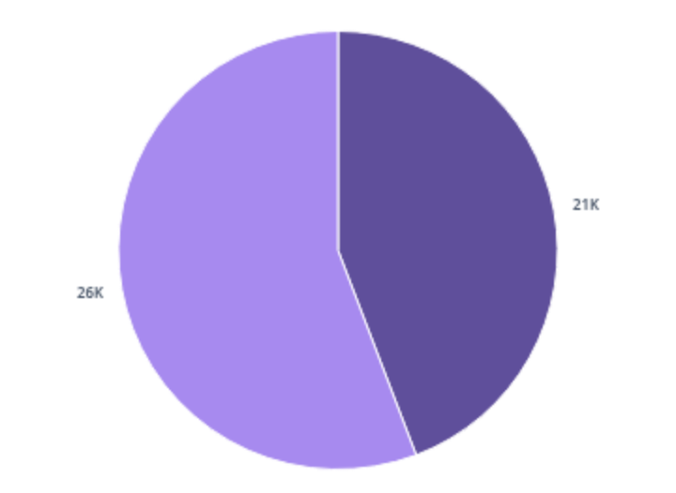
Year-1 SDE is negative $5,575
This is the key figure in the analysis: Year 1 operating profit is $20,880, yet SDE is negative $5,575 due to unpaid founder work.
Year 1 Breakdown
The unpaid contributions of the founders exceed the operating profit, leading to a negative SDE of $5,575 in the initial year.
Page
7
Notes:
In Year 1, the company reports an operating profit of $20,880, but this does not translate into positive Seller's Discretionary Earnings. This result stems from the labor imputed to the two founders working without pay, whose market-equivalent wages surpass the profits generated. This insight speaks volumes about the nature of the initial year as a funded experiment, emphasizing the critical role of founders' unpaid contributions in this phase.

Slide 8
Unit economics
The place catalog enables the $49/year plan.
Cost per active user before: $10/month.
Cost per active user after: $1.40 to $2.00/month.
Blended gross margin in Year 3: 69%.
Advisor seat gross margin: 89%.
Business capital required: $12,061.
Page
8
Notes:
This slide outlines the major financial elements influenced by the place catalog in our business model. Before the catalog was introduced, costs per active user were about $10 per month. Post-catalog, the costs have significantly lowered to a range between $1.40 and $2.00 per month. Our blended gross margin, projected for Year 3, stands at a robust 69%, and specifically, the advisor seat gross margins are at an impressive 89%. To realize these efficiencies and margins, our business capital need—

Slide 9
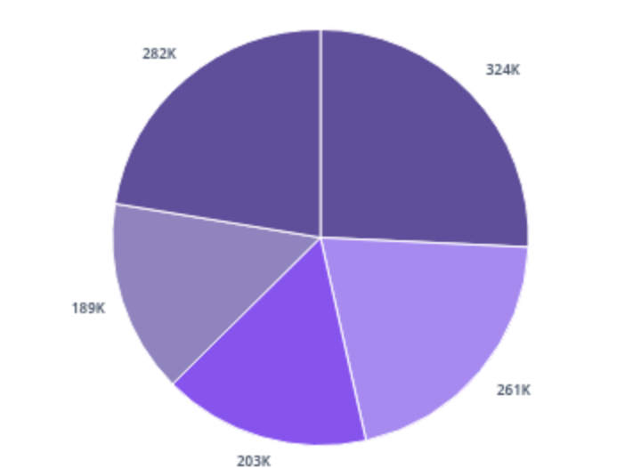
Seven revenue paths, tested
Grounded Year-3 revenue after checking every input against published prices across various revenue streams.
Revenue Breakdown
This chart presents the financial returns from different revenue sources, validating figures through published prices for Year-3.
Page
9
Notes:
In this slide, we are looking at a detailed breakdown of revenue from seven different paths, tested and validated against published pricing. The major categories include white-label DMO which generated $324,000, premium memberships at $261,250, and group and corporate sales at $202,500. Booking commissions added $189,274 and a combined revenue share from data and creator campaigns brought in $282,000. This data helps us understand which areas are most profitable and where strategic focus might,

Slide 10
Portfolio Reality
Seven paths do not add up; staffing is lacking.
Total stated: $8.15M.
Demand total: $1,103,024 in Year 3.
Paths 2, 3, 5 overlap trips/costs.
Paths 1 and 5 share budgets.
Require 3.34 FTE, only 1.25 available.
Page
10
Notes:
This slide highlights key issues with the portfolio's current reality. The seven paths planned do not reconcile in terms of both financial and staffing resources. Financially, while they total $8.15 million as stated, actual demand calculates to be $1,103,024 in Year 3 due to overlaps where different paths monetize the same activities. From a human resource perspective, 3.34 full-time equivalents (FTEs) are needed, but only 1.25 FTEs are available. This staffing shortfall adds to the complexity,

Slide 11
The Sequence
Now — corporate and group planning. The only path needing no users
This week — booking links. Near-100% margin, compounds with every
Months 2 to 9 — white-label DMO. Strategic buyer pays a premium
Months 6 to 18 — membership at $49 to $79. The engine that compo
Page
11
Notes:
This slide outlines a sequence of strategic moves planned over time. Start with corporate and group planning, which requires minimal initial setup. Progress to implementing booking links this week, promising high margins. From months 2 to 9, target the white-label destination management organizations, appealing to strategic buyers. Finally, introduce a membership model priced between $49 and $79 as a sustainable revenue source from months 6 to 18.

Slide 12
What could kill this
Consumers will not pay. Signal: Trip Pass conversion under 2% by 8
Page
12
Notes:
This slide discusses potential risks that could lead to the failure of an initiative. Firstly, the unwillingness of consumers to pay is indicated by a Trip Pass conversion rate of less than 2% by week 8. Additionally, if Google integrates the function natively, it poses a significant threat, given its capability to answer travel queries and book accommodations. Furthermore, pricing controlled by Google Places and OpenRouter restricts our ability to manage gross margins. Lastly, founder-dependent

Slide 13
The Ask
$60,061 and twelve months.
$12,061 for business capital plus $48,000 for runway.
$25,000 available, $35,061 gap.
First decision: Close the gap or adjust scenario.
Next step: Sell three trips to test and generate cash.
Page
13
Notes:
This slide outlines the funding request of $60,061 over twelve months, breaking down into $12,061 for business capital and $48,000 for founder runway. The current funds available are $25,000, leaving a gap of $35,061. The audience should consider how they can bridge this gap or choose an alternative scenario that requires fewer resources. Additionally, we will validate this plan by selling three corporate or concierge trips, providing an initial cash flow and testing the business viability. This

