Slide 1


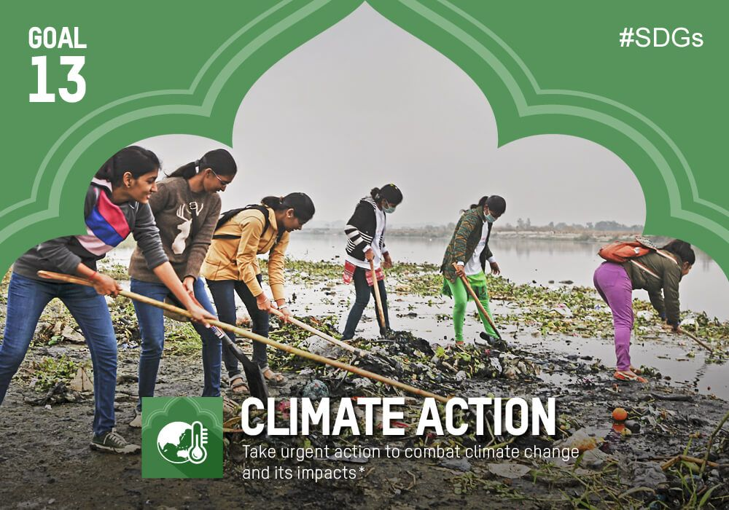

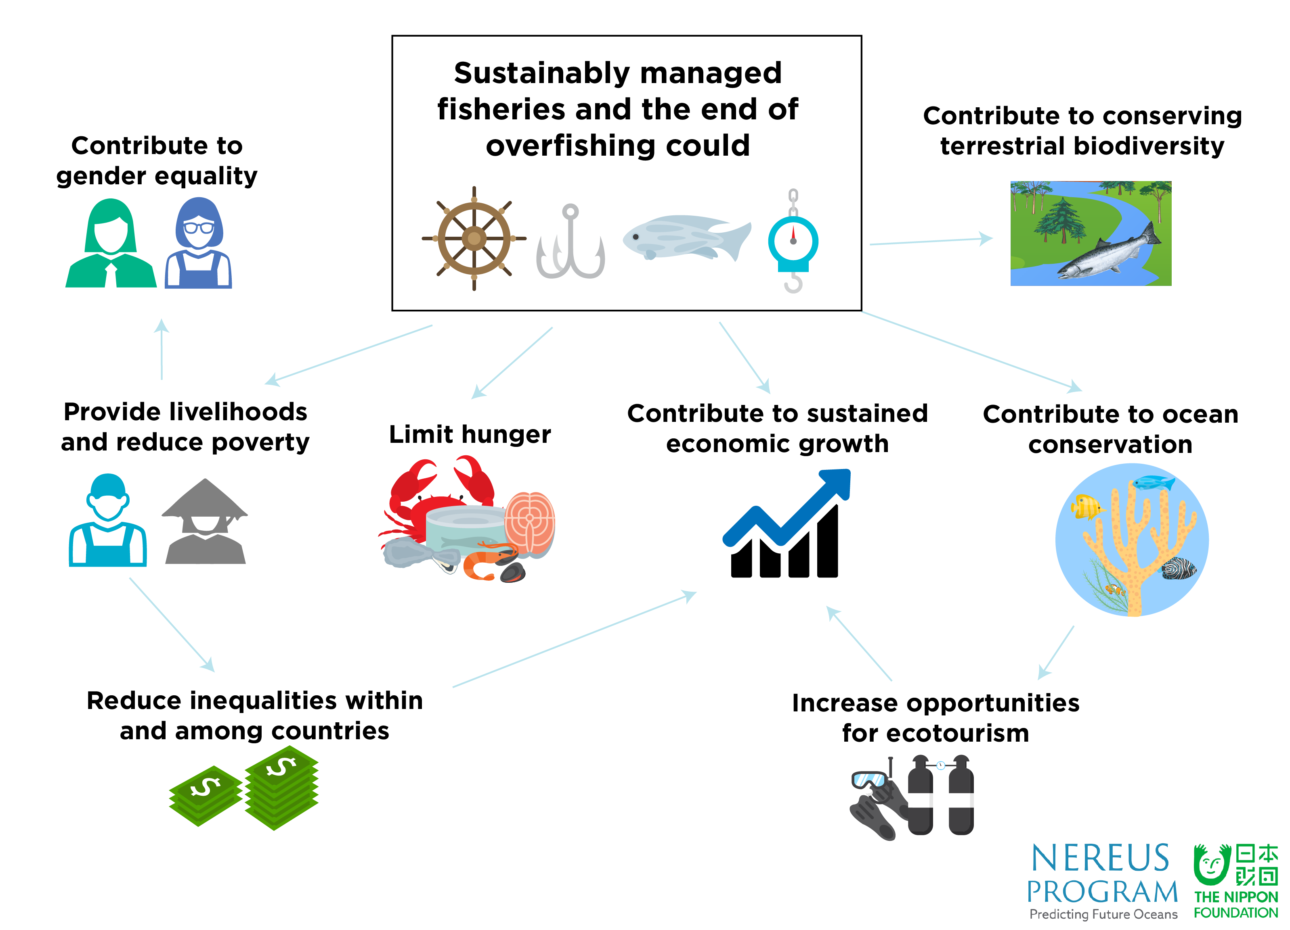
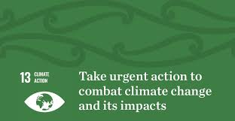

DENMARK’S POLICIES ON SDG 13
INTRODUCTION
In 2015, a set of 17 intertwined goals were created by the United Nations general assembly aimed at achieving a more sustainable future for all, to be achieved by 2030 (UN, 2017). These goals serve as a blueprint for prosperity and stability among the people both for the present and future generation (UN, 2017).
BENEFITS OF SDGS
DANISH POLICIES
Goal 13 of the SDGs centers on climate action, relating to climate change. The Danish government actively seeks to make this goal concrete and actionable with the following policies;
The 2017 SDGs action plan (Danish Government, 2017)
Mandatory annual and status reports to show transparency and accountability
The government accesses legislative proposals in line with the SDGs
Parliamentary agreement to produce energy from renewable sources by 2030
Phasing out fossil fuel cars by 2030
Hosting of workshops to increase the engagements of companies in SDGs (OECD, 2017)
POLICY SUCCESSES
In 2018, according to the climate change performance index, Denmark being a frontrunner in environmental policy, ranked 17th out of 178 countries (Climate Action Network Europe, 2018).
Approval on energy agreement by Folketing in June 2018 for the production of renewable energy leading to offshore windfarms (Bertelsmann Stiftung, 2021).
About 23% of energy consumed is from renewable energy sources with low water usage (Climate Action Network Europe, 2018)
About 20% reduction in carbon dioxide emission compared to the mid-1990s (Bertelsmann Stiftung, 2021).
Reduction in electricity taxes
Budget on green transport such as electric vehicles (Climate Action Network Europe, 2018).
CHALLENGES OF SDGS
The challenges hindering the actualization of the goals towards sustainability are;
Implementation, such as policies, compliance and ensuring alignment with the local context.
lack of political will.
Instability, such as conflict between nations.
Inadequate resources such as funding.
Lack of technical know-how.
HOW THE POLICIES BECAME SUCCESSFUL
Involvement of all actors across society
Workshops by the government
Integration of the policies into business models and strategies by large companies
Reports on accountability
POLICY CHALLENGES
Some challenges that the country faces in her aim to achieve the SDGs are:
Inadequate resources. (Fitton et al, 2021)
Clashing norms from different government paradigms (Lund, 2018)
Educating the masses on the importance of SDGs
For the Danish government to combat these challenges they need to
Increase participation of stakeholders.
Provide access to funding
Invest in awareness programs
CONCLUSION
In conclusion, it is quite phenomenal how up the ladder Denmark is in the pursuance of the SDGs and how the country has strived to build energy-efficient infrastructures and reduce its carbon footprint. The Danish government realizes that the achievement of sustainability is a joint effort. Despite the challenges which they face in pursuing these goals, they take a forefront position in the achievement of these goals based on obvious results.

Slide 2
REFERENCES
Ban, K.M. (2016) Sustainable Development Goals.
Barretto, K.E. (2021) Engaging Citizens in Sustainable Development in Switzerland, France, Denmark, Malta, Sweden, and the Philippines.
Bertelsmann Stiftung (2021) Sustainable Governance Indicators 2020, Available at: https://www.sgi-network.org/2018/Denmark/Environmental_Policies (Accessed on 27 March, 2022).
Bowen, K.J., Cradock-Henry, N.A., Koch, F., Patterson, J., Häyhä, T., Vogt, J. and Barbi, F. (2017) Implementing the “Sustainable Development Goals”: towards addressing three key governance challenges—collective action, trade-offs, and accountability. Current opinion in environmental sustainability, 26, pp.90-96.
Danish Government. (2017) Report for Voluntary National Review: Denmark’s implementation of the 2030 Agenda for Sustainable Development, Ministry of Finance, Copenhagen, Denmark, Available at: (https://sustainabledevelopment.un.org/content/documents/16013Denmark.pdf) (Accessed on 25 March, 2022).
De Lorenzo, V., Prather, K.L., Chen, G.Q., O'Day, E., von Kameke, C., Oyarzún, D.A., Hosta‐Rigau, L., Alsafar, H., Cao, C., Ji, W. and Okano, H. (2018) The power of synthetic biology for bioproduction, remediation, and pollution control: the UN's Sustainable Development Goals will inevitably require the application of molecular biology and biotechnology on a global scale. EMBO reports 19(4), p.e45658.
Fitton, J.M., Addo, K.A., Jayson-Quashigah, P.N., Nagy, G.J., Gutiérrez, O., Panario, D., Carro, I., Seijo, L., Segura, C., Verocai, J.E. and Luoma, S., 2021. Challenges to climate change adaptation in coastal small towns: Examples from Ghana, Uruguay, Finland, Denmark, and Alaska. Ocean & Coastal Management, 212, pp.105787.
Hazlewood, P. and Bouyé, M. (2018) Sustainable development goals: Setting a new course for people and planet.
Lund, D.H. (2018) Governance innovations for climate change adaptation in urban Denmark. Journal of environmental policy & planning, 20(5), pp.632-644.
Nippon Foundation-Nereus Program. (2017) ‘Oceans and Sustainable Development Goals: Co-benefit, Climate Change and Social Equity’, Vancouver, p.28, Available at: https://archives.nereusprogram.org/sdg-report/ (Accessed on: 25 March, 2022).
Organization of Economic Cooperation and Development (OECD). (2017) Digital economy outlook 2017, Available at: (www.oecd.org) (Accessed 14 March, 2022).
United Nations General Assembly. (2017) Work of the Statistical Commission pertaining to the 2030 Agenda for Sustainable Development (A/RES/71/313 Archived 28 November 2020 at the Wayback Machine).

