Slide 1

By
Odutayo Odufuwa
Access Queries here on Github

Slide 2
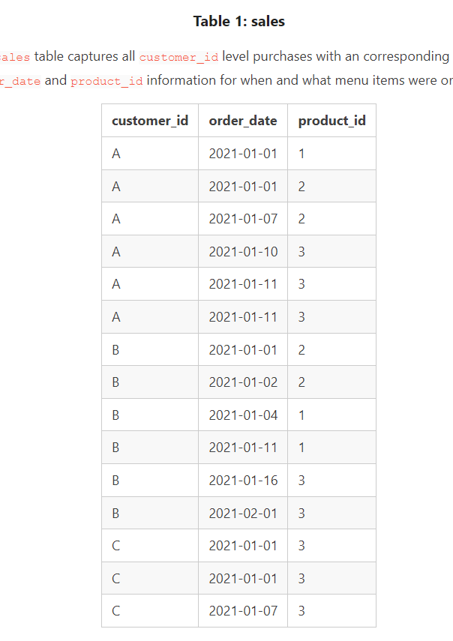
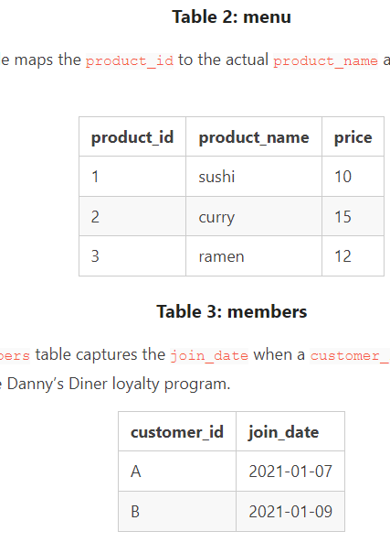
TABLES

Slide 3

Answer to Questions

Slide 4
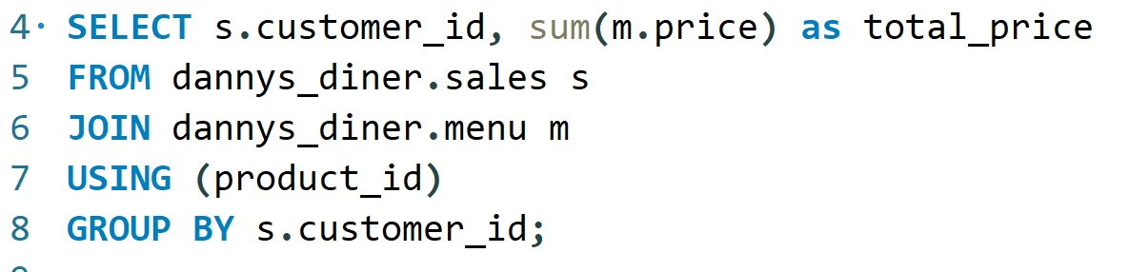
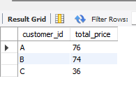
Question 1: What is the total amount each customer spent at the restaurant?
Query
Result

Slide 5
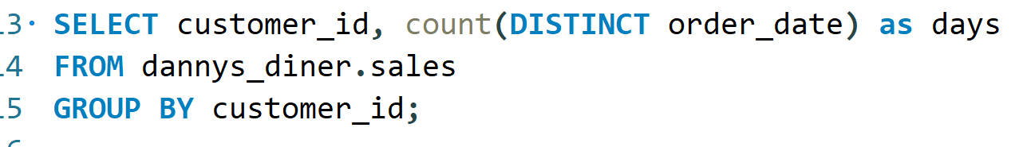
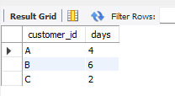
Question 2: How many days has each customer visited the restaurant?
Query
Result

Slide 6
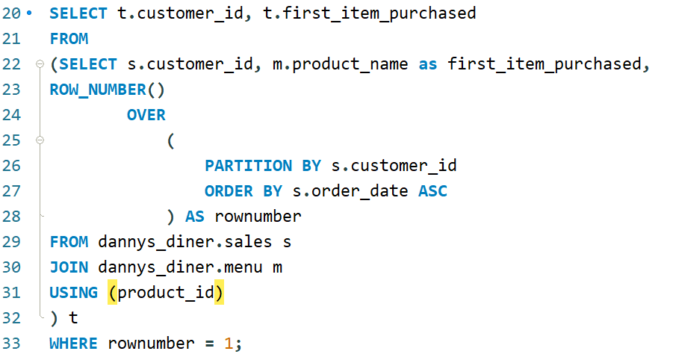
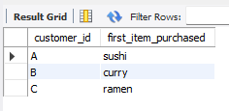
Question 3: What was the first item from the menu purchased by each customer?
Query
Result

Slide 7
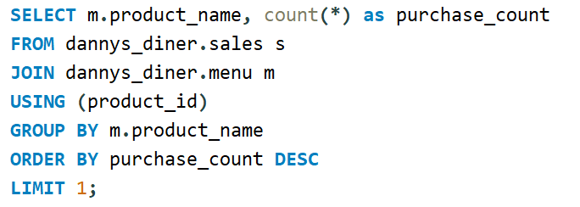
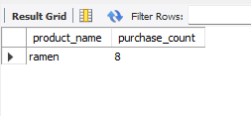
Question 4: What is the most purchased item on the menu and how many times was it purchased by all customers?
Query
Result

Slide 8
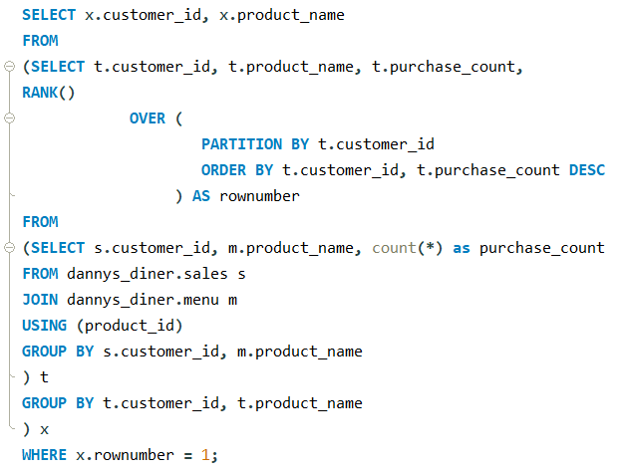
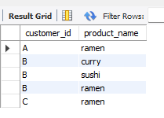
Question 5: Which item was the most popular for each customer?
Query
Result

Slide 9
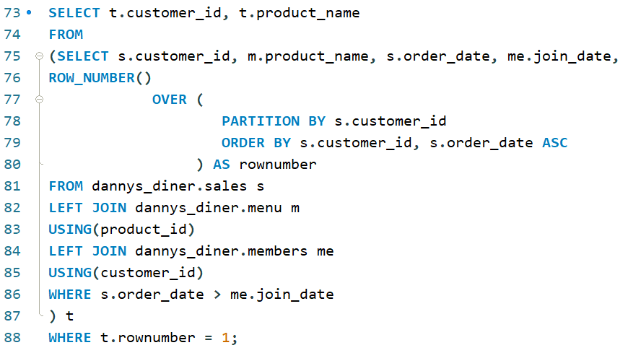
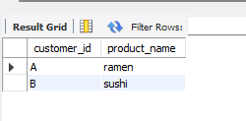
Question 6: Which item was purchased first by the customer after they became a member?
Query
Result

Slide 10
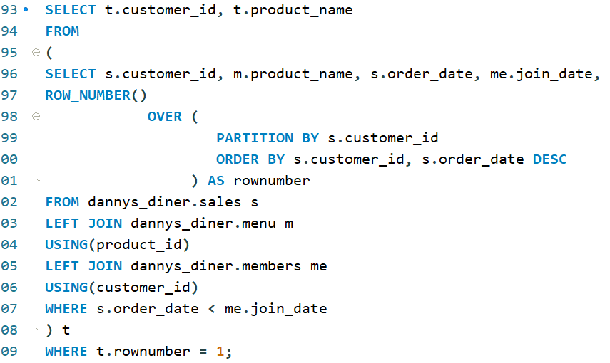
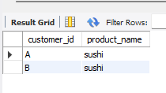
Question 7: Which item was purchased just before the customer became a member?
Query
Result

Slide 11
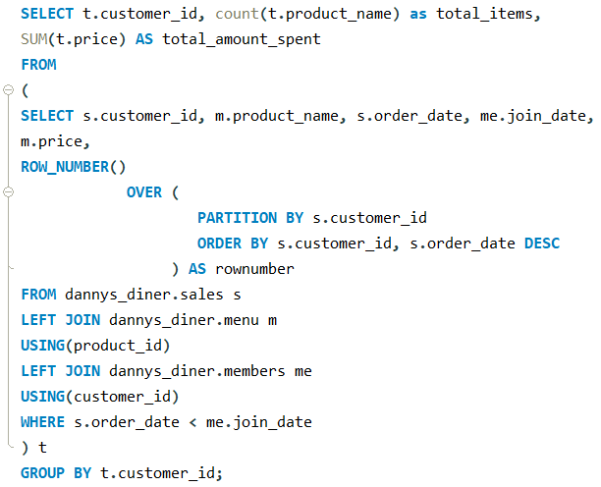
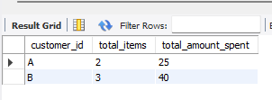
Question 8: What is the total items and amount spent for each member before they became a member?
Query
Result

Slide 12
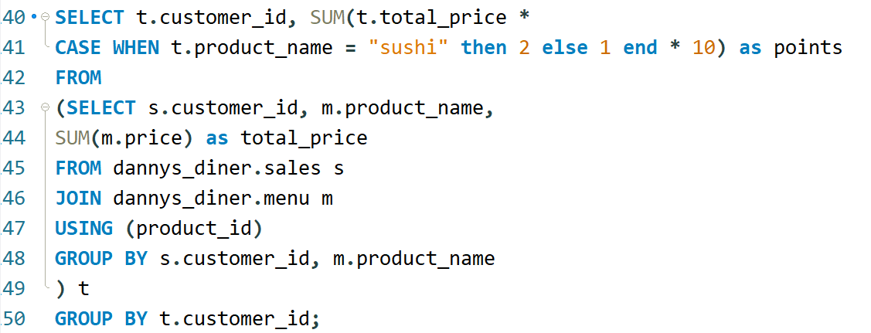
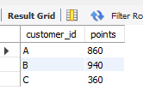
Question 9: If each $1 spent equates to 10 points and sushi has a 2x points multiplier - how many points would each customer have?
Query
Result

Slide 13
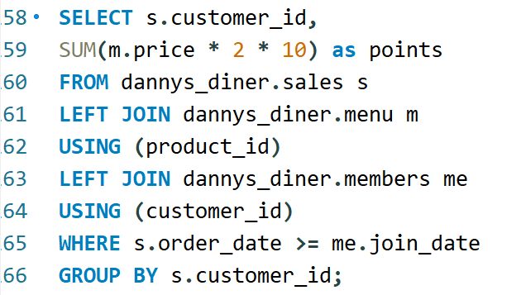
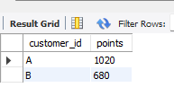
Question 10: In the first week after a customer joins the program (including their join date) they earn 2x points on all items, not just sushi - how many points do customer A and B have at the end of January?
Query
Result

Slide 14
Answer to Bonus Questions

Slide 15
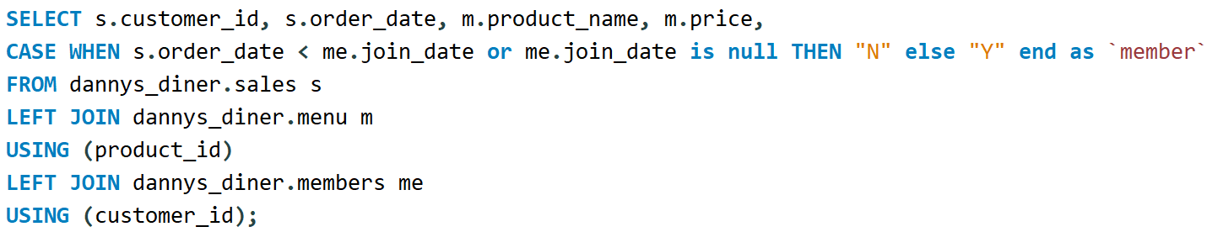
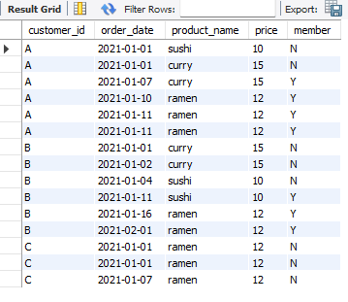
Bonus Question 1: Recreate a table
Query
Result

Slide 16
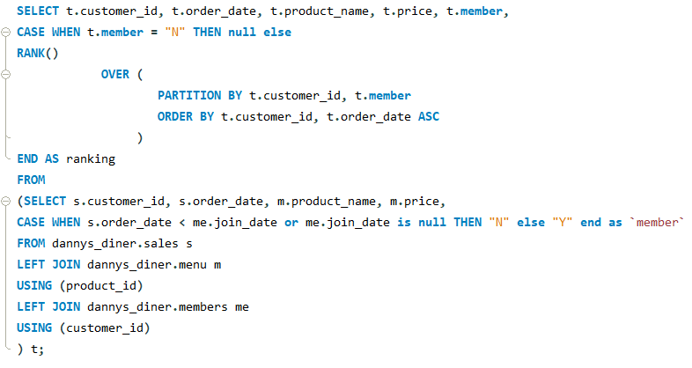
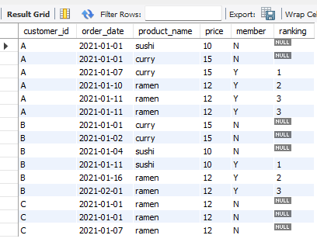
Bonus Question 2: Ranking all things
Query
Result

Slide 17

Thank You

