Slide 1


Slide 2
Spaceships

Slide 3
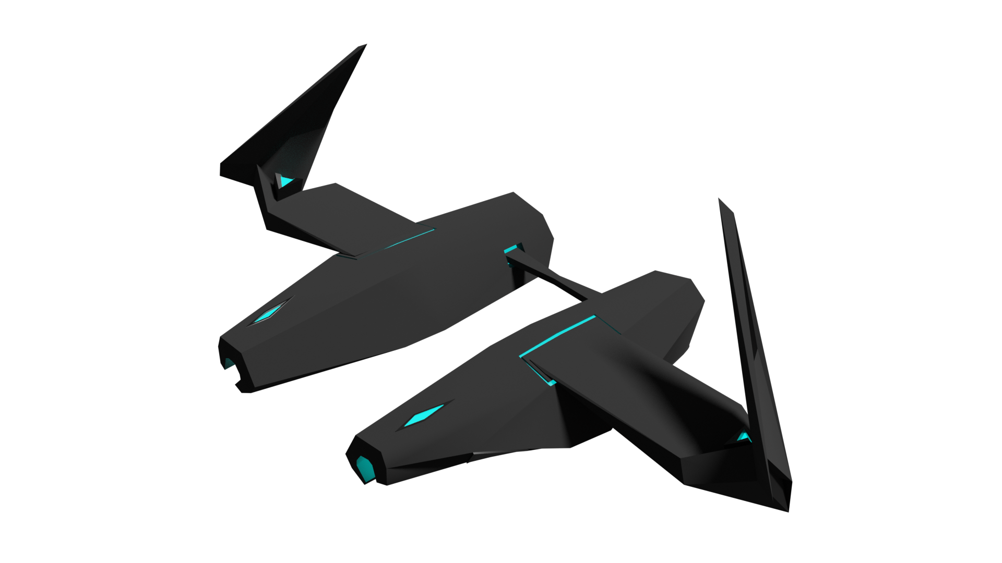
Space Strider
2 Primary Weapons
No Secondary Weapons
Medium Speed

Slide 4
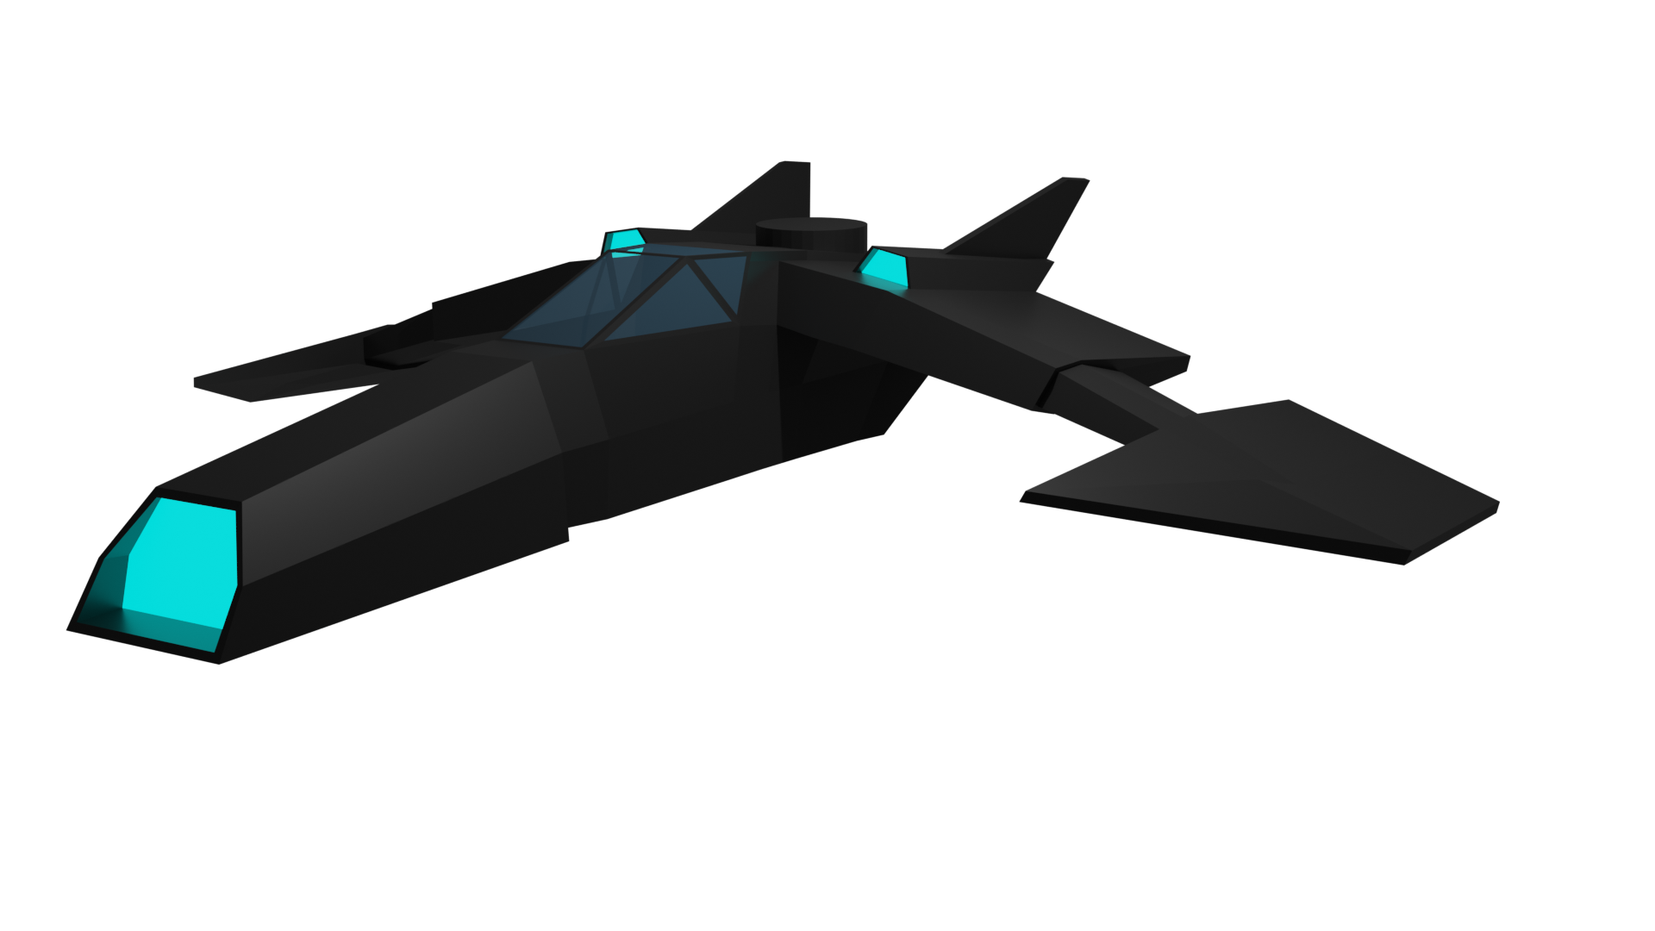
Darkzov
2 Primary Wepons
2 Secondary Weapons
Fast Speed

Slide 5
Enemies

Slide 6
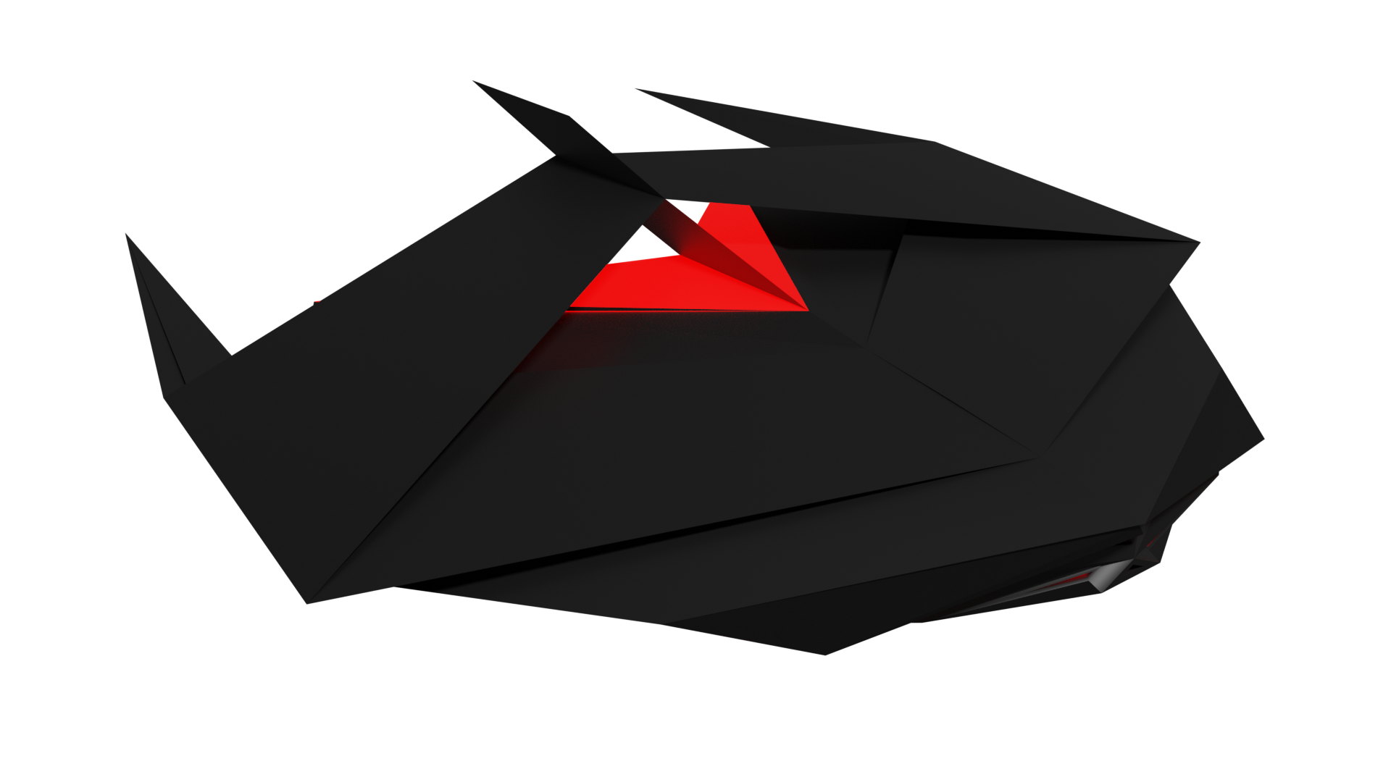
Alien
1 Primary Wepons
Fast

Slide 7

Alien Sentient Missile
Explodes on contact
High Kinetic and Electric damage

Slide 8
Weapons

Slide 9
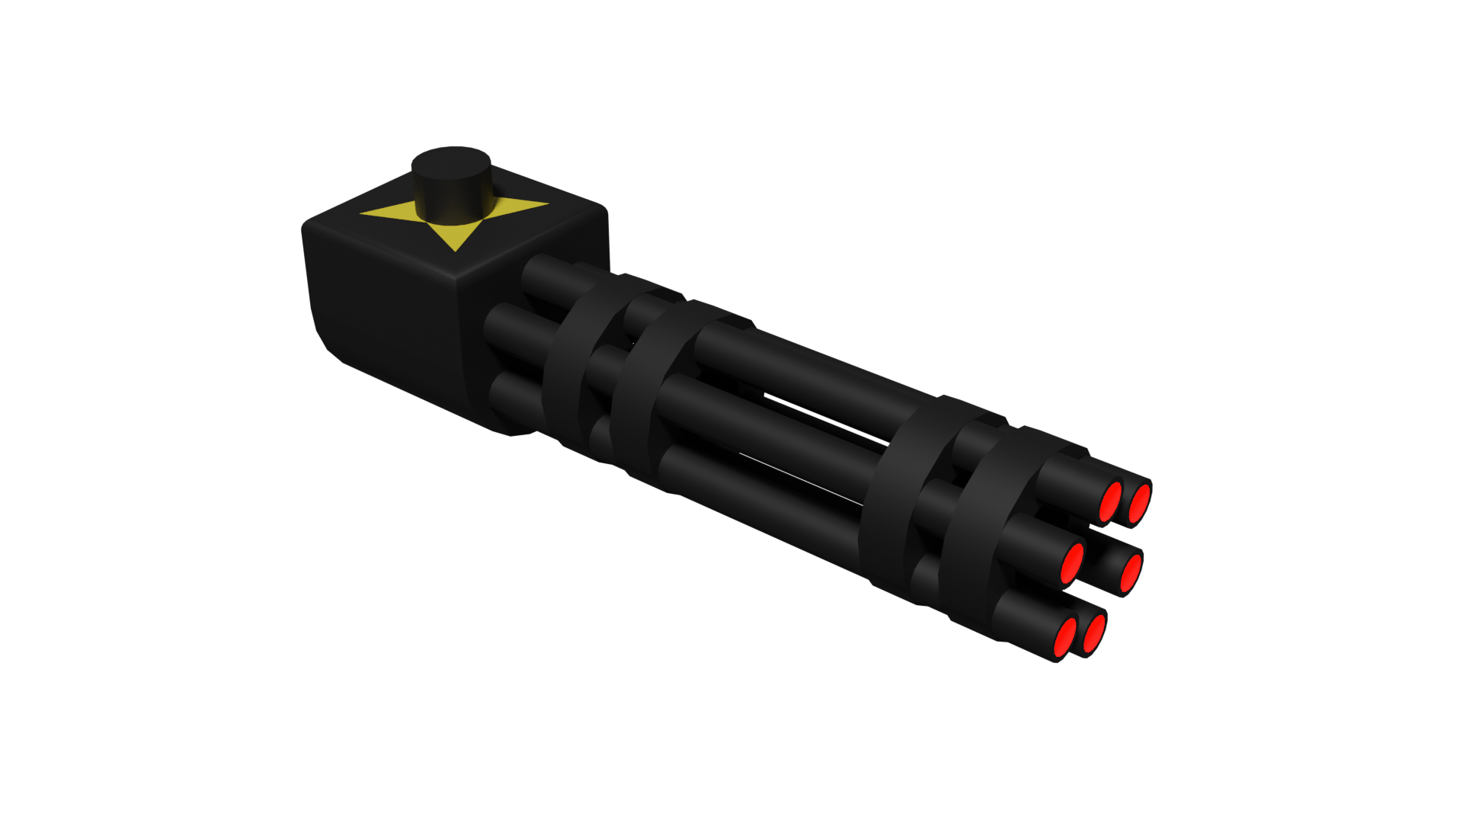
Laser Gun
Fast Fire
Energy Damage

Slide 10
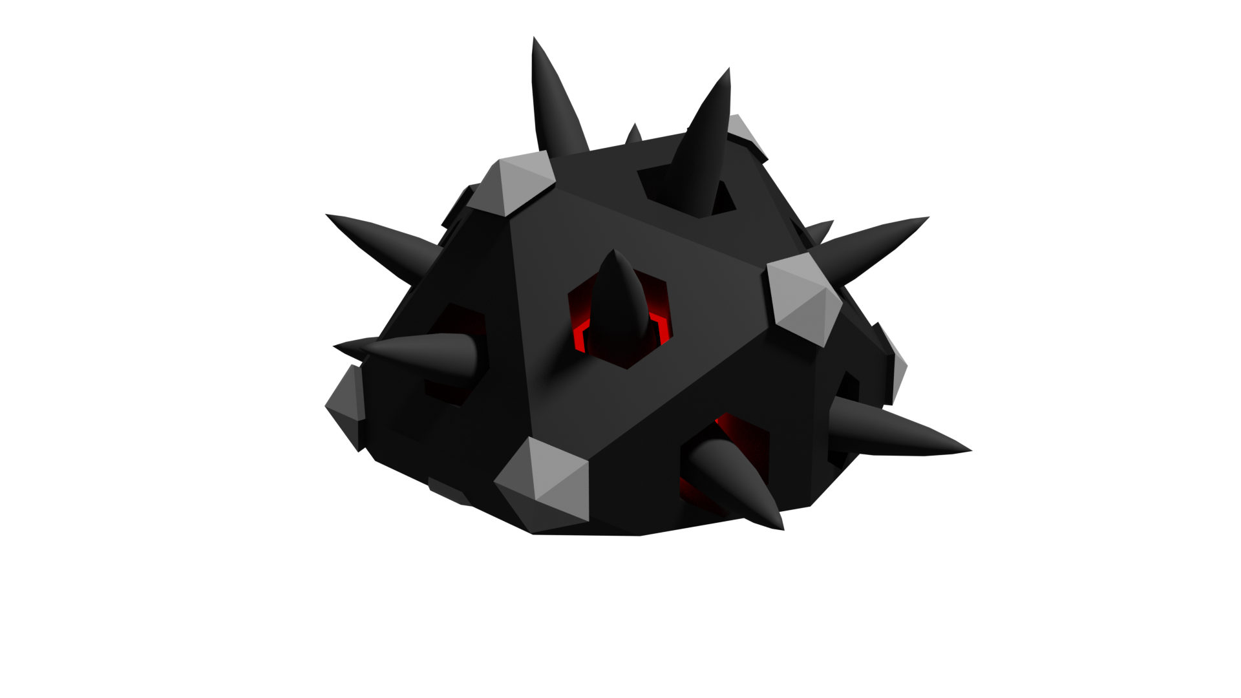
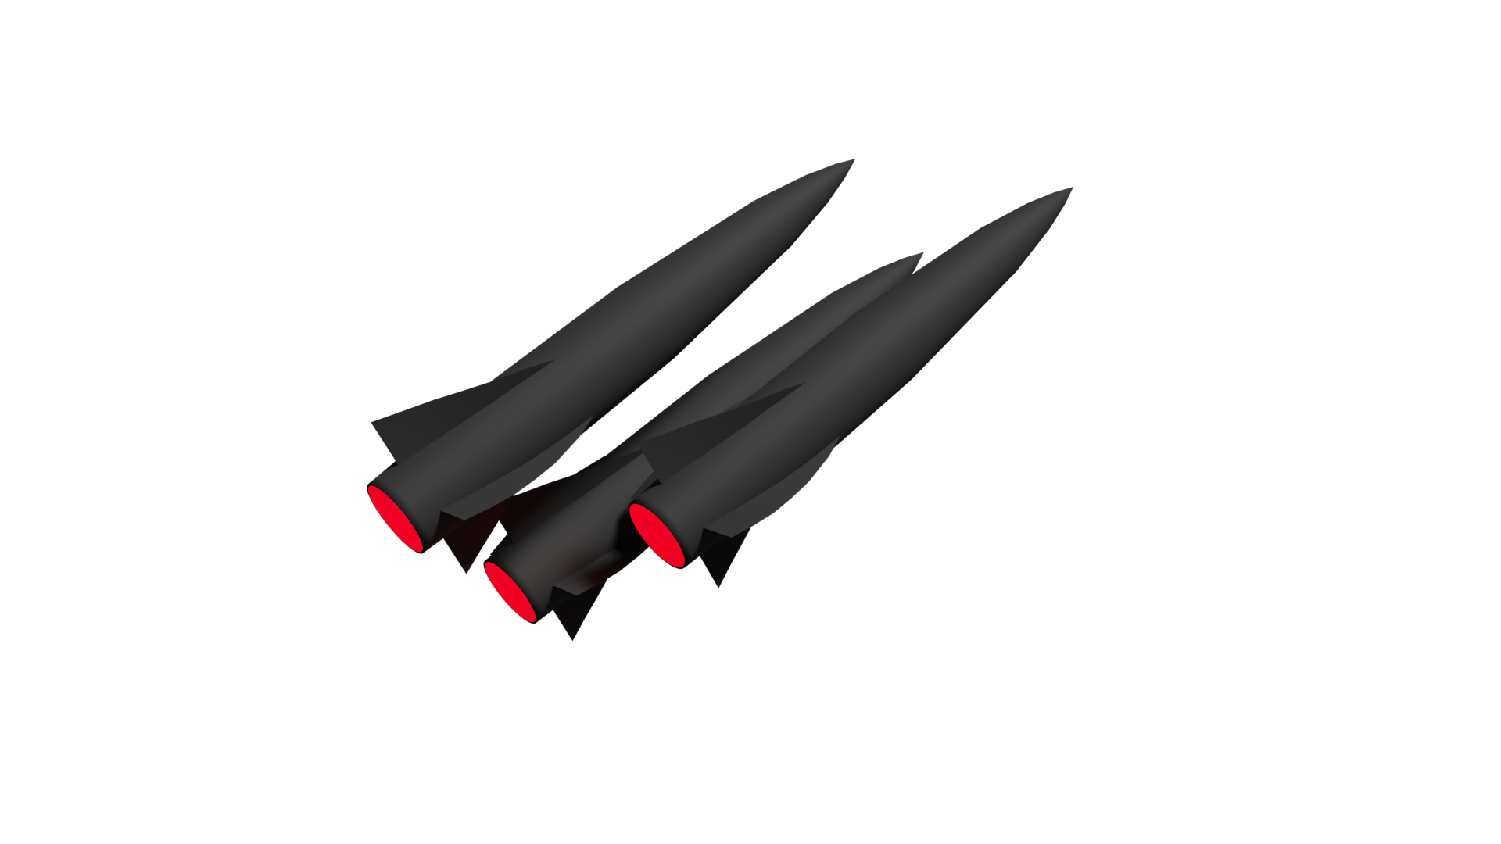
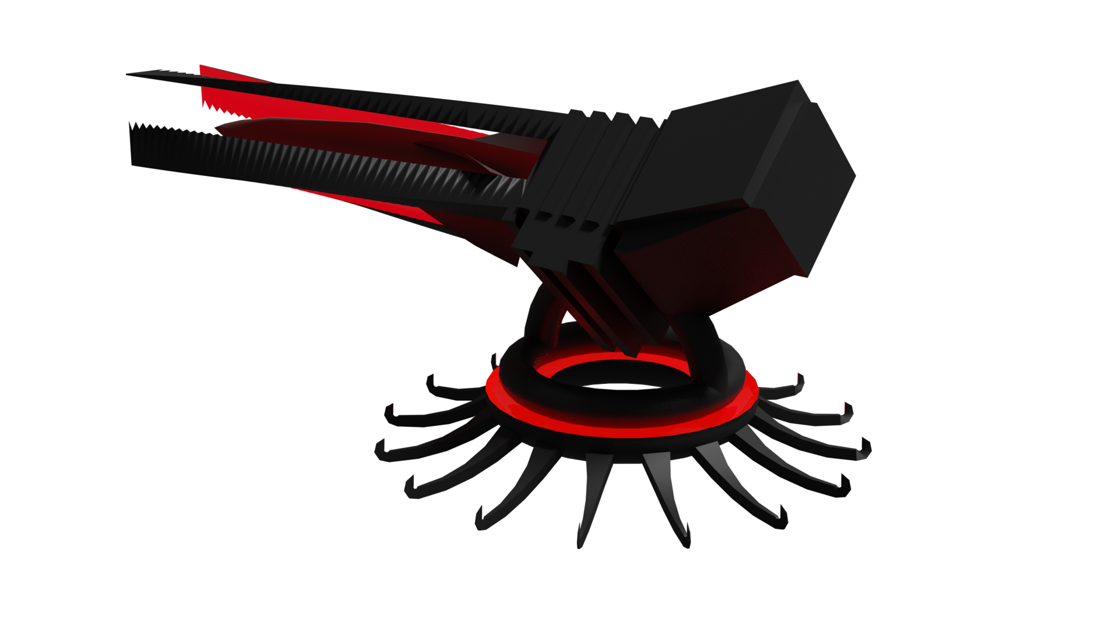
Guided missile
Slower
High Kinetic Damage

Slide 11
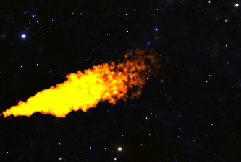
Flamethrower
Continuous
Kinetic Damage

Slide 12
Game Features

Slide 13
Game Footage Here

Slide 14



Now Available!
GalaxyAttackStuidos.com

