Slide 1
AI-POWERED DATA PIPELINE FOR WAREHOUSE DEMAND FORECASTING
MODULAR AND REUSABLE ARCHITECTURE
By Tatenda Manyepa
Personal AWS Solutions Architect Project
February 2025

Slide 2

PROJECT OVERVIEW
•Implemented an AI-powered data pipeline to forecast warehouse product demand.
•Used AWS services for ingestion, ETL processing, machine learning, and prediction delivery.
•Improves inventory decisions by predicting demand based on real-time and historical data.

Slide 3
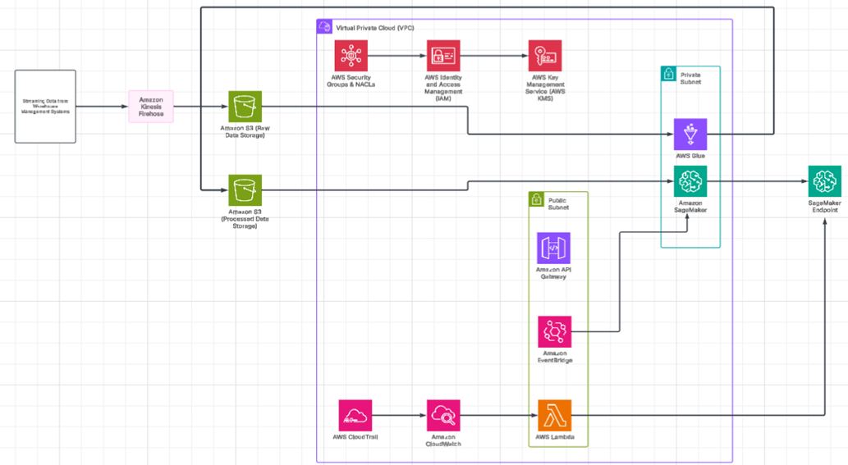
ARCHITECTURE DIAGRAM

Slide 4
ARCHITECTURE FLOW SUMMARY
1. Data Ingestion (Public Subnet):
Kinesis Firehose collects real-time sales & inventory data
Raw data stored in S3
2. Data Processing (Private Subnet):
Glue transforms data; Lambda triggers ETL jobs
Cleaned data stored in S3
3. ML Training (Private Subnet):
SageMaker trains and deploys model.
Model stored in S3 and served via Endpoint.

Slide 5
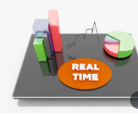
ARCHITECTURE FLOW SUMMARY
4. Real-Time Predictions (Public Subnet):
API Gateway + Lambda invoke SageMaker for forecasts
5. Automation & Monitoring:
EventBridge for retraining; CloudWatch & CloudTrail for logs.
IAM, KMS, Security Groups secure access.

Slide 6
KEY IMPLEMENTATION STEPS
Set up Kinesis Firehose and S3 for ingestion
Process data with Glue and Lambda
Train model using SageMaker
Deploy API with API Gateway and Lambda
Automate retraining via EventBridge
Secure with IAM, KMS, VPC
Validate predictions and tune model

Slide 7

CHALLENGES & RESOLUTIONS
Data latency: Tuned Kinesis buffer settings
Glue job failures: Fixed IAM and schema issues
SageMaker cost: Used Spot Instances, optimised data
API timeouts: Extended Lambda timeout, reduced payloads
EventBridge issues: Fixed permissions, cron syntax

Slide 8

REUSABILITY & INTEGRATION
Modular design supports other AI use cases:
Retail demand forecasting
Finance fraud detection
Logistics and supply chain optimisation
Real-time recommendations
Compatible with AWS Lambda, Glue, and API Gateway
RESULTS AND IMPACT
25% increase in forecast accuracy
40% reduction in ETL time
30% cost savings on ML training
Automated model retraining
Improved inventory decisions and system reliability

Slide 9

EXPECTED BENEFITS
Optimised stock levels and reduced waste
Cost-effective and scalable infrastructure
Real-time business decision support
Continuous model improvement with automation
Adaptable for various industries beyond warehousing

Slide 10



THANK
YOU
"This AI-powered data pipeline enables real-time and predictive insights for warehouse demand forecasting by integrating Amazon Kinesis, AWS Glue, SageMaker, and API Gateway. The modular design ensures scalability, cost optimisation, and seamless integration across diverse operational environments"
+447932793775
https://cloudportfolio.co.uk/

