Slide 1
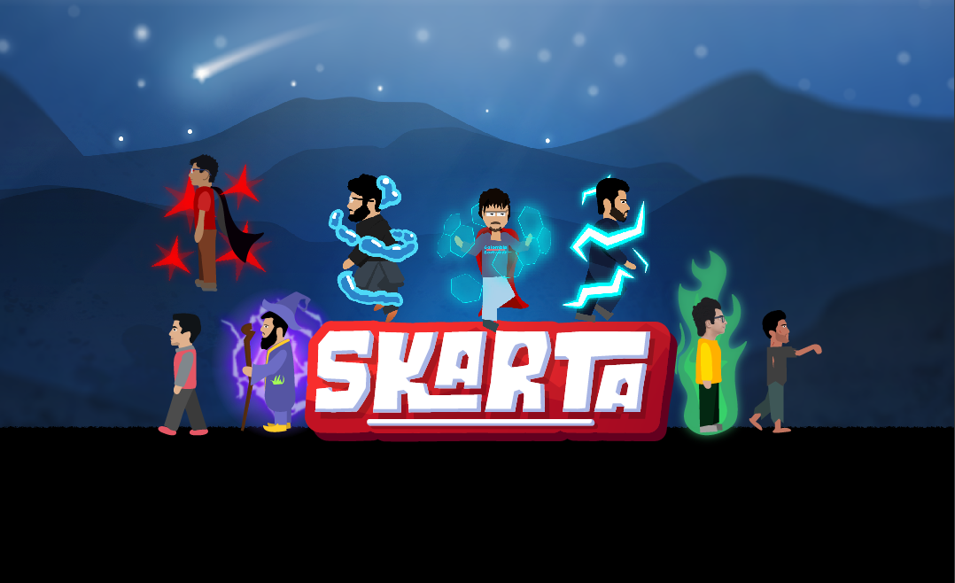
Presented By:
Ahsan Tahir Sarosh Krishan Tayyab Ahmed

Slide 2
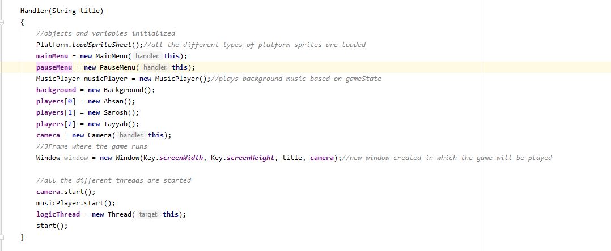
Basic Architecture

Slide 3


Slide 4
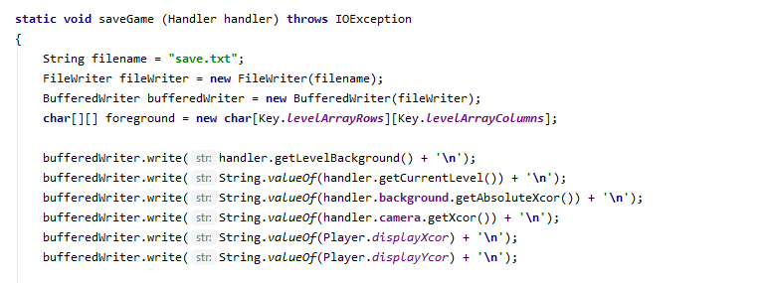

Slide 5
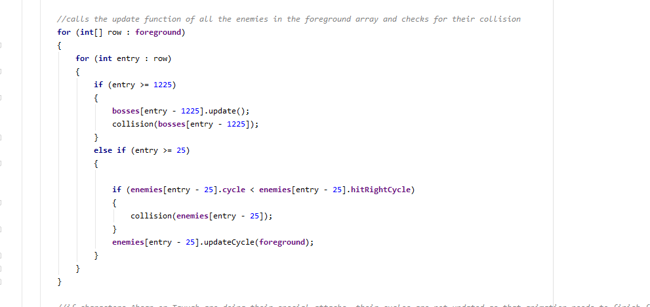
Collision Detection and Mechanics

Slide 6
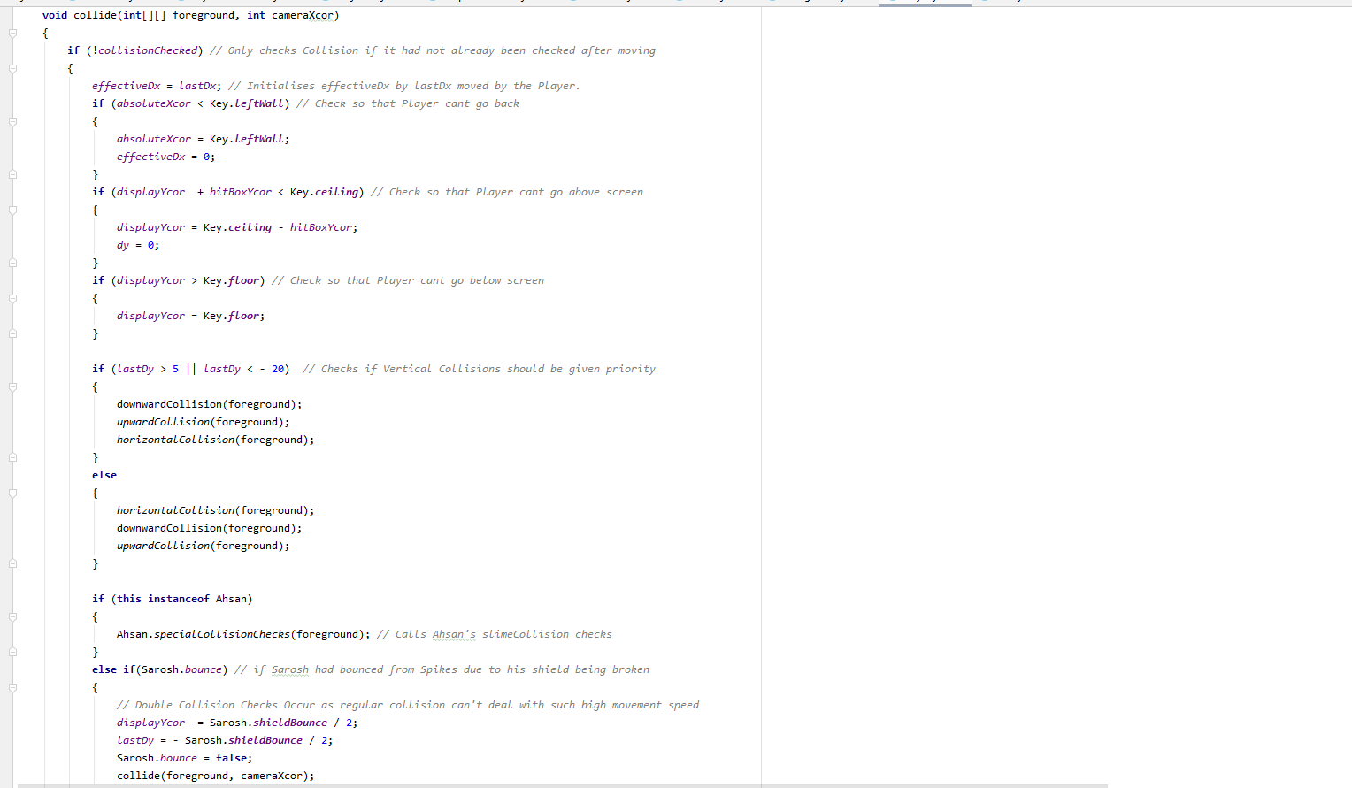

Slide 7
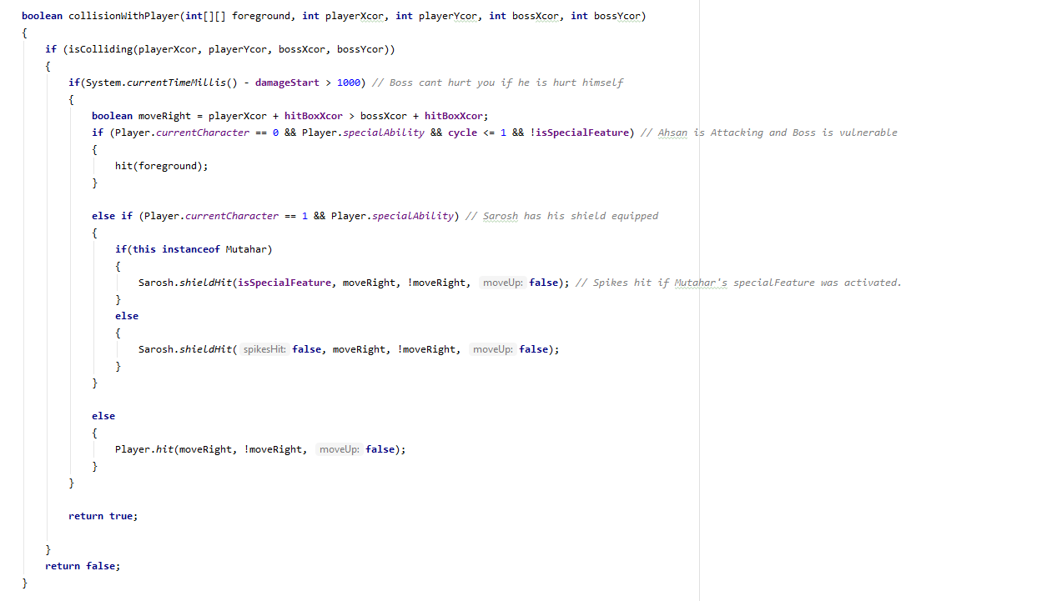

Slide 8
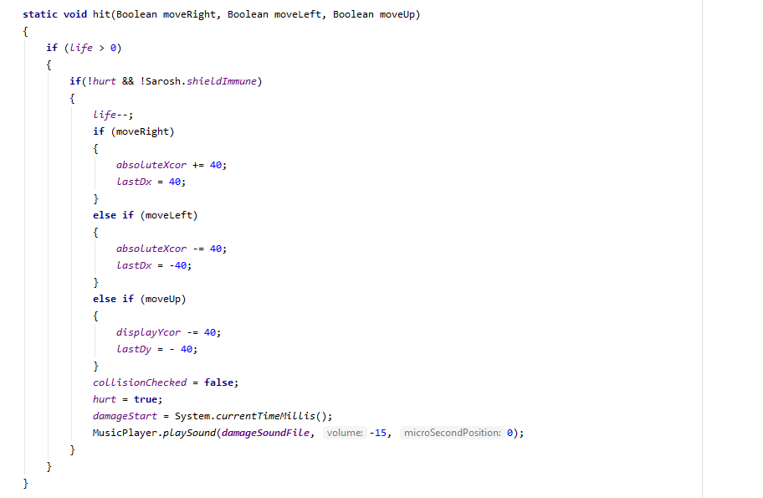

Slide 9
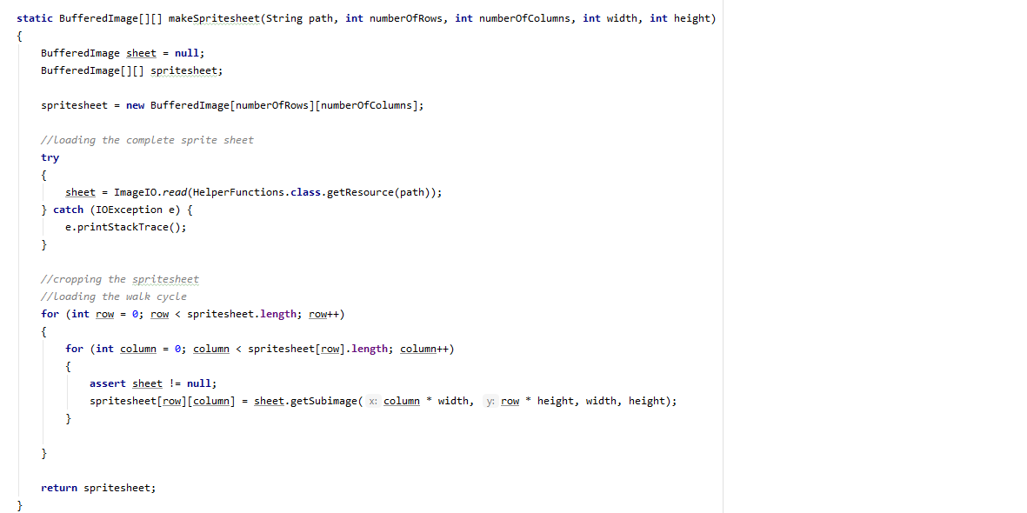
Sprite Sheets and Character Design

Slide 10

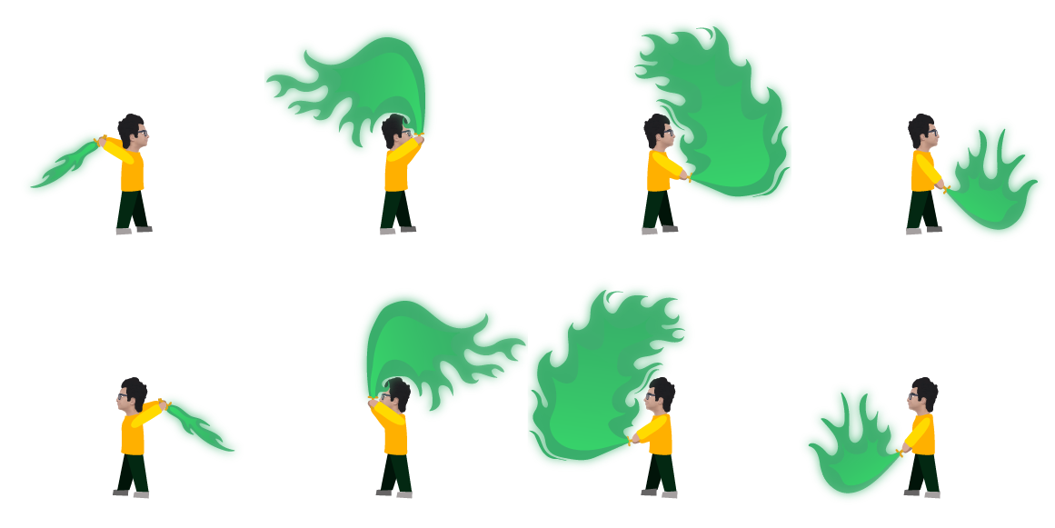


Slide 11


