Slide 1
ASSIGNMENT
BIG DATA
COM745
Name: Amin
Subject: Crime Dataset
Submission Date: 10 January 2025

Slide 2
Problem Statement
Analyzing crime data helps policymakers and law enforcement agencies:
• Identify crime patterns and trends.
• Allocate resources effectively.
• Address public safety concerns using data-driven insights.

Slide 3
Dataset Details
• Dataset Source: Publicly available government data (e.g., data.gov).
• Structure: Contains columns like State, County, Violent Crimes, Murder, Rape, etc.
• Size: 2,518 rows with multiple attributes.

Slide 4
Dataset Justification
The dataset was chosen because:
• It is relevant for crime analysis.
• It provides granular data at the county level.
• Missing values were manageable and were handled effectively.

Slide 5
Hadoop and Hive Setup
• Hadoop was used for storing large datasets in HDFS.
• Hive was used to query and analyze the crime data efficiently.

Slide 6
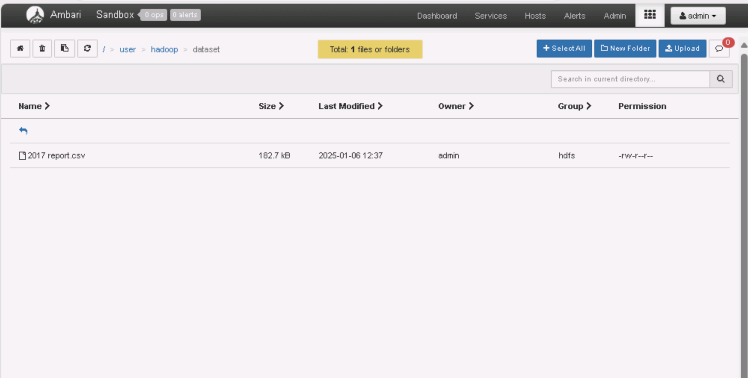
HDFS File Upload
• The crime dataset was uploaded to HDFS at the location:
'/user/hadoop/dataset/2017report.csv'.
• Hive was connected to this file for querying and analysis.

Slide 7
Data Cleaning
• Missing values in key columns ('Murder_and_manslaughter' and 'Rape') were replaced with 0.
• Data types were standardized to ensure accurate analysis.

Slide 8
Tools and Technologies
• Hadoop (HDFS): Used for distributed storage of large datasets.
• Hive: Used for SQL-based querying and data transformation.
• Visualization Tools: Zeppelin and Power BI for data visualization.

Slide 9
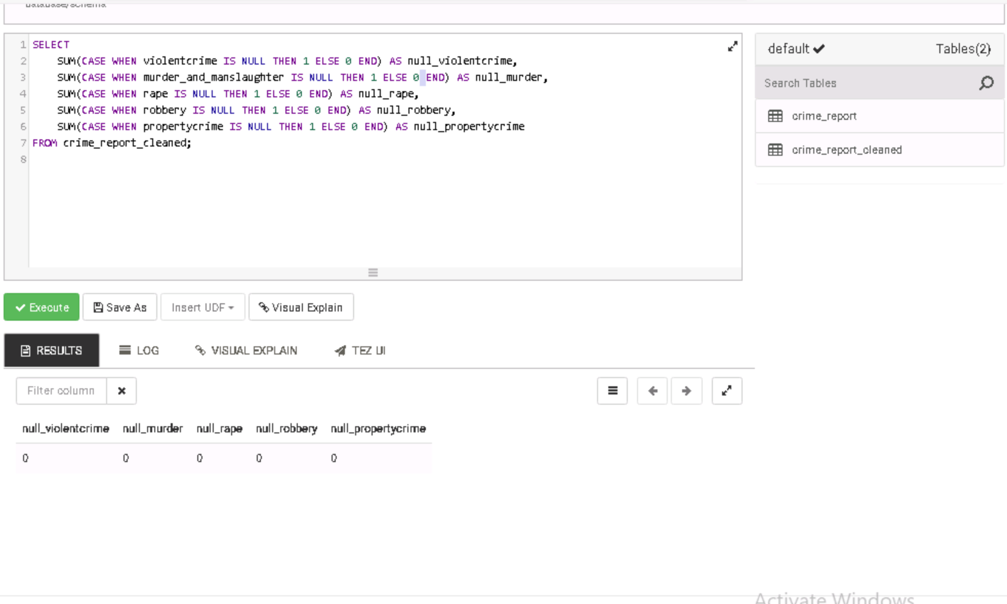
Total Crimes by State
• Analysis revealed total violent and property crimes for each state.
• Top states with the highest crime rates were identified, enabling targeted intervention.

Slide 10
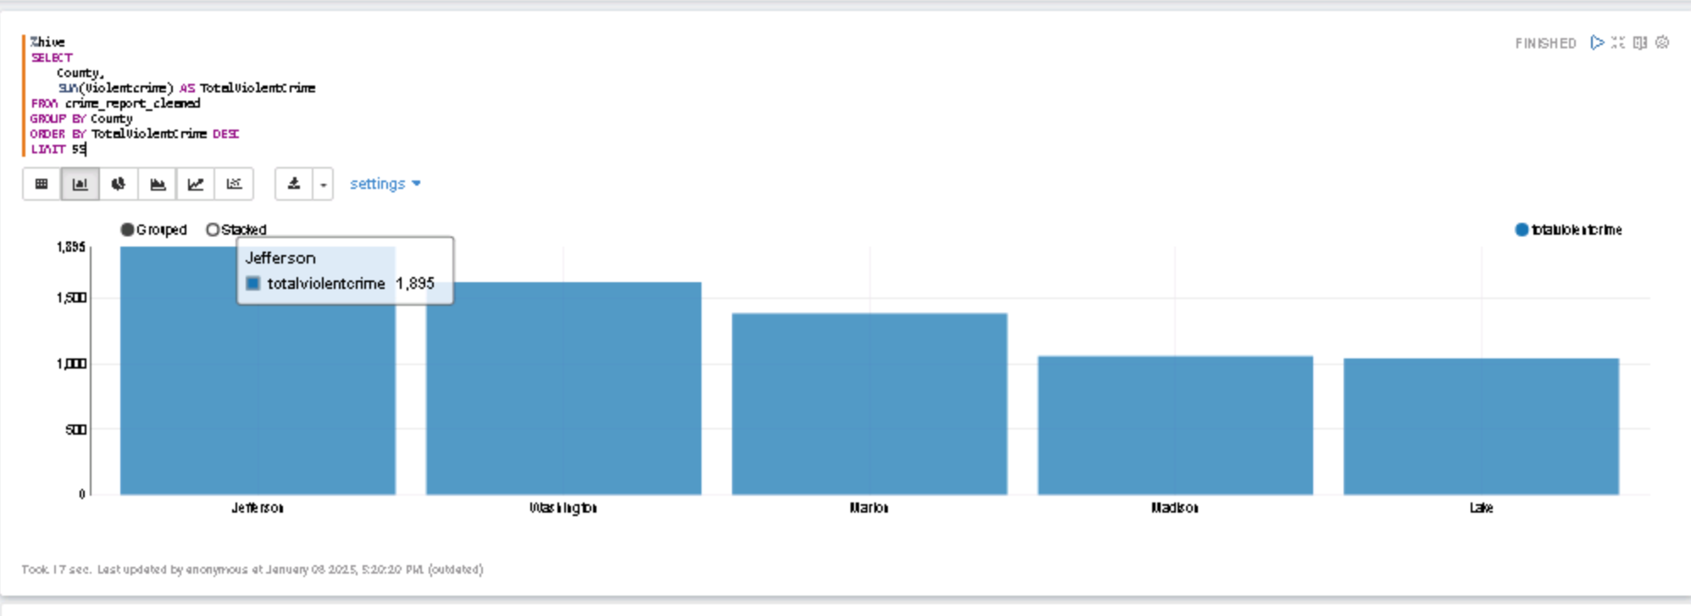
Top 5 Counties
• The analysis highlighted the top 5 counties with the highest violent crime rates.
• These areas require focused resource allocation and preventive measures.

Slide 11
Crime Trends Over Time
• Yearly analysis revealed crime trends over time.
• Patterns showed periods of increasing or decreasing crime rates, providing actionable insights.

Slide 12
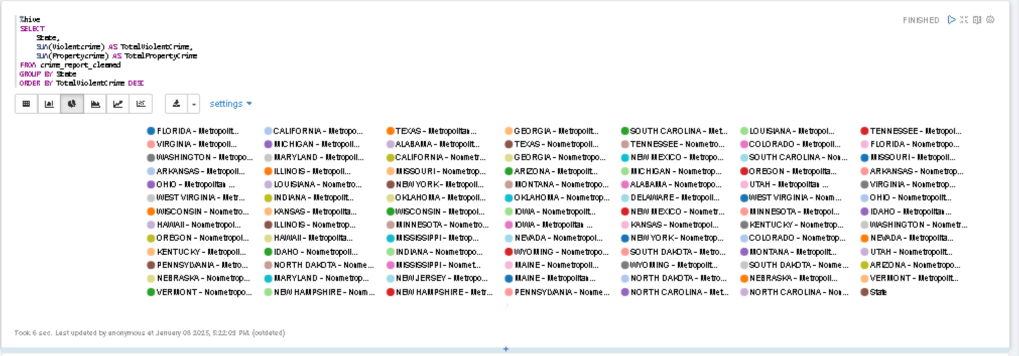
Additional Insights
• Correlation between violent and property crimes was analyzed.
• Regional patterns provided actionable insights for law enforcement and policymakers.

Slide 13
Additional Insights
• States with the largest gaps between violent and property crimes were highlighted.
• Counties with unusual crime patterns (e.g., high violent but low property crimes) were flagged.
• Temporal patterns showed key periods of increased criminal activity.

Slide 14
Concluding Comments
• States and counties with the highest crime rates were identified.
• Patterns and trends offered valuable insights for policymakers.
• This analysis highlights the importance of data-driven decision-making.

Slide 15
Challenge Faced
• Data Quality Issues:
- Missing values and inconsistent data formats required cleaning and standardization.
• Technical Constraints:
- Limited resources for handling large datasets during analysis.
- Query optimization was required for efficient processing in Hive.
• Scalability:
- Future integration with larger and real-time datasets poses scalability challenges.

Slide 16
References
https://www.kaggle.com/datasets/idhers/us-crimes-by-state-by-county-from-2011-to-2017
Ajayakumar, J., & Shook, E. (2020). Leveraging parallel spatio-temporal computing for crime analysis in large datasets: Analyzing trends in near-repeat phenomenon of crime in cities. International Journal of Geographical Information Science, 34(9), 1683–1707. https://doi.org/10.1080/13658816.2020.1732393
Abbott, A. (1997), ‘Of Time and Space: The Contemporary Relevance of the Chicago School’, Social Forces, 75: 1149–82.
M.I. Pramanik, Raymond Y.K. Lau, Wei T. Yue, Yunming Ye and Chunping Li, Big data analytics for security and criminal investigations, WIREs Data Mining Knowl Discov 2017, e1208. doi: 10.1002/widm.1208
(us crimes by state by county from 2011 to 2017)

