Slide 1
Today’s Lecture
Binary Operator overloading (+, -, *, /, %)
Unary Operator overloading (++, --, -)
Pre increment (++a,--a)
Post increment (a++, a++)
Unary negation operator (-a)
Relational Operator(>, >=, <, <=, ==)
Subscript Operator or Array index operator []
Stream insertion << stream extraction >>

Slide 2
Operator Overloading (Binary Operator)
Operator overloading is an important concept in C++. It is a type of polymorphism in which an operator is overloaded to give user-defined meaning to it
An operator with two operands to perform a mathematical operation is called the Binary Operator Overloading.
There are multiple binary operators, like +, -, *, /,%, etc., can directly manipulate or overload the object of a class.

Slide 3
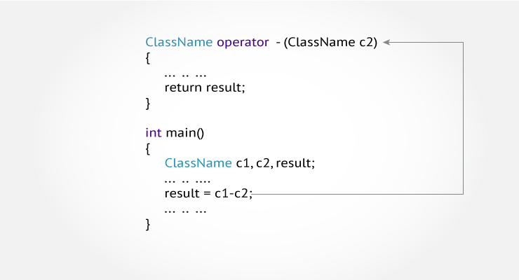
Operator Overloading Syntax

Slide 4
Operator Overloading (Class Activity)
Write a C++ program to create a complex number class. Write getter setter, constructor, destructor, and all overloaded operators needed to run the given driver code.
class complex {
private:
int real;
int imag;
public:
//All functions that are needed. };
int main() {
complex c1(10,7); // for complex numbers, such as 10+7i
complex c2(5); // for numbers without imaginary part as 5 + 2i
complex c3();
complex c4();
c3 = c1+c2;
c4 = c1-c2;
c5 = c3*c4;
c6 = c5/c4; }

Slide 5
Operator Overloading(main.cpp)
#include <iostream>
#include "Header.h"
using namespace std;
int main()
{
{
complex c1(10, 7);
c1.display();
complex c2(5);
c2.display();
//complex c3;
cout << endl;
cout << " Addition: " << endl;
complex c3 = c1 + c2;
c3.display();
cout << endl;
cout << " Subtraction: " << endl;
complexc4 = c1 - c2;
c4.display2();
cout << endl;
cout << " Multiplication: " << endl;
complex c5 = c3 * c4;
c5.display3();
cout << endl;
cout << " Division: " << endl;
complex c6 = c5 / c4;
c6.display4();
cout << endl;
}
system("pause");
}

Slide 6
Operator Overloading (Header.h)
#pragma once
class complex {
private:
int real;
int img;
public:
complex(); // Default Constructor
complex(int r, int i);
complex(int r);
int set_real(int r);
int set_img(int i);
int get_real();
int get_img();
void display();
void display2();
void display3();
void display4();
complex operator+(complex &other);
complex operator-(complex& other);
complex operator*(complex& other);
complex operator/(complex& other);
~complex();
};

Slide 7
Operator Overloading (Source1.cpp)
int complex::set_real(int r)
{
real = r;
return real;
}
int complex::set_img(int i)
{
img = i;
return img;
}
int complex::get_real()
{
return real;
}
int complex::get_img()
{
return img;
}
#include "Header.h"
#include <iostream>
using namespace std;
complex::complex()
{
int real=0;
int img=0;
}
complex::complex(int r)
{
real = r;
img = 0;
}
complex::complex(int r, int i)
{
real = r;
img = i;
}
void complex::display()
{
cout << " Calculation is " << real << " + " << img << "i " << endl;
}
void complex::display2()
{
cout << " Calculation is " << real << " - " << img << "i " << endl;
}
void complex::display3()
{
cout << " Calculation is " << real << " * " << img << "i " << endl;
}
void complex::display4()
{
cout << " Calculation is " << real << " / " << img << "i " << endl;
}

Slide 8
Operator Overloading (Source1.cpp)
complex complex::operator+(complex & other)
{
complex save_info;
save_info.real = real + other.real;
save_info.img = img + other.img;
return save_info;
}
complex complex::operator-(complex& other)
{
complex save_info;
save_info.real = real - other.real;
save_info.img = img - other.img;
return save_info;
}
complex complex::operator*(complex & other)
{
complex save_info;
save_info.real = real * other.real;
save_info.img = img * other.img;
return save_info;
}
complex complex::operator/(complex& other)
{
complex save_info;
save_info.real = real / other.real;
save_info.img = img / other.img;
return save_info;
}
complex::~complex()
{
cout << " Destruction Called " << endl;
}

Slide 9
Class Activity
Write a C++ program that initially takes the length of the two matrixes from the user and puts the values in both matrixes, then performs addition using the operator overloading concept

Slide 10
Operator Overloading (+) (Header.h)
#pragma once
#include<iostream>
using namespace std;
class matrix_addition {
private:
int rows, cols;
public:
int** twodarr;
int** save_data;
public:
matrix_addition() {
}
int set_rows()
{
cout << " Enter the number of rows: ";
cin >> rows;
return rows;
}
int set_cols()
{
cout << " Enter the number of column: ";
cin >> cols;
return cols;
}
void set_data()
{
twodarr = new int* [rows];
for (int i = 0; i < rows; i++)
{
twodarr[i] = new int[cols];
}
for (int i = 0; i < rows; i++)
{
for (int j = 0; j < cols; j++)
{
cin >> twodarr[i][j];
}
}
}
void show_data()
{
for (int i = 0; i < rows; i++)
{
for (int j = 0; j < cols; j++)
{
cout << twodarr[i][j];
cout << "\t";
}
cout << endl;
}
}

Slide 11
Operator Overloading (+) (Header.h)
void operator +(matrix_addition& other)
{
save_data = new int* [rows];
for (int i = 0; i < rows; i++)
{
save_data[i] = new int[cols];
}
for (int i = 0; i < rows; i++)
{
for (int j = 0; j < cols; j++)
{
save_data[i][j] = twodarr[i][j] + other.twodarr[i][j] ;
cout<< save_data[i][j];
cout << "\t";
}
cout << endl;
}
}
};

Slide 12
Operator Overloading (+) (Source.cpp)
#include<iostream>
#include "Header.h"
using namespace std;
int main()
{
matrix_addition obj1, obj2;
obj1.set_rows();
obj1.set_cols();
obj2.set_rows();
obj2.set_cols();
obj1.set_data();
obj2.set_data();
obj1.show_data();
cout << endl;
obj2.show_data();
cout << endl;
obj1 + obj2;
cout << "\n";
system("pause");
}

Slide 13
Operator Overloading (Unary Operator)
Unary operators are used to calculating the result on only one operand.
Unary operators are used on a single operand to calculate the new value of that variable
Unary Operator overloading (++, --, -)
Pre increment (++a,--a)
Post increment (a++, a++)
Unary negation operator (-a)

Slide 14
Operator Overloading(source.cpp)
#include <iostream>
#include "Header.h"
using namespace std;
int main()
{
{
complex c1(10, 7);
c1.display();
complexc4= ++c1; // pre - increment operator
c4.display2();
complex c5 = --c4; // pre - increment operator
c5.display3();
complex c6 = c5++; // post - increment operator
c6.display4();
complex c7 = c6--; // post - increment operator
c7.display5();
complex c8 = -c7;
c8.display6();
}
system("pause");
}

Slide 15
Operator Overloading (Header.h)
#pragma once
class complex {
private:
int real;
int img;
public:
complex(); // Default Constructor
complex(int r, int i);
void display();
void display2();
void display3();
void display4();
void display5();
void display6();
complex operator++();
complex operator--();
complex operator++(int);
complex operator--(int);
complex operator-();
~complex();
};

Slide 16
Operator Overloading (Source1.cpp)
complex complex::operator--(int)
{
complex temp;
real=real--;
temp.real = real;
img = img--;
temp.img = img;
return temp;
}
complex complex::operator-()
{
complex temp;
real = -real;
temp.real = real;
img = -img;
temp.img = img;
return temp;
}
#include "Header.h"
#include <iostream>
using namespace std;
complex::complex()
{
real=0;
img=0;
}
complex::complex(int r, int i)
{
real = r;
img = i;
}
complex complex::operator++()
{ complex temp;
temp.real = ++real;
temp.img = ++img;
return temp; }
complex complex::operator--()
{
complex temp;
temp.real = --real;
temp.img = --img;
return temp;
}
complex complex::operator++(int)
{
complex temp;
real = real++;
temp.real = real;
img = img++;
temp.img = img;
return temp;
}

Slide 17
Operator Overloading (Source1.cpp)
void complex::display()
{
cout << " Calculation is " << real << " + " << img << "i " << endl;
}
void complex::display2()
{
cout << " Pre Increment of real and Img is: " << real << " + " << img << "i " << endl;
}
void complex::display3()
{
cout << " Pre Decrement of real and Img is: " << real << " + " << img << "i " << endl;
}
void complex::display4()
{
cout << " Post Increment of real and Img is: " << real << " + " << img << "i " << endl;
}
void complex::display5()
{
cout << " Post Decrement of real and Img is: " << real << " + " << img << "i " << endl;
}
void complex::display6()
{
cout << " Negation Operator of real and Img is: " << real << " + " << img << "i " << endl;
}
complex::~complex()
{
cout << " Destruction Called " << endl;
}

Slide 18
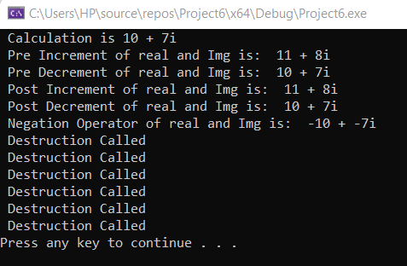
Output of the following program

Slide 19
Operator Overloading (Relational Operator)
There are various relational operators supported by C++ language like (<, >, <=, >=, ==, etc.) which can be used to compare C++ built-in data types.
You can overload any of these operators, which can be used to compare the objects of a class.

Slide 20
Operator Overloading(source.cpp)
#include <iostream>
#include "Header.h"
using namespace std;
int main()
{
{
complex c1(10, 20);
complex c2(20, 30);
complex c3(5, 50);
complex c4(10, 20);
c1.display();
c2.display2();
c3.display3();
c4.display4();
cout << endl;
cout << " Relational Operator c1>c2 " << endl;
if (c1 > c2)
{
cout << " c1 values are greater: " << endl;
}
else
cout << " c2 values are greater: " << endl;
cout << endl;
cout << " Relational Operator c1>=c2 " << endl;
if (c1 >= c2)
{
cout << " c1 values are greater and equal to c2: " << endl;
}
else
cout << " c1 values are not less than and equal to c2: " << endl;
cout << endl;

Slide 21
Operator Overloading(source.cpp)
cout << " Relational Operator c1==c4 " << endl;
if (c1 == c4)
{
cout << " c1 values are == to c2: " << endl;
}
else
cout << " c1 values != to c2: " << endl;
cout << endl;
}
cout << endl;
system("pause");
}
cout << " Relational Operator c1<c2 " << endl;
if (c1 < c2)
{
cout << " c1 values are smaller: " << endl;
}
else
cout << " c2 values are greater: " << endl;
cout << endl;
cout << " Relational Operator c1<=c2 " << endl;
if (c1 <= c2)
{
cout << " c1 values are less and equal to c2: " << endl;
}
else
cout << " c1 values are not less than and equal to c2: " << endl;
cout << endl;

Slide 22
Operator Overloading (Header.h)
#pragma once
class complex {
private:
int real;
int img;
public:
complex(); // Default Constructor
complex(int r, int i);
bool operator >(const complex &other);
bool operator >=(const complex& other);
bool operator <(const complex& other);
bool operator <=(const complex& other);
bool operator ==(const complex& other);
void display();
void display2();
void display3();
void display4();
~complex();
};

Slide 23
Operator Overloading (Source1.cpp)
#include "Header.h"
#include <iostream>
using namespace std;
complex::complex()
{
real=0;
img=0;
}
complex::complex(int r, int i)
{
real = r;
img = i;
}
bool complex::operator >(const complex& other)
{
if (real > other.real)
return true;
else
return false;
}
bool complex::operator >=(const complex& other)
{
if (real > other.real)
return true;
else
return false;
}
bool complex::operator <(const complex& other)
{
if (real < other.real)
return true;
else
return false;
}
bool complex::operator <= (const complex & other)
{
if (real < other.real)
return true;
else
return false;
}
bool complex::operator == (const complex& other)
{
if (real == other.real && img==other.img)
return true;
else
return false;
}

Slide 24
Operator Overloading (Source1.cpp)
void complex::display()
{
cout << " Values of real and img of c1: " << real << " and Imag is: " << img << "i " << endl;
}
void complex::display2()
{
cout << " Values of real and img of c2: " << real << " and Imag is: " << img << "i " << endl;
}
void complex::display3()
{
cout << " Values of real and img of c3: " << real << " and Imag is: " << img << "i " << endl;
}
void complex::display4()
{
cout << " Values of real and img of c4: " << real << " and Imag is: " << img << "i " << endl;
}
complex::~complex()
{
cout << " Destruction Called " << endl;
}

Slide 25
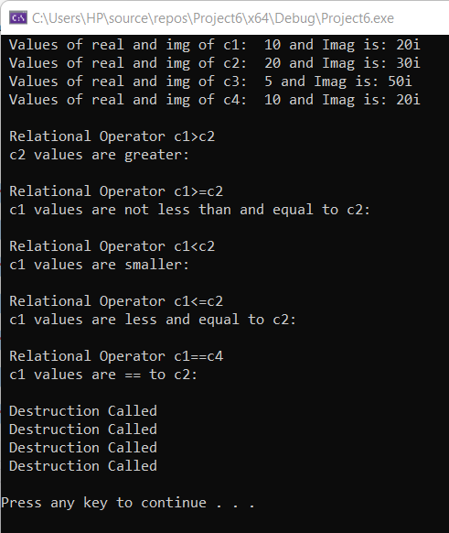
Output program

Slide 26
Subscript Operator or Array index operator
Subscript operator [ ], like the function-call operator, is considered a binary operator. The declaration is identical to any binary operator, with the following exception:
It can not be declared as a non-member function. It must be a non-static member function.
It should take a single argument. The argument can be of any type and designates the desired array subscript.

Slide 27
Operator Overloading(source.cpp)
#include <iostream>
#include "Header.h"
using namespace std;
int main()
{
{
complex c1;
c1.set_marks();
c1[3];
c1.display();
}
cout << endl;
system("pause");
}

Slide 28
Operator Overloading (Header.h)
#pragma once
class complex {
private:
int real;
int img;
int* marks;
int size;
int temp;
public:
complex();
complex(int R, int I);
void set_marks();
int operator[](int index);
void display();
};

Slide 29
Operator Overloading (Source1.cpp)
void complex::set_marks()
{
cout << "Enter the index array: ";
cin >> size;
marks = new int[size];
for (int i = 0; i < size; i++)
{
cout << " Enter the [" << i << "] index value: ";
cin >> marks[i];
}
}
#include "Header.h"
#include <iostream>
using namespace std;
complex::complex()
{
real = 0;
img = 0;
}
complex::complex(int R, int I)
{
real = R;
img = I;
}

Slide 30
Operator Overloading (Source1.cpp)
int complex::operator[](int index)
{
if (index >= size)
cout << " Index out of bound: ";
temp = marks[index];
return temp;
}
void complex::display()
{
cout << " The value at index is " << temp << endl;
}

Slide 31
Stream insertion << stream extraction >>
In C++, stream insertion operator “<<” is used for output and extraction operator “>>” is used for input.

Slide 32
Stream insertion << stream extraction >>
#include<iostream>
using namespace std;
class complex {
private:
int real;
int img;
public:
complex()
{
real = 0;
img = 0;
}
complex(int R, int I)
{
real = R;
img = I;
}
friend istream &operator >>(istream &input, complex& other);
friend ostream& operator <<(ostream& output, complex& other);
};
istream &operator>>(istream &input, complex& other)
{
input >> other.real;
input >> other.img;
return input;
}
ostream& operator<<(ostream& output, complex& other)
{
output << other.real;
output << "+";
output << other.img;
output << "i";
return output;
}

Slide 33
Stream insertion << stream extraction >>
int main()
{
{
cout << "Enter the real and img value: ";
complex c1;
cin >> c1;
cout << " Values of real and img are: ";
cout << c1;
}
cout << endl;
system("pause");
}

Slide 34
Operators that cannot be overloaded
The list of operators which cannot be overloaded is as follows:
Conditional or Ternary Operator (?:) cannot be overloaded.
Size of Operator (sizeof) cannot be overloaded.
Scope Resolution Operator (::) cannot be overloaded.
Class member selector Operator (.) cannot be overloaded.
Member pointer selector Operator (.*) cannot be overloaded.
Object type Operator (typeid) cannot be overloaded.

