Slide 1
Third International Workshop on Serverless Computing (WoSC) 2018
In conjunction with IEEE CLOUD 2018 affiliated with 2018 IEEE World Congress on Services (IEEE SERVICES 2018)

Slide 2
Agenda Overview
8:30 to 10:00 a.m. Welcome and Keynote 10:00 to 10:30 a.m. Break 10:30 to 12:00 p.m. Papers 12:00 to 1:30 p.m. Lunch break 1:30 to 3:00 p.m. Invited speakers 3:00 to 3:30 p.m. Break 3:30 to 5:00 p.m. Invited speaker and panel
Latest agenda, abstracts, speakers, and links to slides posted here:
https://www.serverlesscomputing.org/wosc3/#program

Slide 3
Your Feedback
Please tell us what works and what does not work.
Google feedback form:
https://goo.gl/forms/vTDGOvuKED4FJJA22

Slide 4
Your questions during feedback: Docs and Slack
Workshop program does not leave much time for questions. Please post your questions during workshop to Google doc and join #wosc3 slack channel to discuss: https://docs.google.com/document/d/1AjGEx7sLoVX7FxjpRL3X3QjzYg0bBlNgXyXqaMWx8os/edit?usp=sharing
We will have discussion during panel at the end of workshop and panelists will be checking the slack channel and google do. Sign up for slack channel in browser open wosc-tutorial-invite.mybluemix.net
https://wosc-tutorial-invite.mybluemix.net/
Then open slack server https://future-compute.slack.com and join #wosc3

Slide 5
Workshop purpose:
"Many of the major cloud vendors, have released serverless platforms within the last two years, including Amazon Lambda, Google Cloud Functions, Microsoft Azure Functions, IBM Cloud Functions. There is, however, little attention from the research community.
This workshop brings together researchers and practitioners to discuss their experiences and thoughts on future directions.”

Slide 6
Organization
Latest: https://www.serverlesscomputing.org/wosc3
Previous workshops
Second International Workshop on Serverless Computing (WoSC) 2017 in Las Vegas, NV, USA on December 12th, 2017 part of Middleware 2017.
First International Workshop on Serverless Computing (WoSC) 2017 in Atlanta, GA, USA on June 5th, 2017 part of ICDCS 2017.
Presentations from previous workshops:
https://www.serverlesscomputing.org
Workshop co-chairs
Paul Castro, IBM Research
Vatche Ishakian, Bentley University
Vinod Muthusamy, IBM Research
Aleksander Slominski, IBM Research
Steering Committee
Geoffrey Fox, Indiana University
Dennis Gannon, Indiana University & Formerly Microsoft Research
Arno Jacobsen, MSRG (Middleware Systems Research Group)

Slide 7
Program Committee
Gul Agha, University of Illinois at Urbana-Champaign
Azer Bestavros, Boston University
Flavio Esposito, Saint Louis University
Rodrigo Fonseca, Brown University
Ian Foster, University of Chicago and Argonne National Laboratory
Geoffrey Fox, Indiana University
Dennis Gannon, Indiana University & Formerly Microsoft Research
Arno Jacobsen, MSRG (Middleware Systems Research Group)
Tyler Harter, GSL, Microsoft
Pietro Michiardi, Eurecom
Peter Pietzuch, Imperial College
Rodric Rabbah, IBM Research
Rich Wolski, University of California, Santa Barbara

Slide 8

Fourth International Workshop on Serverless Computing (WoSC)
Part of 11th IEEE/ACM International Conference on Utility and Cloud Computing (UCC) and 5th IEEE/ACM International Conference on Big Data Computing, Applications and Technologies (BDCAT)
Paper Submission: September 01, 2018
Conference: December 17-20, 2018 in Zurich, Switzerland

Slide 9
Serverless in 5 minutes

Slide 10
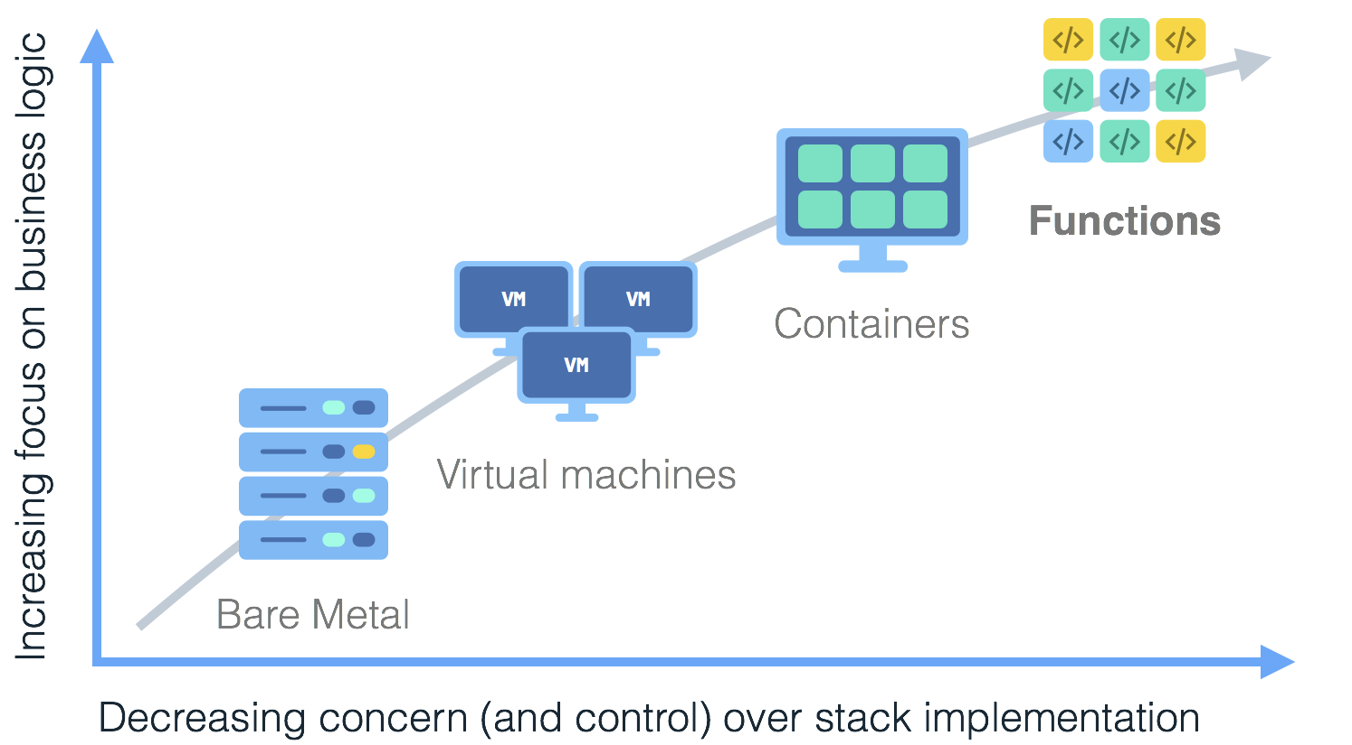
Notes:
Serverless is coming of age, developers want to focus on code instead of managing infrastructure.
Mention some of the companies.
Show the axis later.
Animate the arrow and boxes.

Slide 11
Evolution Of Serverless
PaaS
Container Orchestrators
IaaS
Bare Metal

Slide 12
Enter Serverless
Serverless
PaaS
Container Orchestrators
IaaS
Bare Metal

Slide 13
Monolithic Application
Break-down into microservices
Explosion in number of
containers / processes:
Make each micro service HA
Increase of infrastructure cost footprint
Protect against regional outages
Region A
Region B
Increase of operational
management cost and
complexity
Notes:
Managability
Load anticipation (models) and AutoScaling, Things can fail, load goes up and down.
So how about dividing your work into smaller pieces, but let the platform worry about manageability and autoscaling. Great Ideally, but its hard for the platform to scale and manage the services (So the suggestion is to make them stateless and smaller).

Slide 14
What is Serverless?
a cloud-native platform
for
short-running, stateless computation
and
event-driven applications
which
scales up and down instantly and automatically
and
charges for actual usage at a millisecond granularity

Slide 15
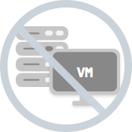
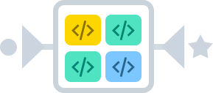
Server-less means no servers?
Or worry-less about servers?
Runs code only on-demand on a per-request basis
Serverless deployment & operations model
No servers
Just code
Notes:
What is Serverless
A cloud-native platform for
short-running, stateless computation
And event-driven applications
Which scales up and down instantly and automatically
And charges for actual usage at a millisecond granularity

Slide 16

What triggers code execution?
Runs code in response to events
Event-programming model
Notes:
What is Serverless

Slide 17
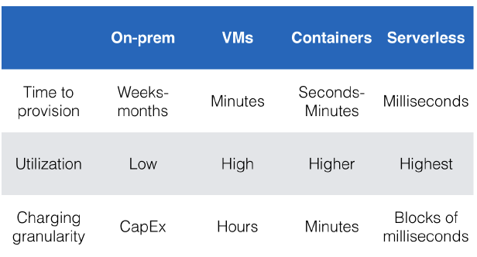
Why is Serverless attractive?
Making app development & ops dramatically faster, cheaper, easier
Drives infrastructure cost savings
Source: Jason McGee, IBM; Serverless Conference 2017.
Notes:
Another key reason for Serverless being attractive is the use of other provider services (logging, Data Analytics, Speech, Inferencing, etc….). Vendor Lock-in.

Slide 18
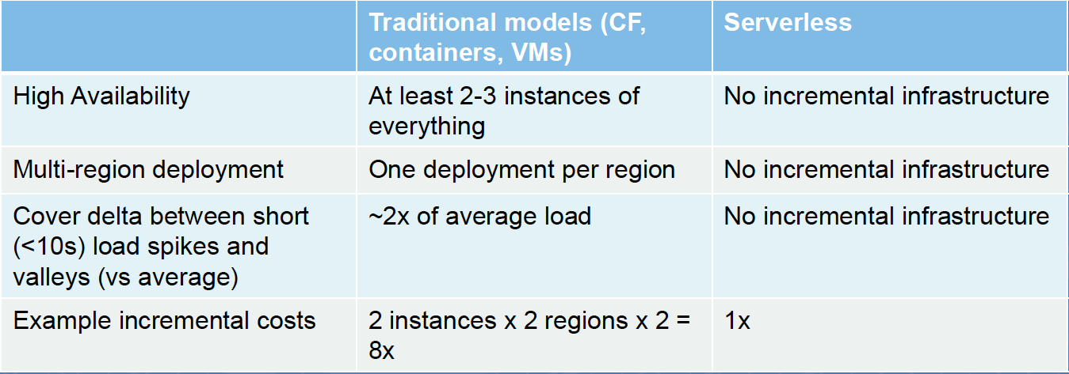
Key factors for infrastructure cost savings

Slide 19
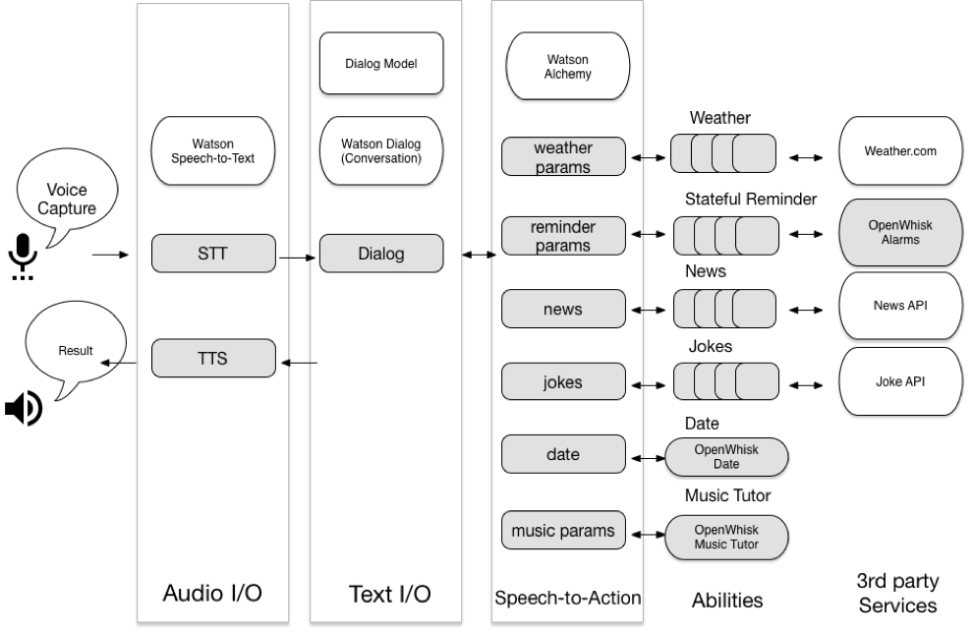
Chatbots
Building a Chatbot with Serverless Computing, Yan, Mengting and Castro, Paul and Cheng, Perry and Ishakian, Vatche, Proceedings of the 1st International Workshop on Mashups of Things and APIs 2016

Slide 20
PyWren: a massive data framework for Lambda
Open Source MapReduce framework using Lambda
Word count job on 83M items is only 17% slower than PySpark running on dedicated servers.
Sort 1TB data in 3.4 minutes (Spark 100TB in 23 min)
https://github.com/pywren/pywren
http://pywren.io/
Occupy the Cloud: Distributed Computing for the 99%, Eric Jonas, Qifan Pu, Shivaram Venkataraman, Ion Stoica, Benjamin Recht, https://arxiv.org/abs/1702.04024

Slide 21
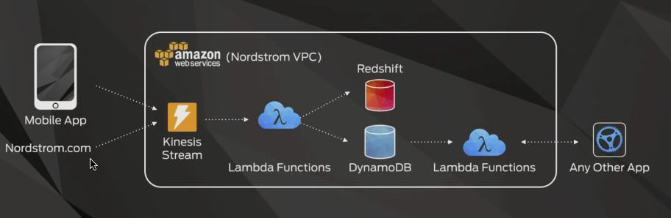
Nordstrom Recommendations
15-20 minutes of processing → now in seconds 2x order of magnitude for cost savings

Slide 22









What is Serverless good for?
Serverless is good for
short-running
stateless
event-driven
Serverless is not good for
long-running
stateful
number crunching
Microservices
Databases
Mobile Backends
Deep Learning Training
Bots, ML Inferencing
Heavy-Duty Stream Analytics
IoT
f(x)
Numerical Simulation
Modest Stream Processing
Video Streaming
Service integration

Slide 23



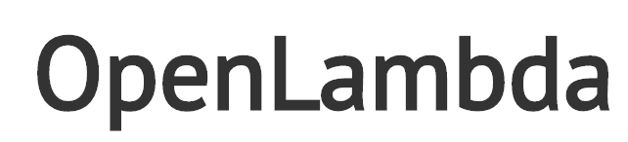







Current Platforms for Serverless
AWS Lambda
Azure Functions
Kubernetes
IBM Cloud Functions
Red-Hat
Google Functions
Notes:
Auth0, Twitter, ..
And many more upcoming / open source

Slide 24
Tutorial Part 0
Account setup

Slide 25
Slack channel
Sign up for slack channel: wosc-tutorial-invite.mybluemix.net
https://wosc-tutorial-invite.mybluemix.net/

Slide 26
Tutorial Setup
slides are available at https://goo.gl/QpD6fi
Log-in with your IBM Cloud (Bluemix) account: create one if you do not yet have one by clicking the sign-up link or by directly navigating to https://developer.ibm.com/dwblog/2017/building-with-ibm-watson and select “IBM Cloud Lite” to get IBM Cloud (Bluemix) account
To use OpenWhisk proceed as follows: open a browser window and navigate to https://console.ng.bluemix.net/openwhisk/
CLick “Start Creating” to create cloud functions directly from browser
Click the Download OpenWhisk command line tools for your operating system: https://console.bluemix.net/openwhisk/learn/cli Direct download link https://openwhisk.ng.bluemix.net/cli/go/download/
Follow steps 1 & 2 (you do not need to perform step 3), i.e. download the CLI for your particular platform and configure it by specifying your namespace and authorization key

Slide 27
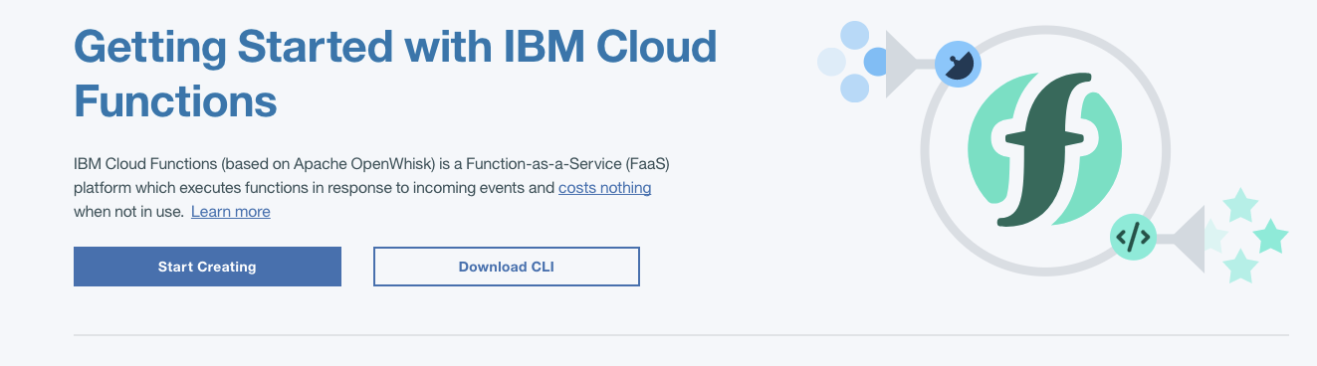
Bluemix screenshot

Slide 28
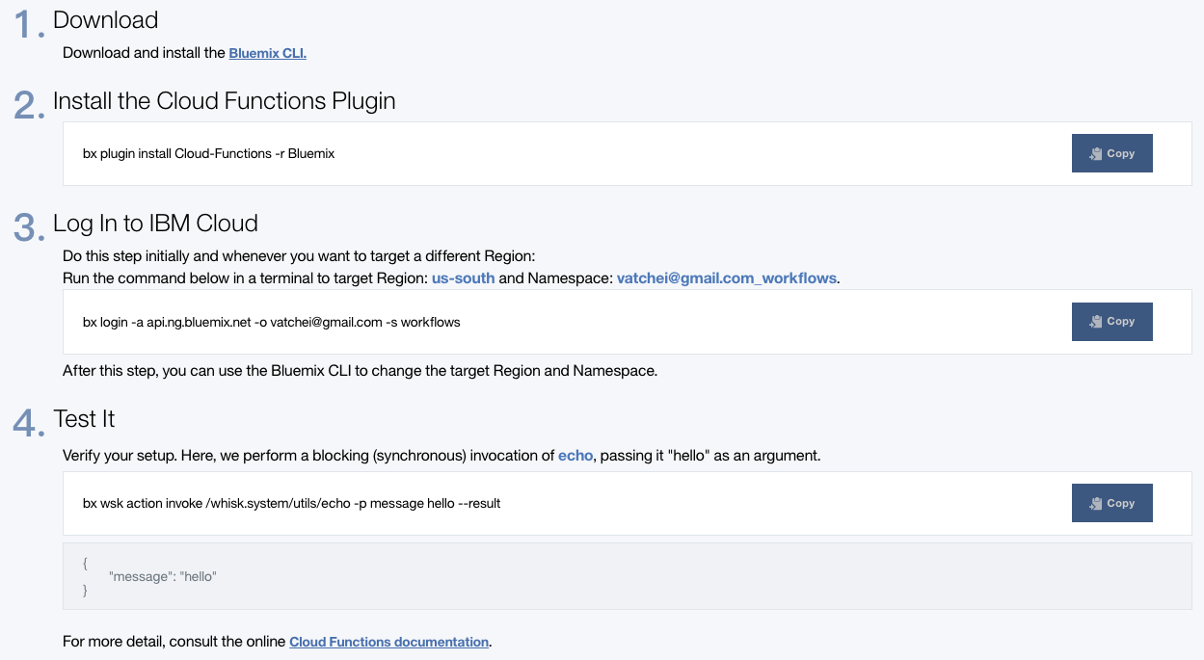
Bluemix screenshot

Slide 29
Using bx command line
bx login -a api.ng.bluemix.net
bx plugin install Cloud-Functions -r Bluemix
bx wsk action invoke /whisk.system/utils/echo -p message hello --result

Slide 30
Using wsk command line (Apache OpenWhisk)
Make sure to run wsk command that set your API key (Step 2)
wsk property set --apihost openwhisk.ng.bluemix.net --auth YOUR-KEY-HERE
and test it:
wsk action invoke /whisk.system/utils/echo -p message middleware --blocking --result
output:
{ "message": "middleware" }

Slide 31
Part 1
OpenWhisk actions, triggers

Slide 32
Creating and invoking JavaScript actions
An action can be a simple JavaScript function that accepts and returns a JSON object.
Create a file called hello.js
function main()
{
return { message: "Hello world" };
}
Create an OpenWhisk action called hello
bx wsk action create hello hello.js

Slide 33
Creating and invoking JavaScript actions
List the actions you created
bx wsk action list
To run an action use the wsk action invoke command.
bx wsk action invoke --blocking hello
You can retrieve the list of activations at any time
bx wsk activation list
Enter the invocation ID shown, for example:
bx wsk activation get dde9212e686f413bb90f22e79e12df74
You can delete an action
bx wsk action delete hello

Slide 34
Passing parameters to actions
Change (and save) your hello action as follows
function main(msg) { return { message: "Hello, " + msg.name + " from " + msg.place }; }
Create the action
bx wsk action create hello2 hellowithparams.js
You can pass named parameters as JSON payload or via the CLI
wsk action invoke -b hello2 -p name "Bernie" -p place "Vermont" --result { "message": "Hello, Bernie from Vermont" }

Slide 35
Using actions to call an external API
var request = require("request"); function main(msg) { var location = msg.location || "Vermont"; var url = "https://query.yahooapis.com/v1/public/yql?q=select item.condition from weather.forecast where woeid in (select woeid from geo.places(1) where text='" + location + "')&format=json"; return new Promise(function(resolve, reject) { request.get(url, function(error, response, body) { if (error) { reject(error); } else { var condition = JSON.parse(body).query.results.channel.item.condition; var text = condition.text; var temperature = condition.temp; var output = "It is " + temperature + " degrees in " + location + " and " + text; resolve({msg: output}); } }); }); }
Notes:
Notice that the action above uses the JavaScript request library to make an HTTP request to the Yahoo Weather API and to extract certain fields from the JSON result.

Slide 36
Using actions to call an external API
Run the following commands to create the action and invoke it
bx wsk action create yahooWeather weather.js
bx wsk action invoke --blocking --result yahooWeather --param location "Brooklyn, NY"
bx wsk action invoke --blocking --result yahooWeather --param location "Las Vegas"
{
"msg": "It is 42 degrees in Las Vegas and Sunny"
}

Slide 37
Triggers and Rules
Let’s create a trigger to send user location updates:
wsk trigger create locationUpdate wsk trigger list
So far we have only created a named channel to which events can be fired. Now lets fire the trigger.
wsk trigger fire locationUpdate -p name "Donald" -p place "Washington, D.C"
Notes:
Did not explain what are rules, so it may not be a good idea to have things as rules.

Slide 38
Triggers and Rules
Rules are used to associate a trigger with an action
wsk rule create myRule locationUpdate hello
wsk trigger fire locationUpdate -p name "Donald" -p place "Washington, D.C"
Check whether the action was really invoked
wsk activation list hello
Enter the top invocation ID, for example:
wsk activation result 12ca88d404ca456eb2e76357c765ccdb

Slide 39
Part 2
Slack integration

Slide 40
Get Access to tutorial slack server
Join the Slack team: https://future-compute.slack.com
Sign up for slack channel: wosc-tutorial-invite.mybluemix.net
https://wosc-tutorial-invite.mybluemix.net/
Join the #tutorial channel in the Slack team
Click on CHANNELS or from slack server run /join tutorial

Slide 41
Post to Slack from OpenWhisk
Create an incoming webhook integration
Documentation https://api.slack.com/incoming-webhooks
Go to your slack channel and open preferences
Configure it to send messages to the #tutorial channel
Record the Webhook URL
It should look something like https://hooks.slack.com/services/T8NGB8FEA/B8NHT9VQD/1cskpNAu8VjSC
Send a message from an OpenWhisk action to your Slack channel
wsk action invoke /whisk.system/slack/post \ -p url https://hooks.slack.com/services/T8NGB8FEA/B8NHT9VQD/1cskpNAu8VjSC \ -p channel tutorial -p text "hello from YOUR_NAME whisk action"
Note: change tutorial to you slack channel
You should see the message in Slack

Slide 42
Invoke an OpenWhisk action from Slack
Test you can run an existing OpenWhisk Web action
curl -X POST -H 'Content-Type: application/json' -d '{"text":"foo"}' 'https://openwhisk.ng.bluemix.net/api/v1/web/vmuthus%40us.ibm.com_dev/default/timenow.json'
This should return something like { "text": "The time is Mon Jun 05 2017 02:58:49 GMT+0000 (UTC)" }

Slide 43
Invoke an OpenWhisk action from Slack
Create an Outgoing Webhook integration
Documentation https://api.slack.com/custom-integrations/outgoing-webhooks
Configure the Slack channel to listen on (e.g., #tutorial) in channel preferences
Configure a trigger word (e.g., your name)
Configure the URL: https://openwhisk.ng.bluemix.net/api/v1/web/vmuthus%40us.ibm.com_dev/default/timenow.json
Type something in the Slack channel you configured above with the trigger word. You should see the current time in Slack.
You’ve just created a Slack chatbot backed by a serverless backend!

Slide 44
Use a custom Web action
Now create your own Web action that returns the time
wsk action create mywebaction timenow.js --web true
(The timenow.js file is in the git repo)
Test that you can invoke it:
curl 'https://openwhisk.ng.bluemix.net/api/v1/web/ORG/default/mywebaction.json'
Replace the value of ORG based on the fully qualified name of your action (do a “wsk list” to see this) - replace ‘@’with ‘%40’ to get
Example: curl https://openwhisk.ng.bluemix.net/api/v1/web/aslom%40us.ibm.com_dev02/default/mywebaction.json
Update your Slack outgoing Webhook integration with the URL to your action

Slide 45
Part 3
Invoke external services from chatbot

Slide 46
Make your chatbot do something interesting
Modify your web action code to do something more interesting than return the time
Here are some ideas
Return a random joke by calling this api: https://api.chucknorris.io/jokes/random
Reply back with a translated string using the Watson Language Translation API: https://www.ibm.com/watson/developercloud/language-translator.html
Return the weather forecast based on a user-specified location using the Yahoo Weather API: https://developer.yahoo.com/weather/
Parse the message and return an appropriate response. Can you beat the Turing test?!

Slide 47
Choose your own adventure
Build a weather Chatbot with OpenWhisk
https://github.com/IBM-Bluemix/openwhisk-workshops/tree/master/bootcamp
Build a video sharing website with AWS Lambda
https://github.com/ACloudGuru/serverless-workshop

