Slide 1

Hobby Project
Week 10 project

Slide 2

Project briEF
The primary objective of this project was …
To create an application using tools, methodologies and technologies covered during training.
Hobby Project – Comic book Collection
AGILE & PROJECT MANAGEMENT (JIRA)
SPRING BOOT
VS CODE (HTML, JS, CSS)
VERSION CONTROL SYSTEM (GIT)
TESTING (MOCKITO)

Slide 3
What hobby did I use and why?
Comic Book collection
Wanted to keep my project simple so that I can better understand the principles being used
Avoid distraction of having a lot of add on to the project.

Slide 4

The requirements of the project were:
A Kanban board with full expansion on user stories and tasks needed to complete the project.
A fully functional application with front end and back end integration
A functional application, following best practices and design principles.
Unit tests and integration tests for validation of the application
Code fully integrated into a Version Control System
Produce a minimum viable product.

Slide 5
What needed to be included? What did you hope to achieve?
A functional project
Deliver the MVP
Frontend
Backend
Linked up to a database

Slide 6
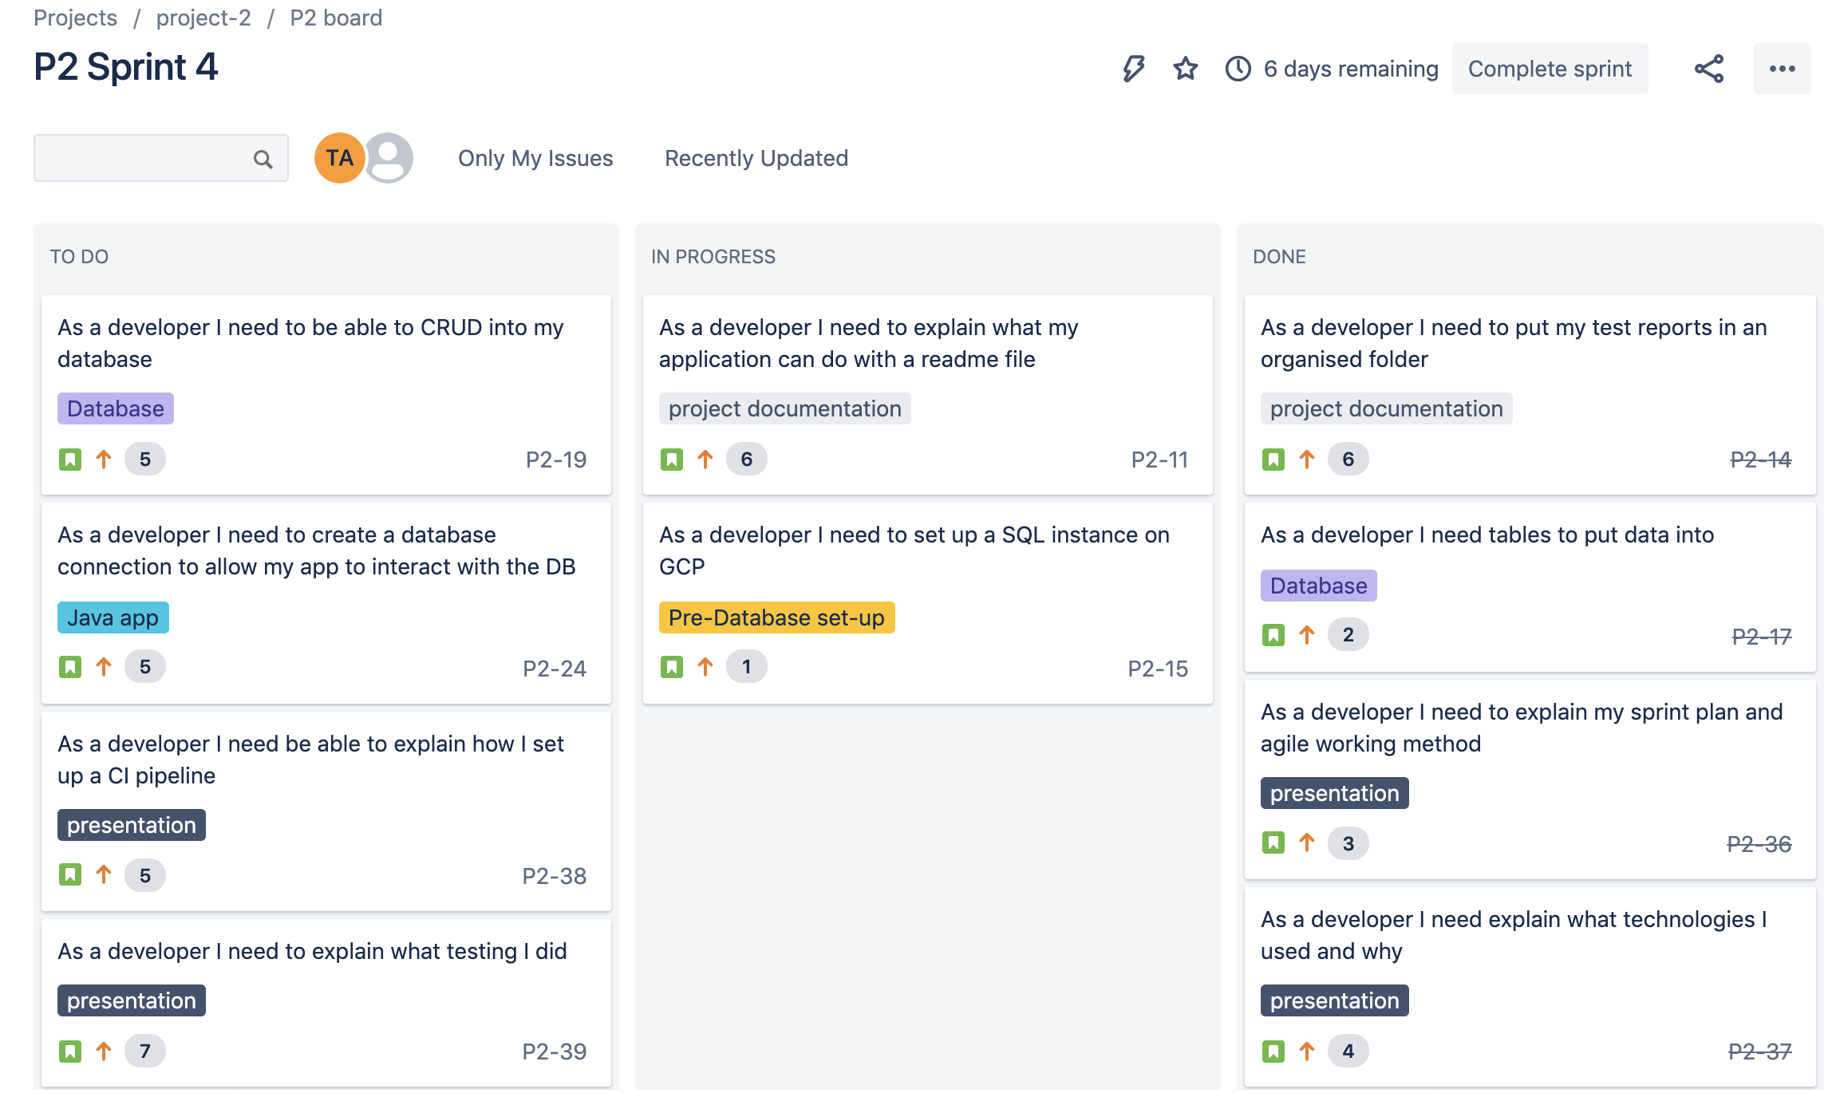
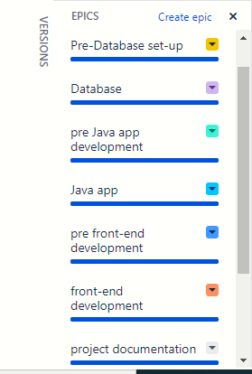
Planning: Jira Board - What needed to be included? What did you hope to achieve?

Slide 7
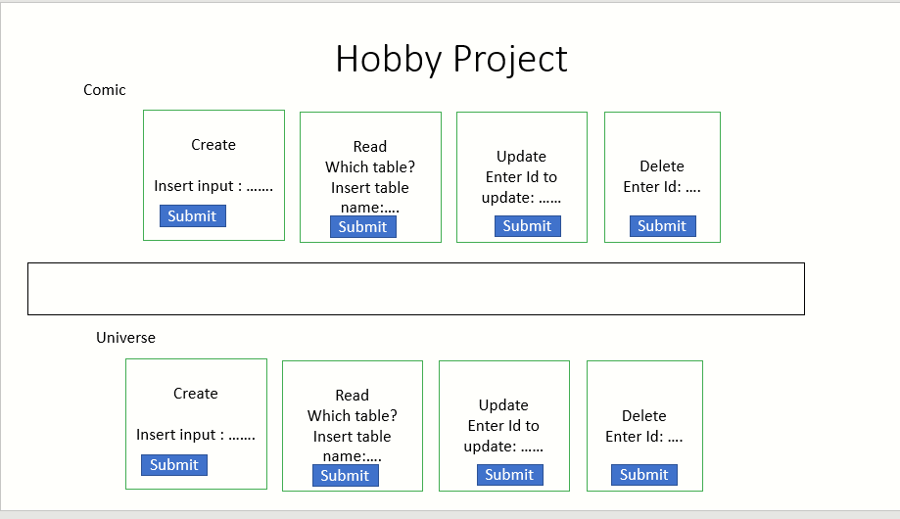
Wire frame

Slide 8
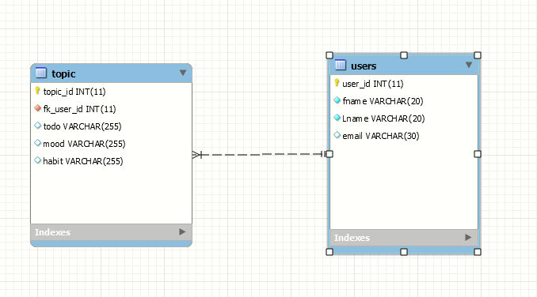
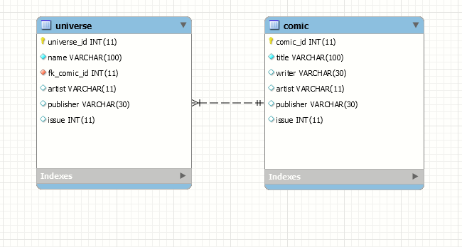
ERD beginning/final

Slide 9
What technologies have you learned for the project?
JavaScript – commonly used for frontend app
Springboot – IDE very well integrated with java
VS Code – IDE used for fronted development
H2 – a light relational database management system
postman– tool to help test each step of api development
Git – version control system
Sonarqube – continuous code inspection software
MySQL – relational database system

Slide 10
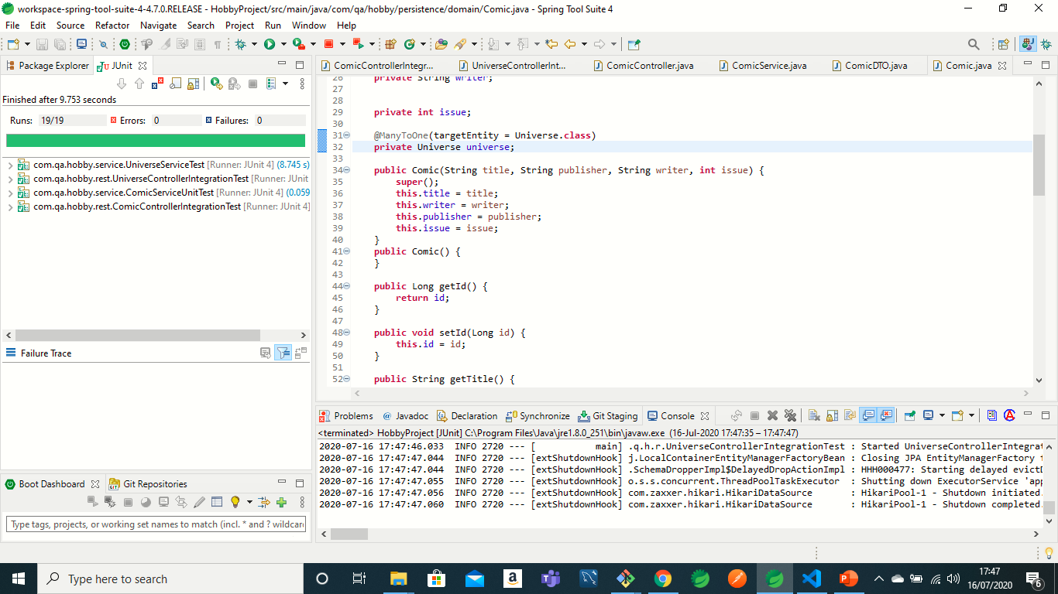
Testing
MockitoUnit and Integration testing carried out on projects.
Goal is to show individual and integrated parts working.
A set criteria must be met by the unit of code
INTEGRATION TESTING is a level of software testing where individual units are combined and tested as a group.
The purpose of this level of testing is to expose faults in the interaction between integrated units.
Notes:
Finds problems early on in development life cycle and also makes developer think through the inputs, outputs and error condition
Leads to greater refinement of unit behaviour
Cost of discovering bugs is lower in early on in project

Slide 11
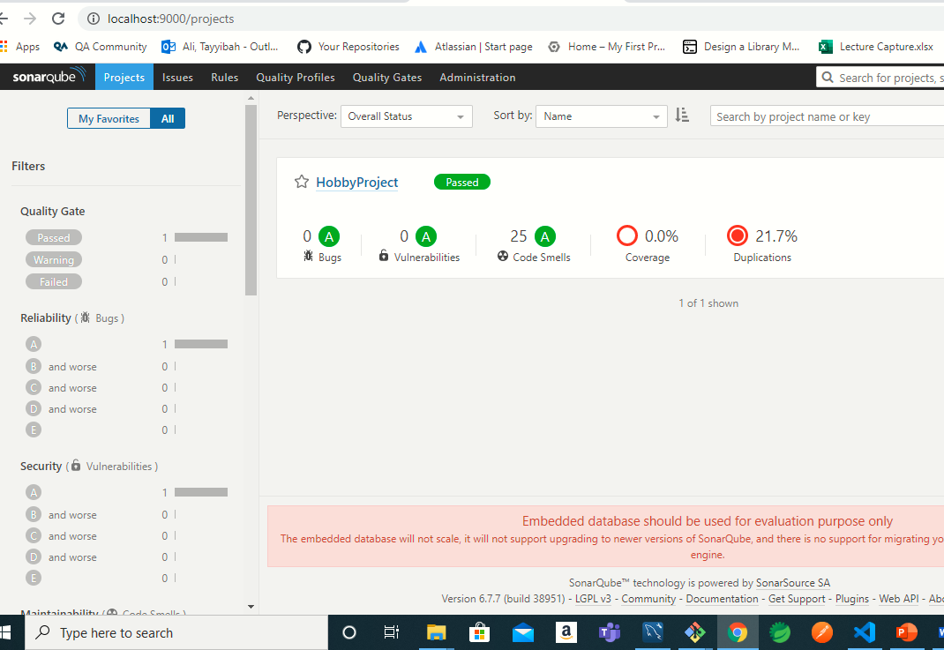
Sonarqube
Sonarqube is used for continuous code inspection in an enterprise level application
Used to check the quality of the code
Points out code smells, bugs and vulnerabilities

Slide 12
What went well? What could be improved?
Springboot
H2 database
Javascript
Postman

Slide 13
Lessons learnt
Still to improve project management – use Kanban more effectively
Do quick short sprints so that you fail fast and learn from the mistakes, bring my project back on track to meet deadline
Get help early on
Follow best practice principles
Fully understand project brief to avoid making bad design decisions
Use partner technologies more to help with each step.

Slide 14
Demo

Slide 15
Thank you
Tayyibah

