Slide 1
Earthquakes and House Prices in Groningen
A spatial difference-in-differences prototype using CBS house-price indices and KNMI seismic events
Causal question
What is the effect of earthquakes on municipal house prices?
- Compare Groningen with Friesland and Drenthe
- Pre-period before 2000; post-period from 2000 onward
- Continuous, distance-decayed earthquake exposure
Based on results/pres.odp, the DOCX case brief, src/ data engineering, notebooks/, and results/ figures

Slide 2
Contents
1. Problem formulation
2. Data and engineering
3. Exploratory evidence
4. Experimental design
5. DAG and identifying assumptions
6. Spatial DiD exposure
7. Model specification
8. Parallel trends and event study
9. Results and conclusion
CBS PBK municipality price index + KNMI seismic events | Spatial DiD prototype

Slide 3
Problem Formulation
The case starts from a practical concern:
- Gas extraction has caused induced earthquakes in Groningen.
- Earthquakes raise worries about safety, physical damage, and lower home values.
- The target estimand is causal: not just whether earthquakes and prices move together, but whether seismic exposure changes prices.
Research question
Wat is het causale effect van aardbevingen op de woningprijzen?
Proposed comparison
Municipalities in Groningen with seismic activity versus similar municipalities in Friesland and Drenthe without that exposure.
CBS PBK municipality price index + KNMI seismic events | Spatial DiD prototype

Slide 4
Data And Engineering
Input data
- CBS PBK house-price index by municipality
- CBS municipality and province boundaries, 1995-2025
- KNMI FDSN earthquake API, 1995-2025
- Processed outputs written to Parquet
Engineering steps in src/
- Parse year and quarter into dates
- Harmonize municipality and province geometries by year
- Spatially join municipalities to provinces
- Clean KNMI events and remove preliminary/explosion/other events
- Save geospatial panels for analysis
Why it matters
- Municipal boundaries change over time
- Earthquake effects depend on location, magnitude, and depth
- The analysis needs a municipality-quarter panel with consistent geography
CBS PBK municipality price index + KNMI seismic events | Spatial DiD prototype

Slide 5
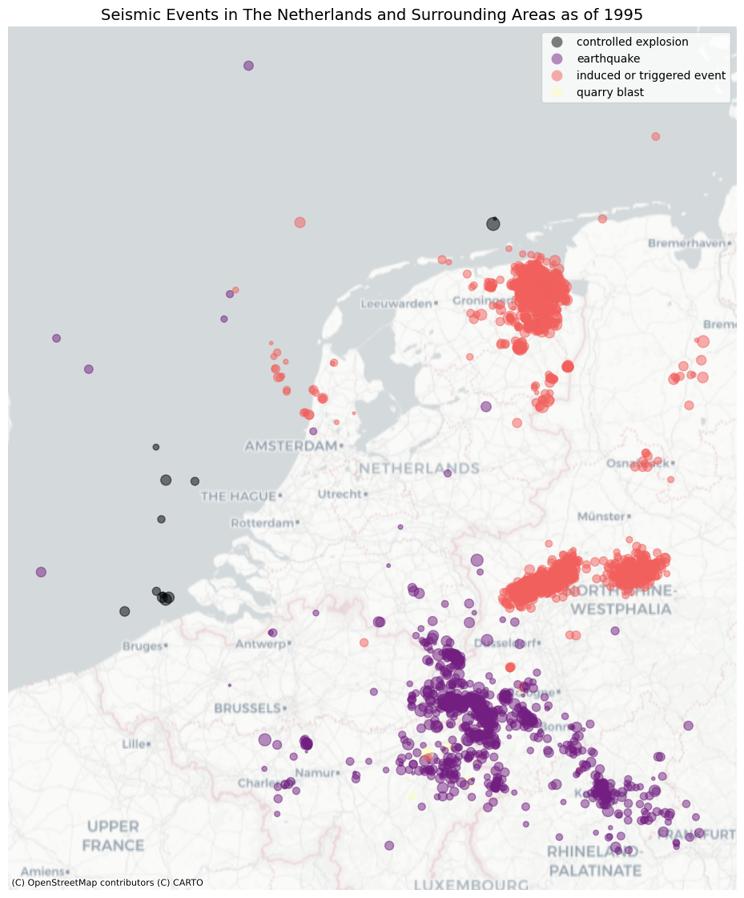
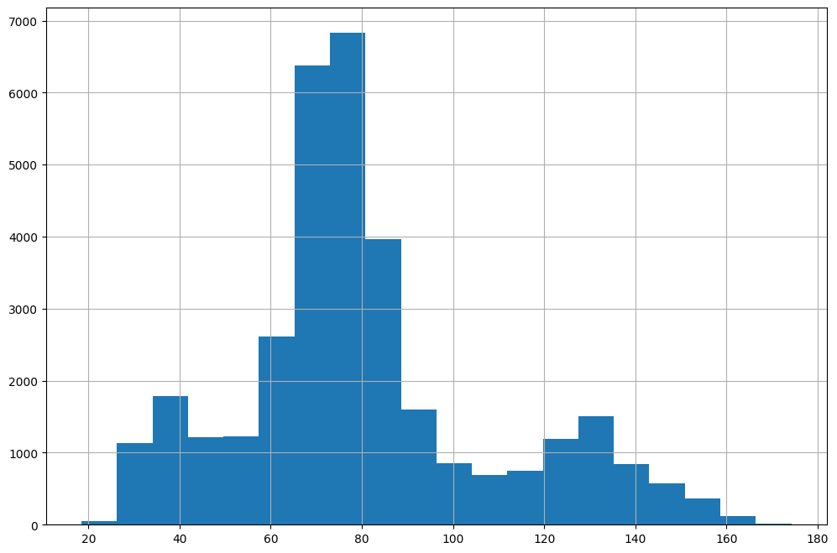
Exploratory Evidence
The map shows a dense cluster of induced/triggered events around Groningen; the histogram confirms broad variation in the municipal price index over the full panel.
CBS PBK municipality price index + KNMI seismic events | Spatial DiD prototype

Slide 6
Experimental Design Choices
Chosen design
- Spatial DiD on municipality-quarter data
- Groningen, Friesland, and Drenthe define the analysis region
- Post period starts in 2000
- Exposure is continuous, not binary
- Exposure is non-cumulative within each quarter
Alternatives considered
- Binary treatment: Groningen after 2000
- Single-event design around Huizinge 2012
- Staggered treatment / sunab()
- Lagged or cumulative exposure
- RDD or IV designs if a credible threshold/instrument is available
CBS PBK municipality price index + KNMI seismic events | Spatial DiD prototype

Slide 7
DAG And Assumptions
Simple causal story
Seismic activity -> damage/risk perception -> house prices
Location characteristics -> seismic exposure
Location characteristics -> house prices
Time shocks -> house prices
Key assumptions
- Conditional on municipality and quarter fixed effects, remaining exposure timing/intensity is as-good-as comparable.
- Friesland and Drenthe provide a useful regional counterfactual for Groningen.
- Parallel trends are plausible before the post-period.
- No major omitted local shocks are perfectly aligned with earthquake exposure.
CBS PBK municipality price index + KNMI seismic events | Spatial DiD prototype

Slide 8
Spatial Exposure Construction
Distance matrix
- Use municipality boundaries (from CBS) rather than centroids.
- Transform events and municipalities to ensure same projection
- Compute distance from each municipality boundary to each earthquake (from KNMI API).
- Keep exposure quarter-specific, so earthquakes only affect the quarter in which they occur.
Exposure formula
exposure_it = sum_e in t [10^(1.5 * M_e) / (1 + depth_e)] * exp(-lambda * distance_ie)
Interpretation
- Larger magnitudes get higher weight.
- Deeper events get lower weight.
- More distant events decay exponentially.
- This turns many point events into a continuous municipal treatment intensity.
CBS PBK municipality price index + KNMI seismic events | Spatial DiD prototype

Slide 9
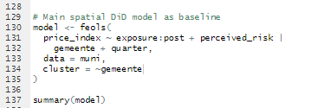
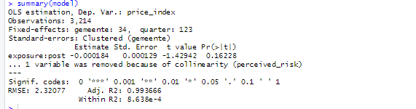
Main Spatial DiD Model
Result
- Coefficient on exposure x post: -0.000184
- Clustered p-value: 0.162
- 3,214 observations, 34 municipalities, 123 quarters
- Municipality and quarter fixed effects absorb time-invariant risk differences.
- perceived_risk is removed as collinear with municipality fixed effects.
CBS PBK municipality price index + KNMI seismic events | Spatial DiD prototype

Slide 10
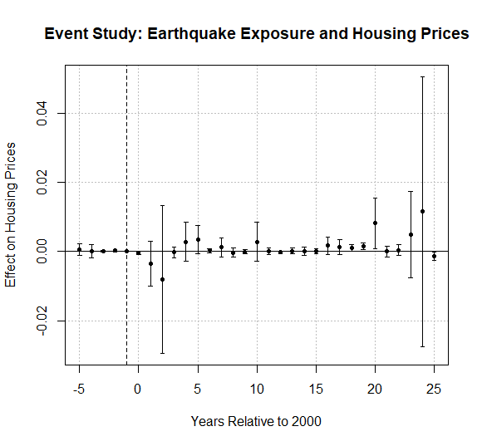
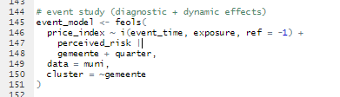
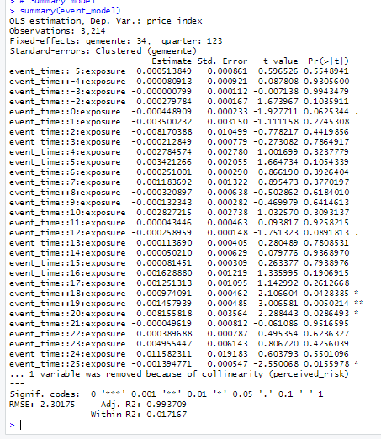
Event Study And Parallel Trends
Pre-period estimates are close to zero, which is supportive for the parallel-trends diagnostic, though the dynamic pattern remains noisy.
CBS PBK municipality price index + KNMI seismic events | Spatial DiD prototype

Slide 11
Conclusion
What we can say
- The current specification does not give strong evidence of a robust negative average price effect.
- The baseline estimate is negative but not statistically significant.
- The event study is mostly centered near zero before treatment, with noisy post-period dynamics.
- The design is a useful prototype, not a final causal claim.
What to improve next
- Test cumulative and lagged exposure.
- Separate physical damage from risk perception.
- Add municipality-specific trends or matching.
- Consider a Huizinge 2012 event-study specification.
- Use transaction-level or WOZ data if available.
Bottom line: the pipeline is in place; the present evidence is cautious and inconclusive, which is exactly where a causal prototype should be honest.
CBS PBK municipality price index + KNMI seismic events | Spatial DiD prototype

