Slide 1
Version Control
Version control is a system that records changes to a file or set of files over time so that we can recall specific versions later.
A software that helps software developers to work together and maintain a complete history of their work.
It allows us to revert files back to a previous state,
Compare changes over time, see who last modified something that might be causing a problem, who introduced an issue and when, and more.
Allows developers to work simultaneously.
Notes:
Using a VCS also generally means that if you screw things up or lose files, you can easily recover.

Slide 2
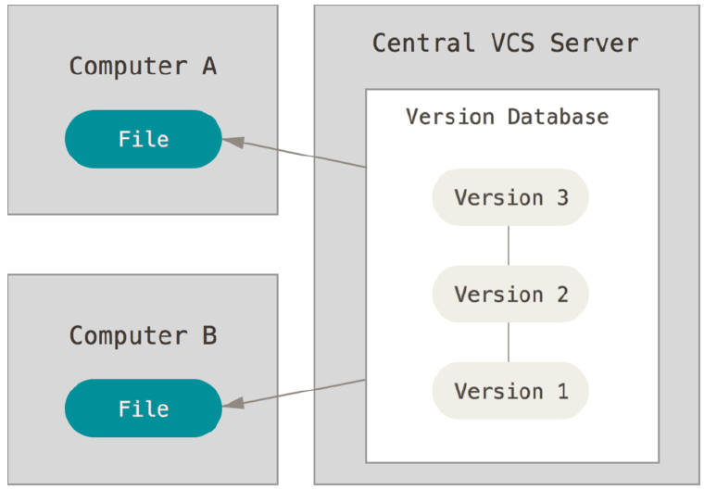
Centralized Version Control Systems
Most people like to collaborate with other developers on other systems.
A single server that contains all the versioned files, and a number of clients that check out files from that central place.
Notes:
This setup offers many advantages, especially over local VCSs. For example, everyone knows to a certain degree what everyone else on the project is doing.
Administrators have fine-grained control over who can do what; and it’s far easier to administer a CVCS than it is to deal with local databases on every client.
However, this setup also has some serious downsides. The most obvious is the single point of failure that the centralized server represents. If that server
goes down for an hour, then during that hour nobody can collaborate at all or save versioned changes to anything they’re working on. If the hard disk the central
database is on becomes corrupted, and proper backups haven’t been kept, you lose absolutely everything – the entire history of the project except whatever
single snapshots people happen to have on their local machines. Local VCS systems suffer from this same problem – whenever you have the entire history
of the project in a single place, you risk losing everything.

Slide 3
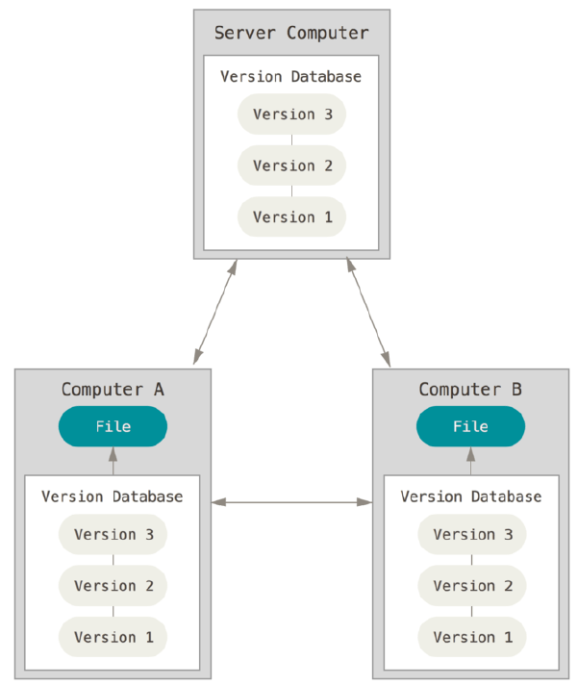
Distributed Version Control Systems
Every client fully mirror the repository.
If any server dies, then any of the client repositories can be copied back up to the server to restore it.
Every clone is really a full backup of all the data.
Notes:
Furthermore, many of these systems deal pretty well with having several remote repositories they can work with, so you can collaborate with different groups of people in different ways simultaneously within the same project.
In a distributed system, you get a repository of your own when you clone the project. This means you can work and add code to the repo even when offline, since the repository lives on your computer. But this also means you need a bit of discipline in keeping in sync with the rest of development, since your repository is separate from the others.

Slide 4
GitHub
Website to upload git repository online
Provide a backup of the files
Visual interface to navigate to repository
Other people can also navigate to repository
Collaboration is easy
Git
System for version control
Run on command line in local machine
Allow us to keep track of the files + modification (known as repository)
In a team, everyone can work independently on those files, merge their changes together and record who makes what changes.

Slide 5
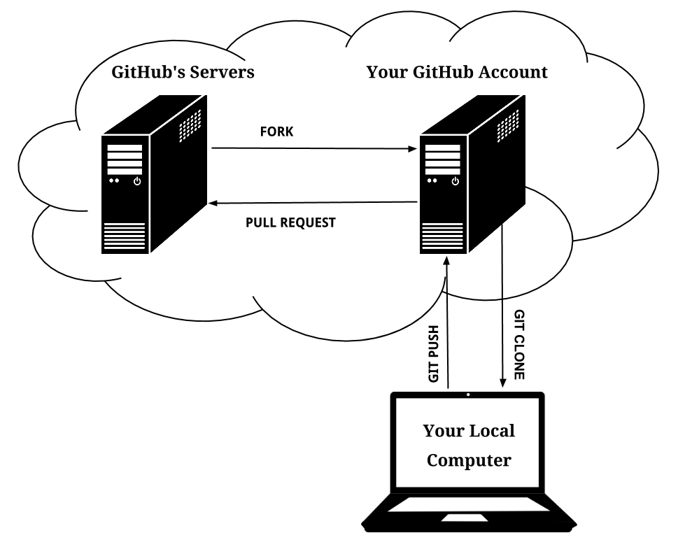

Slide 6
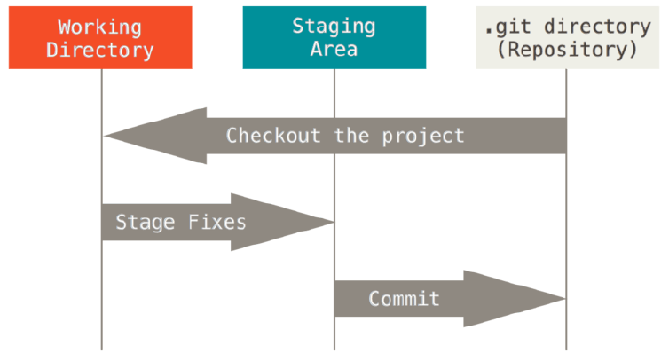
The Three States
Unmodified/modified Files
Staged Files
Committed Files
Notes:
The Git directory is where Git stores the metadata and object database for your project. This is the most important part of Git, and it is what is copied when you clone a repository from another computer.
The working directory is a single checkout of one version of the project. These files are pulled out of the compressed database in the Git directory and placed on disk for you to use or modify.
The staging area is a file, generally contained in your Git directory, that stores information about what will go into your next commit. It’s sometimes referred to as the “index”, but it’s also common to refer to it as the staging area.

Slide 7
Getting Started
A basic workflow
(Possible init or clone) Init a repo
Edit files
Stage the changes
Review your changes
Commit the changes

Slide 8
Getting Started
Init a repository
Git init
zachary@zachary-desktop:~/code/gitdemo$ git init
Initialized empty Git repository in /home/zachary/code/gitdemo/.git/
zachary@zachary-desktop:~/code/gitdemo$ ls -l .git/
total 32
drwxr-xr-x 2 zachary zachary 4096 2011-08-28 14:51 branches
-rw-r--r-- 1 zachary zachary 92 2011-08-28 14:51 config
-rw-r--r-- 1 zachary zachary 73 2011-08-28 14:51 description
-rw-r--r-- 1 zachary zachary 23 2011-08-28 14:51 HEAD
drwxr-xr-x 2 zachary zachary 4096 2011-08-28 14:51 hooks
drwxr-xr-x 2 zachary zachary 4096 2011-08-28 14:51 info
drwxr-xr-x 4 zachary zachary 4096 2011-08-28 14:51 objects
drwxr-xr-x 4 zachary zachary 4096 2011-08-28 14:51 refs

Slide 9
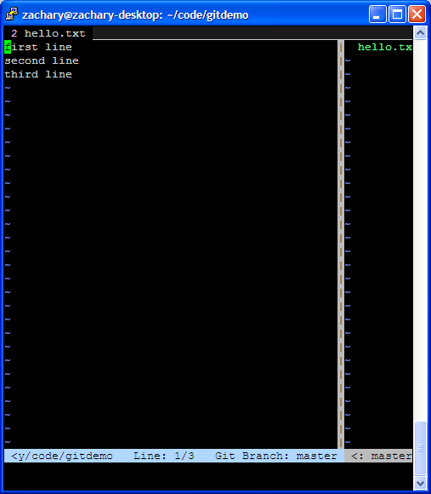
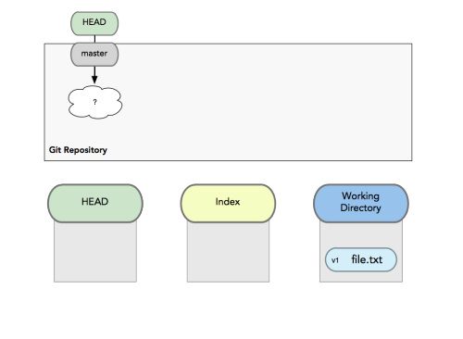
Getting Started
A basic workflow
Edit files
Stage the changes
Review your changes
Commit the changes
Use your favorite editor

Slide 10
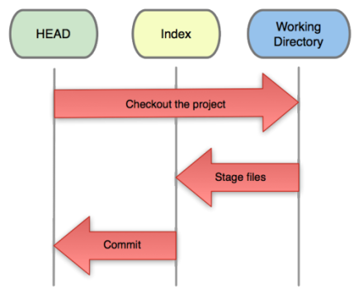
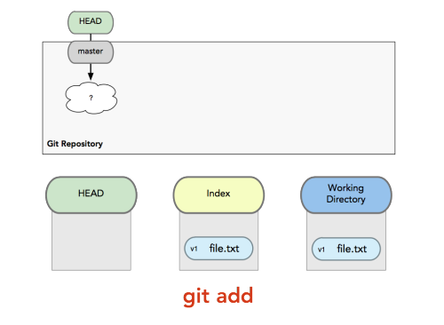
Getting Started
A basic workflow
Edit files
Stage the changes
Review your changes
Commit the changes
Git add filename
zachary@zachary-desktop:~/code/gitdemo$ git status
# On branch master
# Changes not staged for commit:
# (use "git add <file>..." to update what will be committed)
# (use "git checkout -- <file>..." to discard changes in working directory)
#
# modified: hello.txt
#
no changes added to commit (use "git add" and/or "git commit -a")

Slide 11
Getting Started
A basic workflow
Edit files
Stage the changes
Review your changes
Commit the changes
Git status
zachary@zachary-desktop:~/code/gitdemo$ git add hello.txt
zachary@zachary-desktop:~/code/gitdemo$ git status
# On branch master
# Changes to be committed:
# (use "git reset HEAD <file>..." to unstage)
#
# modified: hello.txt
#

Slide 12
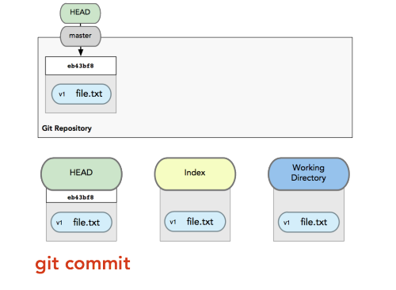
Getting Started
A basic workflow
Edit files
Stage the changes
Review your changes
Commit the changes
Git commit
# Please enter the commit message for your changes. Lines starting
# with '#' will be ignored, and an empty message aborts the commit.
# On branch master
# Changes to be committed:
# (use "git reset HEAD <file>..." to unstage)
#
# modified: hello.txt
#

Slide 13
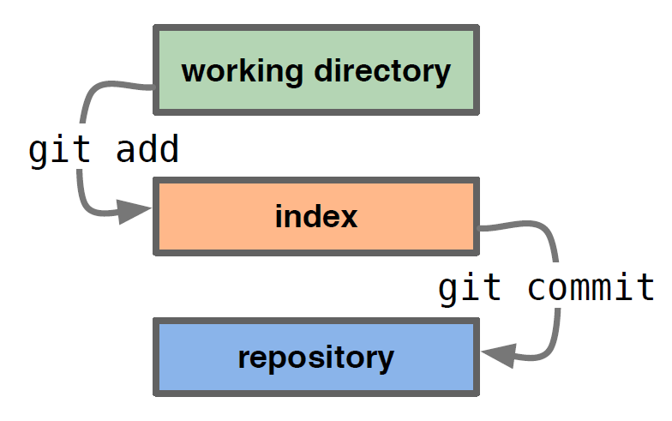
Getting Started
A basic workflow
Edit files
Stage the changes
Review your changes
Commit the changes

Slide 14
Branches
Branches are used to create another line of development.
By default, Git has a master branch.
Usually , a branch is created to work on a new feature . Once the feature is completed, it is merged back with the master branch and sometimes we delete the branch.
Every branch is referenced by HEAD, which points to the latest commit in the branch.
Whenever we make a commit, HEAD is updated with the latest commit

Slide 15
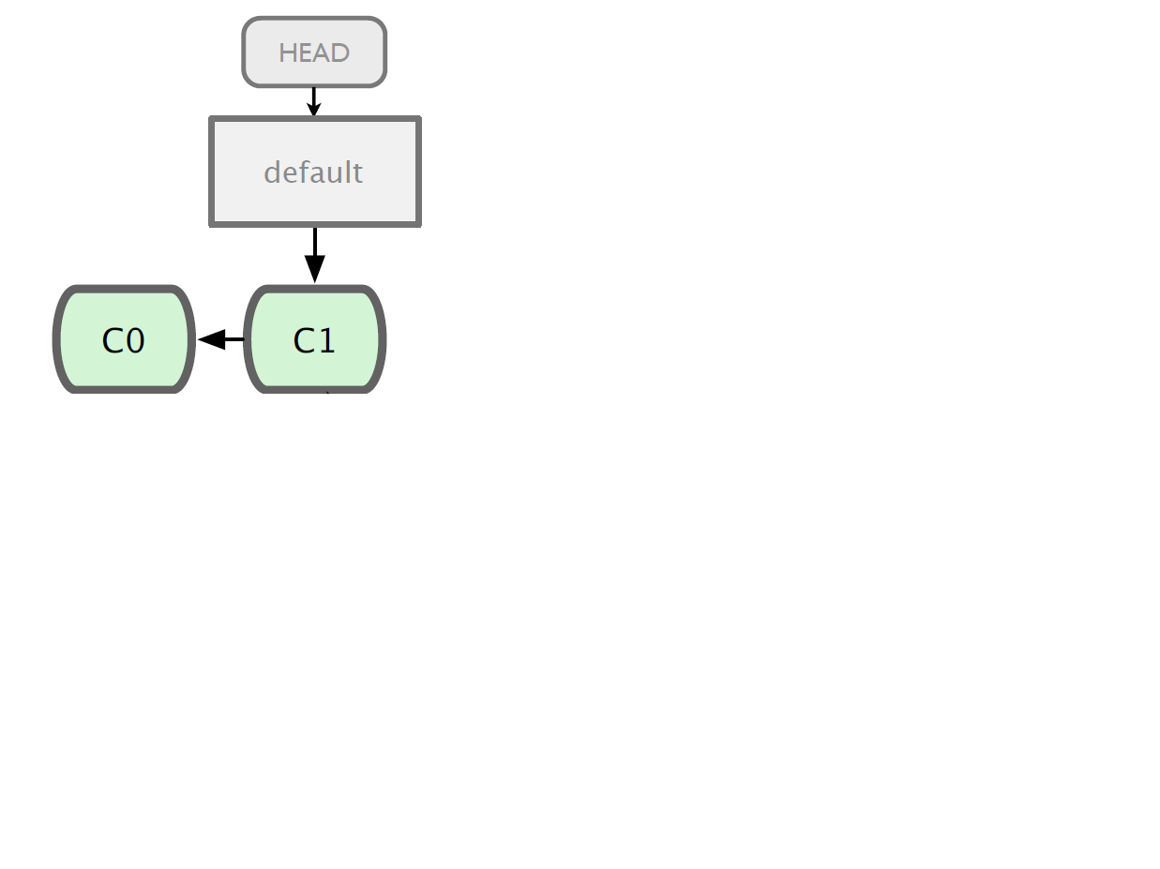
Branching

Slide 16
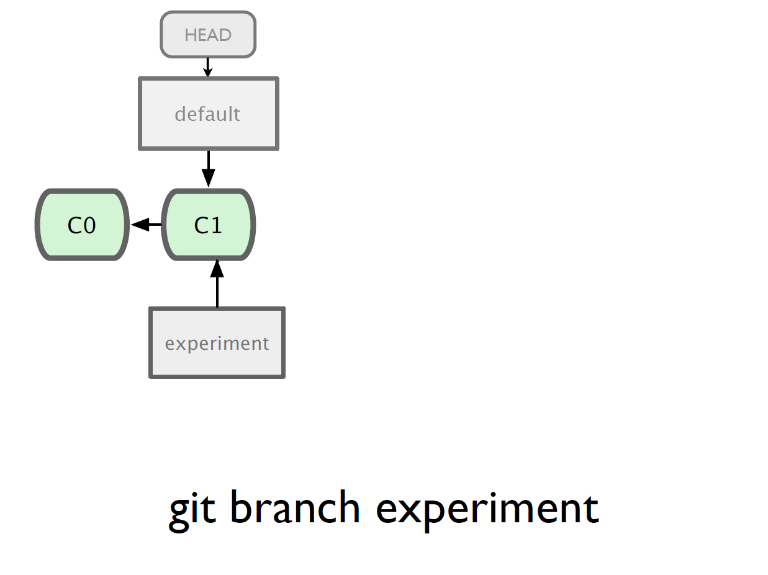

Slide 17
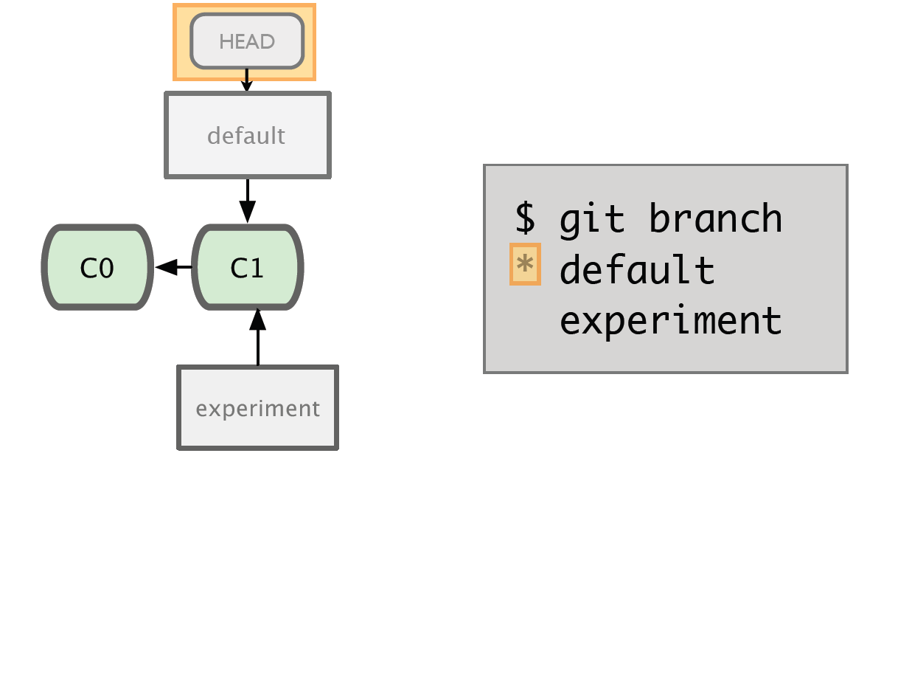

Slide 18
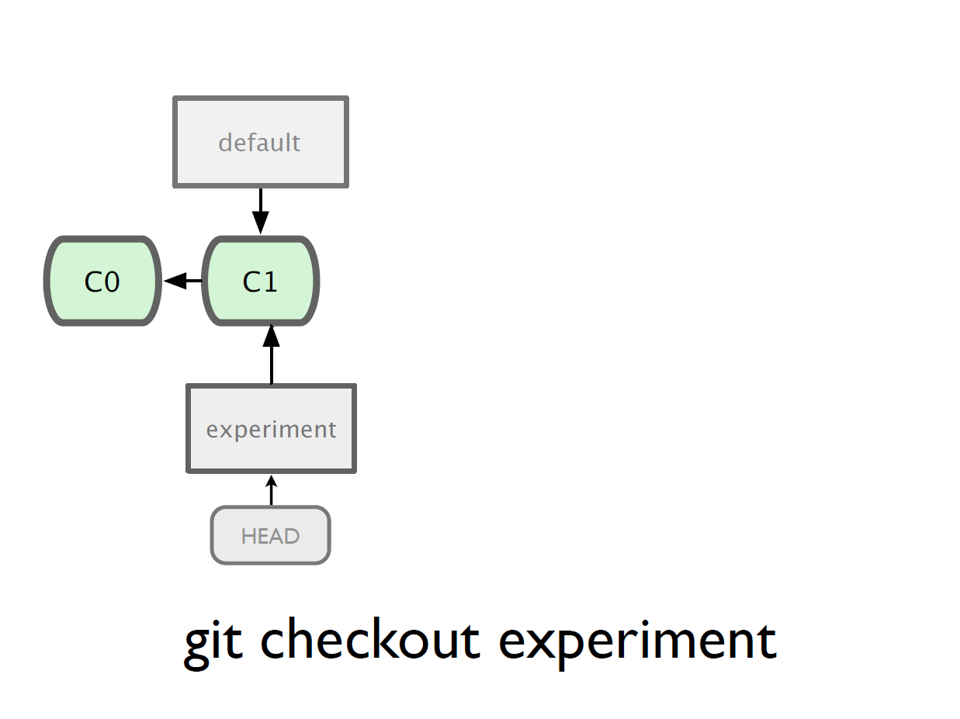

Slide 19
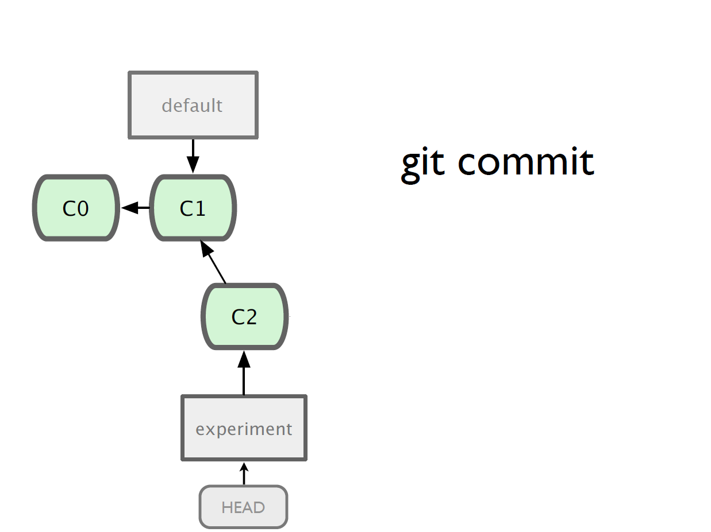

Slide 20
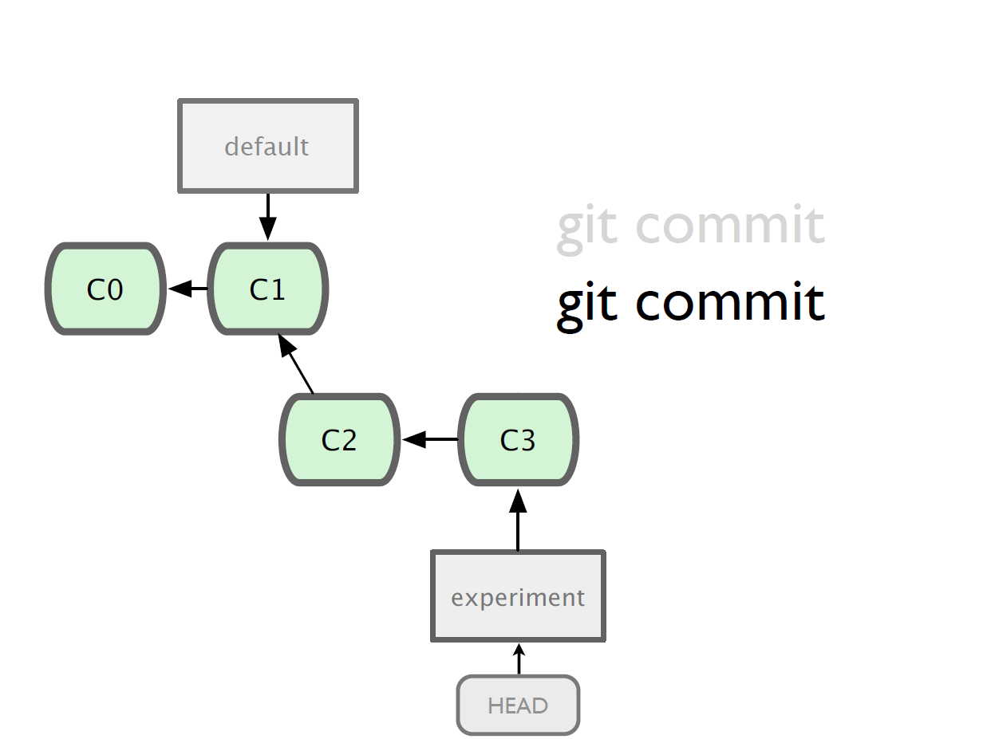

Slide 21
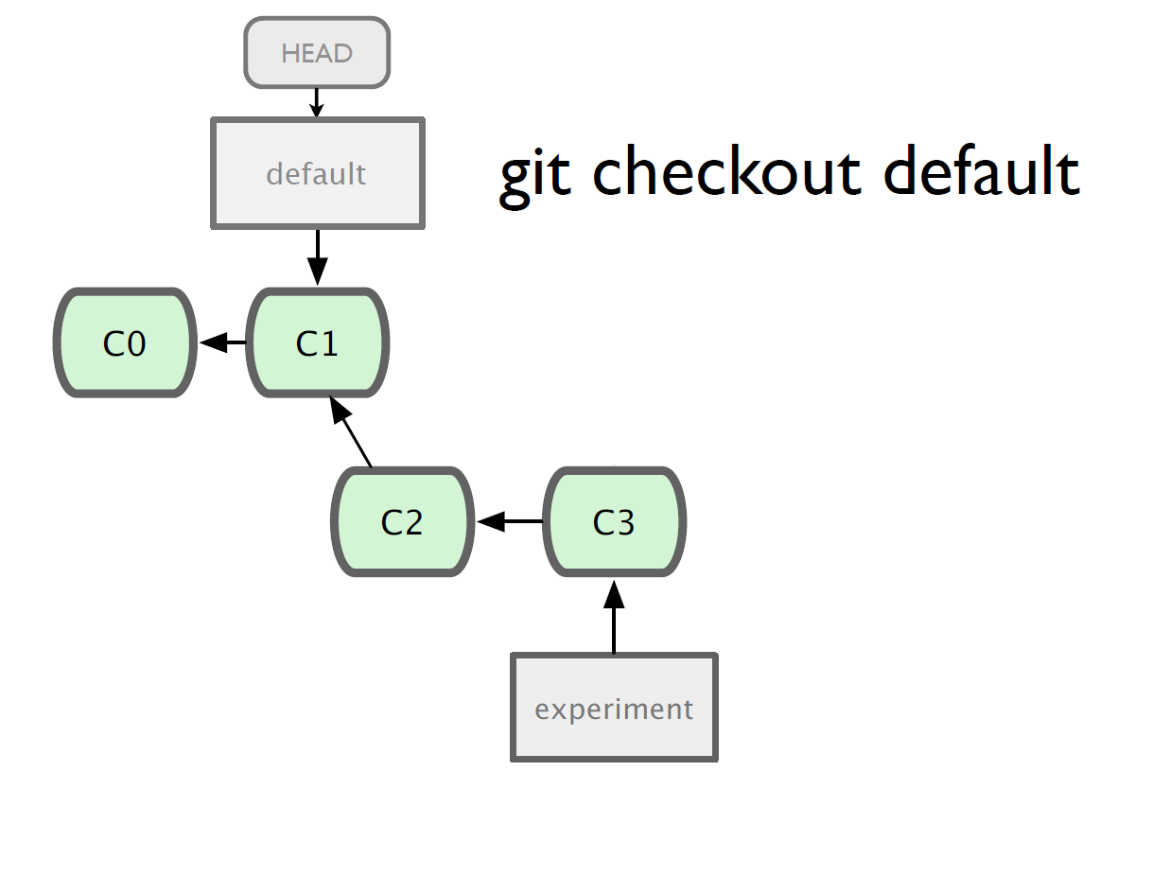

Slide 22
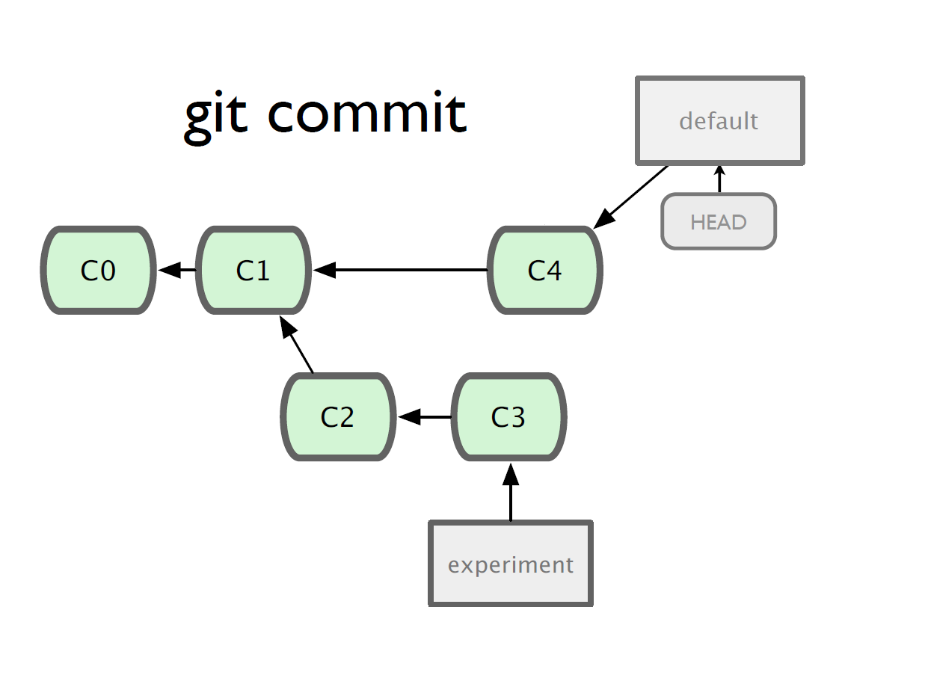

Slide 23
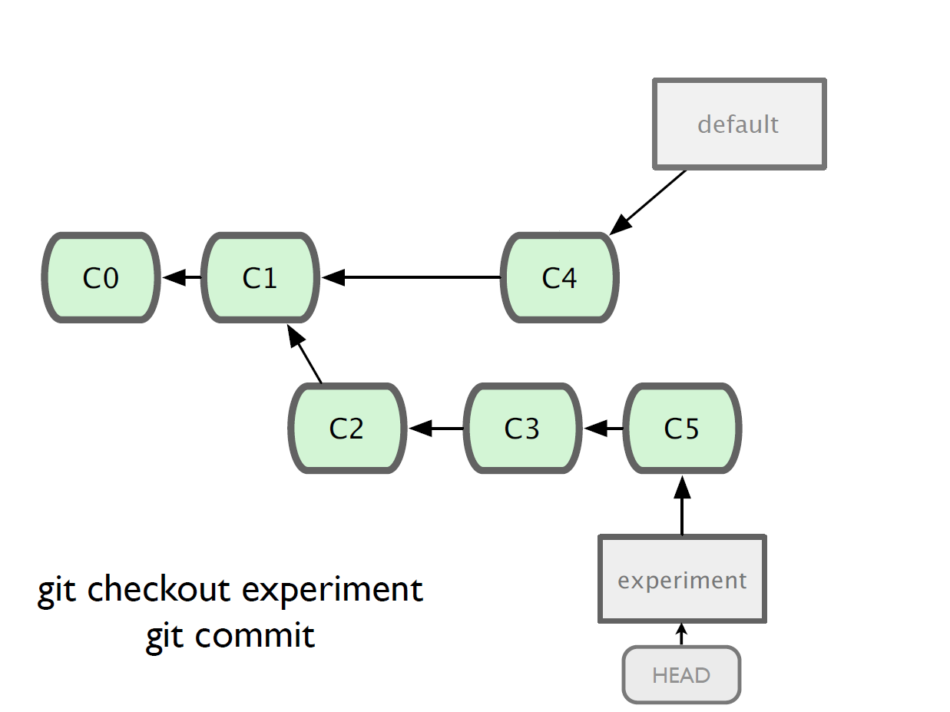

Slide 24
Merging
What do we do with this mess?
Merge them

Slide 25
Merging
Steps to merge two branch
Checkout the branch we want to merge onto
Merge the branch we want to merge

Slide 26
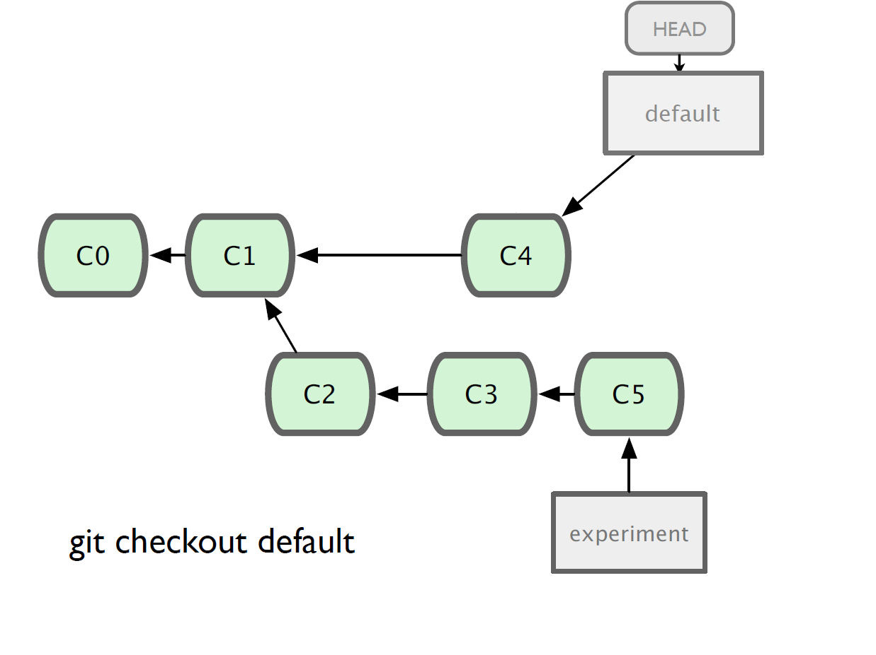

Slide 27
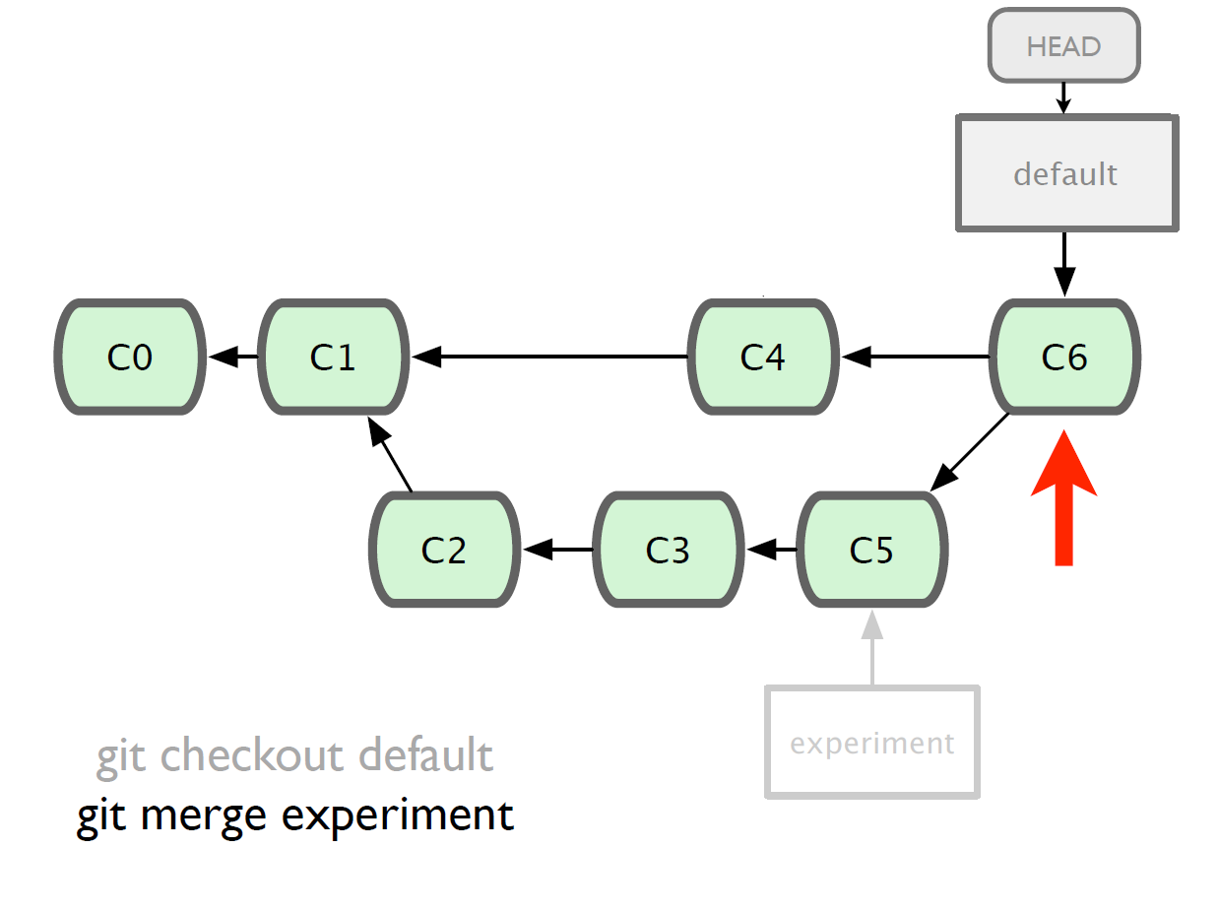

Slide 28
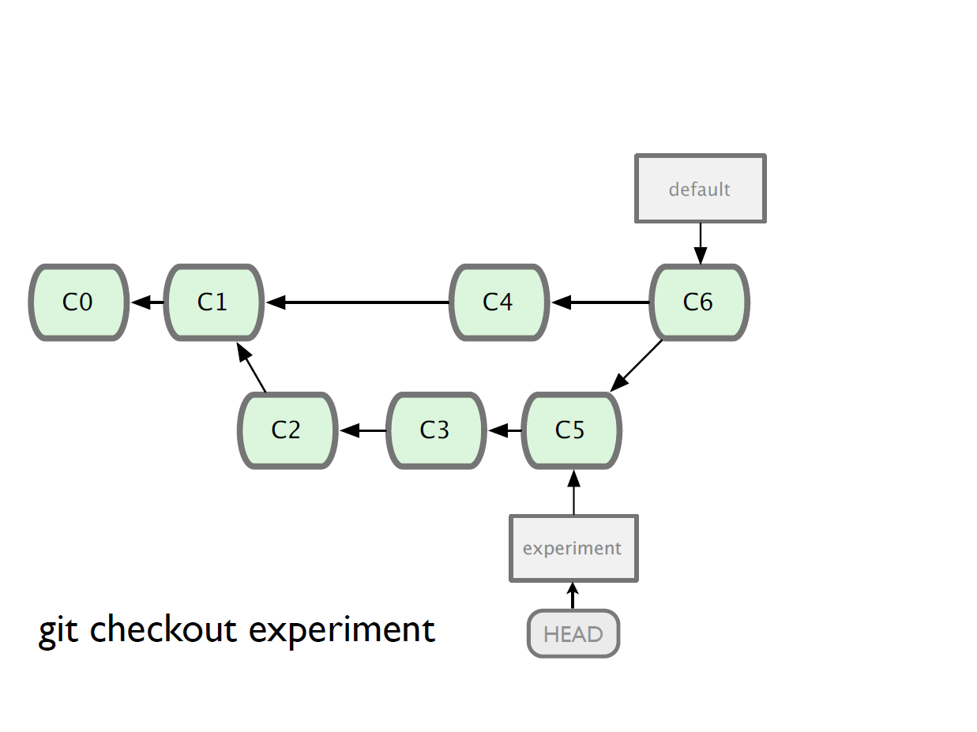

Slide 29
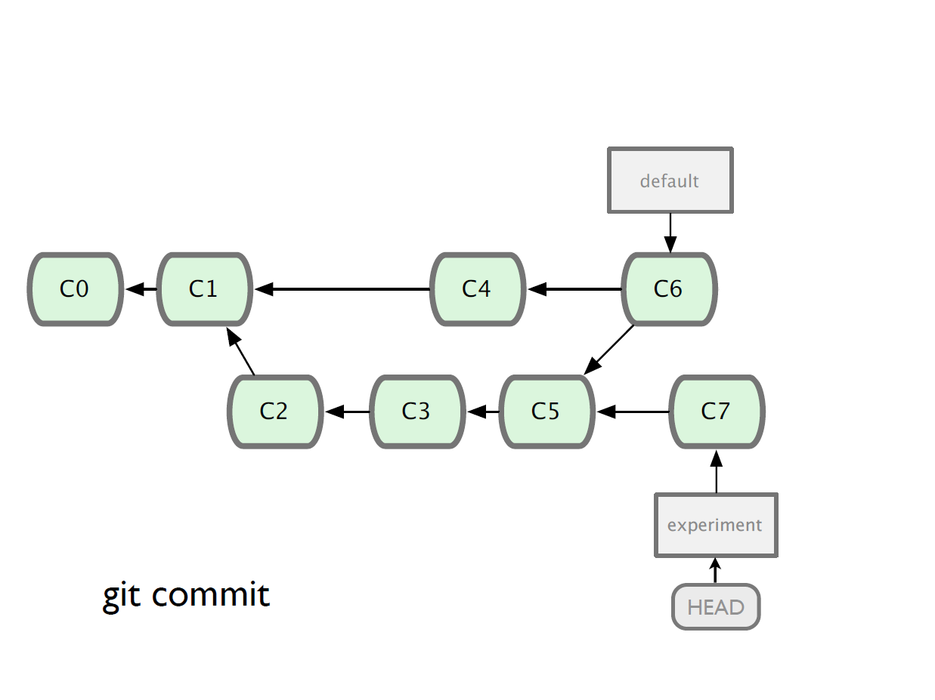

Slide 30
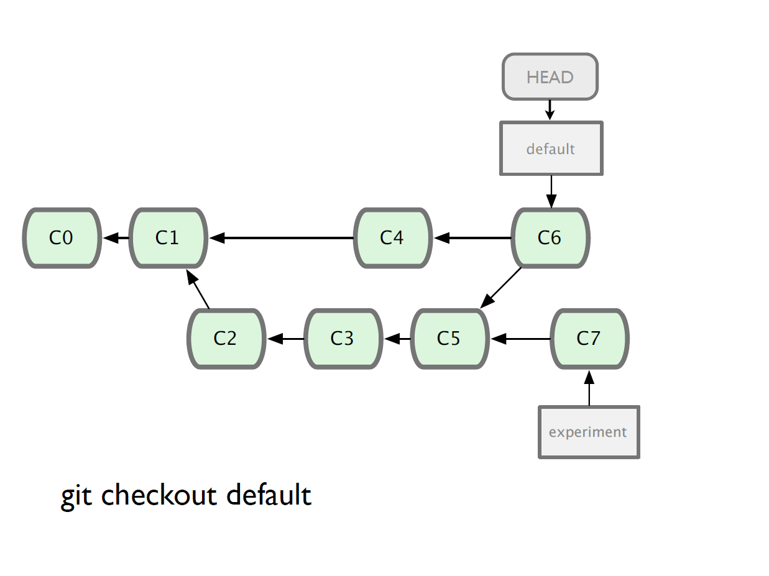

Slide 31
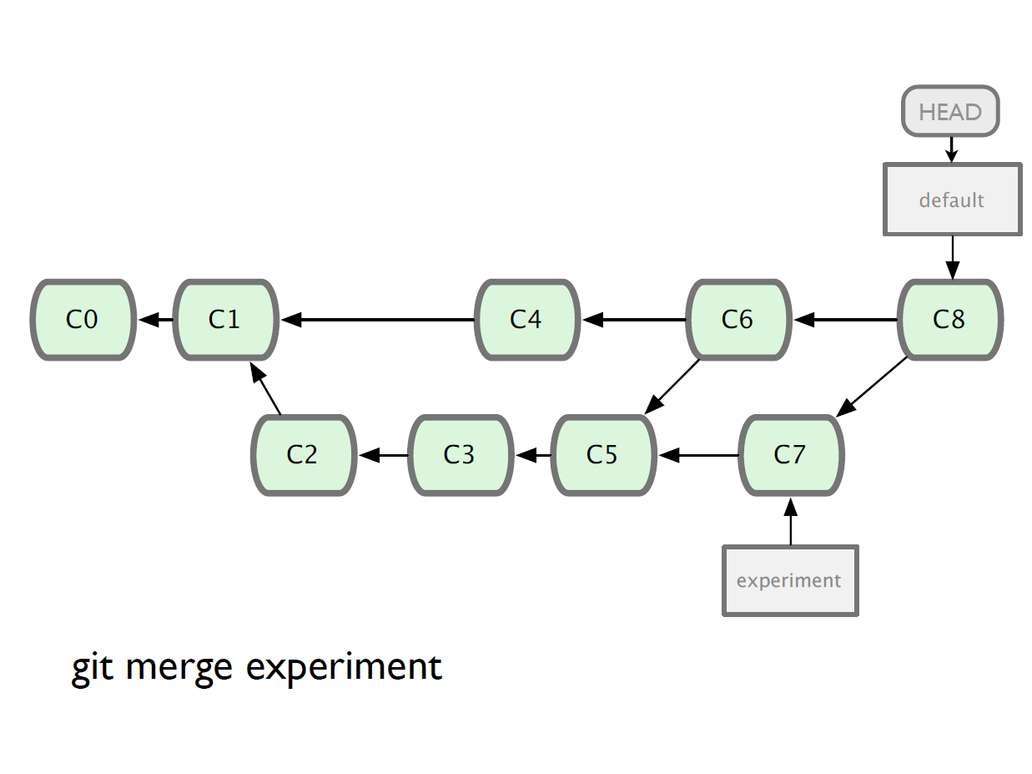

Slide 32
Working with remote
Use git clone to replicate repository
Get changes with
git fetch
git pull (fetches and merges)
Propagate changes with
git push
Protocols
Local filesystem (file://)
SSH (ssh://)
HTTP (http:// https://)
Git protocol (git://)

Slide 33
Remote Branches
All the branching we’ve done so far has been local
Remote repositories (e.g., github) also have branches

Slide 34
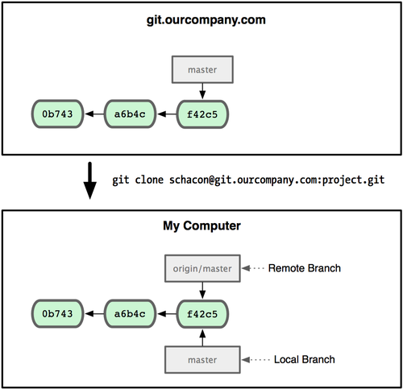
Understanding remote branches
Git server
right now, only have master
clone files from server into our working directory.
Remote branch – on server – [remote]/[branch]
clone names our remote origin by default
Local branch – [branch]

Slide 35
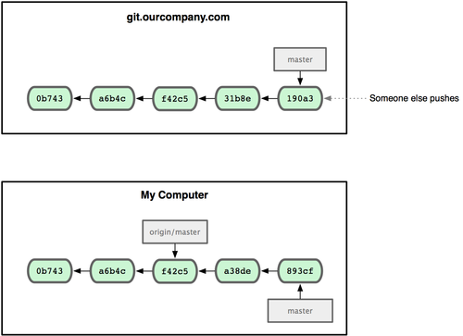
Branches diverging
We made changes.
Someone else pushed changes.
master on remote NOT the same as your master!
BUT, both are master (we’re not dealing with local branches yet)

Slide 36
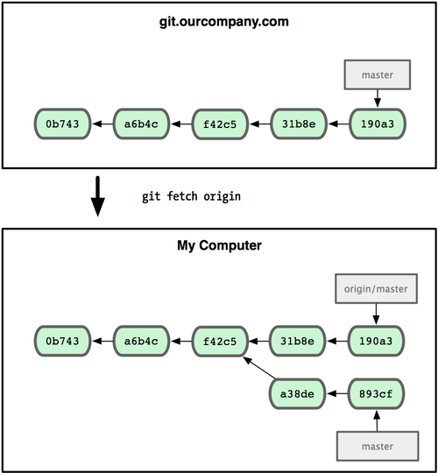
Synchronize our work
note: fetch doesn’t merge!
Need to:
git fetch origin
git merge origin/master
(handle conflicts if any, note that branch name is
origin/master)
git push
We can also do:
git pull origin master
(does fetch and merge)

Slide 37
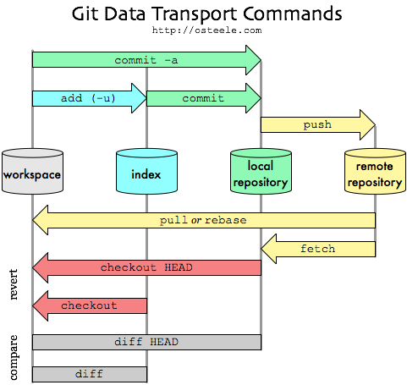
The Big Picture
http://blog.mikepearce.net/2010/05/18/the-difference-between-git-pull-git-fetch-and-git-clone-and-git-rebase/

