Slide 1
t = .1
t = .2
t = .3
t = .4
t = .5
t = .6
t = .7
t = .8
t = .9
t = 1

Slide 2
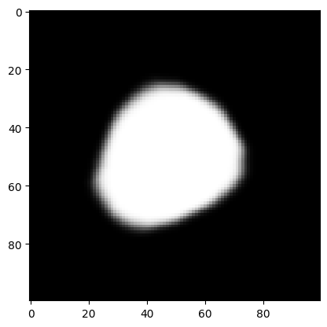









t = .1
t = .2
t = .3
t = .4
t = .5
t = .6
t = .7
t = .8
t = .9
t = 1

Slide 3
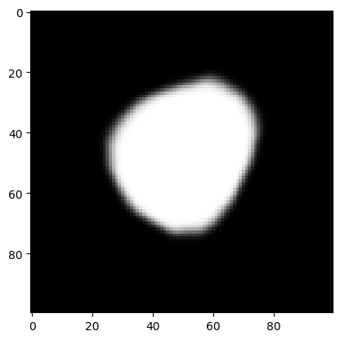
t = .1
t = .2
t = .3
t = .4
t = .5
t = .6
t = .7
t = .8
t = .9
t = 1

Slide 4
t = .1
t = .2
t = .3
t = .4
t = .5
t = .6
t = .7
t = .8
t = .9
t = 1

Slide 5
t = .1
t = .2
t = .3
t = .4
t = .5
t = .6
t = .7
t = .8
t = .9
t = 1

