Slide 1
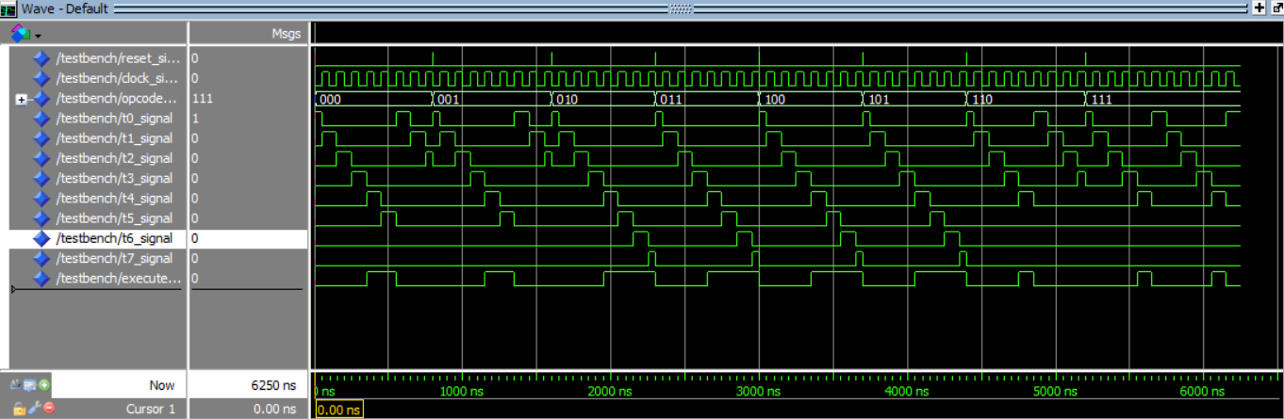
For when opcode = 000, the signal wave illustrates a “staircase” pattern indicating that the instruction sequencer is going through all the steps and appropriately outputs the execute signal. In addition, the signal wave indicates that it immediately goes back to t0.
For opcode = 111, fewer microinstructions are called so execute = 1 for a short period of time
Similar case except when opcode = 011, more microinstructions are called making execute = 1 for a long period of time.

Slide 2
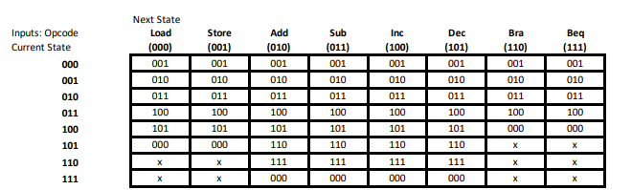

Slide 3
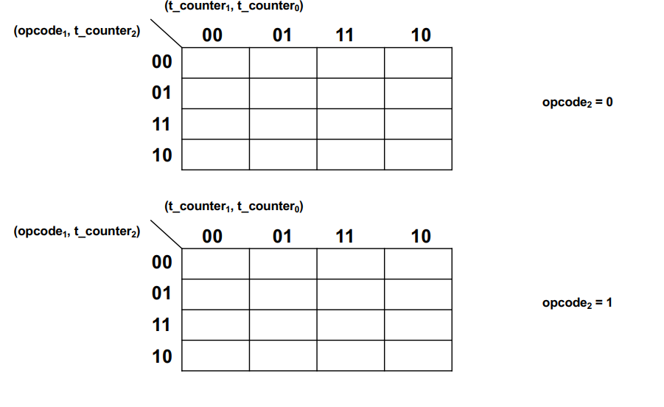
1
0
0
1
1
0
X
X
1
0
0
1
1
0
0
1
1
0
0
1
1
0
0
1
0
X
X
X
1
0
0
1
t_counter_next[0] = (opcode[1]’ and t_counter[0]’) or (opcode[2]’ and t_counter[0]’) or (t_counter[2]’ and t_counter[0]’)

Slide 4
0
1
0
1
0
0
X
X
0
1
0
1
0
1
0
1
0
1
0
1
0
1
0
1
0
X
X
X
0
1
0
1
t_counter_next[0] = (t_counter[0] and t_counter[0]’) or (opcode(2) and t_counter[1]’ and t_counter[0]) or (opcode(2)’ and opcode(1)’ and t_counter[2]’ and t_counter[1]’ and t_counter[0]) or (opcode[2]’ and opcode[1] and t_counter[1]’ and t_counter[0])

Slide 5
0
0
1
0
1
0
X
X
1
1
0
1
0
0
1
0
0
0
1
0
1
1
0
1
0
X
X
X
0
0
1
0
t_counter_next[0] = (t_counter[2] and t_counter[1] and t_counter[0]’) or (opcode[1]’ and t_counter[2]’ and t_counter[1] and t_counter[0]) or (opcode[1] and t_counter[2] and t_counter[1] and t_counter[0]) or (opcode[2] and opcode[1]’ and t_counter[2] and t_counter[1]’) or (opcode[2]’ and opcode[1] and t_counter[2] and t_counter[1]’) or (opcode[2]’ and t_counter[2] and t_counter[1]’ and t_counter[0]’)

